Slide 1
MBUG 2016
Session Title: Banner Boot Camp I and II (Combined Session)
Presented By: Lisa Williams
Institution: Mississippi Delta Community College
September 2016

Slide 2
Session Rules of Etiquette
Please turn off your cell phone.
If you must leave the session early, please do so discreetly.
Please avoid side conversation during the session.

Slide 3
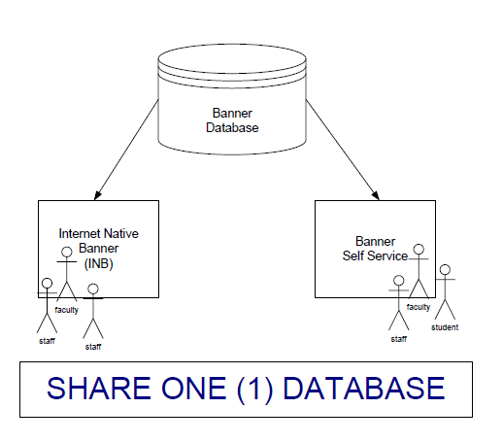
Introduction to Banner
Banner has five (5) functional areas:
Student
Financial Aid
Finance
Human Resources
Advancement
Integrated System
All functional areas share one (1) common database, which is an Oracle database.
In an integrated system, only one record should be created for each individual or vendor.
Each record in Banner has a unique identification number referred to as a PIDM (Personal Identification Master). This is NOT the Banner ID #. This is another unique identification number behind the scenes in the database.
Duplicate PIDMs cause major problems in Banner. To avoid creating duplicates, please do thorough INB searches prior to adding individuals to Banner.

Slide 4
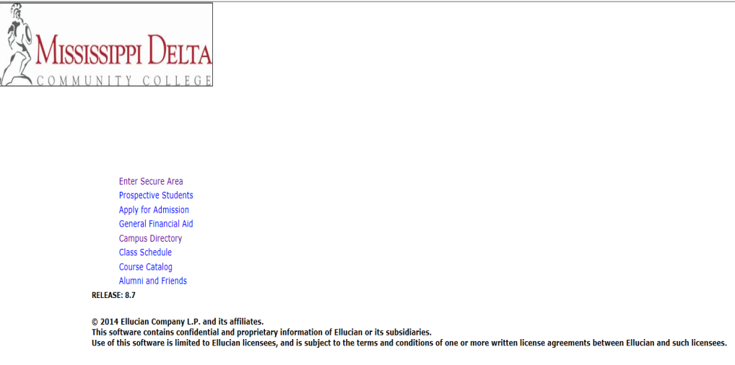
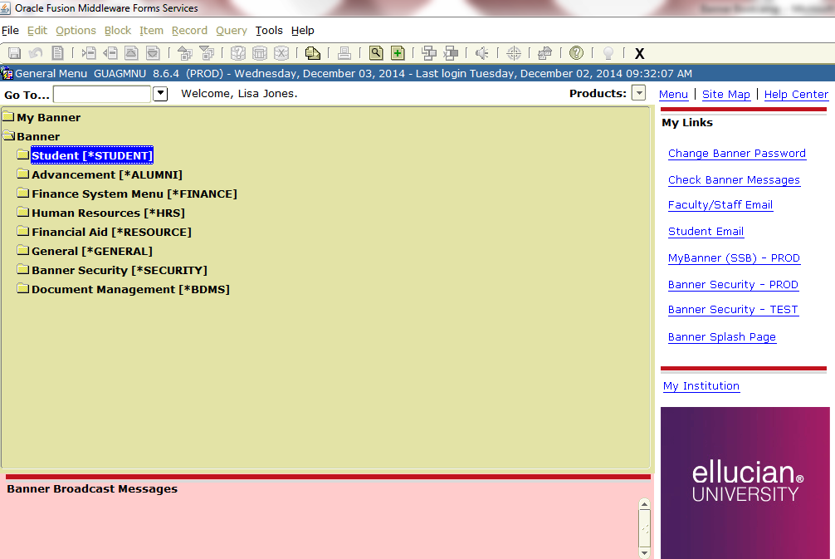
Introduction to Banner
Continued……
Banner Self Service (SSB)
Web-based, accessible through the institution’s website.
Access given to all students, faculty and staff.
Used by students to register for classes, check grades, update addresses.
Used by administration, faculty and staff to access pay stubs, view leave balances, check budgets, report grades, and check class schedule etc.
Internet Native Banner (INB)
Web-based, accessible through a browser.
Access restricted to users who require it for their jobs.
Banner Self Service
Internet Native Banner

Slide 5
Introduction to Banner
Continued……
Banner Environments
Banner may run in two or more environments: TEST and PROD are the most common.
TEST Environment has real data that is periodically cloned from the PROD environment, but is used for testing purposes only. We only clone data from PROD to TEST environment about once or twice per year, sometimes more if needed for a particular reason or for a major upgrade. Since the data in TEST is still real data that has been cloned from PROD, please remember that it is your responsibility to treat this data and your log in information to a TEST environment as securely as you should treat data and log in information to PROD. You can use INB TEST and/or Self-Service TEST at any time to test anything in your module. There will be times that you will be required to test some or all functions within your module(s) when we apply new updates to modules or when we apply updates to the database. It is critical that you comply with any request to test Banner in a timely manner. Testing allows us to work thru any errors or problems with a new release upgrade before we actually apply the upgrades to the live production (PROD) environment. If you do not thoroughly test all existing and/or new functions when requested, you stand a chance of the upgrade getting applied to PROD and it not working because you didn’t test it out in TEST.
PROD Environment is the live production environment where the administration, faculty & staff do their daily day-to-day operations. No testing should be done in a PROD environment.

Slide 6
Banner support
With ellucian action line
Ellucian Action Line / Ellucian Hub
Ellucian Hub is where you can submit action line cases when you need help from Support for issues you run into with Banner, where you can access up-to-date module documentation, etc. If you don’t already have an account, you may want to sign up so you will be able to submit action line cases, access documentation, etc.
Self-register for the Ellucian Hub by accessing this website -- https://clientapps.ellucian.com/SignUp
You will be prompted thru the steps for the information they need to setup your account.
Once you have submitted your information, you should receive an email from Ellucian. If you’re a new person requesting an account, they will email your system administrator to verify that you are in fact an employee of the institution before accepting your registration for an account.
Once the system administrator has confirmed your identity and your employment status, your account will be setup and you’ll receive an email notifying you.
The link to the FAQ for Ellucian Hub Registration should be read before signing up for your account. -- https://www.ellucian.com/Support-and-Training/FAQ-for-Ellucian-Hub-Registration/

Slide 7
DATA ENTRY STANDARDS
It is critical that data entry standards are followed to reduce duplicate personal identification records, to promote search capability through uniform data entry, to promote accurate mailings, and to promote accurate local, state & federal reporting. If your institution has implemented specific data entry standards, please familiarize yourself with these.
All of the info in our Data Entry Standards manual is important, but here are just a few of the more prominent items we’ve had issues with in the past.
When entering a new person in the system, ALWAYS do a THOROUGH search to make sure the person does not already exist.
Always enter name and address information in mixed case. (not all lower case & not all caps)
Names should be entered as full legal names. Preferred names or nicknames should be entered in the Preferred Name field.
Titles/Prefixes such as Dr., Mr., Mrs., etc. should NOT be entered in the first, middle or last name fields. Only enter these in the appropriate Prefix field.
Suffixes such as Jr., Sr., II, IV, etc. should NOT be entered in the first, middle or last name fields. Only enter suffixes in the appropriate Suffix field.
There should ONLY be ONE ACTIVE record for each address type (MA, PR, etc). In other words, if student Jane Doe has an MA and PR address record, she should only have one active MA record and one active PR record. Other MAs and PRs should either have an end date that has deactivated that address and/or have the Inactive box checked.
Students must have at least one ACTIVE address record. We’ve had students left out of state and federal reporting because all of their address records were inactive, either by an End date inactivating them or by the Inactive box being checked.
Pay close attention to the section in the manual about addresses entry.
Pay close attention to phone number entry also.
Email entry – CAMP (MDCC student email addresses) & EMP (MDCC employee email addresses) mail types are ONLY to be entered & maintained by Computer Services. This is to ensure that the account is already setup in the respective email servers. Other email types such as BUS and PERS can be entered or maintained by offices as needed.
Pay close attention to SSN entry section in the manual. SSN is used for federal and state reporting and needs to be accurate.
Instructional areas - when entering course titles in Banner (in course catalog and when creating sections of a course for a term), DO NOT enter any punctuation such as commas in a course title.

Slide 8
DATA ENTRY STANDARDS
Continued……
Race/ethnicity- clarification on how to code the race and ethnicity fields on SPAIDEN or in Payroll.
The field titled “Ethnicity” is a letter code such as W = White; B = Black/African American; etc. DO NOT leave this field blank! Only use O for Other if those individuals with Unknown Ethnicity.
The field titled “New Ethnicity” is a drop down box that allows you to select either “Not Hispanic or Latino” or “Hispanic or Latino” or “None”. You MUST select one of those. Be as accurate as you can in answering this question.
The parameter that is titled “Ethnicity and Race Confirmed” MUST be checked that you have confirmed the individual’s ethnicity and race. The field titled “Confirmed Date” must also have a date there. It may default the current date once you check the box next to “Ethnicity and Race Confirmed”, but if not, a date MUST be entered. If these two fields are not updated, they will be reported as Unknown on IPEDS. We do not want to report anyone as Unknown race/ethnicity unless they absolutely declined to answer their race/ethnicity on their application.
The field titled “Race” at the bottom of the screen must also be populated. An individual may report multiple races. If so, this is where you can put their multiple races. At a minimum though, every individual should have at least one entry in this field. In most cases, when you select the appropriate letter code for the “Ethnicity” field above, it will auto-populate the corresponding “Race” code here. If it does not auto-populate the “Race” field, you MUST populate it unless it’s O for Other in which case, this race field will be left blank and reported as Unknown on IPEDS. Also, any individual reported as H for Hispanic in the “Ethnicity” field above, will not have a value in the “Race” field, but MUST be classified as “Hispanic or Latino” in the “New Ethnicity” field.

Slide 9
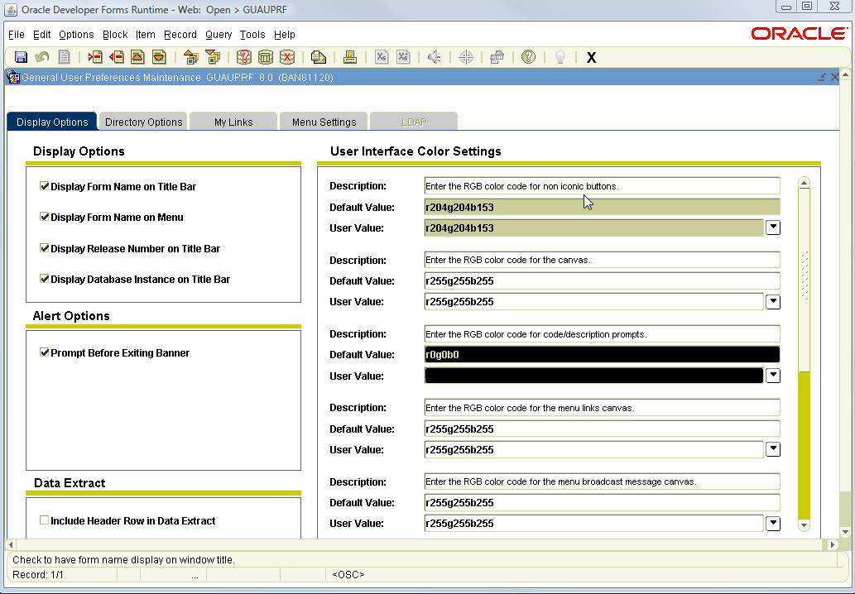
INB User Preferences
GUAUPRF is the User Preferences Form. File>Preferences also opens the form. You can now control some aspects of the appearance of Banner screens.
Display Options Tab
Display Options (1) allows control over name display on the Title and Menu Bars.
User Interface Color Settings (2) (right) control your Banner color scheme. Use the scroll bar to see all color control options.
Arrows by the User Value fields open Color Selection windows. A preview pane simulates the chosen color.
Reset (3) the default colors on the Color Selection Window by clicking Reset and OK. Use to select color for text to indicate LOV and Searchable fields
Use Alert Options (4) to turn alerts on and off. By default a prompt asks if you want to end your Banner session. This prompt can be turned off.
Use Data Extract (5) to control whether a header row is downloaded with the data.
2
1
4
3
5

Slide 10
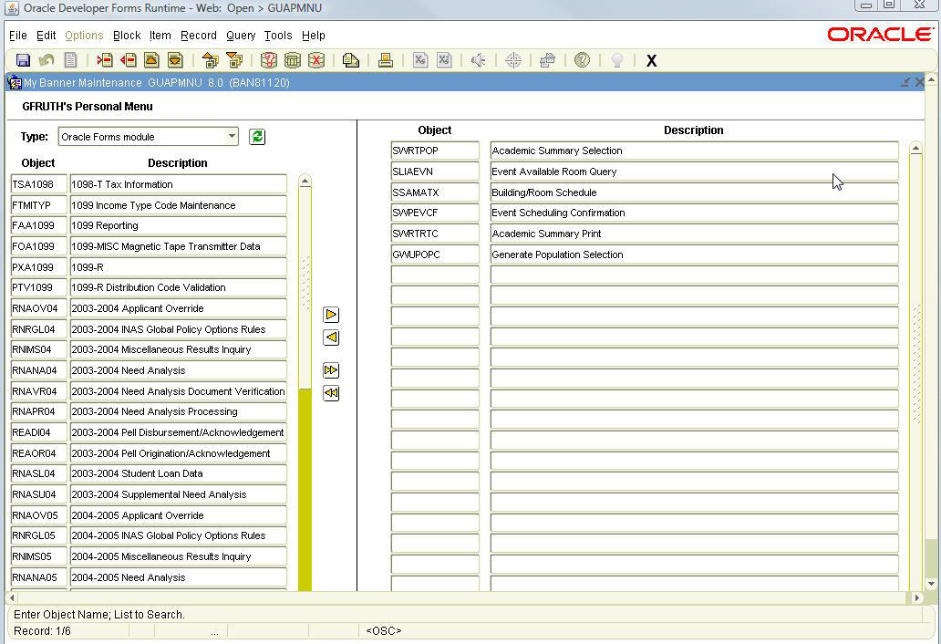
INB User Preferences Continued……
Menu Settings Tab
Use to personalize your start up menu. (1)
Set “My Banner” to open at start up by clicking the arrow by User Default.
Select *PERSONAL from the list.
Click the Save icon.
Close GUAUPRF.
Adding Forms to My Banner
Open GUAPMNU.
For the Type, select Oracle Forms module. (2)
Double click a form name (text will turn blue) and then use the Insert arrow to push the form to the right hand column. (3)
OR
Enter the 7 character form name in the Object column and press the Enter key. (4)
Remove forms by reversing the process.
Save the changes.
1
2
4
3

Slide 11
INB KEYBOARD SHORTCUTS
F5 – Display Navigation Window lets you toggle between screens.
F6 in the key block on SAAADMS will take you to SPAIDEN.
Keystroke Navigation:
Rollback – Shift+F7
Next Block – Ctrl+PgDn
Previous Block – Ctrl+PgUp
Insert Record – F6
Remove Record – Shift+f6
Duplicate Record – F4
Next Record – Down Arrow
Previous Record – Up Arrow
Next Field – Tab
Previous Field – Shift+Tab
Enter Query – F7
Execute Query – F8
Cancel Query – Ctrl+Q
Save – F10
List of Values – F9
Direct Access F5
Options List – F2
Print – Shift+F8
Exit – Ctrl+Q
Help – F1
Radio Button – Space Bar
Select – Shift+F3

Slide 12
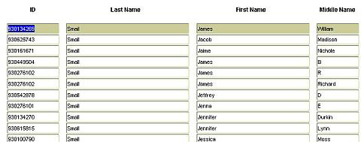
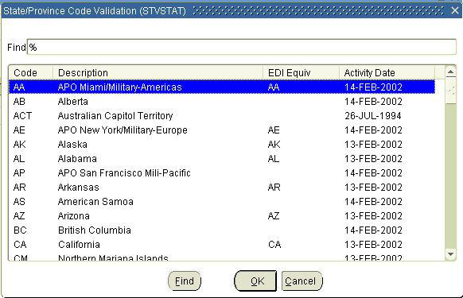
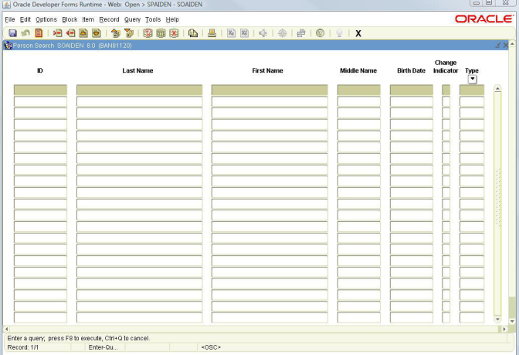
INB SEARCHES
Most users will, at some point, perform a search or query within Banner. Searchable fields have a Search icon that looks like a drop down arrow next to them. When the icon is clicked, either a list menu or a search form opens.
Wildcards - (1) Percentage (%) and Underscore (_) signs. Percentage sign (%) can be used at the beginning, middle, or end of a word and can represent any character or a set of characters. The Underscore sign (_) represents one character but can be used multiple times.
List Menu - (2) Contains lists of values. Notice this list menu, like most of them, has a Find field at the top. Wildcards can be used in this field to quickly find an entry without scrolling through the table. Lists of Values are clearly defined and relatively easy to display. When an entry is found, simply double click and it will be automatically entered into the form field.
Search Form - (3) Use to find information that may reside in many different tables.
Next are several search techniques you should use to thoroughly check for an existing record before adding an individual to Banner.
1
2
3

Slide 13
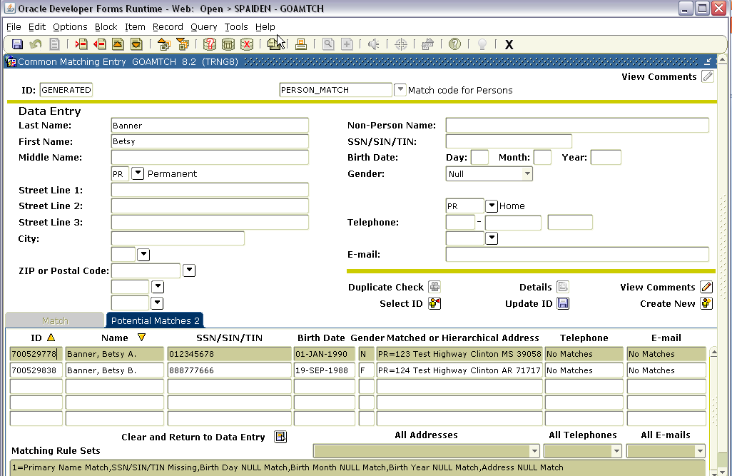
INB SEARCHES Continued……
Common Matching (GOAMTCH)
Use common matching to help prevent duplicate records in Banner.
Can go to directly to GOAMTCH or while in SPAIDEN or Payroll when creating a person record.

Slide 14
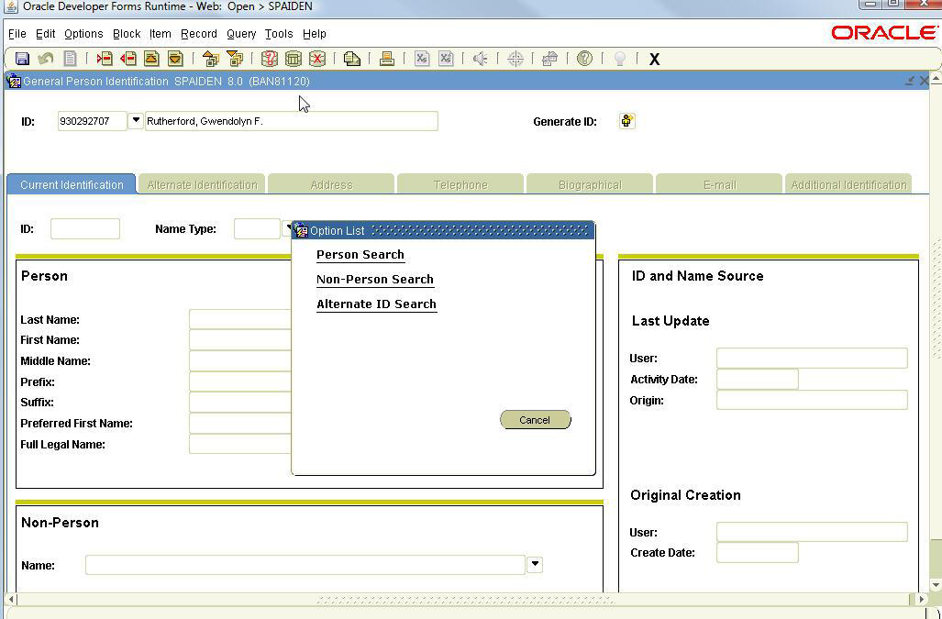
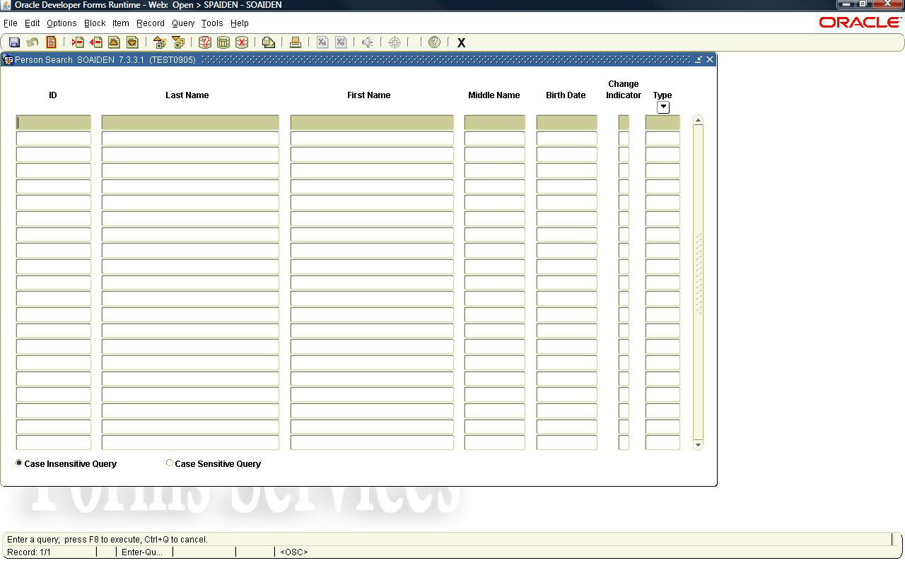
INB SEARCHES Continued……
Person Search (SOAIDEN)
Enter ID (A number) if known
OR
Click the Search icon next to the ID field.
Select Person Search from the Options List.
Enter Last Name
Enter First Name
Click the Execute Query icon or F8.
NOTE: You can make the search case sensitive if you click the radio button.
Example:
Enter flem% to find Fleming or Flemming
Enter m%c%don% to find McDonald or Mac Donald
Enter o%con% to find O’Connell or O Conell or Oconnell

Slide 15
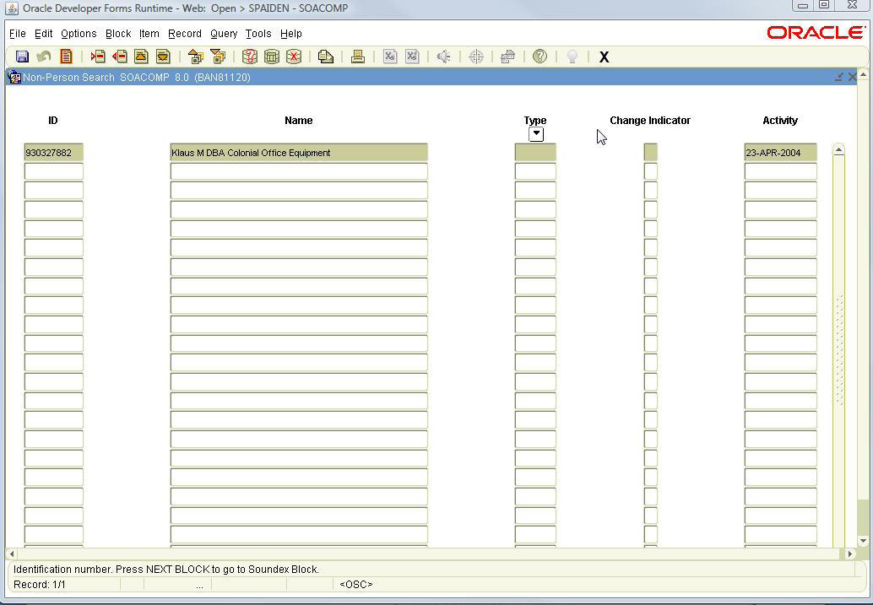
INB SEARCHES Continued……
Non-Person Search (SOACOMP)
Enter ID (Vendors) if known
OR
Click the Search icon next to the ID field.
Select Non-Person Search from the Options List.
Enter Name
Click the Execute Query icon or F8.
Example:
Enter %colonial%office%equipment% to find any companies with these three words, in this order, in the name.

Slide 16
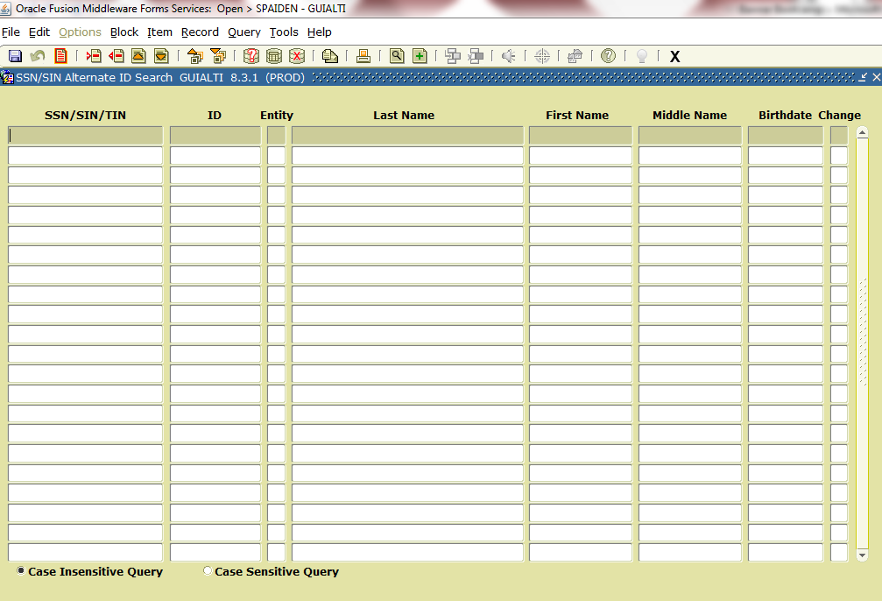
INB SEARCHES Continued……
Alternate ID Search (GUIALTI)
Click the Search icon next to the ID field.
Select Alternate ID Search from the Options List.
Enter SSN/TIN number.
Click the Execute Query icon or F8.
Difference in this search and SOAIDEN (Person Search) is that you can search on DOB. DOB must be entered in this format: DD-MON-YYYY.
You can only search on SSN/TIN if you have access to that field. You will be able to open the form even if you don’t have access to SSN/TIN.

Slide 17
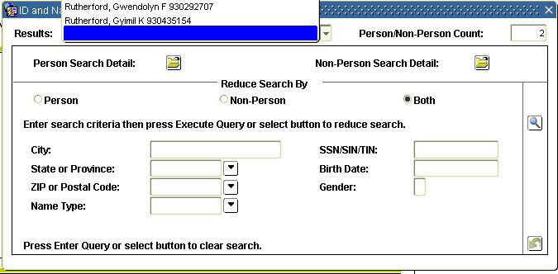
INB SEARCHES Continued……
ID and Name Extended Search
Enter name (including wildcards) directly into the Name field.
Must be in Last Name, First Name format.
Press the Enter key.
If only one match, ID number is populated.
If more than one match is found, the ID and Name Extended Search box displays.
Click drop down arrow to view results. Double click the name to return it to the Name field.
Number of matches found.
Narrow the search by entering additional criteria such as: City, State, Birth Date and Gender. Use the Reduce Search icon to rerun the search.

Slide 18
INB SEARCHES Continued……
General Search (GUISRCH)
This search was new in Banner 8.4 release.
Can search by: Additional ID, E-mail, Country Code, Area Code and Phone Number

Slide 19
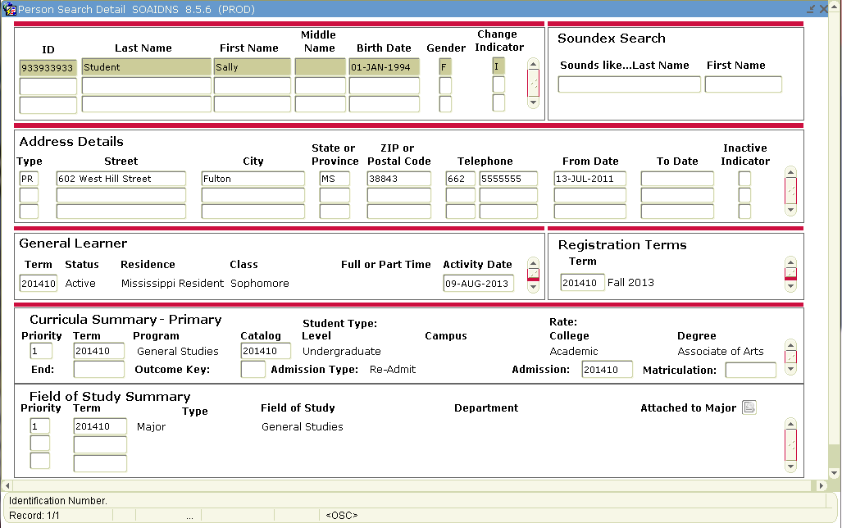
INB SEARCHES Continued……
Person Search Detail (SOAIDNS)
Can search by Student Name, DOB, Gender, Address Details, General Learner, Registration Terms, Curriculum

Slide 20
Creating and Using QuickFlows
What is a QuickFlow?
A QuickFlow in Banner allows you to access multiple forms in a specific sequence.
When is a QuickFlow useful?
A QuickFlow is useful when your job function repeatedly requires you to process several forms in a specific order to complete a task. Once a QuickFlow is set up, you need only to access the QuickFlow, and then all forms in the QuickFlow will open in the order specified in setup.
What are the forms used in setting up or using QuickFlows?
GTVQUIK—defines the QuickFlow code and description
GUAQUIK—defines the forms in the QuickFlow and the sequence in which the forms are processed
GUAQFLW—allows you to enter the identifier defined in GUAQUIK to execute the QuickFlow

Slide 21
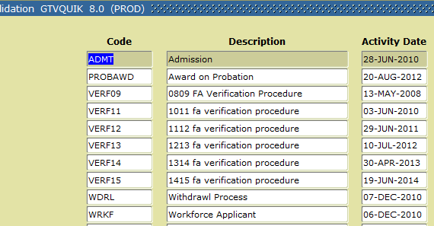
Creating and Using QuickFlows Continued……
1. Determine the following:
Purpose of QuickFlow
Forms needed in QuickFlow
Order in which the forms should be accessed
2. Access the form GTVQUIK. The form will list all active QuickFlows.
Click the Insert Record toolbar button.
In the QuickFlow column of the blank record, enter a code that will identify your QuickFlow.
In the Description column, type a brief description of the QuickFlow.
Click the Save toolbar button.
Your QuickFlow code and description have now been defined.
3. Access the form GUAQUIK.
Enter the QuickFlow code you defined in Step 2 above.
If you wish to search for existing Quick Flows, click the Search button in the Key Block. Select QuickFlow Codes from the Options List. You will be taken to the QuickFlow validation table where you can double-click the desired QuickFlow code and description. This information will be returned to GUAQUIK.
Click the Next Block toolbar button.
In the left pane, you will see a list of all objects in the database.

Slide 22
Creating and Using QuickFlows Continued……
To add objects to your QuickFlow in GUAQUIK, use one of the steps below:
Find the code for the desired object in the left pane, drag it to the right pane, and then drop it. The object name and description appear in the right pane. If you do not want to scroll to find the object name, you can type the object name in the Find field in the left pane and press ENTER. Repeat to add additional forms.
OR
In the right pane, enter the seven-character name of the objects you wish to add.
IMPORTANT NOTE: You must list the objects in the order in which you want them to appear in the Quick Flow. For example, if you want users of the QuickFlow to access GUASYST, SPAIDEN, and SAAADMS in that order, you must list GUASYST, then SPAIDEN, then SAAADMS in the right pane.
Click the Save toolbar button.
Your QuickFlow is now set up and ready for use!

Slide 23
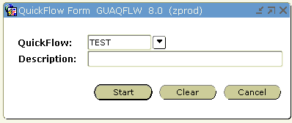
Creating and Using QuickFlows Continued……
How do I use a QuickFlow?
Access the form GUAQFLW.
Enter the code for your QuickFlow. To search for existing QuickFlows, press the Search button.
Click the Start button.
The first form you listed in the QuickFlow definition will appear.
Enter the appropriate data.
Click the Save toolbar button.
Click the Exit toolbar button.
The next form you listed in the QuickFlow definition will appear.
Continue as in Step 2 until all forms have been completed. When you exit the last form, you will see the GUAQFLW form again.
IMPORTANT NOTE: A form that has been defined in the QuickFlow cannot be skipped. You must complete all forms. To exit the QuickFlow, choose Exit QuickFlow from the File menu.

Slide 24
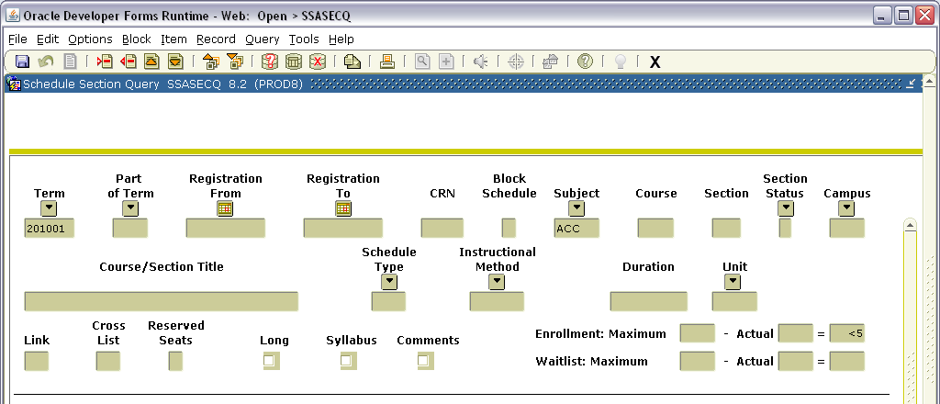
EXTRACTING DATA
In this example SSASECQ is being used. Enter desired data to extract and execute the query.

Slide 25
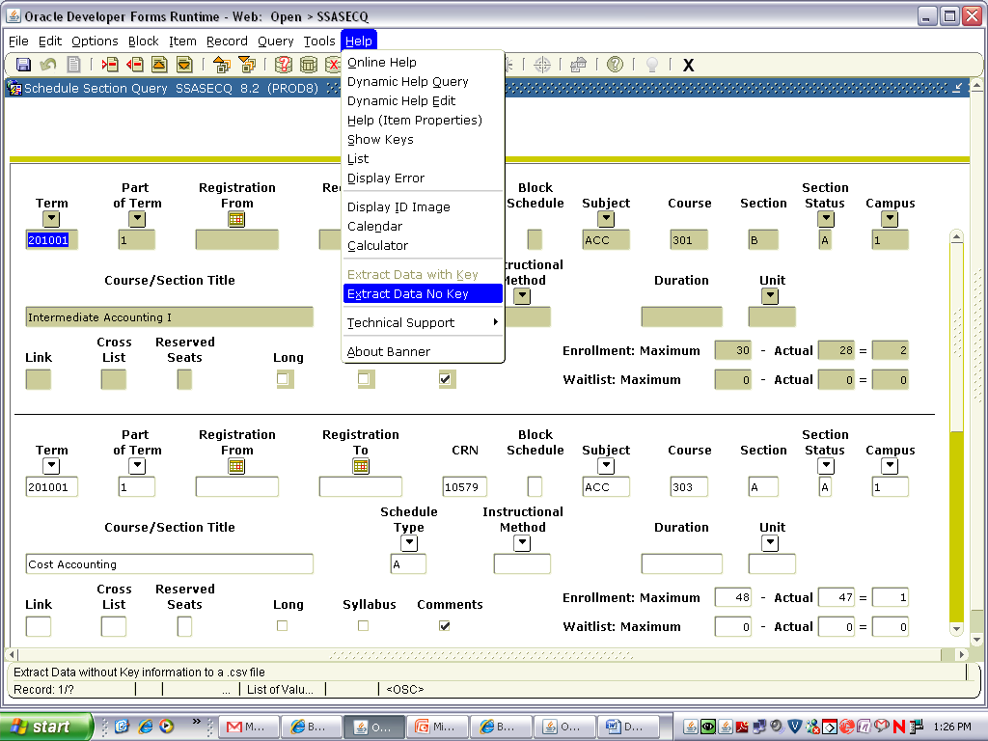
EXTRACTING DATA Continued……
Click Help on the Menu Bar and select Extract Data No Key.

Slide 26
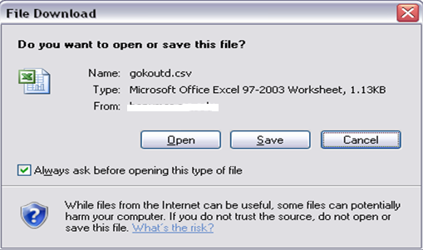
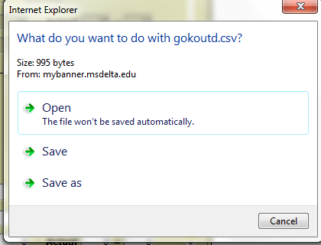
EXTRACTING DATA Continued……
A popup similar to one of these below will appear. Choose to Open or Save. If you Open, the extracted data will open in Excel. If you Save, you will prompted with where to save the file.

Slide 27
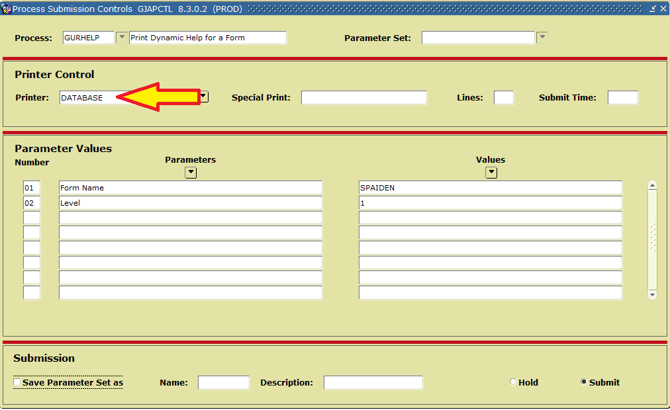
Running jobs to the database
Running Banner jobs to the database will save paper. Enter the Process Name, Next Block, enter Database for the Printer, Next Block, enter necessary parameters, Next Block,and finally click the Save icon (or click File and then Save).
*NOTE: You will receive a message in the lower left corner of the screen indicating the job was submitted to job submission (“jobsub”). This includes the job number.

Slide 28
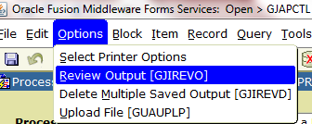
Running jobs to the database Continued…
To review the output of the job you ran, click Options on the Menu bar and then Review Output.
Make sure your job # is listed; then double click the empty box next to File Name.

Slide 29
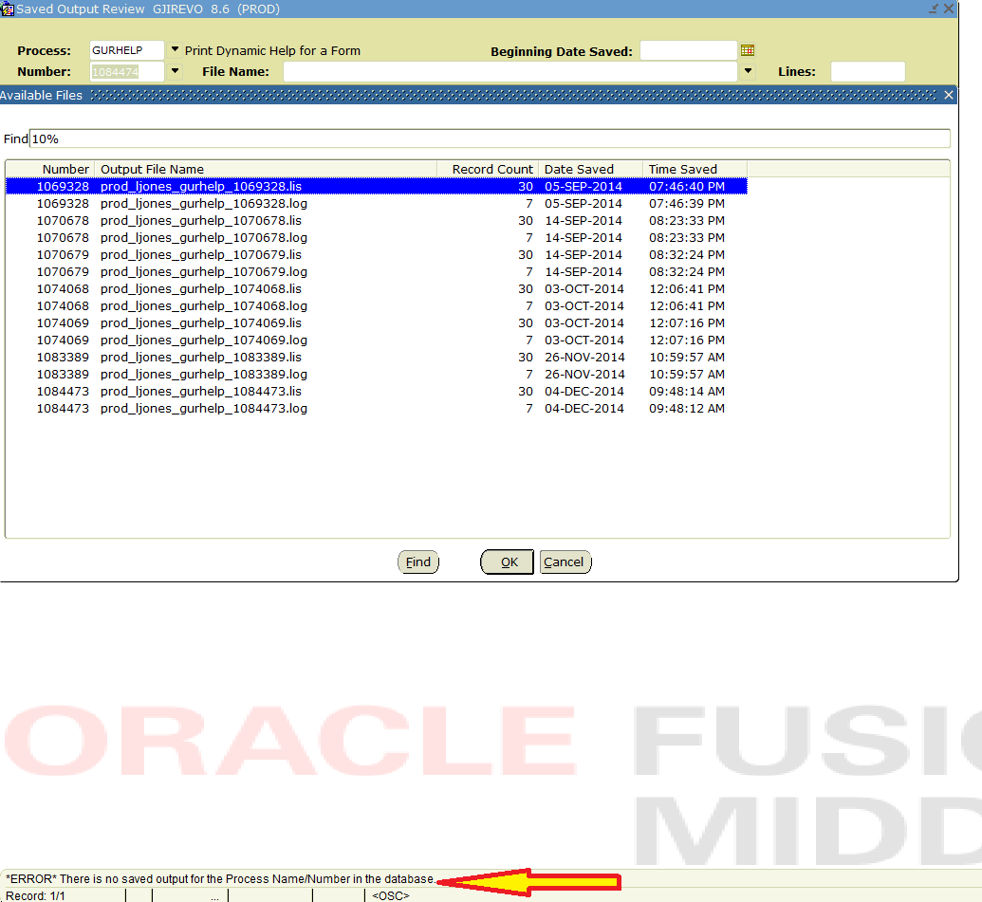
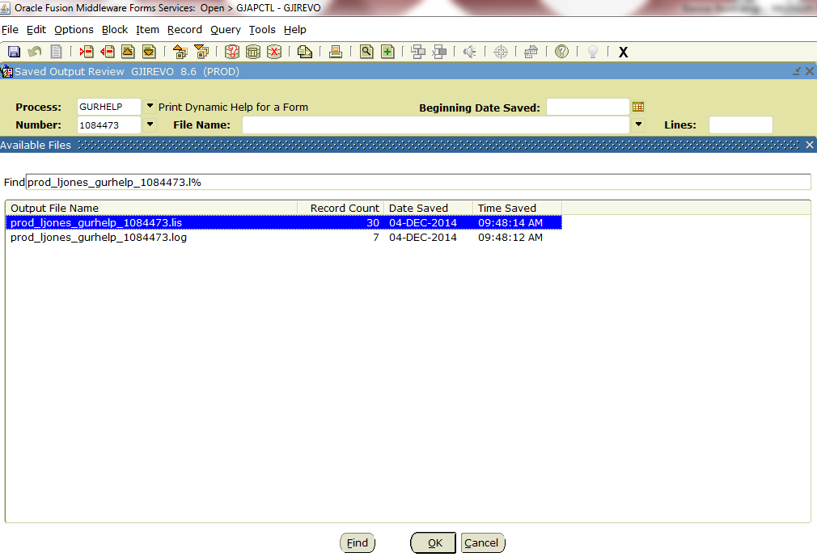
Running jobs to the database Continued…
1
If the job has not finished processing or if you enter an incorrect job number, you will get a list of previous job #s for this process as well as a message at the bottom left saying there is no saved output for the Process Name/Job Number in the database.
If the job has finished processing, you can review it by double clicking the file that ends in “.lis”.
2
1
2

Slide 30
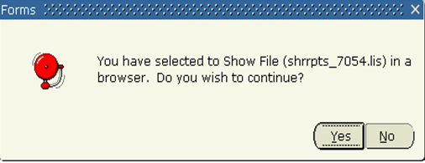
Running jobs to the database Continued…
While you have the “.lis” file output open, if you want to save it and view it in a more readable/workable format, click Options on the Menu Bar and select Show Document(Save and Print File).
You will get the following pop up message. Click Yes and the output will open in your browser.

Slide 31
MBUG (Mississippi Banner users group)
Mississippi Banner Users Group (MBUG) is an association of community colleges, universities and IHL in Mississippi. Any Ellucian Banner user from an institution in the state is eligible for membership. It is MBUG’s hope that through communication, sharing and the annual MBUG Conference, the member institutions will maximize their use of Ellucian Banner. MBUG's Board of Directors is made up of a technical person and a functional user from each member institution. If you are on Facebook, you may want to "Like" the MS Banner User Group Facebook page to keep up with MBUG. The link to that page is below: https://www.facebook.com/MississippiBannerUsersGroup?fref=ts MBUG also has a website that you may want to save in your browser's favorites/bookmarks. http://www.mbug.net/
MBUG has its own Listserv, thanks to Mississippi State. Members are encouraged to subscribe and post questions or suggestions. To subscribe, simply send an email message to: sympa@Lists.MsState.Edu with the message: subscribe mbug-l. To post a message to MBUG-L, address your message to: mbug-l@Lists.MsState.Edu To unsubscribe, simply send an email message to: sympa@Lists.MsState.Edu with the message: unsubscribe mbug-l.

Slide 32
THE END!
Questions?
This Banner Boot Camp guide was created using parts of Banner Boot Camp I and Banner Boot Camp II presentations from previous MBUG (Mississippi Banner Users Group) Conferences. Thanks to those original creators from Alcorn State University and Itawamba Community College!

