Slide 1
MBUG 2016
Session Title: Automating & Streamlining in the FAO
Presented By: Terry Bland
Institution: ICC
Date: September 12, 2016

Slide 2
SESSION RULES OF ETIQUETTE
Please turn off your cell phone
If you must leave the session early, please do so discreetly
Please avoid side conversation during the session

Slide 3
TOOLS

Slide 4
AUTOMATING & STREAMLINING
TOOLS
Population Selections
Rules
Email Letters
Self-Service

Slide 5
POPULATION SELECTION

Slide 6
AUTOMATING & STREAMLINING
POPULATION SELECTION
GLBDATA – Population Selection Extract
GLRSLCT – Population Selection Definition Rules
GLAEXTR – Population Selection Extract Data

Slide 7
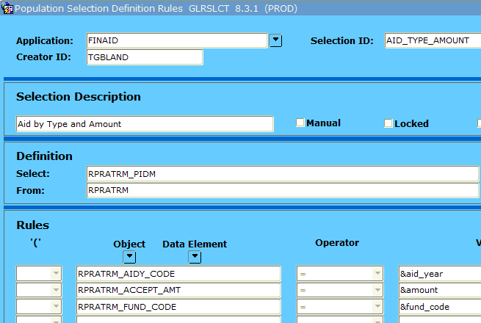
AUTOMATING & STREAMLINING
Finds aid type by amount
POPULATION SELECTION

Slide 8
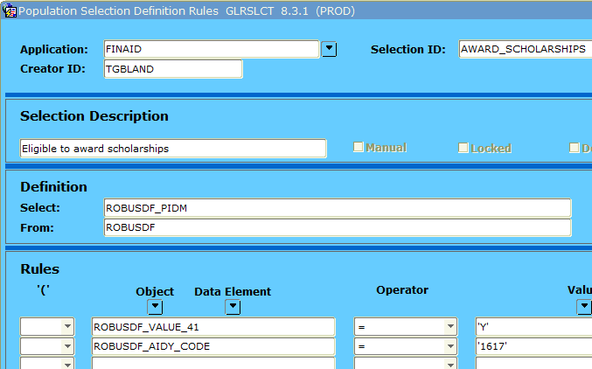
AUTOMATING & STREAMLINING
Finds scholarship applicants
POPULATION SELECTION

Slide 9
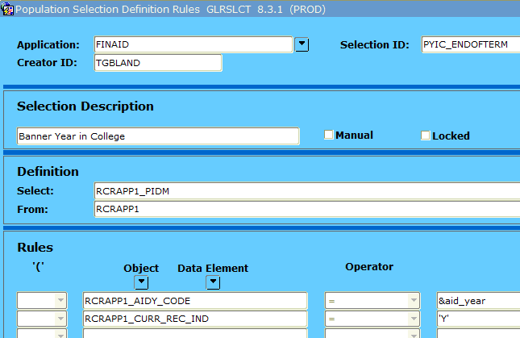
AUTOMATING & STREAMLINING
Finds all who filed FAFSA
POPULATION SELECTION

Slide 10
AUTOMATING & STREAMLINING
POPULATION SELECTION
Table Name | Description
RCRAPP1 | FAFSA Table Part 1
RPRATRM | Applicant Award by Term
RRRAREQ | FA Requirements
SFRSTCR | Enrollment
TBRACCD | Student Account Detail
RPRTIIV | R2T4
RORSAPR | SAP
RORSTAT | Applicant Status

Slide 11
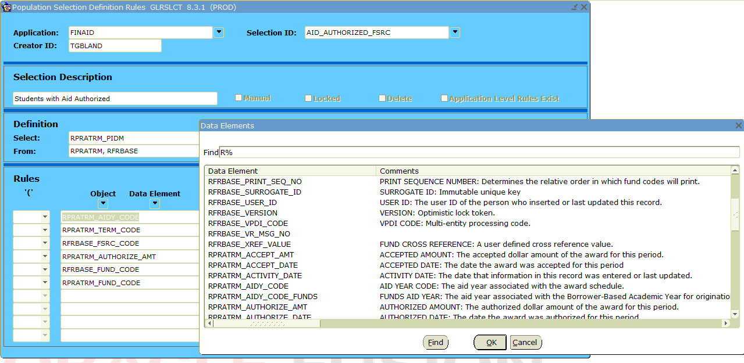
AUTOMATING & STREAMLINING
POPULATION SELECTION

Slide 12
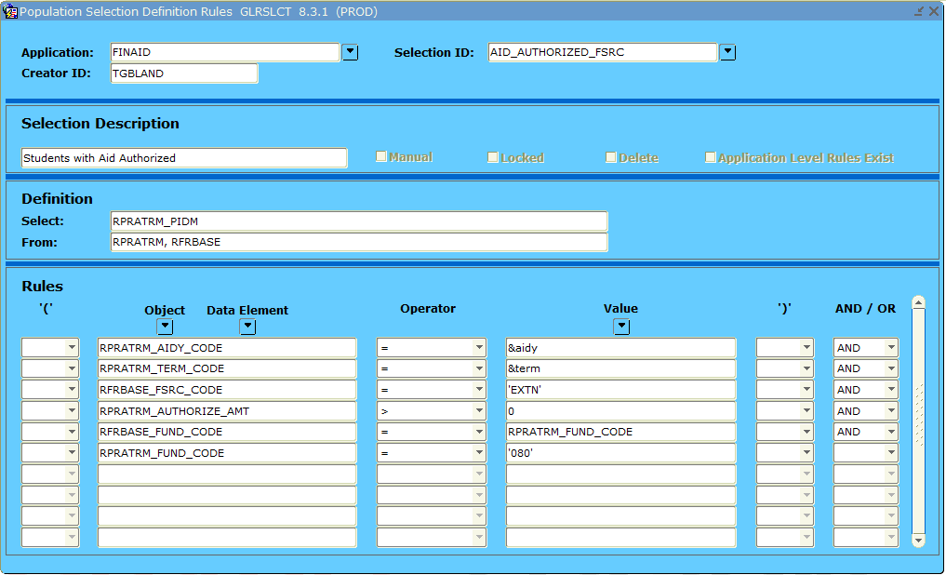
AUTOMATING & STREAMLINING
POPULATION SELECTION

Slide 13
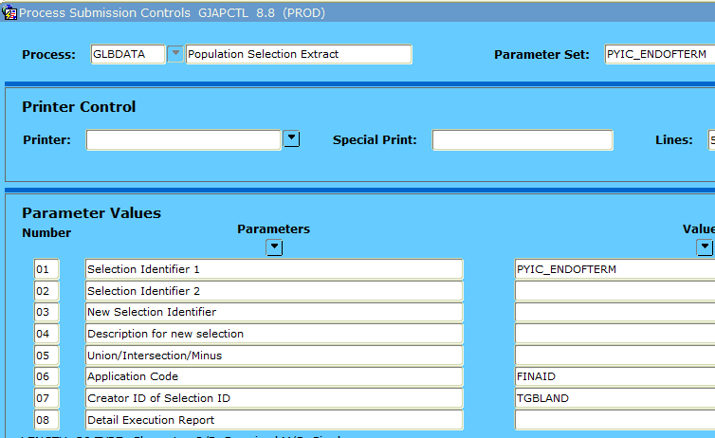
AUTOMATING & STREAMLINING
Gathers the popsel data
POPULATION SELECTION

Slide 14
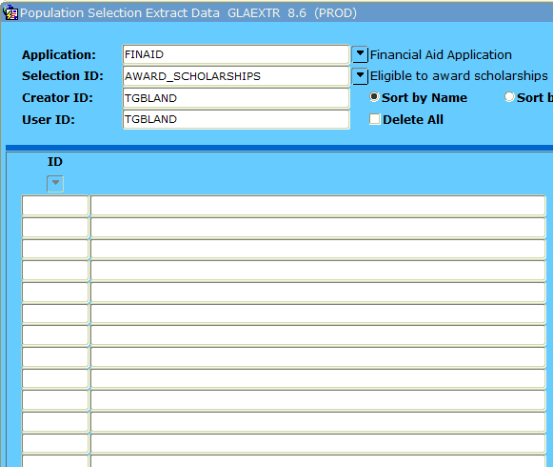
AUTOMATING & STREAMLINING
Displays the popsel data
POPULATION SELECTION
Davy Jones
Tom Jones
Clark Kent
Bruce Wayne

Slide 15
RULES

Slide 16
AUTOMATING & STREAMLINING
RULES
RORPOST – Batch Posting Rules
RORRULE – FA Selection Rules
RORALGO – General Algorithmic Rules
RORWTAB - Web Tab Rules
RORWTXT – Web Text Rules

Slide 17
AUTOMATING & STREAMLINING
RULES
RORALGO
Set Period Year in College on ROASTAT Tab 2 for use in loan processing.
Roll period budget to Spring/Summer if student does not enroll for Fall/Spring.

Slide 18
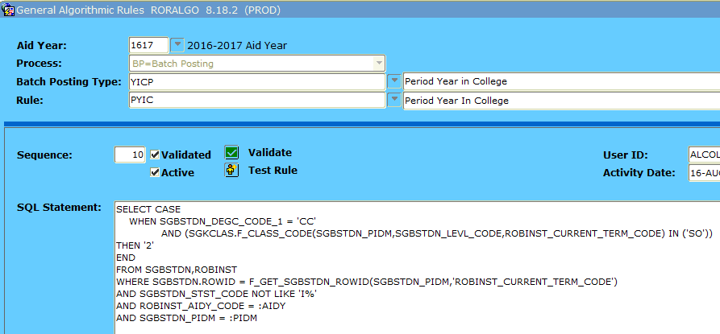
AUTOMATING & STREAMLINING
RULES

Slide 19
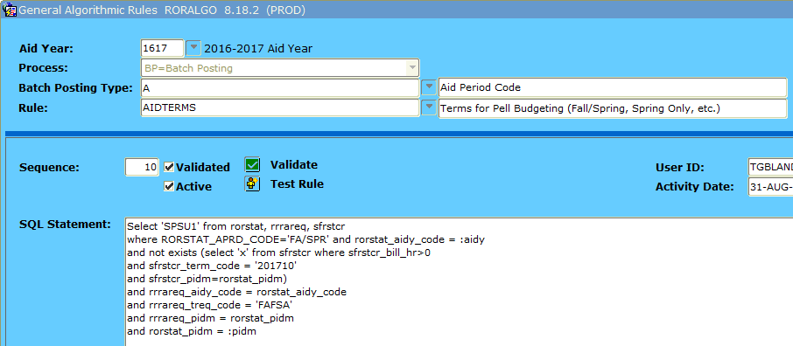
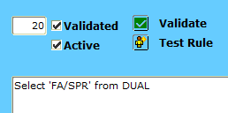
AUTOMATING & STREAMLINING
RULES

Slide 20
AUTOMATING & STREAMLINING
RULES
RORPOST
Batch post requirement codes based on SAR comments after upload.
Batch post requirement codes based on answers within the FAFSA data (i.e. legal guardianship, foster child/ward of the court, active military, etc.)
Batch update requirement code statuses (i.e. bankruptcy set to E for “not yet received” but needs to be S for “satisfied”).

Slide 21
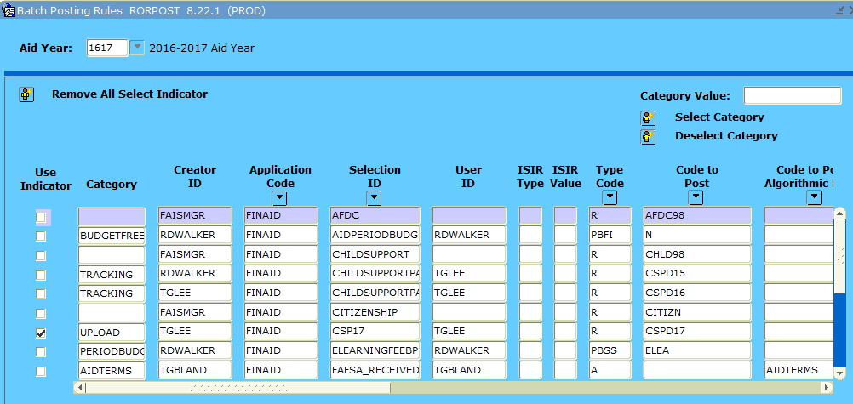
AUTOMATING & STREAMLINING
RULES

Slide 22
AUTOMATING & STREAMLINING
RULES
RORRULE
Stop Pell from disbursing/authorizing until receive COD acknowledgement. (prevent reconciling issues)
Stop scholarships from disbursing if student is enrolled in less than 15 hours with exception of healthcare students who are enrolled in at least 6 hours.
Package scholarships if ROAUSDF fields are marked appropriately.

Slide 23
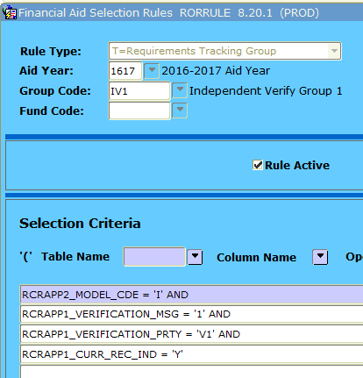
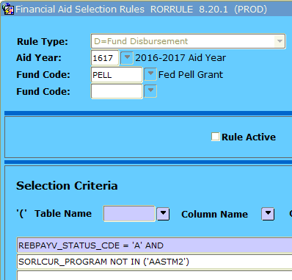
AUTOMATING & STREAMLINING
RULES

Slide 24
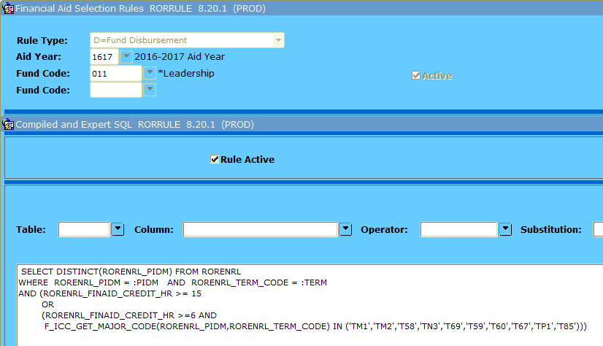
AUTOMATING & STREAMLINING
RULES

Slide 25
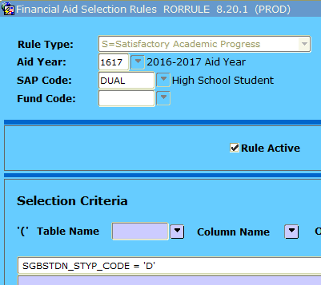
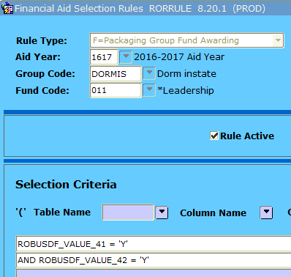
AUTOMATING & STREAMLINING
RULES

Slide 26
EMAIL LETTERS

Slide 27
AUTOMATING & STREAMLINING
EMAIL
GTVLETR – Letter Code Validation
RORELTR – E-Mail Letter Rules
RORELTF – E-Mail Letter Format Rules
ROREMAL – Generate Financial Aid E-Mail
RUAMAIL – Applicant Mail Inquiry
GLBDATA – Population Selection Extract
GLRSLCT – Population Selection Definition Rules

Slide 28
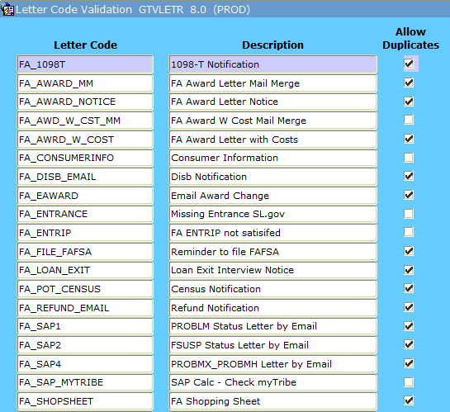
AUTOMATING & STREAMLINING
EMAIL
SETUP

Slide 29
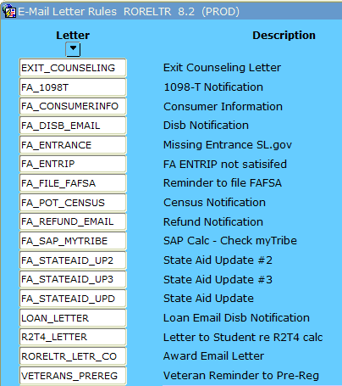
AUTOMATING & STREAMLINING
EMAIL
SETUP

Slide 30
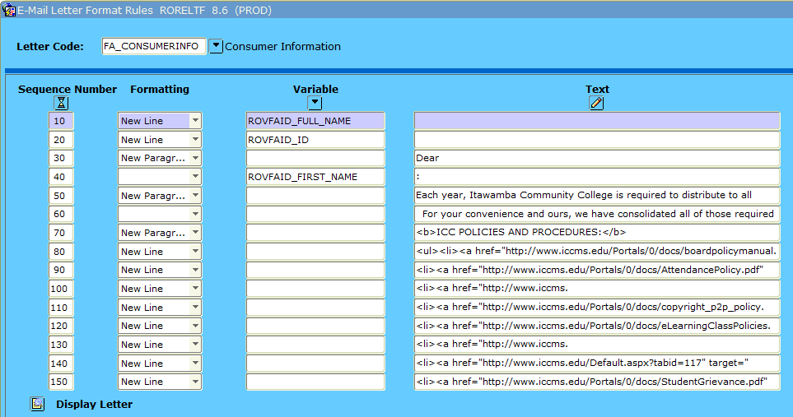
AUTOMATING & STREAMLINING
EMAIL
SETUP

Slide 31
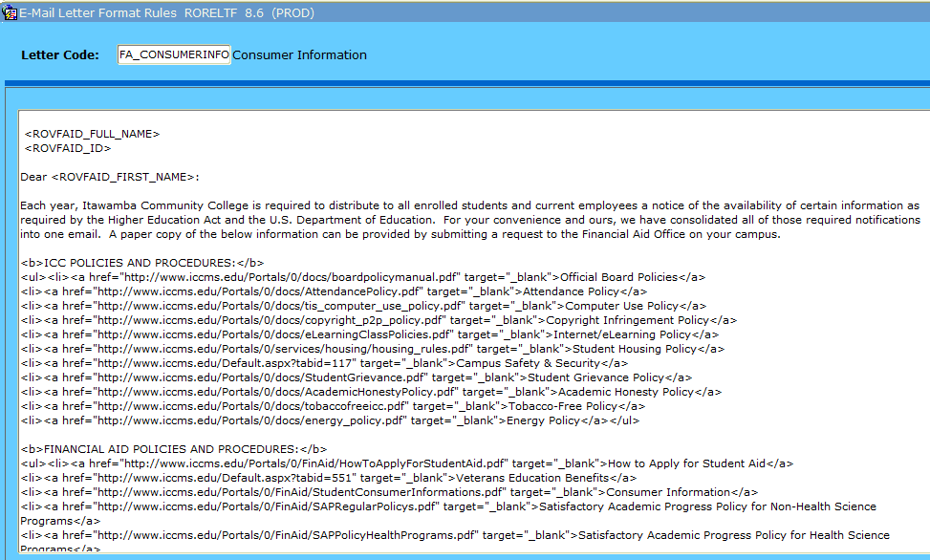
AUTOMATING & STREAMLINING
EMAIL
SETUP

Slide 32
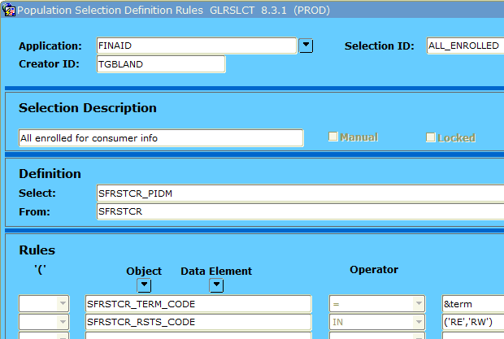
AUTOMATING & STREAMLINING
EMAIL
SETUP

Slide 33
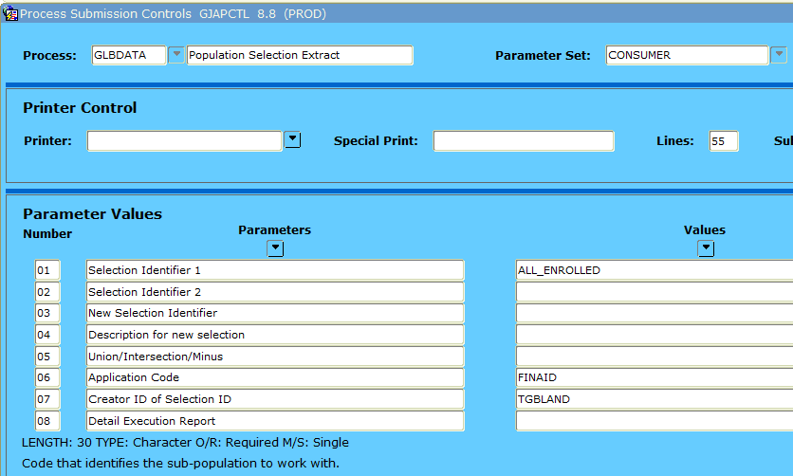
AUTOMATING & STREAMLINING
EMAIL

Slide 34
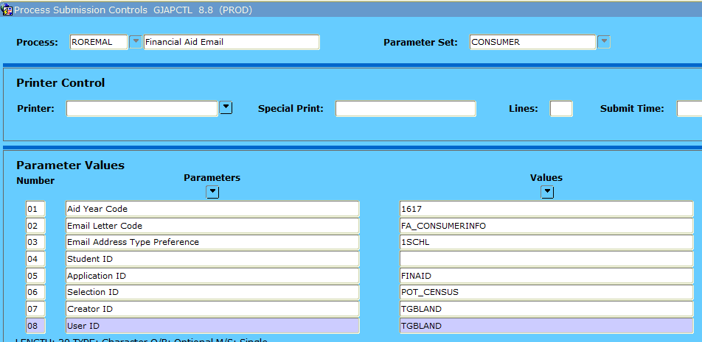
AUTOMATING & STREAMLINING
EMAIL

Slide 35
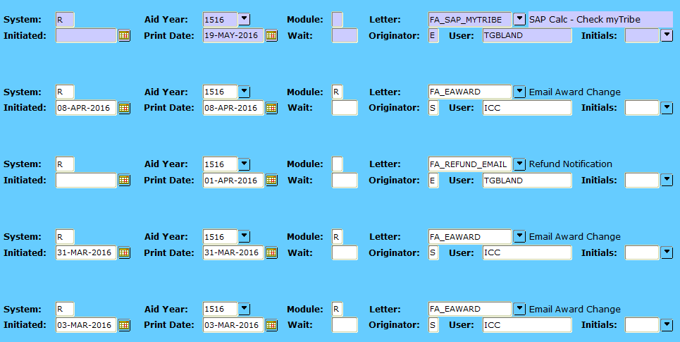
AUTOMATING & STREAMLINING
EMAIL

Slide 36
SELF-SERVICE

Slide 37
AUTOMATING & STREAMLINING
SELF-SERVICE
RORWTAB / RORWTXT to display messages on Self-Service
Display a message that FAFSA rejected
Pull comments from RHACOMM to display reasons appeal was denied
Display R2T4 information (% earned, amount owed)

Slide 38
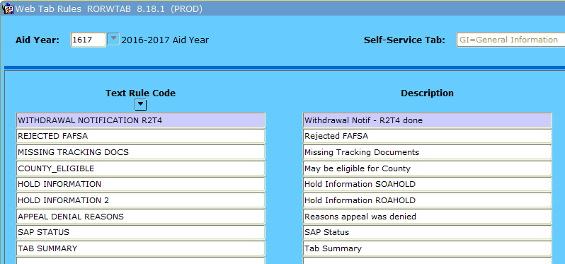
AUTOMATING & STREAMLINING
SELF-SERVICE

Slide 39
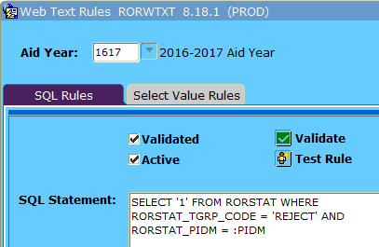
AUTOMATING & STREAMLINING
SELF-SERVICE

Slide 40
AUTOMATING & STREAMLINING
SELF-SERVICE

Slide 41
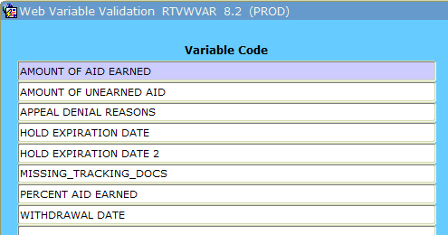
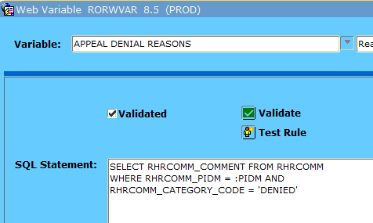
AUTOMATING & STREAMLINING
SELF-SERVICE
Create a Web Variable with RTVWVAR/RORWVAR

Slide 42
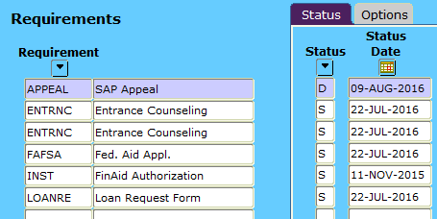
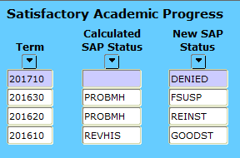
AUTOMATING & STREAMLINING
SELF-SERVICE
RRAAREQ
ROASTAT
RHACOMM

Slide 43
AUTOMATING & STREAMLINING
SELF-SERVICE
Display the results of SAP Appeal and reasons on Academic Progress tab in Self-Service:

Slide 44
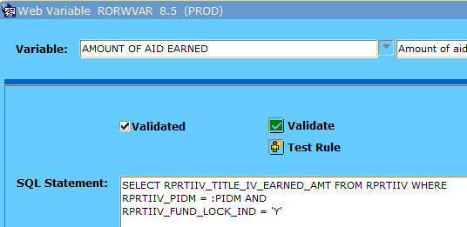
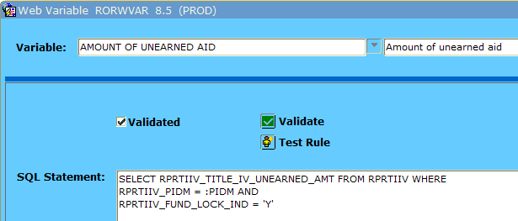
AUTOMATING & STREAMLINING
SELF-SERVICE
Create a Web Variable with RTVWVAR/RORWVAR

Slide 45
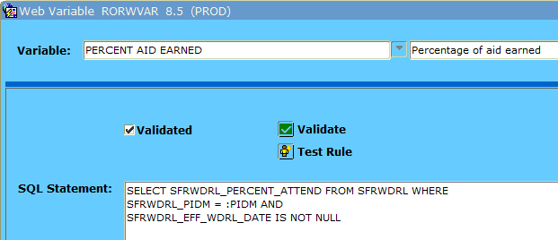
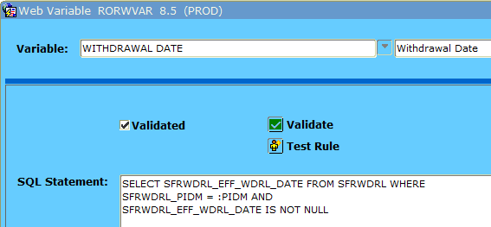
AUTOMATING & STREAMLINING
SELF-SERVICE
Create a Web Variable with RTVWVAR/RORWVAR

Slide 46
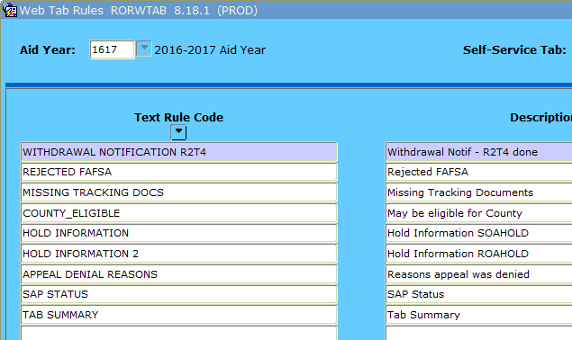
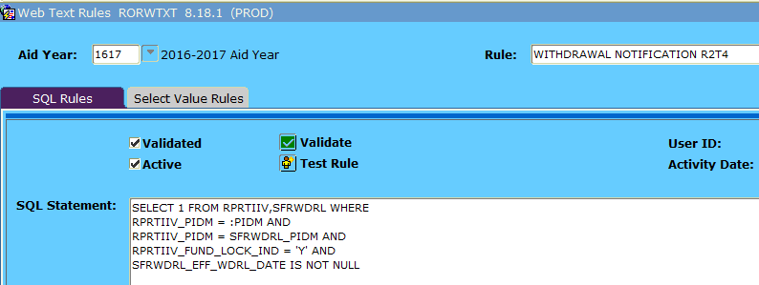
AUTOMATING & STREAMLINING
SELF-SERVICE

Slide 47
AUTOMATING & STREAMLINING
SELF-SERVICE
Variables:
<**WITHDRAWAL DATE**>
<**PERCENT AID EARNED**>
<**AMOUNT OF AID EARNED**>
<**AMOUNT OF UNEARNED AID**>

Slide 48
AUTOMATING & STREAMLINING
SELF-SERVICE
WITHDRAWAL NOTIFICATION AND RETURN OF FUNDS
The Financial Aid Office has been notified of your withdrawal effective 09/07/2016. We are required by law to perform a calculation called "Return to Title IV" to determine the percentage of federal aid you earned and return any unearned portion to the U.S. Department of Education. The calculation shows that you earned 15% or $500.00 of the federal funds you were previously awarded. Unfortunately, that means we must return $1000.00 which may leave you owing a balance in the Business Office. Please contact them at 662-862-8010 to make payment arrangements. You will not be able to order a transcript or register for future classes until your balance is paid in full. You may also want to review the policy regarding Treatment of Title IV Aid When a Student Withdraws.

Slide 49
QUESTIONS?

