Slide 1
MBUG 2016
Session Title: Approving Documents: A User’s Perspective
Presented By: Tamara Gibson
Senior IT Consultant/BANNER Trainer
ITS-User Services
gibson@its.msstate.edu
(662) 722-0262
Institution: Mississippi State University
September 13, 2016 @ 9:00 a.m.
Hilton Garden Inn-Pecan Room
Tupelo, MS

Slide 2
Session Rules of Etiquette
Please turn off your cell phone
If you must leave the session early, please do so discreetly
Please avoid side conversations during the session

Slide 3
Session Overview
This session will provide you with the knowledge and practice to perform online approvals at your institution. The intended audience is staff and administrators that create and/or approve requisition, invoice and journal voucher documents in Banner.
Queue Setup Process
Banner Access Requirements
Queue Search Forms
Queue Reports

Slide 4
Approval Queue Setup
All approval queue setups are handled by ITS
Department must complete the appropriate form for Requisitions/Invoices or Journal Vouchers
http://www.its.msstate.edu/files/approve.pdf
http://www.its.msstate.edu/files/JVapprovalrequest.pdf
Instructional factsheets are provided online
http://www.its.msstate.edu/files/aqrf-req-inv.pdf
http://www.its.msstate.edu/files/aqrf-jv.pdf
Form must have ALL required signatures

Slide 5
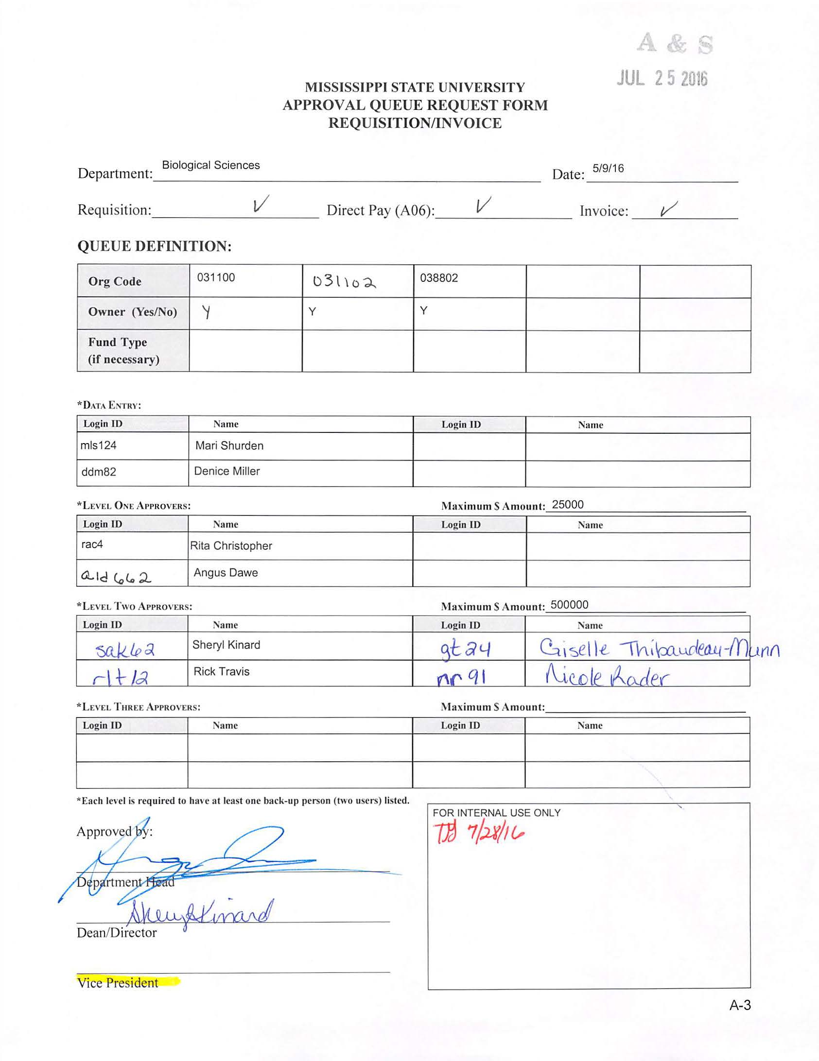

Slide 6
Approval Queue Setup (REQ/INV)
Queue forms used for setup are located on the Finance Approval Menu [*FINAPPR]
Queue Setup
If needed, check queue ID and name for availability [FTVAPPQ]
Create/Query Queue ID and Name [FTMAPPQ]
Create/Update levels and/or add approvers
INVA queue is the NEXT QUEUE for final approval of all INV documents
Setup/Update Routing structure [FOMAQRC]
Create a INV and JV record (includes PC documents)
Email department (data entry and approvers)
Users are automatically terminated from all queues upon employment termination

Slide 7
APPROVAL QUEUE VALIDATION FORM [FTVAPPQ]

Slide 8
APPROVAL QUEUE MAINTENANCE FORM [FTMAPPQ]

Slide 9
APPROVAL QUEUE MAINTENANCE FORM [FTMAPPQ]

Slide 10
APPROVAL QUEUE ROUTING CODES FORM [FOMAQRC]

Slide 11
APPROVAL QUEUE ROUTING CODES FORM [FOMAQRC]

Slide 12
Approval Queue Setup (JV)
Setup must be completed by Reporting, Planning and Analysis
Set up rule code (ex. FTIR) and doc prefix (ex. IR)
Create rule group (ex. JVIR) for rule class FTIR
Queue Setup
Create/Query Queue ID and Name [FTMAPPQ]
Create/Update levels and/or add approvers
Setup/Update Routing structure [FOMAQRC]
Email department (data entry and approvers)
Copy Reporting, Planning and Analysis

Slide 13
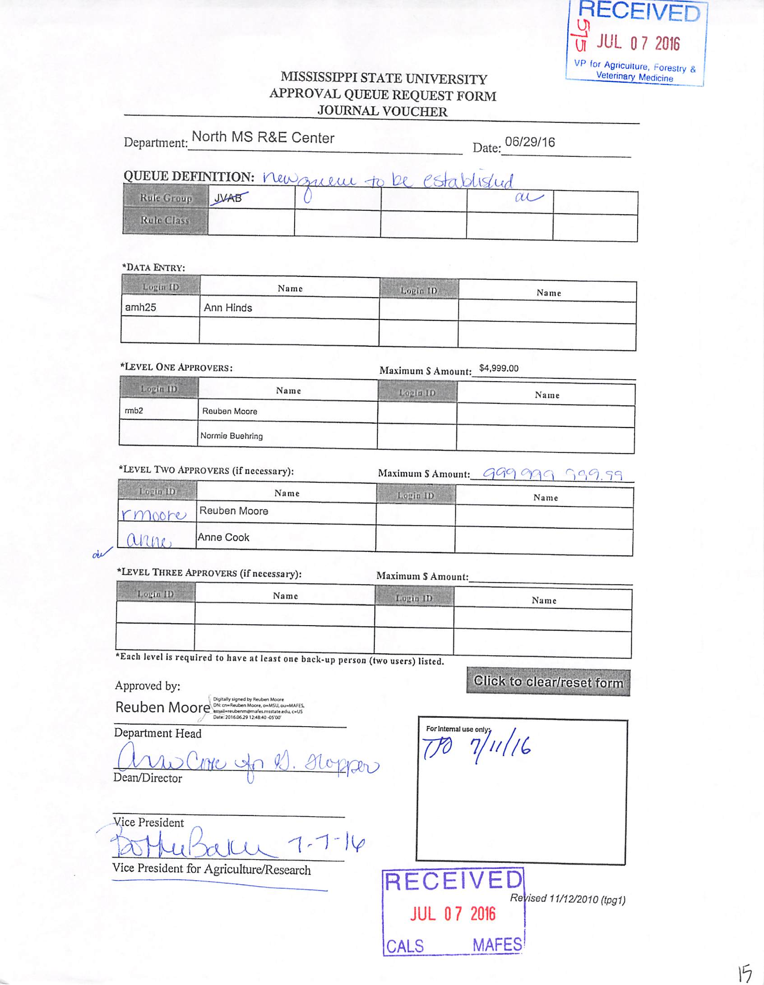

Slide 14
APPROVAL QUEUE ROUTING CODES FORM [FOMAQRC]

Slide 15
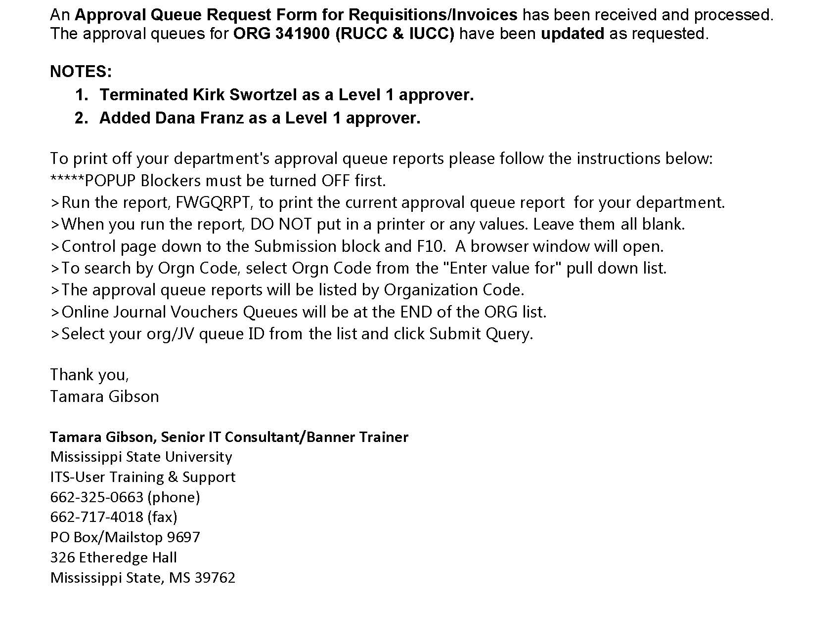

Slide 16
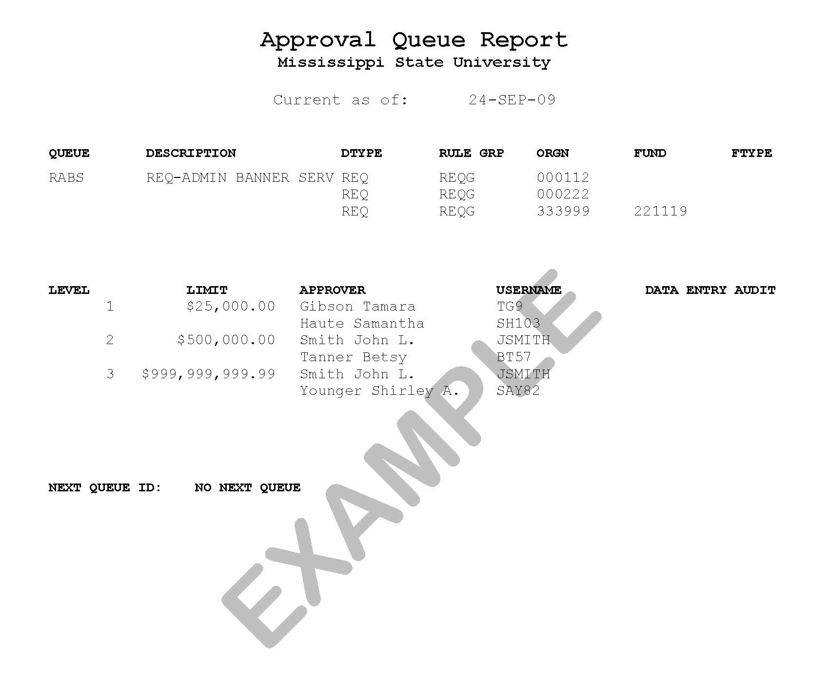

Slide 17
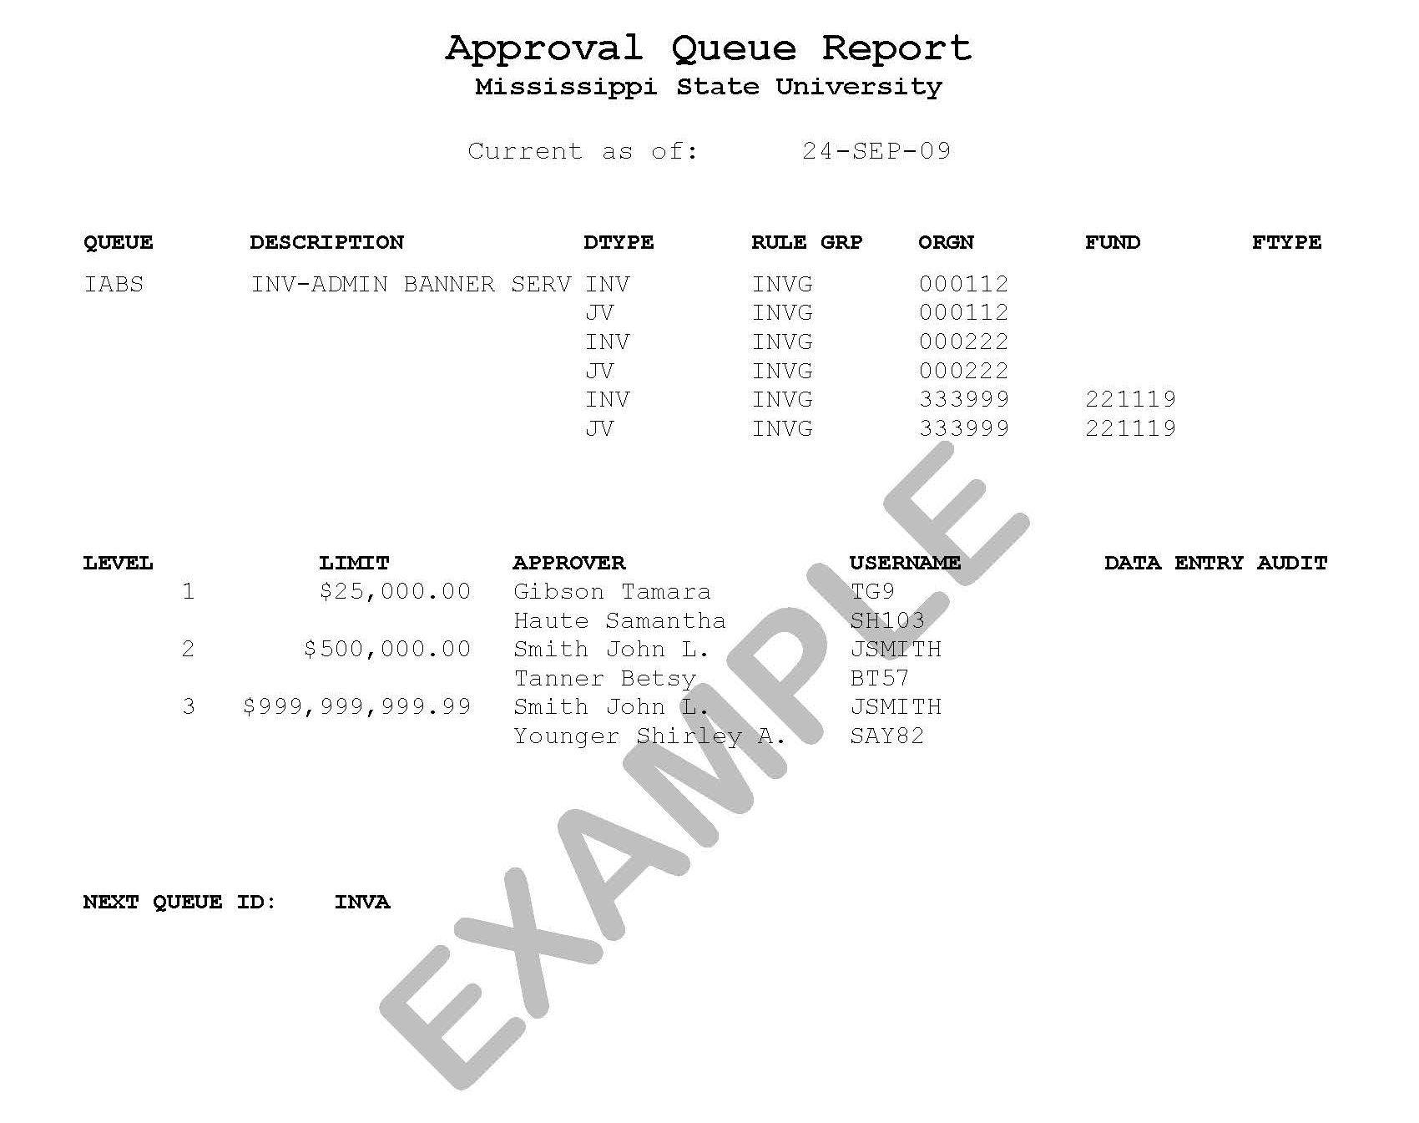

Slide 18
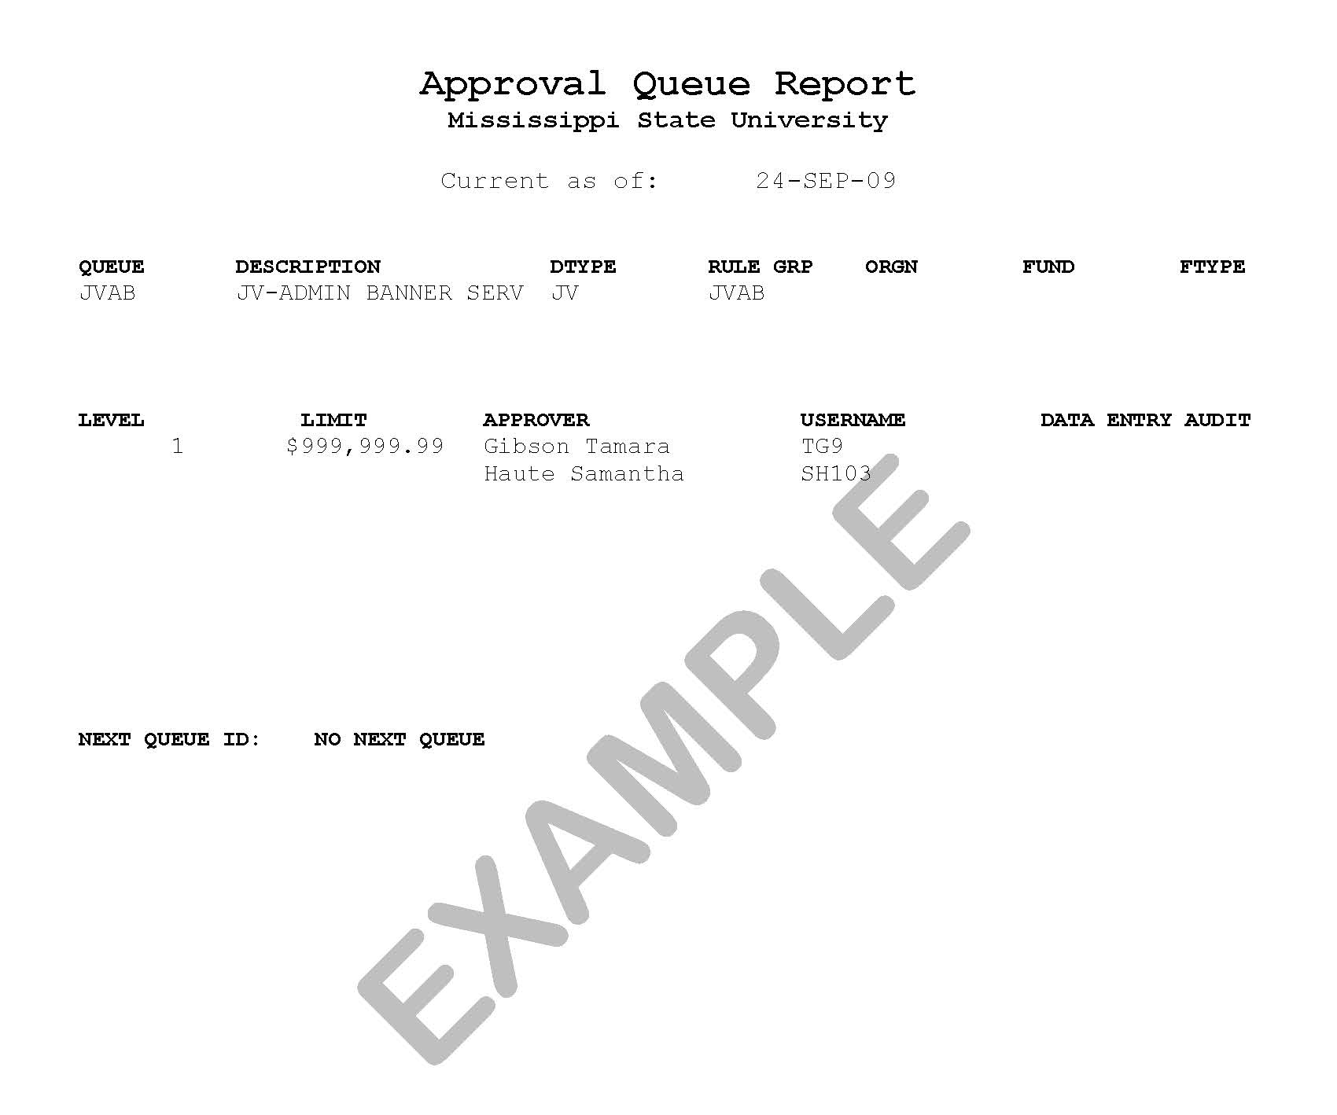

Slide 19
Queue Reports
Departmental Reports:
Approval Queue Structure [FWGQRPT]
Reports for ITS:
Approvals User Report [FWGQUSR]
Approval Queue Audit [FWGQAUD]
Approval Queue History [FWGQHIS]
Enter and Approval Audit Report [FWGAUDT]

Slide 21
Banner Access Requirements
Submit a Banner Access Request Form
http://www.its.msstate.edu/files/barf.pdf
BAN_YQRYFIN
BAN_OLJV (online journal voucher queues only)
BAN_APPR
MSU Policy
Users cannot have BAN_REQ, BAN_INV or BAN_PROCARD access and BAN_APPR access
Does not apply to BAN_OLJV access for JV queues

Slide 22
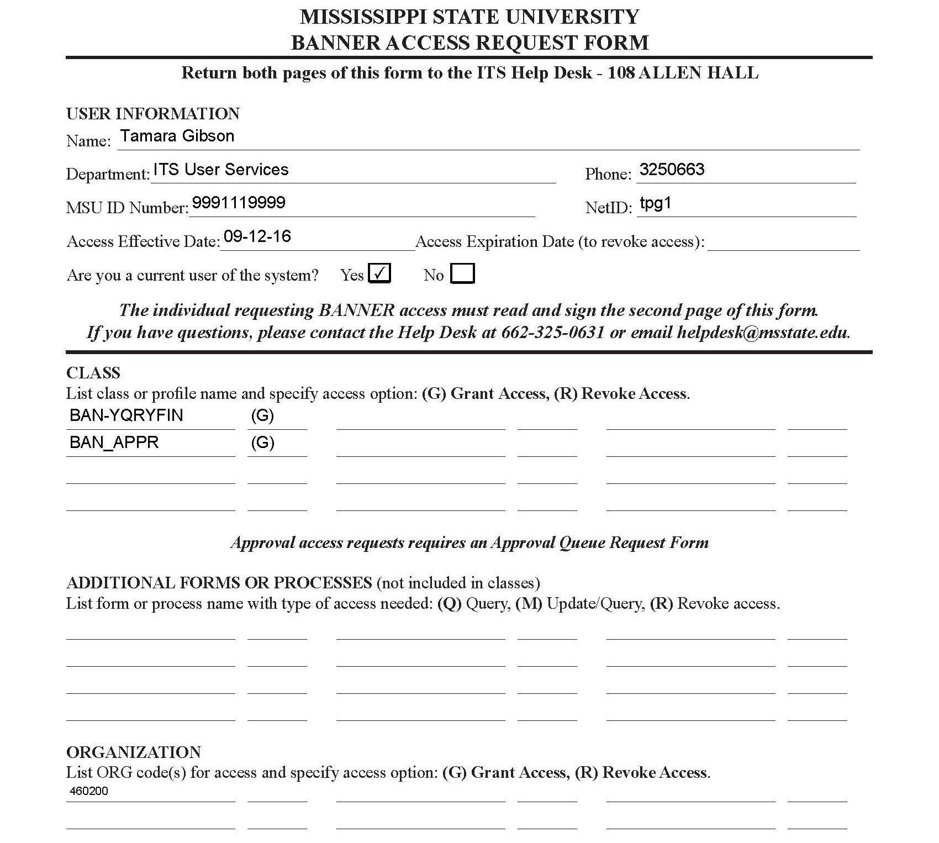

Slide 23
Departmental User Approval Forms
Approvals Notification Form (FOIAINP)
User Approval Form (FOAUAPP)
Document Approval Form (FOAAINP)
Document Approval History Form (FOIAPPH)
Approval History Form (FOIAPHT)

Slide 24
User Approval Form (FOAUAPP)

Slide 25
Document Approval Form (FOAAINP)

Slide 26
Document Approval History Form (FOIAPPH)

Slide 27
Approval History Form (FOIAPHT)

Slide 28
General Message Form (GUAMESG)
Banner generates a message to the user when a document is DISAPPROVED
Purchasing agents cannot disapprove a Requisition

Slide 29
MBUG 2016
Session Title: Approving Documents: A User’s Perspective
Presented By: Tamara Gibson
Senior IT Consultant/BANNER Trainer
ITS-User Services
gibson@its.msstate.edu
(662) 722-0262
Institution: Mississippi State University
September 13, 2016 @ 9:00 a.m.
Hilton Garden Inn-Pecan Room
Tupelo, MS

