Slide 1
MBUG 2016
Session Title: Banner Advancement Basic
Presented By: Cindy Hampton
Institution: Mississippi College
September 12, 2016

Slide 2
Session Rules of Etiquette
Please turn off your cell phone
If you must leave the session early, please do so discreetly
Please avoid side conversation during the session

Slide 3
AGENDA
Navigating to Advancement Forms
Navigating in Advancement Forms
Searching for Persons/Constituents
Where Do I Find It?

Slide 4
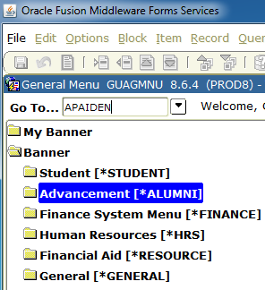
NAVIGATING TO ADVANCEMENT FORMS
* There are numerous ways to navigate to the forms in Banner.
1. DIRECT ACCESS – Type the seven letter form name in the Go To…field and press Enter.

Slide 5
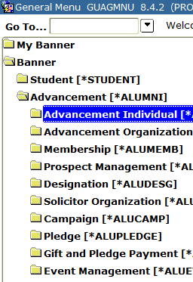
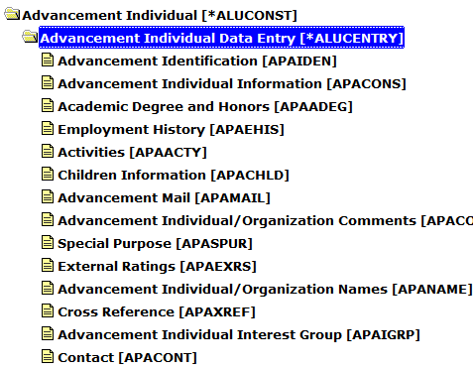
2. ADVANCEMENT MENU-The Advancement Menu provides an easy way to go through a module within the Advancement system.

Slide 6
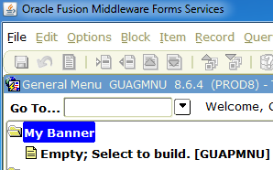
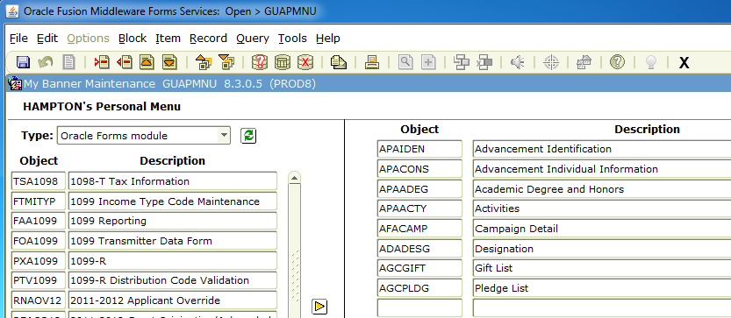
3. MY BANNER MENU-You can create your own personal Banner menu of forms that you use. Click on My Banner, then Empty; Select to build[GUAPMNU]
Enter the names of the forms you would like to add to your menu. If you do not know the form names, you can search in the Object List on the left. Press SAVE.

Slide 7
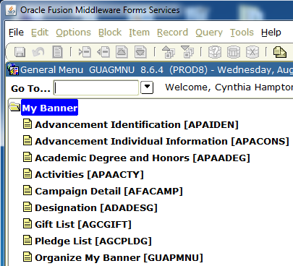
When you return to the Go To…field, type REFRESH and press Enter.
Click on your My Banner folder and the forms you selected will now display for you.

Slide 8
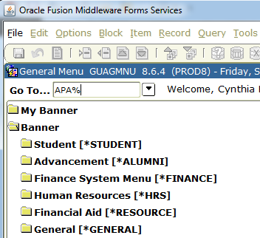
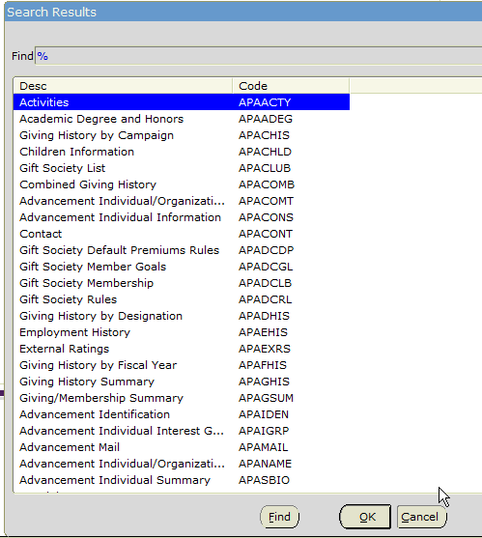
4. If you know part of the form name, you can enter that in the Go To.. field followed by the % sign, then press Enter. Banner will display all forms that meet that criteria. You can review the list of forms displayed and double click on the form you need or highlight it and click OK.

Slide 9
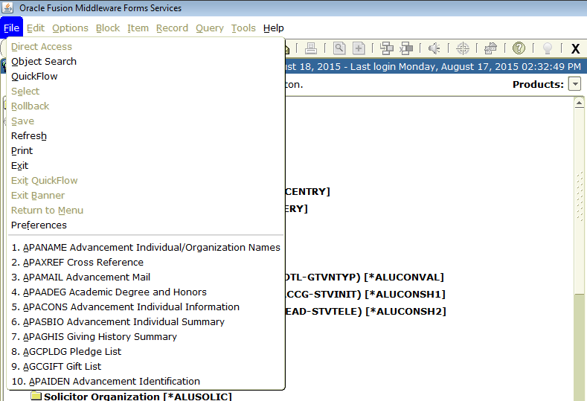
5. Banner keeps up with the forms you have accessed while in your Banner session. You can click File on the menu bar and the last 10 forms you have accessed will display for you. You can click on the form you want to access.
NOTE: This list will change as you navigate different forms during your Banner session.

Slide 10
From the Go To…field, you may also use your UP and Down arrow keys on your keyboard to navigate between forms you have previously accessed.

Slide 11
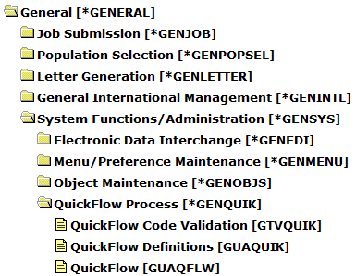
6. You can use a Quickflow to connect Banner forms together when doing a lot of data entry that involves populating the same forms over and over. Quickflow lives in the General module and can be found in the System Functions/Administration folder.

Slide 12
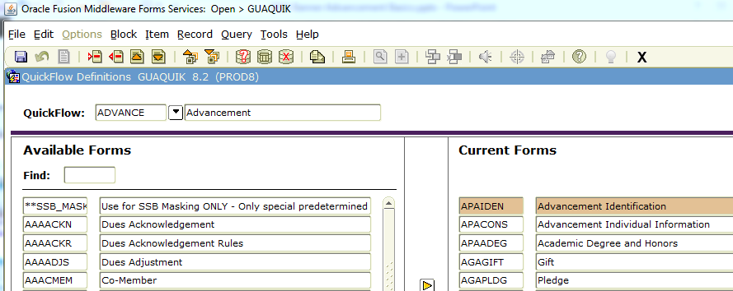
Define the name of your Quickflow process on GTVQUIK.
Enter the form names, in the order you would like to access them, on GUAQUIK.

Slide 13
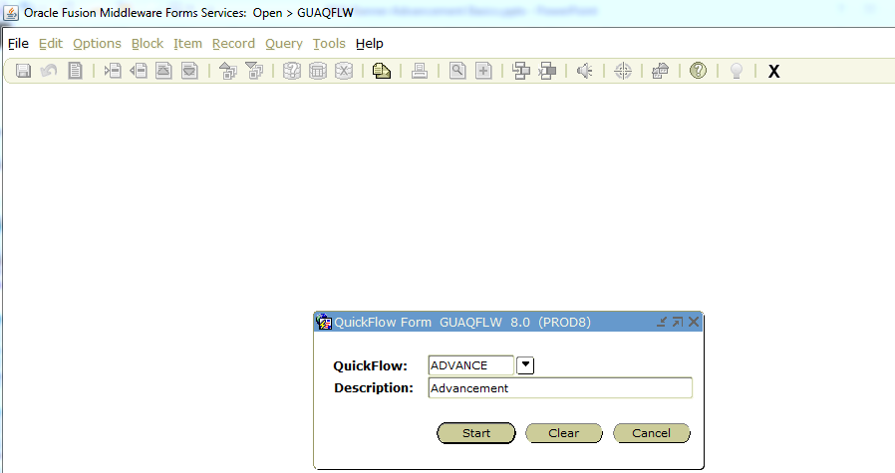
Go to GUAQFLW to start your Quickflow process. Enter your Quickflow name and press Start.

Slide 14
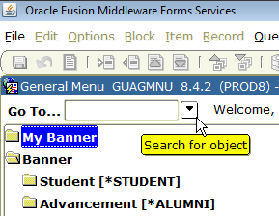
7. You may also search for form/s by clicking the dropdown arrow beside the Go To…field.
Enter part of the form name and use the %(wildcard) sign or tab to the Description field and enter part of the form name, also using the % sign before and after your entry as shown.

Slide 15
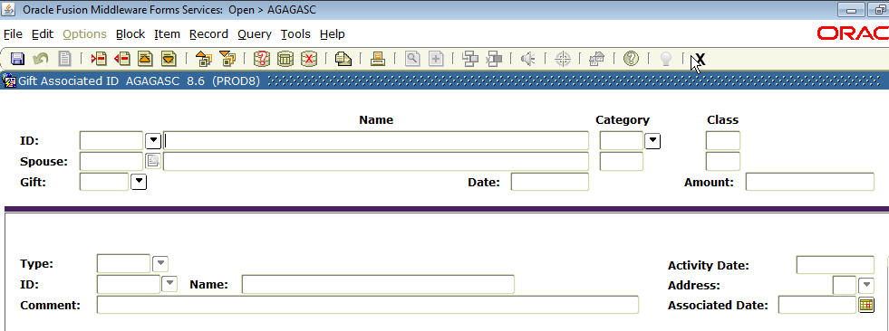
Execute the query to see what forms display that contain the name Gift. Double click on the form name needed and Banner will return you to that form. You may also highlight the form name and click OK.
Be mindful of the scroll bar to ensure you are seeing all the query results.

Slide 16
NAVIGATING in ADVANCEMENT FORMS
1. You can use the Menu bar, Toolbar or Keystrokes to navigate through Banner forms.
Using the Menu Bar: Click on the function you would like to perform. If you would like to perform a Next Block, then from the Menu Bar you would select Block then Next.
Or you can choose to click the Next Block icon on the toolbar.
Or you could press the Ctrl and Page Down keys.

Slide 17
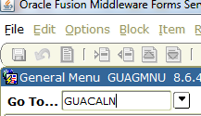
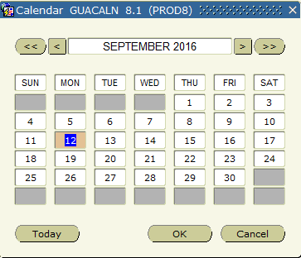
Using the Calendar
There are three ways to display the calendar:
Double-click in any date field
Click the calendar button.
In the Go To field enter form name GUACALN.
Double-click

Slide 18
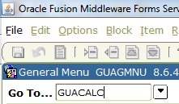
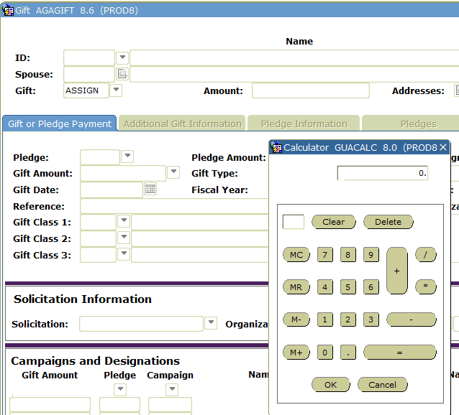
Using the Banner Calculator
There are three ways to display the calculator:
1. Double-click in any numeric field in a form.
2. Click the Calculator button.
3. In the Go To field enter form name GUACALC.
Double-click

Slide 19
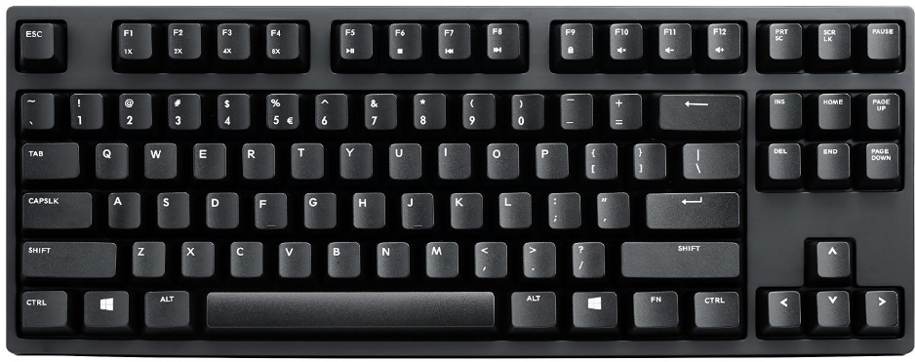
Direct Access From a Form
If you are working in one Banner form, you have the option to navigate to another form without leaving the form you are in by clicking File, then Direct Access. Function key F5 will also pop up the Direct Access field.

Slide 20
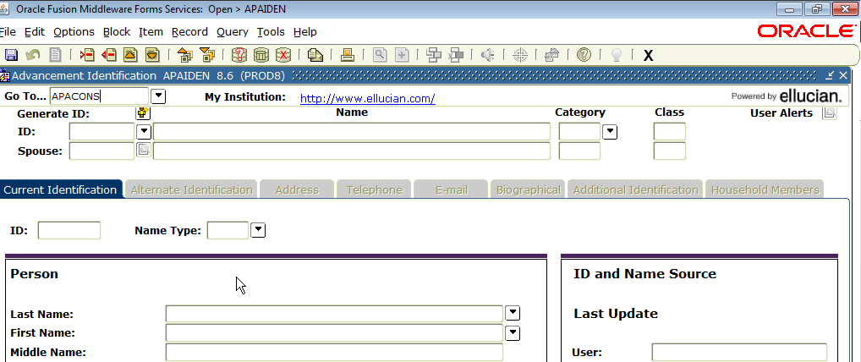
Once you have called up Direct Access, in the Go To….field, type the form name you want to navigate to and press enter. This will navigate you to the form you chose. In our example, you are in APAIDEN and wish to navigate to APACONS. When you exit APACONS, you will be returned to the previous form you had accessed.

Slide 21
Searching for Constituents
To begin searching the Banner database for a constituent/person, go to GUASYST and enter the name. This screen affords you a view of all the modules a person may have data within Banner. This screen can be helpful in preventing duplicates, especially if you do not already recognize the person/organization as a alum or donor.
ALERT! Never assume because a person may not be a constituent, they may not already be in the system as a Student, Faculty, Employee, Vendor, etc. That is what creates duplicates when all options are not explored before creating a new ID.

Slide 22
You can search for a constituent/organization/person from any form that contains an ID block. Beside the ID field, click the search arrow to display the Option List.

Slide 23
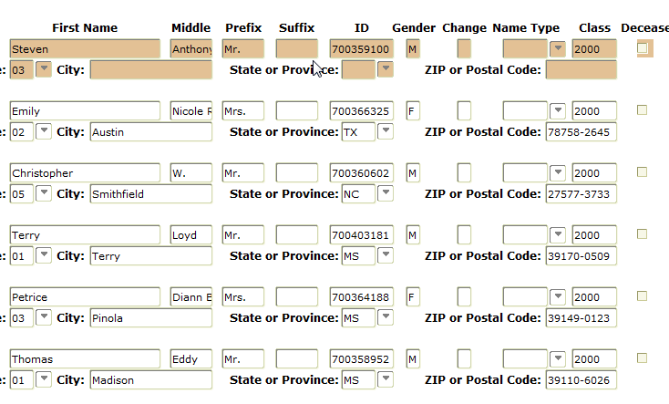
There are many searchable fields on AOAIDEN. In this example, a search is being done only for the students who are in the Class of 2000. When you execute the query, the results will only display those constituents with that class year.

Slide 24
In another query, you may only want to see the constituents from a particular state and class year. In this example, we only want those from any class in 2000 or greater from the state of TX. Remember to use your %(wildcard) to help you search multiple years.
Once you execute your query, the results will display for you.

Slide 25
The results of your query on AOAIDEN can be extracted into a spreadsheet. Click on Help on the Menu Bar and choose Extract Data No Key Note: Your DBA will have to turn on the Extract feature for any form if you do not have form access to do it yourself.

Slide 26
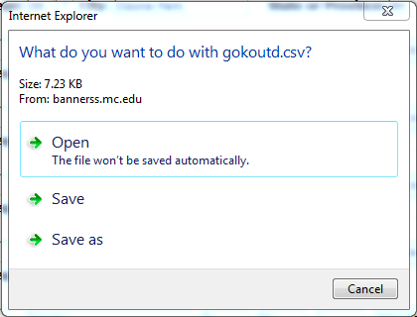
Once you extract, in our system, this box will display and ask you what do you want to do with the extract.
You will then be able to open or Save the spreadsheet.

Slide 27
Where Do I Find It?
Donor Category/Class Year – APACONS
Address/Telephone/Email Info – APAIDEN
Organization Info - AOAORGN
Gift Info – AGCGIFT
Pledge Info – AGCPLDG
Giving History – APAGHIS
Contact Reports – AMACONT
Academic Info – APAADEG
Cross Reference Info – APAXREF
Employment History – APAEHIS
Summary Info – APASBIO
Salutations, Exclusion Info – APAMAIL
Combined Mailing Info – APANAME
Activity Info – APAACTY
Designation Info – ADADESG
Campaign Info - AFACAMP

Slide 28
QUESTIONS
Thank you for attending this session!
Cindy Hampton
Mississippi College
Hampton@mc.edu

