Slide 1
MBUG 2015
Session Title: Using SQL and PL/SQL for Queries and Reporting
Presented By: Stephen Frederic
Institution: IHL
September 15, 2015

Slide 2
Session Rules of Etiquette
Please turn off your cell phone
If you must leave the session early, please do so discreetly
Please avoid side conversation during the session

Slide 4
Session Overview
Intro to SQL
Parts of an SQL statement
Performing SQL queries

Slide 5
Session Overview Continued
Intro to PL/SQL
Parts of PL/SQL file
Using SQL in PL/SQL
Writing PL/SQL reports

Slide 6
Computer Humor
There are 10 types of people in the world: those who understand binary and those who don’t.

Slide 7
SQL

Slide 8
What is SQL?
Structured Query Language
Used for managing data held in a relational database management system
Initially developed by IBM in the early 1970s

Slide 9
Queries
SELECT – data fields retrieved from tables
FROM – table name(s)
WHERE – conditions using operators to filter what data is retrieved

Slide 10
Conditions
AND
OR
LIKE
IN
BETWEEN

Slide 11
Operators
Equal to: =
Not equal to: != or <>
Greater than: >
Less than: <
Greater than or equal to: >=
Less than or equal to: <=
IS or IS NOT

Slide 12
Writing to Files
Spool – saves query results in a file
spool filename
Everything following ‘spool’ is written to file
When finished ‘spool off’

Slide 13
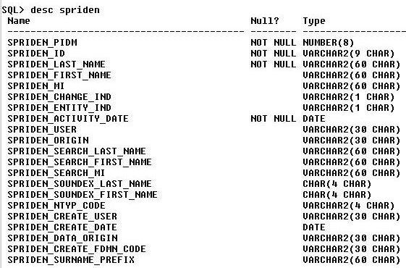
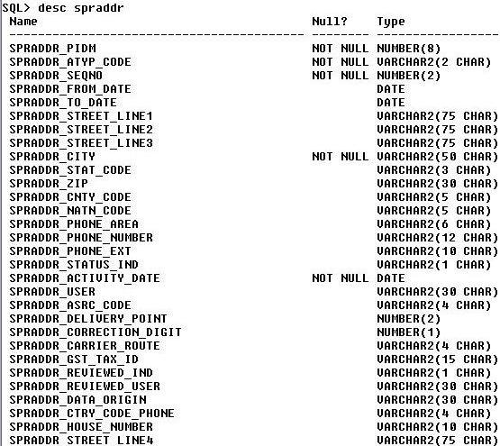
Describing Tables

Slide 14
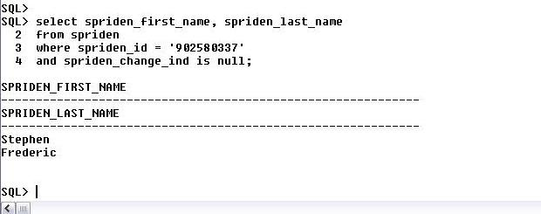
Simple SQL Query
SELECT spriden_first_name, spriden_last_name
FROM spriden
WHERE spriden_id = ‘902580337’
AND spriden_change_ind is null;

Slide 15
Getting Address Information

Slide 16
SQL Questions?

Slide 17
PL/SQL

Slide 18
PL/SQL
Procedural Language/Structured Query Language
Oracle’s procedural extention to SQL
Can use conditional statements such as if/then/else as well as loops
Handles errors and exceptions

Slide 19
Parts of PL/SQL Blocks
Declaration
Execution
Exception

Slide 20
Declaration Section
Is optional
Begins with ‘DECLARE’
Where SQL cursors are written for use in execution section

Slide 21
Declare Section Continued
Defines variables
Variables can also be initialized
Example:
age number(2);
message varchar2(12) := ‘Hello World’;

Slide 22
Execution Section
Is mandatory
Starts with ‘BEGIN’ and ends with ‘END’
Where if/then statements, loops, and cursors are used

Slide 23
Exception Section
Is optional
Begins with ‘EXCEPTION’
Handles errors so blocks terminate without problems
Useful when updating or deleting information in tables

Slide 24
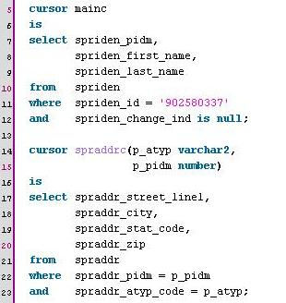
Cursors
Found in Declaration section
Where SQL statements are written
Variables can be passed to cursors for dynamic queries

Slide 25
Calling Cursors
OPEN, FETCH, CLOSE
Pass variables in OPEN
FETCH into variable names
CLOSE when finished
Loops

Slide 26
Getting Output
Spool on/off can be written into PL/SQL file
Dbms_output.put(‘text’) – prints lines, appends to line
Dbms_output.put_line(‘text’) – prints line and then returns to new line

Slide 27
Saving and Running Files
Save both SQL and PL/SQL files with .sql extension
To run: @filename

Slide 28
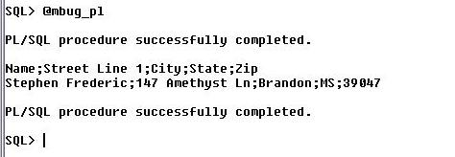
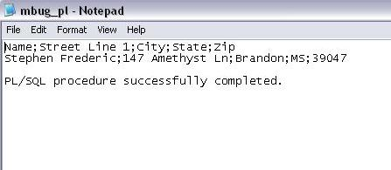
PL/SQL Example

Slide 29
Additional Help
http://www.techonthenet.com/oracle/
http://www.w3schools.com/sql/

