Slide 1
MBUG 2015
Session Title: Back to the Basics –
Human Resources
Presented By: Teresa B. Yarbrough
Institution: Delta State University
September 14 & 15, 2015

Slide 2
Session Rules of Etiquette
  Please turn off your cell phone
  If you must leave the session early, please do so discreetly
  Please avoid side conversation during the session

Slide 3
ATTRIBUTES
The following list specifies the attributes included in the “Employee Profile” view.
This morning we will look at each attribute, form and the necessary information needed.

Slide 4

ATTRIBUTES
PPAIDEN –You will enter all the employee information: Name, address, phone number, birthday, etc.
GOMATCH – This will be used with PPAIDEN. You will see GOMATCH come up with this attribute when it is new employee. This will help generate the employee ID number.
PEAEMPL – Here you will indicate whether the employee is full time, part time, monthly or bi-weekly. You will also need to indicate what organization he/she will be paid from. You will also enter the start date of the new employee. If the employee terms, this where you will find the termination date plus the reason.

Slide 5
ATTRIBUTES
NBAJOBS – You will need the employee position number, rate of pay. Will this employee be 12 month or 9month, etc. You can also search to see if this employee has any other jobs active.
NBAJQUE – Each employee has someone in charge of approving their time. The supervisor’s position should be entered
PDADEDN – All important tax, health, etc. deductions
PEAESCH – Term employee. DO NOT PEAESCH if it is a student or employee who has other jobs open. If you PEAESCH it will term ALL information

Slide 6

PPAIDEN
Employee ID ID_NUMBER
Employee Last Name Prefix
Employee Last Name
Employee First Name
Employee Middle Name
Employee Middle Initial
Employee Name Prefix
Employee Marital Status Code

Slide 7
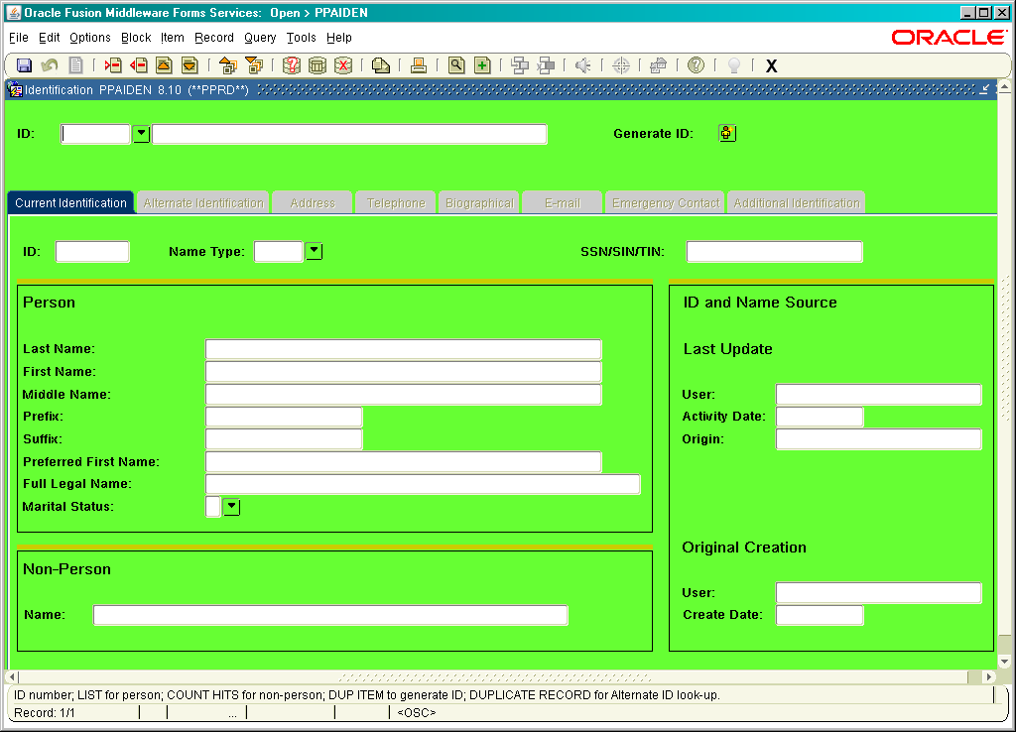
PPAIDEN – EMPLOYEE PROFILE

Slide 8
PPAIDEN-GOAMTCH
NEW Employee

Slide 9
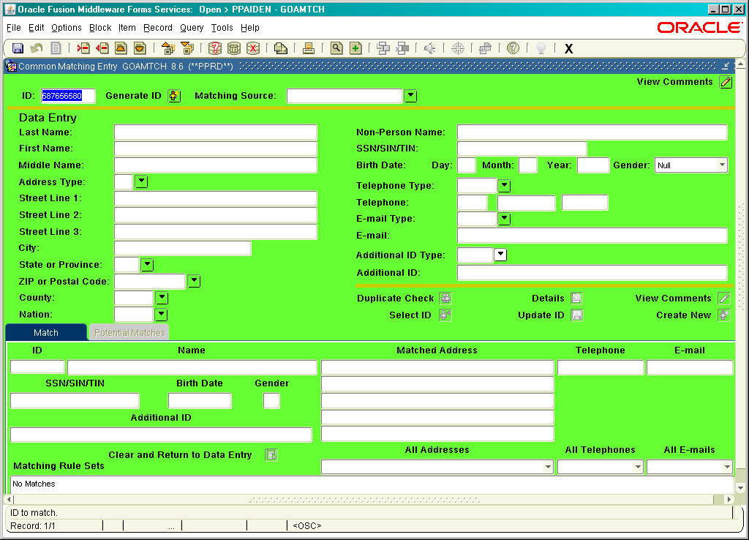

Slide 10
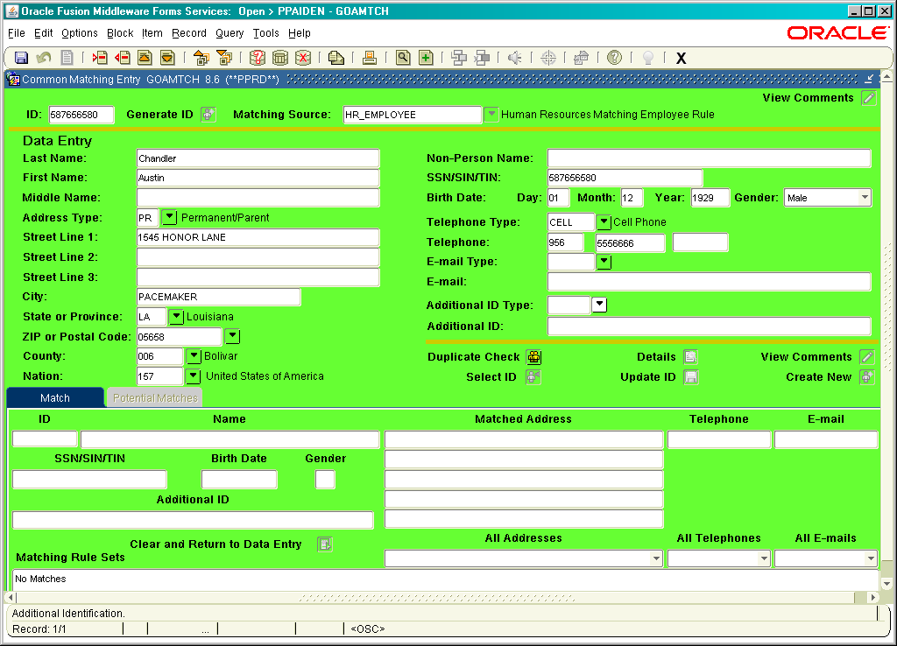

Slide 11
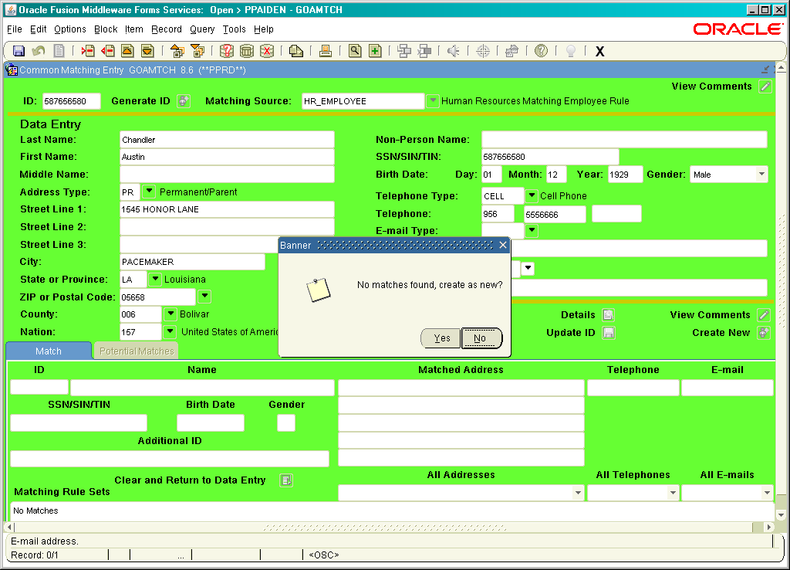

Slide 12
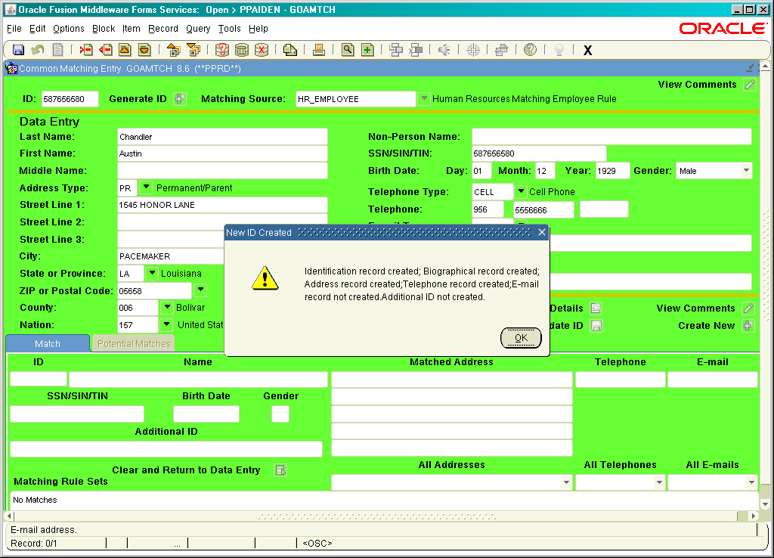

Slide 13
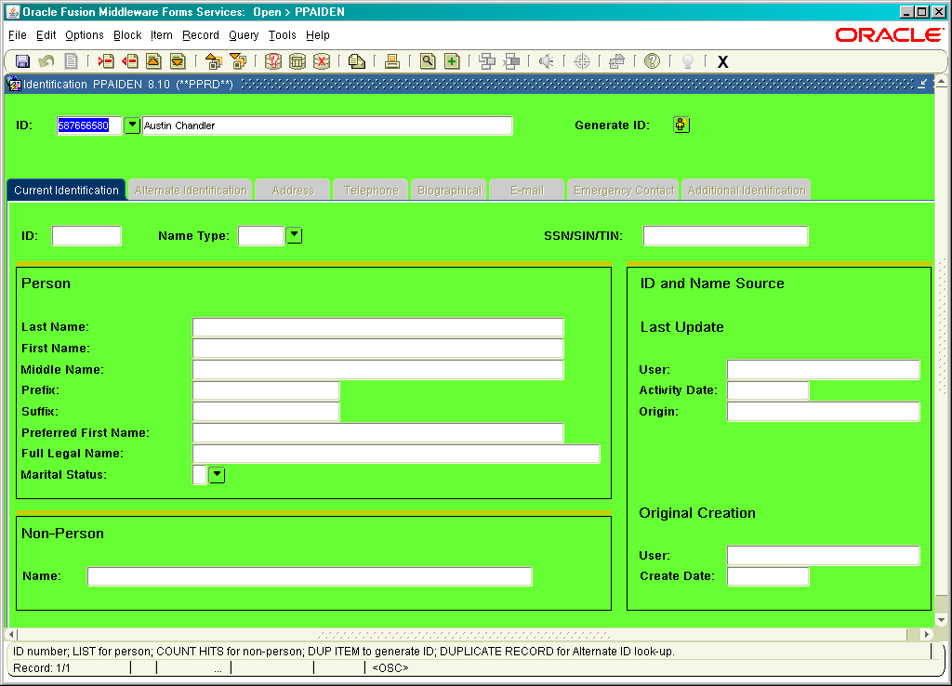
Notes:
Once you see this page. You would control page down. On the ID: delete SS# and type “GENERATED”, Save, (F10)
900# will appear.

Slide 14
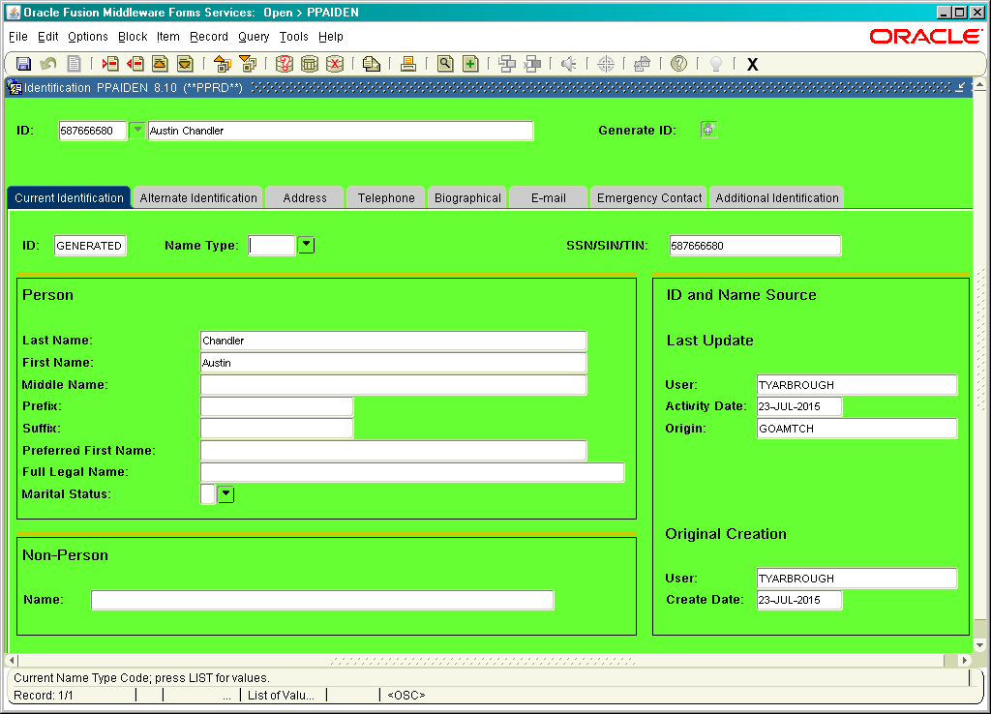

Slide 15
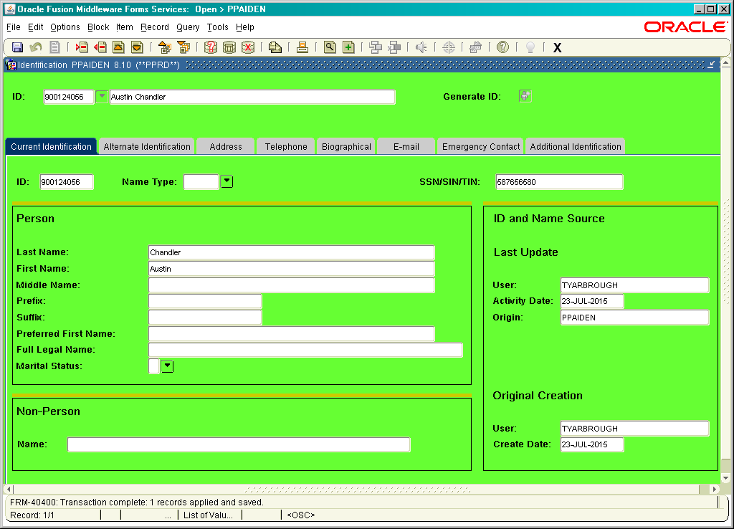
Notes:
As you can see in the ID space, 900 is generated.

Slide 16
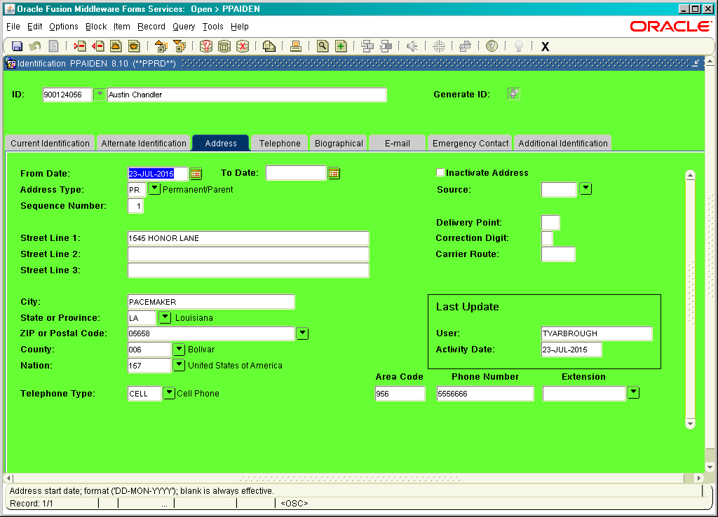

Slide 17
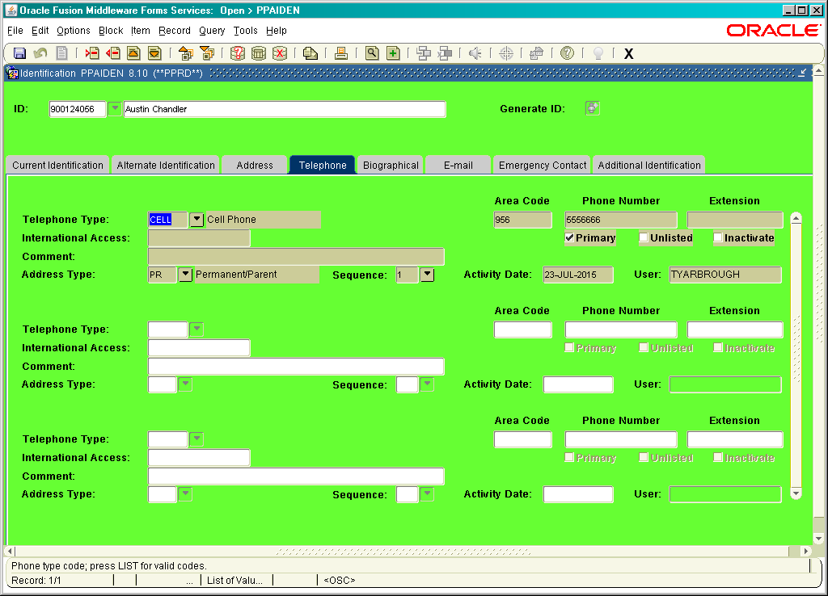

Slide 18
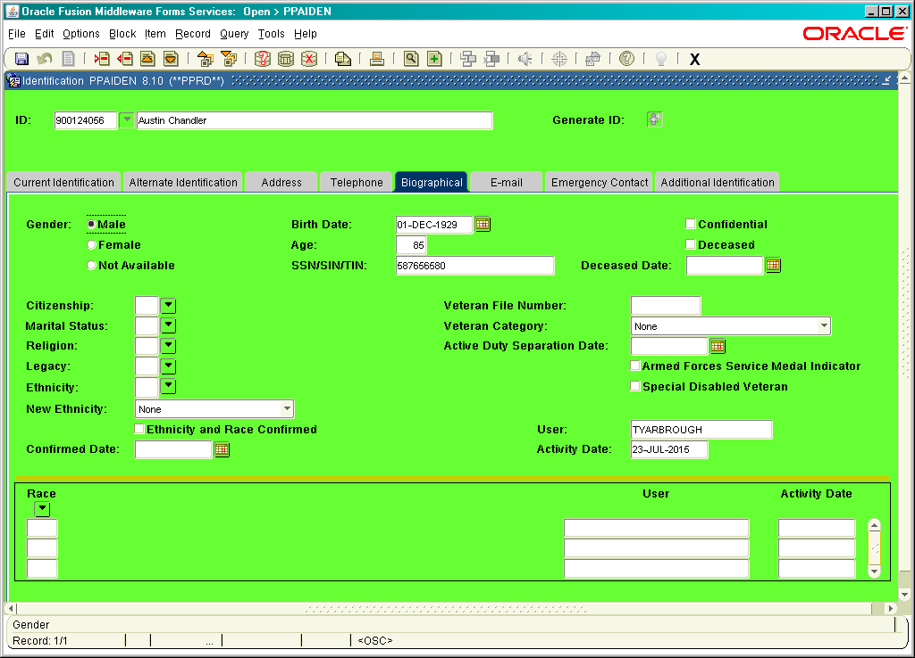

Slide 19
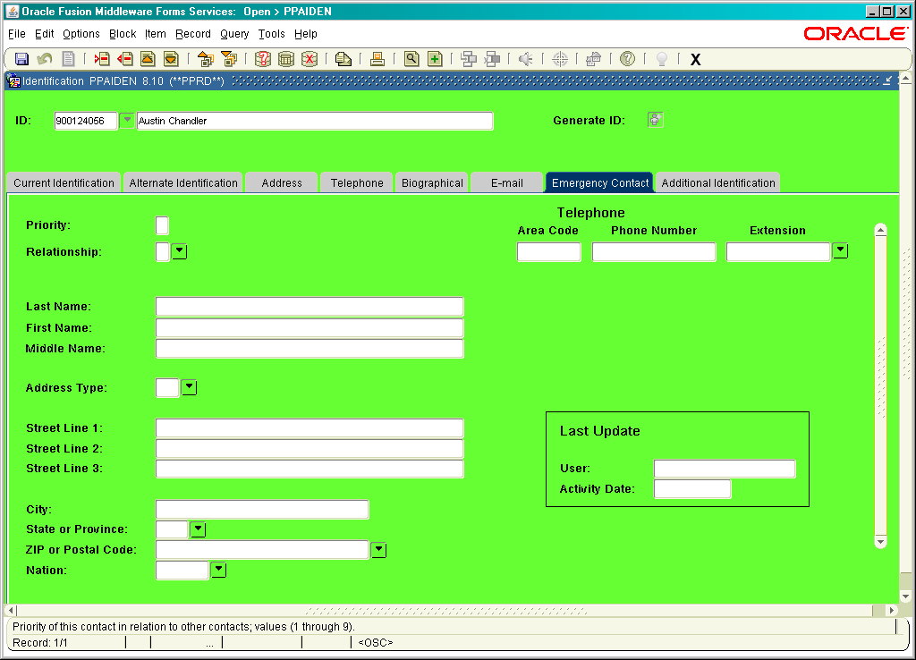

Slide 20
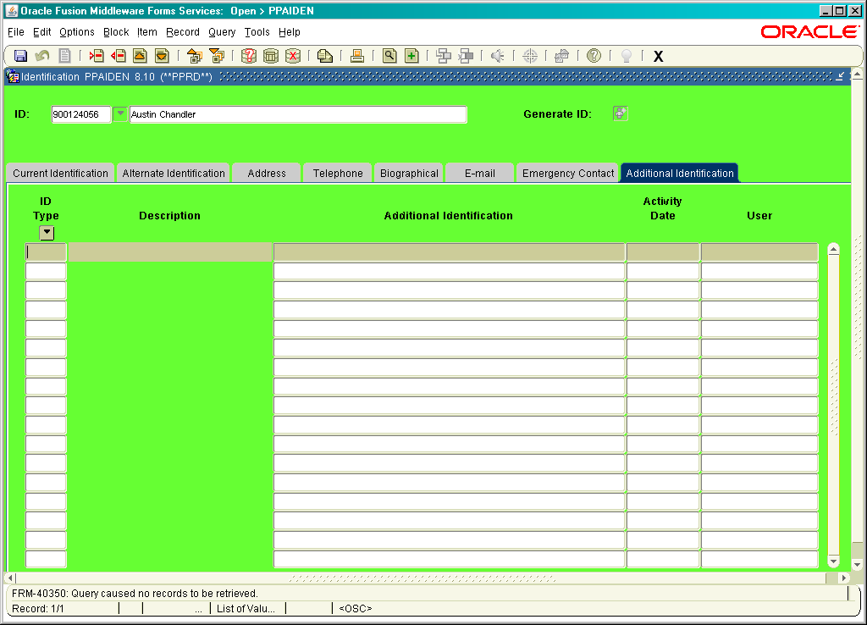

Slide 21

PEAEMPL
Employee Status:
  ‘A’ = Active
  ‘B’ = Leave without pay and with benefit
  ‘L’ = Leave without pay and without benefit
  ‘F’ = Leave with pay and with benefit
  ‘P’ = Leave with part pay and with benefit
  ‘T’ = Terminated
Employee Class Code :(examples below)
S1 – Full Time Staff
S2 Part Time Staff (9mth)
H1 Hourly with benefits
H2 Hourly without benefits
F1 Faculty 9/12
F2 Faculty 9/9

Slide 22

PEAEMPL
Employee Group – left blank
Leave Category Code and the Benefit category should default in
PLUS the part time/full time status
COA 1
Organization – Should be able to “arrow” drop down
      0379
      4113
      4109

Slide 23
PEAEMPL
Current Hire Date – Date entering
Original Hire date – may be the same as current;
Rehire: Date stays as is.
Adj./Seniority/First Work date – do not use
Last work day - termination date
Leave of Absence/Hiring location – do not use.
UNITED STATES REGULATORY:
Social Security Name:
This information should come directly from the individual’s social security card.
I9 – Mark received and date

Slide 24
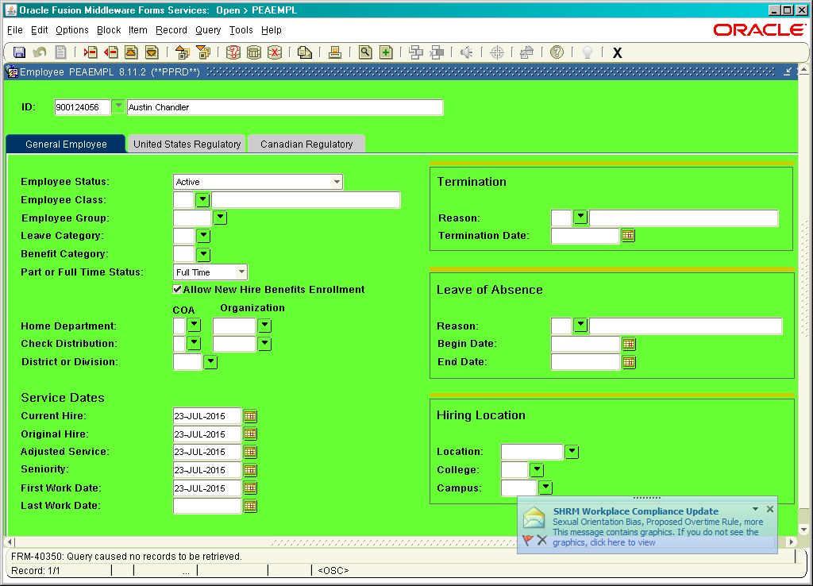

Slide 25
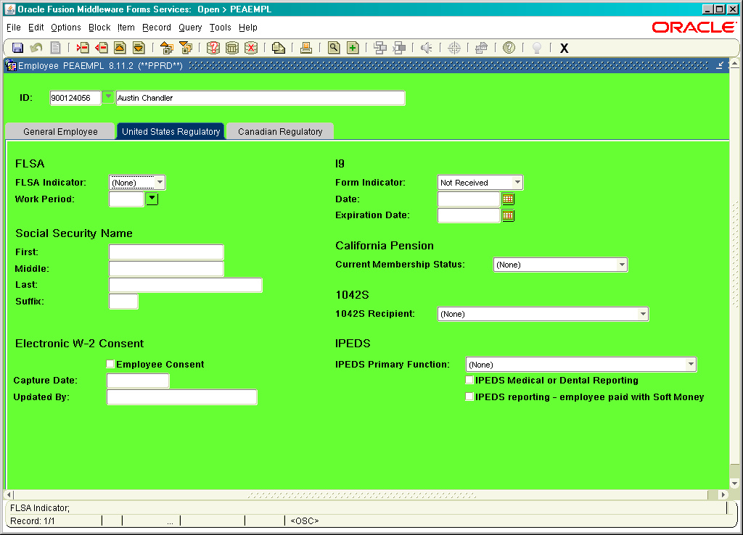

Slide 26
NBAJOBS
ID: 900#
POSITION NUMBER :
SUFFIX: 00,01,02, ETC.
QUERY DATE: If this is a new employee, this will be the start date. If you are researching the different position’s the one employee has, you may put a date (example: 01/01/2010), go back to position and click down arrow. This will bring up all “position numbers”
If benefit eligible employee, make sure “accrue leave” is marked”
JOB TYPE:
  Primary
  Secondary
  Overload
Monthly: Salary/yearly
Bi-weekly: $50.00/hourly rate
PROBATIONARY DATA:
Probation Period: Usually 185 days
Probation Begin Date: Current Begin date
Probation End Date: Should auto populate

Slide 27
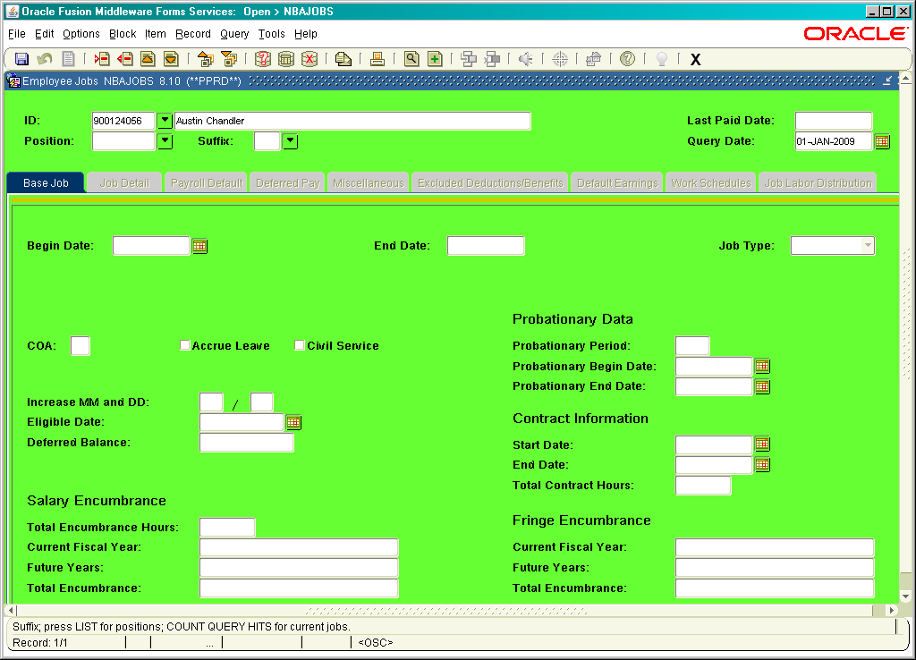

Slide 28
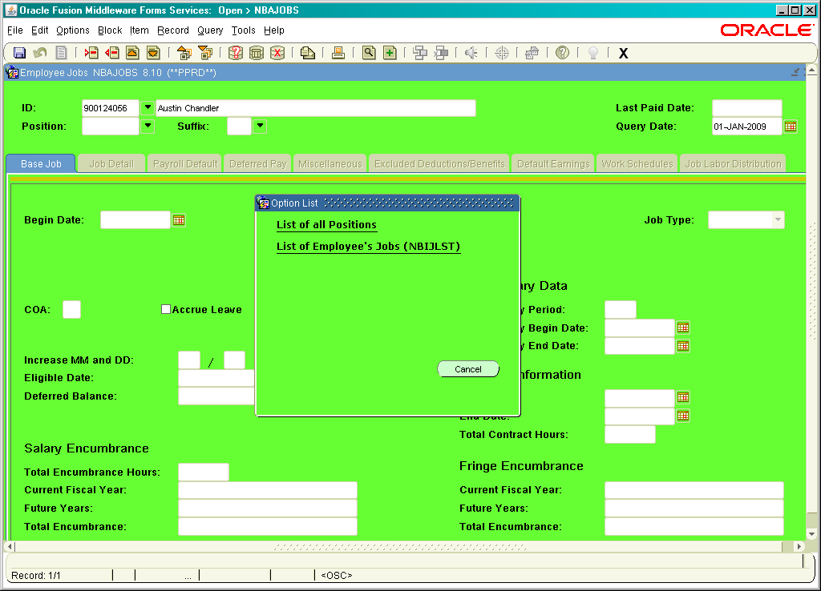

Slide 29
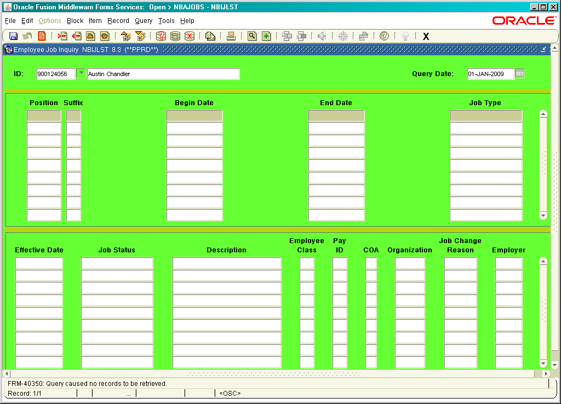

Slide 30
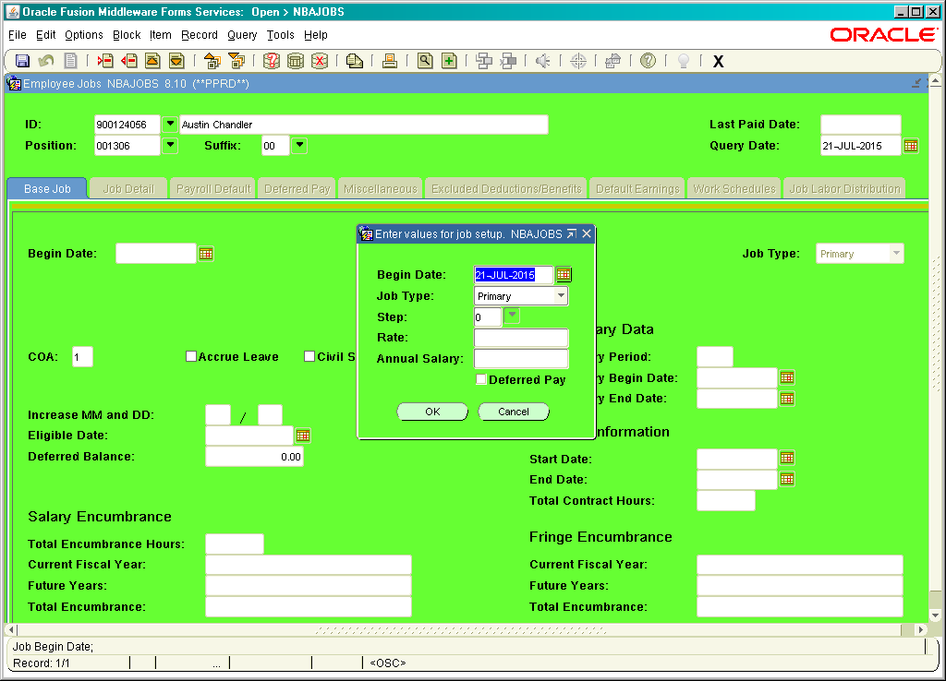

Slide 31
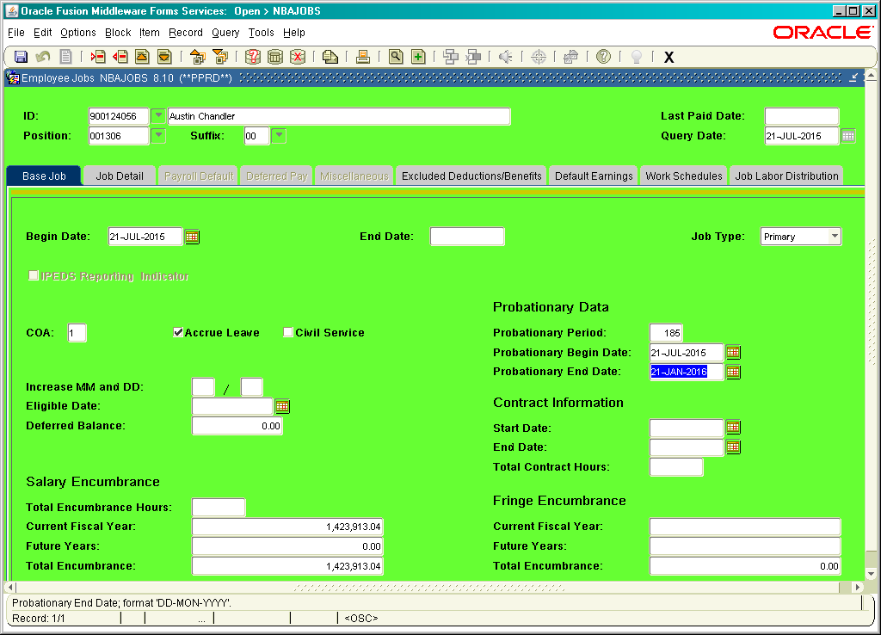

Slide 32
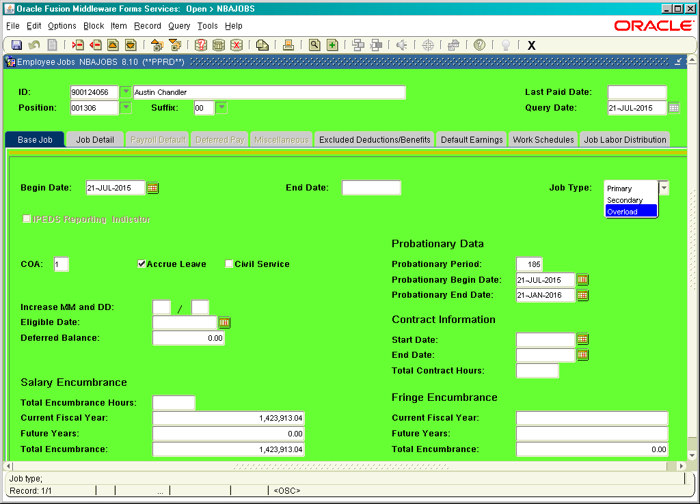

Slide 33
NBAJOBS
Effective Date: This would the date began working. Always remember you will need enter a new effective date when changing information
Personnel Date: If a rehire, the date will state the same. New hire, will be same as effective date.
Status: ‘A’ = Active
‘B’ = Leave without pay and with benefit
‘L’ = Leave without pay and without benefit
‘F’ = Leave with pay and with benefit
‘P’ = Leave with part pay and with benefit
‘T’ = Terminated
Job FTE: 1:00 would be full time; .50 -.75 part time; Adjunct Faculty would be lower. (Set by Academic Affairs)
Appt. %: 100
Encumbrance hours: Blank
Encumbrance Indicator: Self populate

Slide 34
NBAJOBS
Hours per day: 8 hours
Employee Class: S1 – Full time Staff
(examples) S2 – Part Time Staff
F1 – Faculty 9/9
F2 – Faculty 9/12
H1 – Biweekly with benefits
H2 – Biweekly non benefits
Leave Category:
Change Reason: Anytime you make a change, you have to put a new effective day and the reason for change. (promotion, transfer, degree completion, term, etc)
Employer code: This should automatically populate.

Slide 35
NBAJOBS
Pay Plan: Group; Grade; Table; Step (These should self populate)
Compensation:
Rate: (Biweekly payroll, $0.00 would be entered)
Hours per pay: (populate)
Assign Salary:
Factor: Could be any number 1-12
Pays: Could be any number 1-12
Annual Salary: Yearly salary

Slide 36
NBAJOBS
Effective Date: This date will self populate.
Timesheet Defaults
    Timesheet COA: Will be 1
    Timesheet ORG: This will be the organization that the payroll is charged to.
    Payroll ID: Could be M1, M2, BW
    Default Shift: Will be 1
    Time Entry Method: (These could be different)
        Examples:
          Payroll time entry
          Employee time entry via web
          Department time entry with approval
          Third party with approvals

Slide 37
NBAJOBS
    Time Entry Type:
        Pay period time sheet
        Pay period exception Time only
        None
    Leave Report Method:
        NONE (Payroll)
        Leave Report on the Web
        Departmental Leave Report
        Third party report
    Leave Report Payroll ID:
    M1, M2, BW, etc.
    Premium Pay Methods (DO NOT USE AT DSU)
    Longevity:
    Premium Pay:

Slide 38
NBAJOBS
  Deferred Pay
    Effective Date
    Deferred Pay:
    Per Pay Salary
    Factor:
    Pays:
    Deferred Amount:
    (This will self populate with what was entered under the JOB DETAIL tab)
    ALWAYS check.

Slide 39
NBAJOBS
EEO
EEO location:
School:
  Miscellaneous:
    Effective Date: This date will self populate
Supervisor:
ID:
Position: Suffix:
Title:
Additional Information:
Workers Compensation:
Job Location:
Contract Number:
California Pension
STRS Assignment Code:
California STRS Pay Code:
California PERS Pay Code:

Slide 40
NBAJOBS
EXCLUDED DEDUCTIONS/BENEFITS
CODE:
If employee would like a deduction excluded from a additional compensation check.
Example: RET, FED, SIT, HEA

Slide 41
NBAJOBS
Default Earnings
Query date: Default in
Effective date: Usually will be the query date
Earnings Code: This is will be regular pay, Sumer School, etc.
Hours or Units: 84 or 164; You will “zero” if a biweekly payroll
Deemed: blank
Special Rate: blank
Shift: 1
Ended as of Date: blank

Slide 42
NBAJOBS
Work Schedules
Effective date:
Schedule begin date: 1
Schedule end date:
Base Earnings code: Regular, Summer School etc.
Deemed Hours:

Slide 43
NBAJOBS
Job Labor Distribution
Effective date: Default in
COA: 1
Fund:
Org.:
Account:
Program:
Percent:
These will default in. When changing the effective date
Always “Control F6” to delete Fund, Org, and Account.
Then enter the correct numbers. The Program number
should self populate.

Slide 44
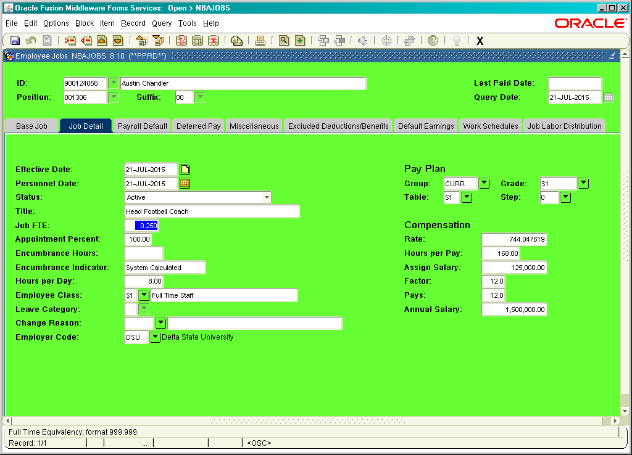

Slide 45
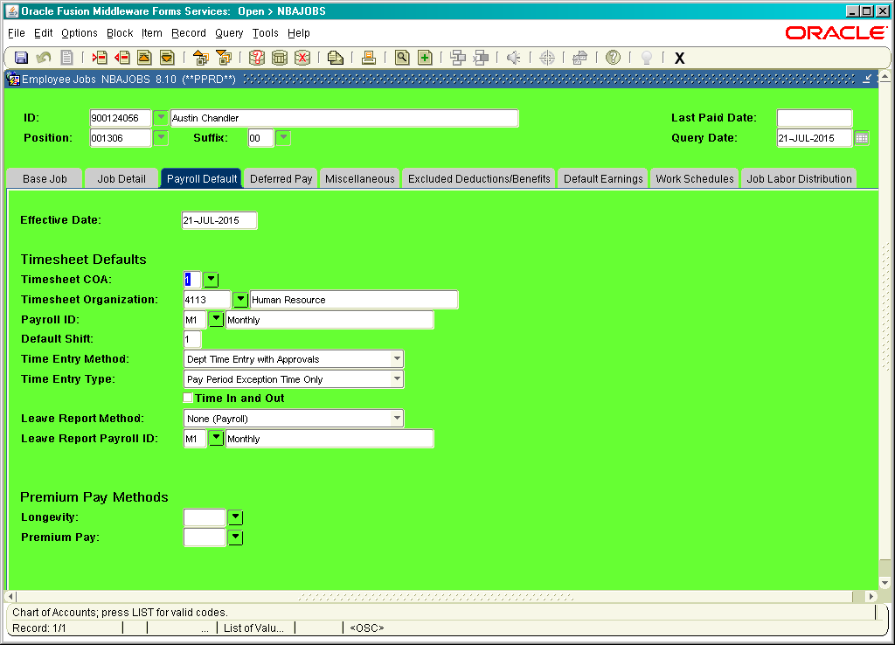

Slide 46
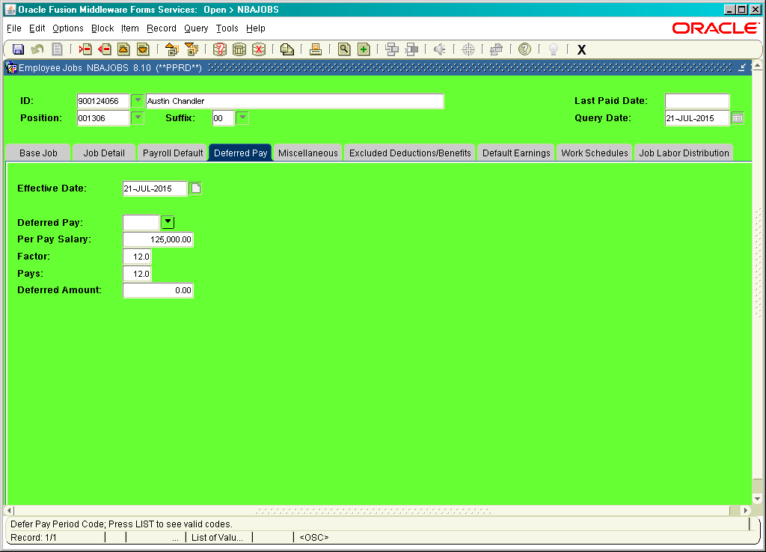

Slide 47
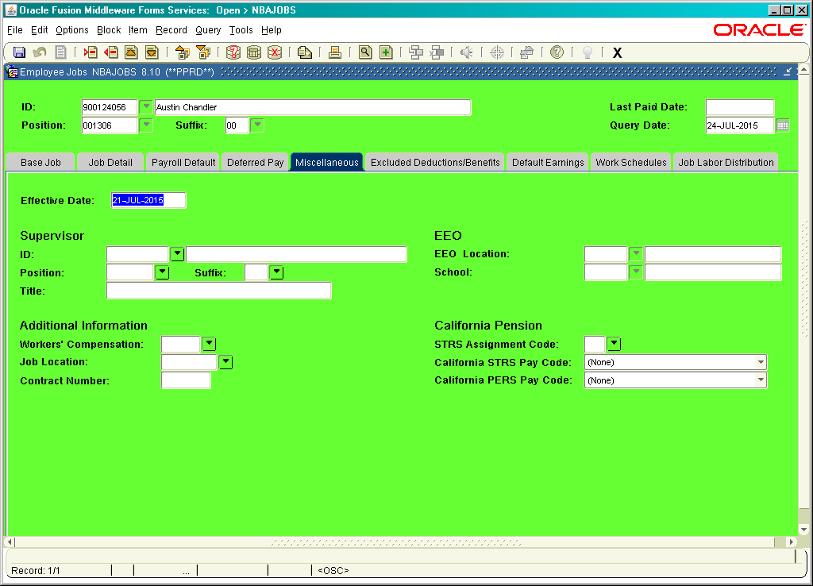

Slide 48
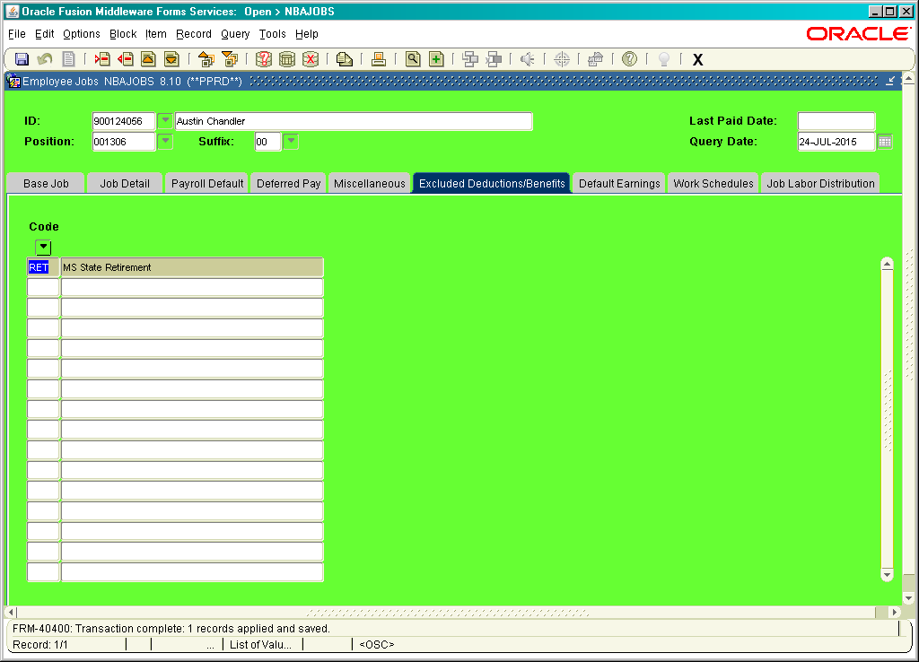

Slide 49
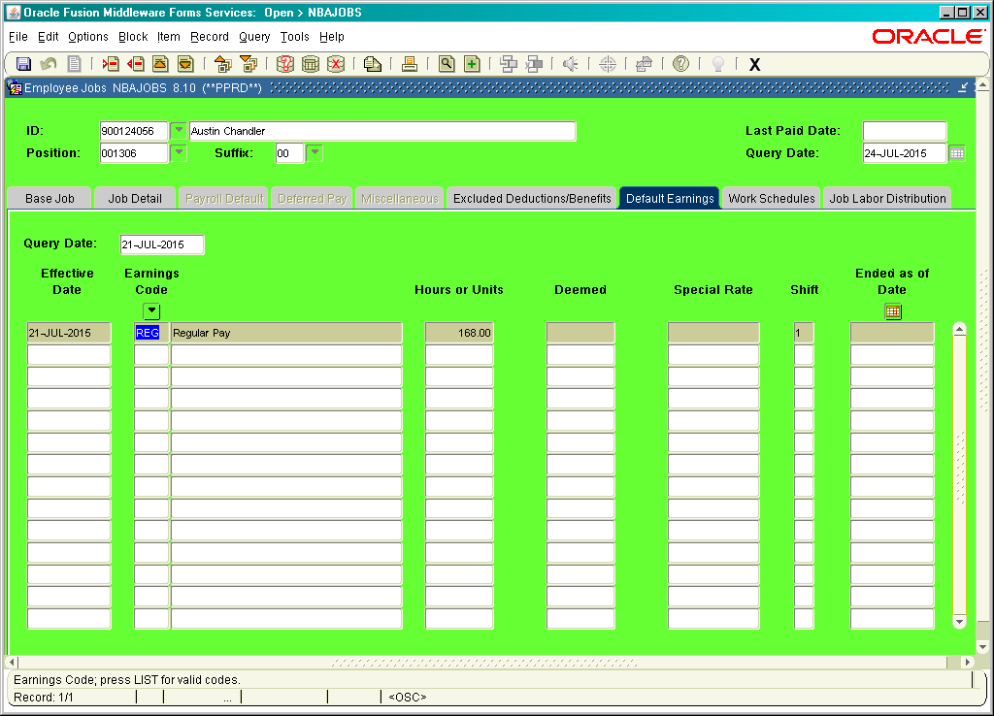

Slide 50
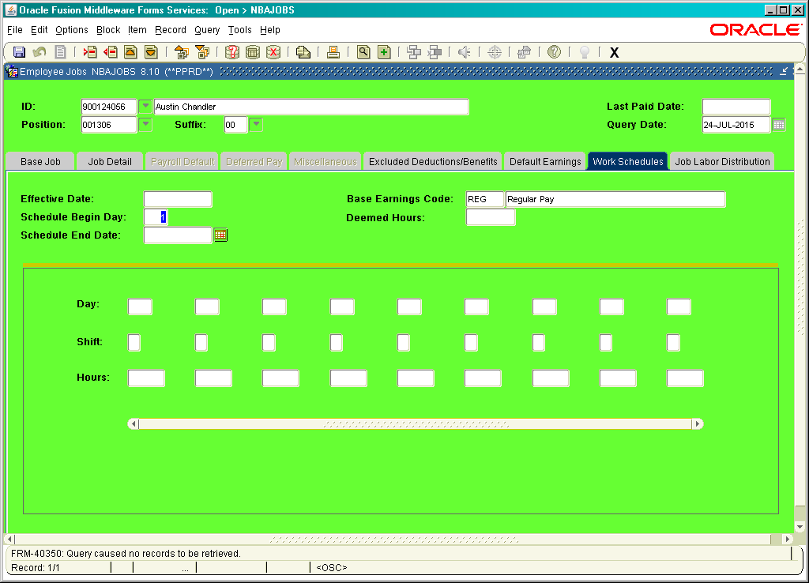

Slide 51
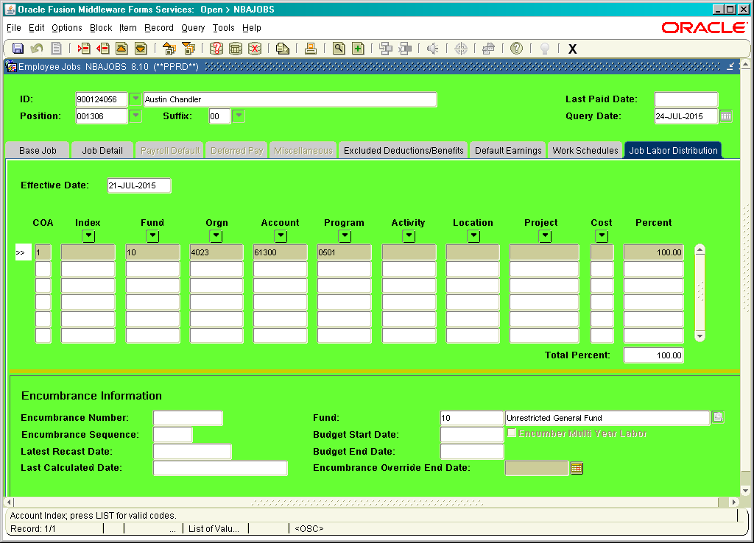

Slide 52
NBAJQUE
Approval Category: TIME
Approver Sequence: 1
Approver Position: This will be the supervisor of the employee. (You can have several)
Approver or Incumbent: After finding the approver position, this should self populate

Slide 53
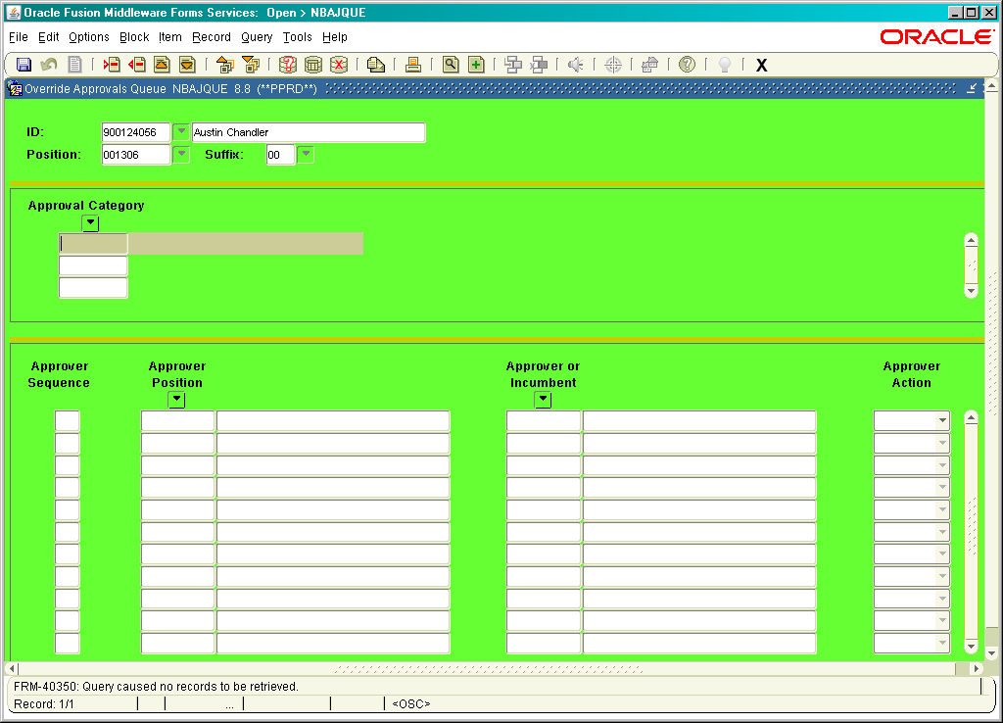

Slide 54
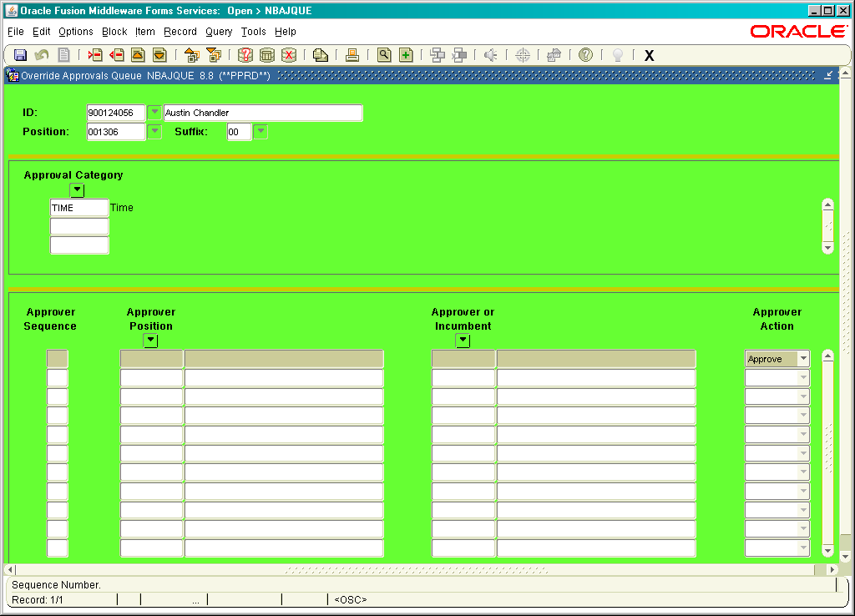

Slide 55
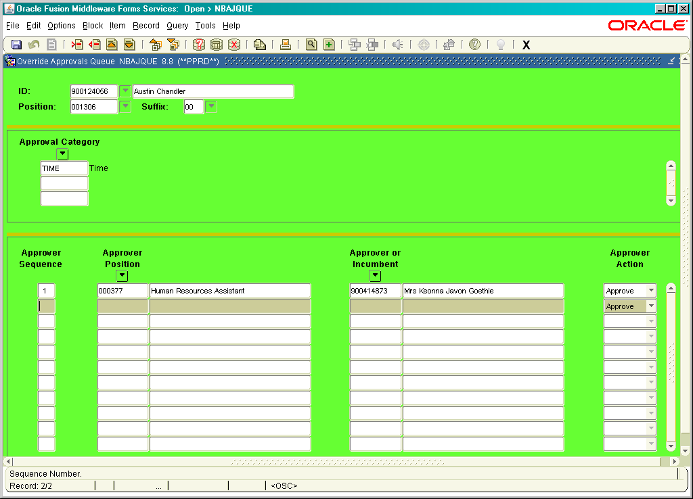

Slide 56
PDADEDN
ID: Employee #
Benefit Category: This should self populate
Deduction: FED; SIT; UEM; FIM; FIO; Benefits
(control page down)
DEDUCTION
Begin Date: Date of employment
End Date: This would be end of employment, termination
Effective Date: This would be change, term date
Status:
Active, exempt, termed, or waived
Deduction Change Reason: blank
Options:
Title:
Plan Code:
Value will come from plan code chosen; rest will self populate

Slide 57
PDADEDN
Add or Replace and Arrears:
(Sometimes you have to collect more or may be even repay. )
ADD or REPLACE or NEITHER
Employee amount:
Employer Amount:
Applicable gross: Blank
Payroll ID: M1, M2, BW
ARREARS:
Active Arrear Status
Arrear balance
Maximum Recover Amount

Slide 58
PDADEDN
Excluded Payroll ID:
Again here is another place where you can exclude a deduction for an employee
Comments:
Comment Date:
Comment User ID:
Comments
(Never have used before)

Slide 59
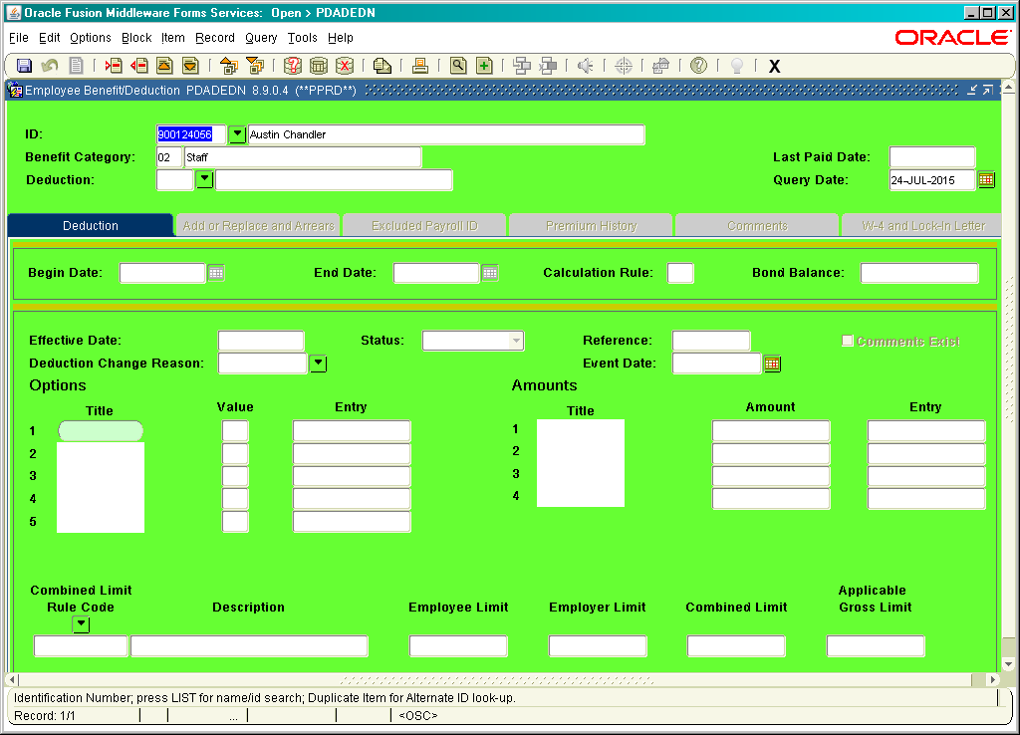

Slide 60
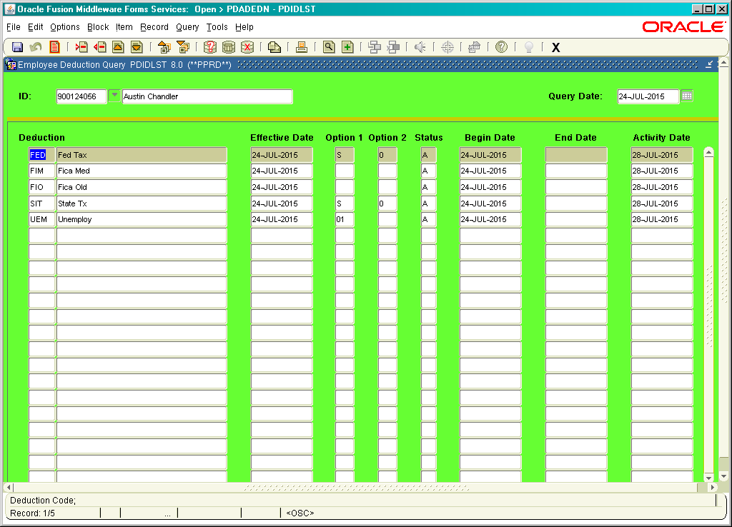

Slide 61
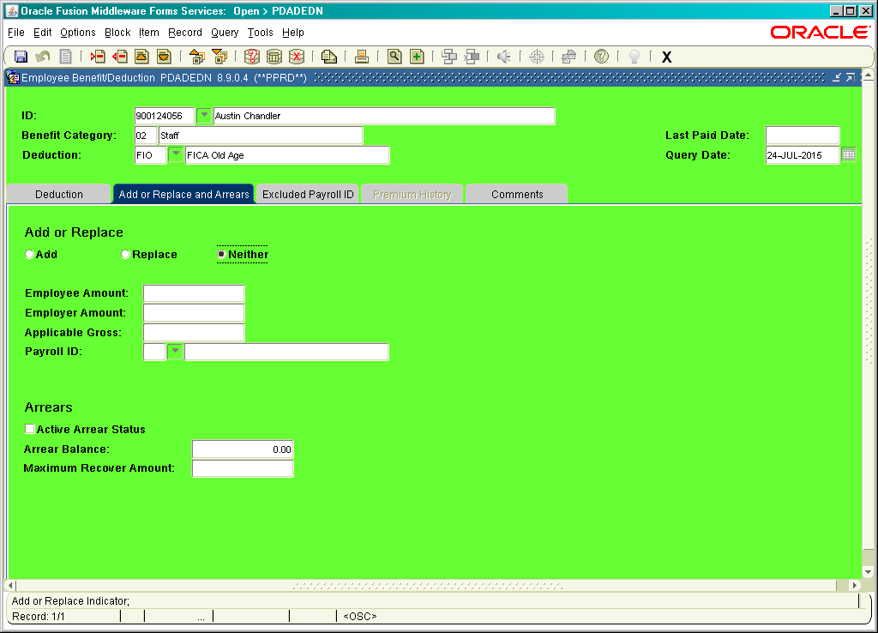

Slide 62
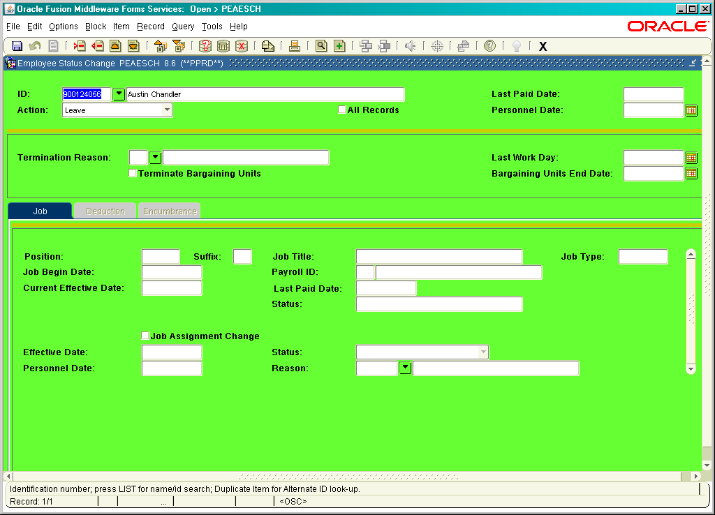

Slide 63
PEAESCH
ID: Employee 900#
Last Paid Date: Will self populate
Action:
Leave, return from leave, terminate
All Records: Check when it effects all records
Personnel Date: Will be the last paid date
Termination Reason: Drop down arrow should bring up choices that have been set up
Last Work Day: Date of last work
Terminate Bargaining Units: blank
Bargaining Units End Date: blank
Job, Deduction, Encumbrance
Self populates
BE CAREFUL PEAESCHing!
Sometime a student is hired and if you check “ALL RECORDS” it will clear schools records too!

Slide 64
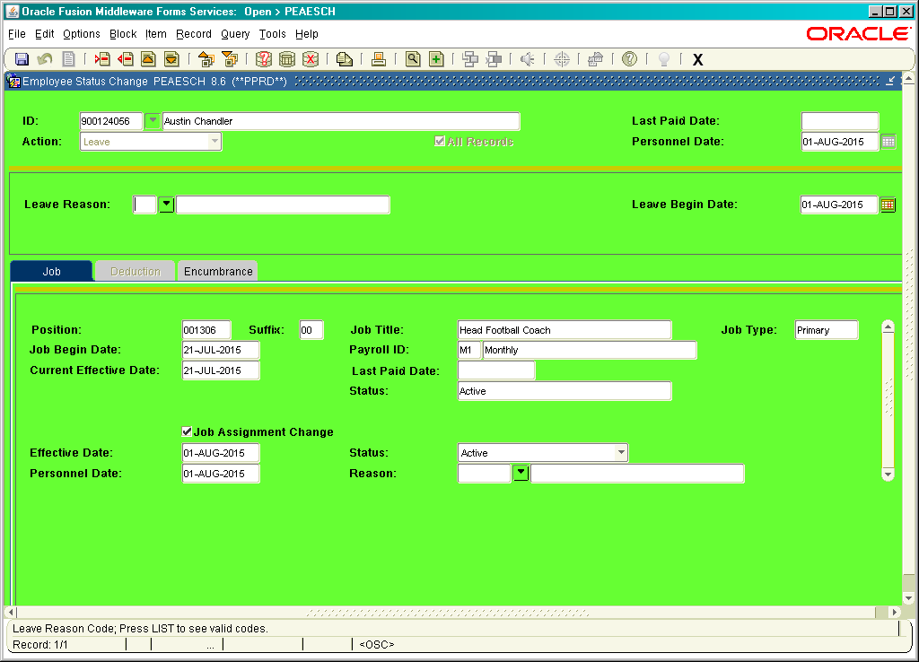

Slide 65
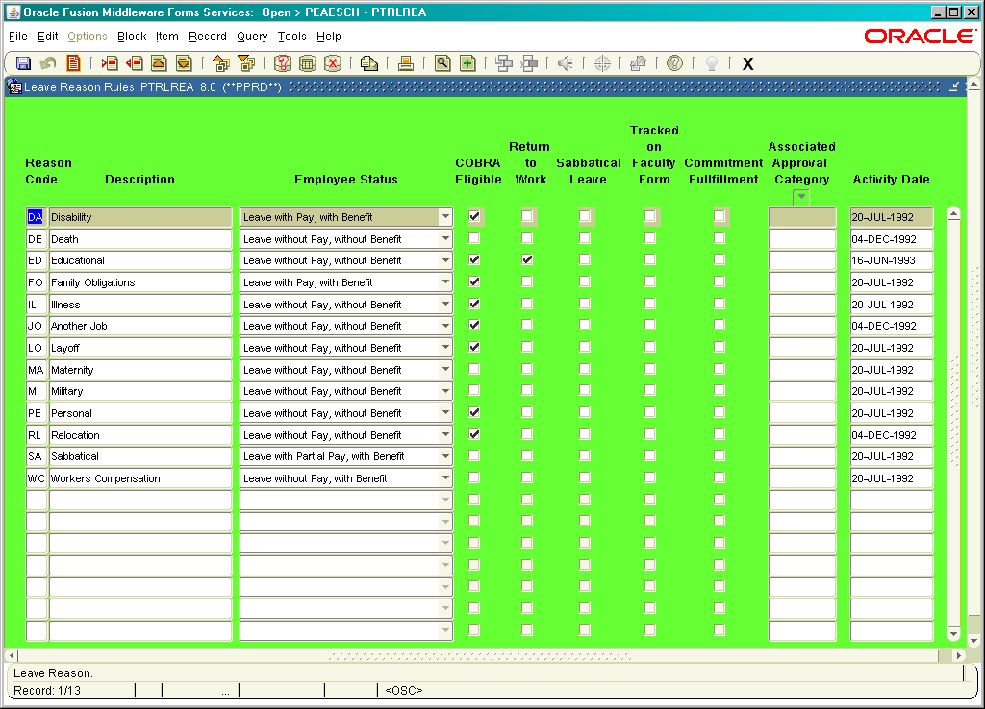

Slide 66

QUESTIONS……

