Slide 1



Welcome MS Colleges and Universities!
Streamline Processes and Cut Costs with CLEAN_Address® for Banner®

Slide 2
Agenda
About RunnerTech
Overview of Address Verification
Demo
CLEAN_Address Benefits
Data Enhancement Options
Technical Overview
Copyright RunnerTech 2000-2015 All Rights Reserved

Slide 3





CurreCurrent Mississippi Customers
Copyright RunnerTech 2000-2015 All Rights Reserved

Slide 4



























Over 600 Higher Education Customers
Copyright RunnerTech 2000-2015 All Rights Reserved

Slide 5
As an Institution this is what you’re facing…
These are the FACTS:
USPS Survey - 5% of all mail was Undeliverable As Addressed
USPS - Over 70% of all returned mail is undeliverable
Gartner study found - 14-22% undeliverable addresses
Gartner study found -18% data entry errors are due to human error
RunnerTech’s CLEAN_Address solves these issues!
Copyright RunnerTech 2000-2015 All Rights Reserved

Slide 6



About RunnerTech:
Address Verification & Higher Education Experts
18+ Years in Data Quality / Address Verification
Over 700 customers using CLEAN_Address
Proven – No Risk – High Value return
    ®, Ellucian® Advance®, Oracle’s PeopleSoft, Oracle E-Business Suite
Copyright RunnerTech 2000-2015 All Rights Reserved

Slide 7

Why RunnerTech & CLEAN_Address?
Directly integrated into Banner
    Real-Time
    Batch
    Change of Address processing
Up to 99% Reduction of Returned Mail
Save Time and Money
Enforce YOUR data standards across the Enterprise
Maximize Staff Productivity
Copyright RunnerTech 2000-2015 All Rights Reserved

Slide 8

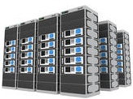





Typical Institution Mail Process
Campus Postal Services Department
Campus
User
Recipient
Thirdparty Provider

Slide 9

What if you can’t deliver?
Recruitment Brochures
Acceptance Letters
Financial Aid Forms
Diplomas
Transcripts
W2s
1098’s & 1099’s
Benefits Packages
Alumni Correspondences
Copyright RunnerTech 2000-2015 All Rights Reserved

Slide 10
Why is Mail Non-Deliverable?
Address is Missing components
Address has Invalid components
Address is Misspelldd
Person has moved over a year ago
Apartment
Apt 4D
Directional
NW
Street Suffix
Blvd
123 Main St 123 Main Blvd
123 Univrsty Way
Copyright RunnerTech 2000-2015 All Rights Reserved

Slide 11

Address Verification: What is it?
Verifying it is deliverable
Correcting it if necessary
Standardizing by returning a valid deliverable address in a consistent format
Or providing an address suggestion or error list to help the user provide better input
It is a process that starts by taking an address, as it’s entered …
Copyright RunnerTech 2000-2015 All Rights Reserved

Slide 12
It’s challenging to know if that letter or package will reach its destination
What if you find various combinations of these addresses in your student records? Which combination will get delivered?
Street Choices
1515 N Maine St unit 305
City/Post Choices
Jackson, MS 32901
1515 Main Stret Apt 305
1515 S Main Street 305
1515 Main St #305
jacksan, MS 32902
jakson, MS 32903
Jaakson, MS 32904
1515 N Main Street
Suite 305
Jackson, MS 32901-1953

Slide 13
What’s your Address Standard?
1515 N Federal Hwy Ste 305
Boca Raton, FL 33432-1953
1515 N Federal Hwy
Ste 305
Boca Raton, FL 33432-1953
STE 305
1515 N FEDERAL HWY
BOCA RATON, FL 33432-1953
1515 North Federal Highway
Suite 305
Boca Raton, FL 33432
1515 North Federal Hwy Ste 305
Boca Raton, FL 33432-1953
1515 North Federal Highway Suite 305
Boca Raton, FL 33432-1953
Each Institution or Dept. can customize it’s own Standards:
  Spell out street suffix?
  Abbreviate directional?
  Where does Apt go?
  Same Line, Above, Below
Copyright RunnerTech 2000-2015 All Rights Reserved

Slide 14

Complete Data Quality Suite:
3 Components
Seamless Real-Time verification
Integrated Batch processing
Change of Address processing
Copyright RunnerTech 2000-2015 All Rights Reserved

Slide 15
Real-Time Verification
  Real-Time Integration:
    Corrects and validates addresses at point of entry (as you type the address into the address fields)
  Seamless Integration:
    Address verification is done automatically without
    user intervention
    User is notified real-time only if address is
    non-deliverable
    No training is required
Copyright RunnerTech 2000-2015 All Rights Reserved

Slide 16

Email Validation
Checks email address for valid syntax (x@y.z)
Formats email to lowercase or UPPERCASE
Performs DNS lookup on domain name for a valid MX record (Mail Exchange)
Email append is a data enhancement service option
Copyright RunnerTech 2000-2015 All Rights Reserved

Slide 17
Name Parsing & Checking
Parses name components into correct fields
    First, Middle, Last, Prefix, Suffix
Capitalizes name components correctly
Override checkbox to force specific capitalization or parsing
Identifies misspellings in first name
Informational Warnings only
Customize functionality by Name Type
Copyright RunnerTech 2000-2015 All Rights Reserved

Slide 18
Telephone Checking
Checks for a valid Area Code and Prefix
  NPA NXX - first 6 digits of telephone number
Inserts missing area codes based on ZIP Code
Updates based on Area Code splits
Warns about distance if phone number exceeds a certain distance from Postal Code
  Suggests alternative Area Code
Warns if phone number is too long or too short
Works for US and Canada telephone exchanges
Customize functionality by Telephone Type
Copyright RunnerTech 2000-2015 All Rights Reserved

Slide 19
Demo
Copyright RunnerTech 2000-2015 All Rights Reserved

Slide 20
Banner Forms / INB Support
Support for all address related forms in Banner INB (21 forms total):
GOQCLIB -- Address Form Reference Library supporting:
  - SPAIDEN -- General Person for Student
  - PPAIDEN -- General Person for HR / Personnel
  - APAIDEN -- General Person for Alumni
  - FOAIDEN -- General Person for Finance
  - FTMVEND -- Vendor Maintenance
  - FTMAGCY -- Agency for Finance
  - FTMCUST -- Customer Maintenance Form
  - FTMFMGR -- Financial Manager Detail
  - SPAEMRG -- Emergency Contact Form
  - SAAQUIK -- Quick Admissions
  - SRAQUIK -- Quick Recruit
  - APAEHIS -- Employment History Form
  - GOAEMAL -- Email Maintenance Form
APAERVW -- Employer Review Form
PEA1PAY -- One-Time Payment and Quick hire
SAAETBL -- Admissions
SHADIPL -- Diploma Address
SHARQTC -- Transcript Request
GOAMTCH -- Address Matching Form
SOASBGI -- High School / College Code Address
GOAADDR -- Address Review and Verification Form
Copyright RunnerTech 2000-2015 All Rights Reserved

Slide 21
Banner Self-Service
CLEAN_Address supports all Banner Self-Service interfaces.
Banner Flexible Registration:
  Online Student Registration
Web Self-Service Modules:
  Admissions
    Student and Parent Address
  Prospect
    Student, Parent, High School, College Addresses
  Student / HR / Finance / Alumni
  Emergency Contact
  Transcript Request
Copyright RunnerTech 2000-2015 All Rights Reserved

Slide 22
Batch Verification
PL/SQL Procedures for Batch updates existing address records
  Addresses are updated “in-place” in the database without exporting or importing
11 Banner tables are supported:
  SPRADDR -- Student / HR / Finance / Alumni Address Table
  SARADDR -- Electronics Admission Address Table
  SPREMRG -- Emergency Contact Address Table
  SHTTRAN -- Transcript Request Table
  SHBDIPL -- Diploma Address Table
  SPTADDR -- Temporary SPRADDR Table
  ROTADDR -- Financial Aid Temporary SPRADDR Table
  SRTADDR -- Electronic Prospect Address Table loaded from search and test
  score tapes, or entered on Web for Prospects
  SOBSBGI -- College Code Address Table
  SRTHSCH -- High School Address Table
  SRTPCOL -- Prior College Address Table
Copyright RunnerTech 2000-2015 All Rights Reserved

Slide 23
Batch Reporting
Several standard reports are supplied with CLEAN_Address:
  Address Error Summary
    shows a summary of all address errors in the address table(s)
  Address Error Detail
    shows the detail of all addresses with deliverability errors
  Duplicate Addresses
    shows duplicate addresses after all records have been standardized
  Compare Address Changes
    shows before and after addresses after a batch verification
  Radius Search
    shows all addresses within a specified radius of the institution
Copyright RunnerTech 2000-2015 All Rights Reserved

Slide 24

Keep your data at home while it’s verified
Verify and update directly in the database
No exporting or importing cycle with batch
Identify all bad records with delivery code
Copyright RunnerTech 2000-2015 All Rights Reserved

Slide 25

Process all your address related source files with CLEAN_File before you load them
SAT/ACT
NRCCUA
CLEAN_File
Third Party
Lists
Alumni
Copyright RunnerTech 2000-2015 All Rights Reserved

Slide 26
Address Verification Benefits
Who? | Usage
Recruitment / Admissions | Applicant, Parent, High School, College, ACT / SAT Test Scores load
Student Records | Current address, Emergency Contact, Transcript, Diploma, Address Changes
Advancement / Foundation | Alumni, Donors, Constituents, Fund Raising
Human Resources / Payroll | Employee Payroll / Benefits Mailings / W2’s, Job Applicants
Accounts Receivable | Credit card transactions, Bill To, Collections
Accounts Payable | Vendor addresses, Financial Aid Checks
Infrastructure | Parking Permits, Health Clinic, Housing, Security, Gym
Copyright RunnerTech 2000-2015 All Rights Reserved

Slide 27





The Value of Data Enhancement
Do More With Your Data!
Change of Address Processing
Email Append
  Phone Append
GeoCoding
Copyright RunnerTech 2000-2015 All Rights Reserved

Slide 28
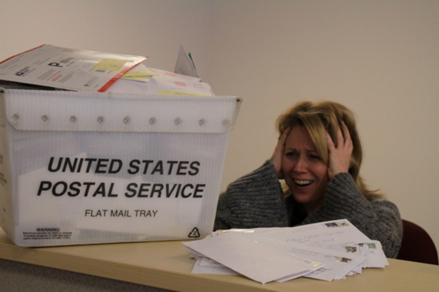
Change of Address Processing
    Addressing the Problem of Mailing to a Moving Target
NCOA^{Link} – National Change Of Address
  USPS change of address processing for residential and business
  Pre-built interfaces for exporting / importing / reporting
mCOA – multi-Source Change Of Address
  Covers the past 5 years and includes a database
  Collection of address changes compiled from several sources:
    credit card companies, banks, magazine subscriptions, catalog houses, insurance groups, and utility companies
pCOA – proprietary Change Of Address
  Covers the past 30 years and includes a database of “lost addresses”
  Includes Deceased Append service
  Collection of address changes compiled from several sources:
    credit card companies, banks, magazine subscriptions, catalog houses, insurance groups, and utility companies
CCOA – Canadian Change Of Address
  Covers the past 3 years for families and companies that have filed change of address through Canada Post

Slide 29



Email Append
Adding Intelligence to Your List
Adds corporate or residential email addresses to your records.
Provides the Email address associated with the name and street address from your list.
Updates your CRM data with contact Email information.
Enhances your Email marketing capabilities.
Copyright RunnerTech 2000-2015 All Rights Reserved

Slide 30

Telephone Append
Adding Intelligence to Your List
Adds corporate or residential phone numbers to your records.
Provides the phone number associated with the name and street address from your list.
Updates your CRM data with contact phone information.
Enhances your contact data.
Copyright RunnerTech 2000-2015 All Rights Reserved

Slide 31

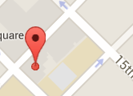
GeoCoding
Locate Your Target Audience to Market More Effectively
Identifies the Latitude and Longitude coordinates for an address
Used to compute distance, direction, and perform radial searches for the following purposes:
  Target marketing campaigns
  Enrollment strategies
  Student & employee housing assistance
  Car pooling
  Political influence
For Example:
  How many students applying live within 5 miles, 10 miles of the university have a 1300 SAT score?
  How many alumni live within 50 miles of an event?
Copyright RunnerTech 2000-2015 All Rights Reserved

Slide 32
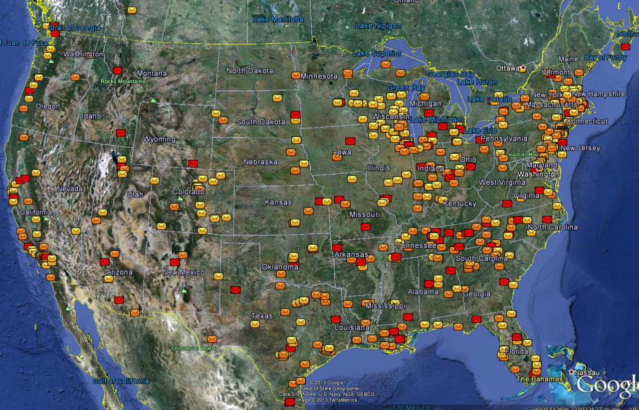
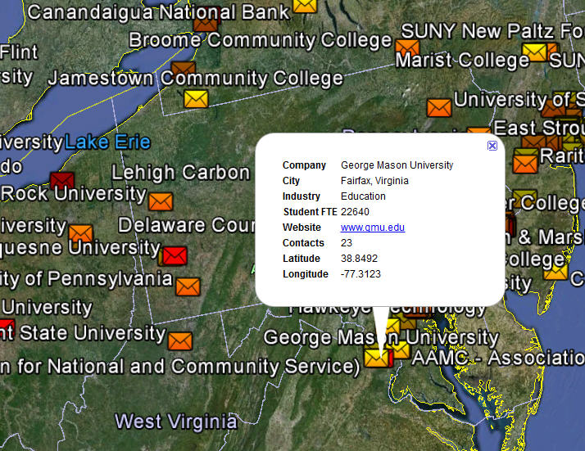
GeoCoding Benefits
Show all students or alumni in Google Earth Pro
- Color-code locations based on data
Click on icon to show detailed information
Copyright RunnerTech 2000-2015 All Rights Reserved

Slide 33
User Exit Options
A User Exit package is supplied to support customizations of business rules
  Provides PRE and POST transaction triggers
  Enables customization of address standards
Create rules in PL/SQL or Transact-SQL
Copyright RunnerTech 2000-2015 All Rights Reserved

Slide 34
Enterprise Architecture
Database
  - Unidata
  - SQL Svr
  - Oracle
Web Svc call
CLEAN_Address
Server
  O/S Platforms:
  Windows
  Linux
  Solaris
  AIX
  HP-UX
Embedded
USPS / CAN
Database (2GB)
Web Svc call
CLEAN_Address
Server
Embedded
USPS / CAN
Database (2GB)
  Seamless Fail-over
  Redundancy
  Load Balancing
  Scalability
  100% Availability
Verify
International
Address
Copyright RunnerTech 2000-2015 All Rights Reserved

Slide 35
Service Oriented Architecture (SOA)
Database
-
Development
Database
-
Test
CLEAN_Address
Server
CLEAN_Address
Server
ERP
-
Production
Database
-
Alumni
  Multiple databases can be supported from one CLEAN_Address server installation
  Address Verification Servers supply a service to any database that needs them
  USPS data is updated centrally on the CLEAN_Address server every 2 months

Slide 36


Summary
CLEAN_Address will
  Save money by reducing or eliminating undeliverable mail
  Improve the quality of your database
  Save time by reducing administrative effort to deal with data quality issues
CLEAN_Address provides 100% seamless real-time and batch address verification for Banner and Advance
Allow end-user self-service updates on the Web
    Reduce centralized data entry
Affordable pricing for every institution size
Copyright RunnerTech 2000-2015 All Rights Reserved

Slide 37
Contact Information
RunnerTech
6530 West Rogers Cir, Ste 31
Boca Raton, FL 33487-2753
Chris@RunnerTech.com
www.RunnerTech.com
561-910-7804
Copyright RunnerTech 2000-2015 All Rights Reserved

Slide 38
Thank you for attending our presentation on CLEAN_Address.
Copyright RunnerTech 2000-2015 All Rights Reserved

