Slide 1
MBUG 2015
Session Title: Banner Boot Camp II
Presented By: Cay Lollar
Institution: Itawamba Community College
September 14, 2015

Slide 2
Session Rules of Etiquette
Please turn off your cell phone
If you must leave the session early, please do so discreetly
Please avoid side conversation during the session

Slide 3
GOAMTCH Common Matching
Use common matching to help prevent duplicate records – IT staff hates duplicate PIDMS. Stay on their good side by always searching before entering a new student into Banner.
Can go to directly or though SPAIDEN when creating a person record.

Slide 4
GOAMTCH

Slide 5
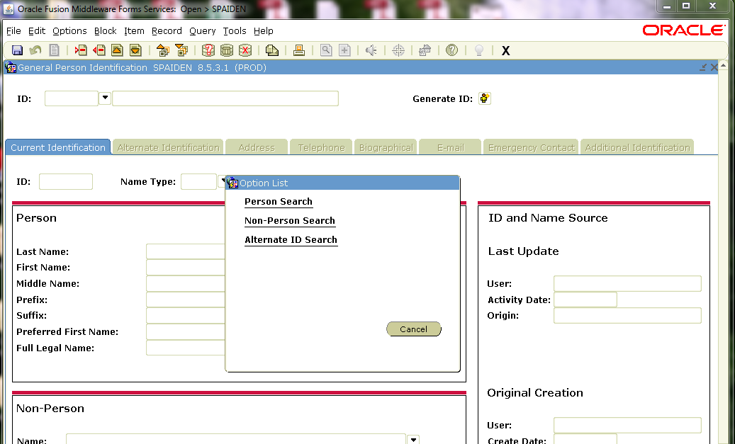
SOAIDEN Person Search
Always search before entering a new person in the system.

Slide 6
GUIALTI Alternate ID Search
Difference in this search and SOAIDEN (Person Search) is that one can search on DOB. DOB must be entered as DD-MON-YYYY.

Slide 7
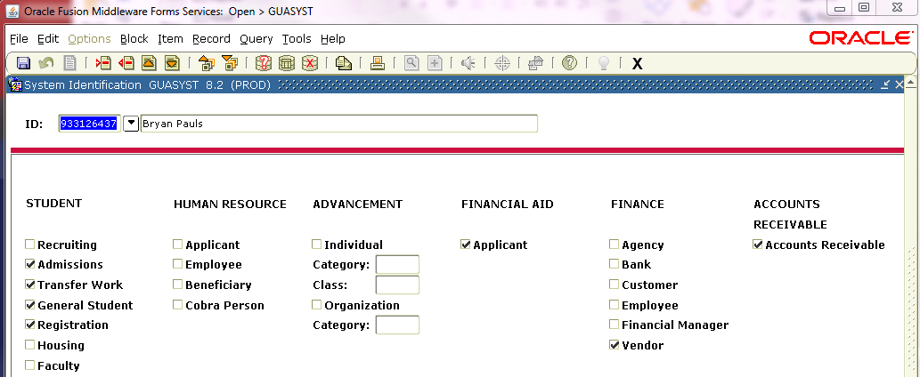
GUASYST System Identification
Provides a reference to modules where information about an ID may be stored.
Used when duplicates exist for a student and data must be combined into one record.
Does not list by term or date

Slide 8
GUISRCH General Search
Banner 8.4
Search by
Additional ID
E-mail
Country Code
Area Code and Phone Number

Slide 9
GUISRCH cont.

Slide 10
SOAIDNS Person Search Detail
Student Name, DOB, Gender
Address Details
General Learner
Registration Terms
Curriculum

Slide 11
SOAIDNS

Slide 12
SPAIDEN or PPAIDEN General Person Identification
Address Information (Cannot be over 30 characters per line including spaces at ICC).
Telephone
Biographical (SPAPERS)
Gender
Date of Birth
Social Security Number
Citizenship
Ethnicity
Confidential
Deceased Date

Slide 13
REGISTRATION SFAREGS – SFAREGQ - SFAREGF
SFAREGS – Student Course Registration
SFAREGQ – Registration Query – Display the student’s schedule with meeting times, building, and rooms
SFAREGF – Student Course/Fee Assessment Query – Shows Percentage Tuition Refund

Slide 14
SGASTDN General Student
General Learner Record – Term, Student Status, Student Type, Residence
Curricula Summary
Field of Study
Veteran
Comments
Academic and Graduation Status
Miscellaneous

Slide 15
Academic and Graduation Status on General Student Form SGASTDN
Academic Term
Academic Status
Academic Standing Override – (i.e., Student was dismissed after the spring term and has appealed to return the fall term. Enter override of standing so student can register for fall term)
Graduation Status
Expected Graduation Date – Typically populated by scrip for Student Clearinghouse Reports.

Slide 16
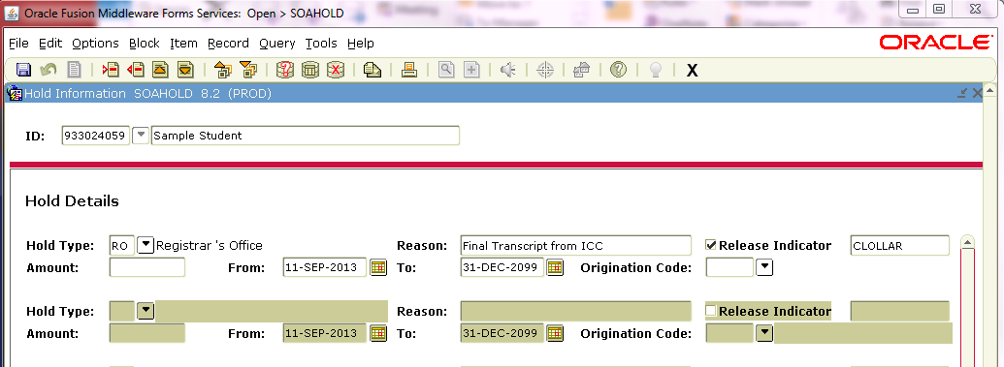
SOAHOLD Hold Information
Note: If Release Indicator is checked, only the person that placed the hold can remove the hold.

Slide 17
SAAADMS Admissions Application
Admission Type
Student Type
Residence
Application Status
D – Decision Made
C – Complete and Ready for Review
I – Incomplete Items Outstanding

Slide 18
SGASADD Additional Student Information Used to identify cohort groups and dual credit/dual enrollment at ICC

Slide 19
Residency ICC Uses SOAHSCH
MSRE – Need two proof of residency for student 21 years of age or older
Use MSRE for high school code (build in STVSBGI)
Use MSRE for Admissions Request (build in STVADMR)
PARE – Need two proofs of residency for parents – Student under 21 years of age.
Reports can then be run for students with one of these incomplete on the checklist.

Slide 20
SOAHSCH ICC Uses for Proof of Residency

Slide 21
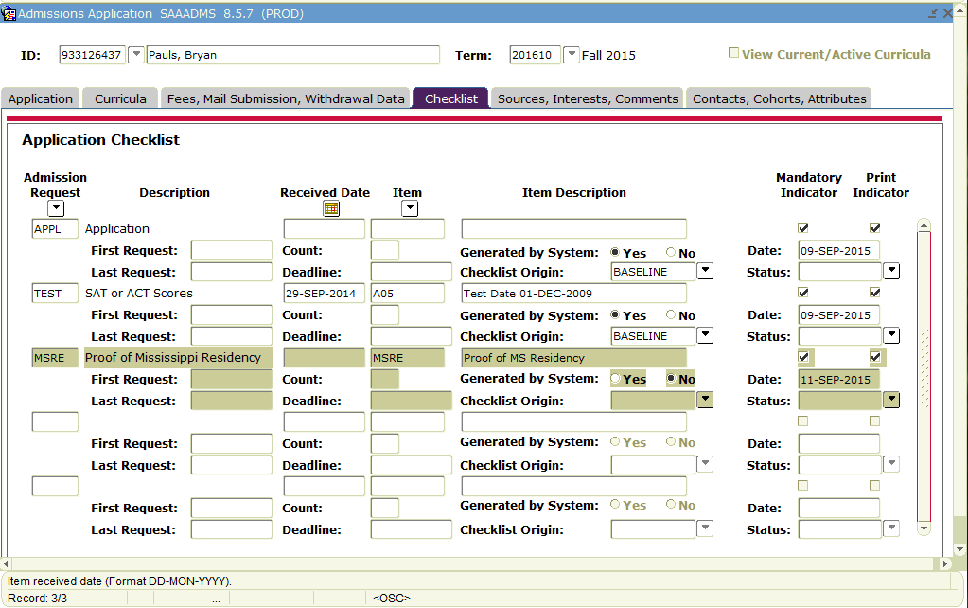
Checklist MSRE Displays on Checklist

Slide 22
SPACMNT Person Comment Form Used at ICC to show if a Transcript Release Form is on file for dual credit/dual enrollment students.

Slide 23
SHATERM Term Sequence Course History
Current Standing
First Term Attended
Last Term Attended
Academic Standing
Academic Standing Override
Institutional – Transfer and Overall
Attempted Hours (Financial Aid)
Passed Hours
Earned Hours
GPA Hours
Quality Points
GPA

Slide 24
SHATERM cont. Term GPA and Course Detail Information
Term GPA and Course Detail Information
Transfer by term
Transfer Number
Attendance Period
Institutional by term
Term and Cumulative Attempted Hours, Passed Hours, Earned Hours, GPA Hours, Quality Points, GPA

Slide 25
SHADEGR Degree and Other Formal Awards

Slide 26
SHADGMQ Degree Summary

Slide 27
SHATCMT Transcript Events and Comments
Academic Comments
PTK, NCATE, ASHA, etc.
Transcript Comments By Level
Degrees from prior institutions
Transcript Comments By Term
Withdrawal Dates
Approved for Readmission

Slide 28
SHATCMT Transcript Events and Comments

Slide 29
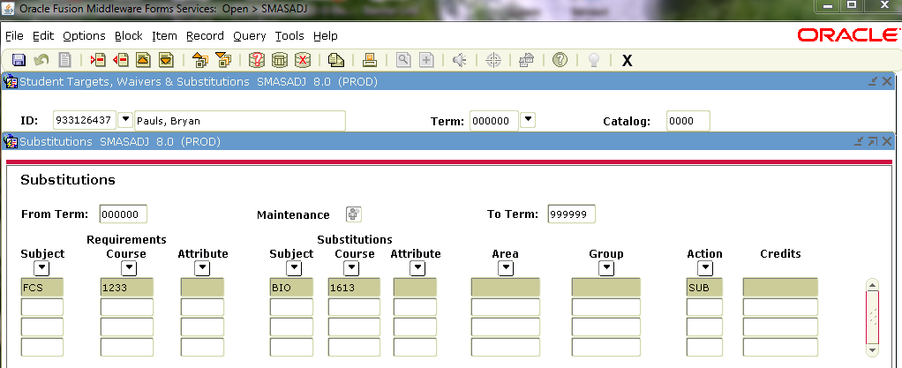
SMASADJ Student Waivers & Substitutions

Slide 30
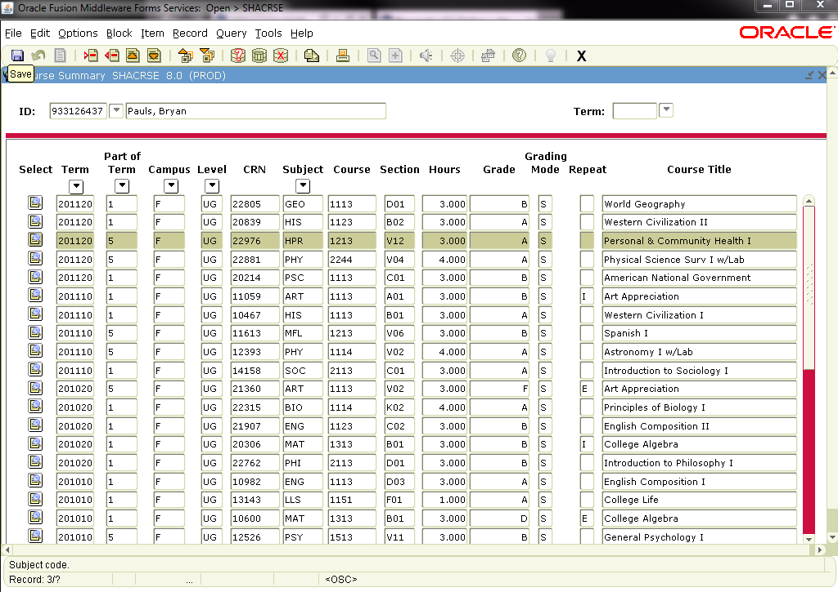
SHACRSE Course Summary
Institutional Course Summary
Leave Key Term Blank if you want all history

Slide 31
TSAAREV Account Detail Review Form

Slide 32
ROASTAT Applicant Status (Financial Aid)

Slide 33
ROASMRY Applicant Summary (Financial Aid)
Financial Aid and Scholarship Awards

Slide 34
End of Term Processing Steps
SHAGRDE – Grade Code Maintenance
Identify the institution’s grading policy. One time set up. Change if the institution adopts new grades/grading policy.
SHAGRDS –Grade Substitution Maintenance
Build substitute grades. One time set up. Change if the institution adopts new grades/grading policy.
SFASLST or SFAALST– Class Roster or Class Attendance Roster
Enter grades

Slide 35
Steps continued…..
SHRROLL– Grade Roll to Academic History
Roll grades to Academic History
SHRCGPA – Calculate GPA
Calculate GPAs based on the current term and a selected group of students using A = All R = Rolled C = Collector
SHARPTR – Repeat/Multiple Course Rules
Set up rules for using repeated (and equivalent) courses in GPA computations
SHRRPTS – Repeat/Equivalent Course Check
Identify the repeated (and equivalent) courses to be used in computing GPAs
Must recalculate GPA using “Collector” once this process is completed.

Slide 36
Steps continued…..
SHAACST – Academic Standing Rules
Set up academic standing rules on Academic Difficulty (academic warning, probation, suspension, dismissal, etc.) and honors (Dean’s List, President’s List
SHRASTD – Calculate Academic Standing
Calculate academic standing for currently enrolled students
SHRGRDE – Grade Mailer (optional)
Run this process even if you no longer mail grades
SFRRGAM – Registration Admin Messages (optional)
Tracks registration errors for administrative purposes, checks for in-progress prerequisites errors, views any potential schedule conflicts due to changes in class schedule, fins students who took in-progress prerequisites that may have not met the requirements.
Notes:
The key to the SOABGTA form is the institution code and the effective term associated with the transfer information. The transfer institution must be established on the Source/Background Institution Validation Form (STVSBGI) prior to building data on this form.

Slide 37
Steps continued…..
SOACTRM – Continuant Terms Rule
Used to establish the rules for how the existing student type, maintained on the General Student form (SGASTDN), will be updated to the Next Student Type, which is maintained on the Student Type Validation Form (STVSTYP).
STVSTYP – Student Type Code Validation
Set up student type codes on the student type code validation table (STVSTYP)
SHRTYPE – Student Type Update
Automatically updates the student type based on the rules established on SOACTRM. This process should be run after the courses have been rolled to history at the end of the term.
If the Next Student Type field is null on the Student Type Validation Form (STVSTYP) then no update of the student type occurs.
SHARCINC – Incomplete Grade Process (Optional)
Must setup Incomplete Grade Rules (SHAINCG) if you use the Incomplete Grade Process.

Slide 38
SHRCGPA – Calculate GPA
Re-Calculate GPAs for students who repeated courses using “Collector”
01 – Term – Current Term
02 – Select All, Rolled or Collector ---- “C” for collector
03 – Selection Identifier
04 – Application code
05 – Creator
SHRCONV – Campus GPA Conversion Process
Run only if a Campus GPA is used (see SHATRMC)

Slide 39
Academic Standing Rules SHAACST
Academic Difficulty Rules
Term Effective
Sequence # is not important
Hour Type (“A” – Attempted, “E” -- Earned and “G” – GPA) used must be the same for all rules
Dean’s List Rules/Excluded Grades
If a student has any “Excluded Grade” values, not eligible for Dean’s/President’s List processing.
If a student qualifies for multiple rules, most restrictive is used to assign status code.

Slide 40
SHAACST cont…
Progress Evaluation Rules
Sequence is critical
Counts number of grades for the processing term
Minimum percentage = % of grades that count toward progress
Progress Evaluation Grade Exclusions
Grades defined on “Progress Evaluation Grade Exclusion do NOT count toward progress (aka Bad Progress grades)
Combined Academic Standing Rules
Does not depend on previous term status code
Adds newly calculated academic status and progress status together
Academic Difficulty Rules by Student Centric Period

Slide 41
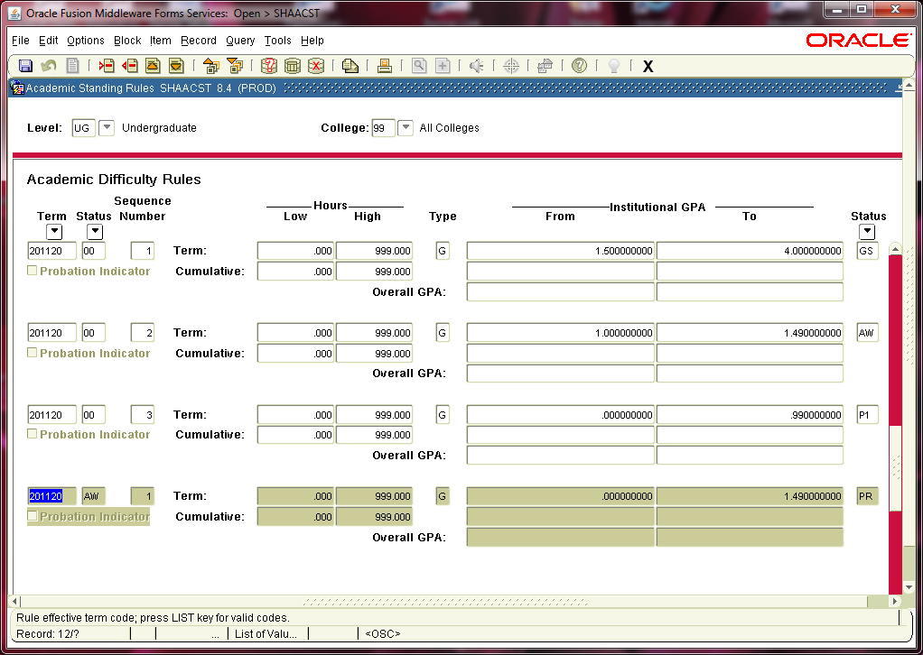
Academic Standing Rules SHAACST

Slide 42
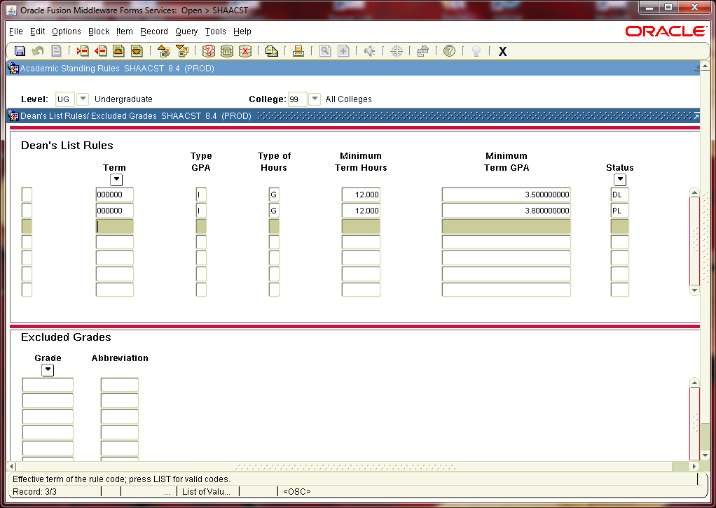
Dean’s List Rules SHAACST

Slide 43
Academic Standing Issues
Don’t Use “00” for good standing. Banner’s default is “00”. This allows one to find missing logic/rules.
Complicated Rules – Still using quality point deficiency instead of GPA.
Poorly written policy
Three strikes and your out
Use P1 – Probation 1, P2 – Probation 2, P3 – Probation 3, etc.
Must calculate standing for every term that gets academic history
If you do not calculate a standing – Banner assumes “00”. Note: “00” is default for good standing.
Can create “dummy standing rules” to populate.

Slide 44
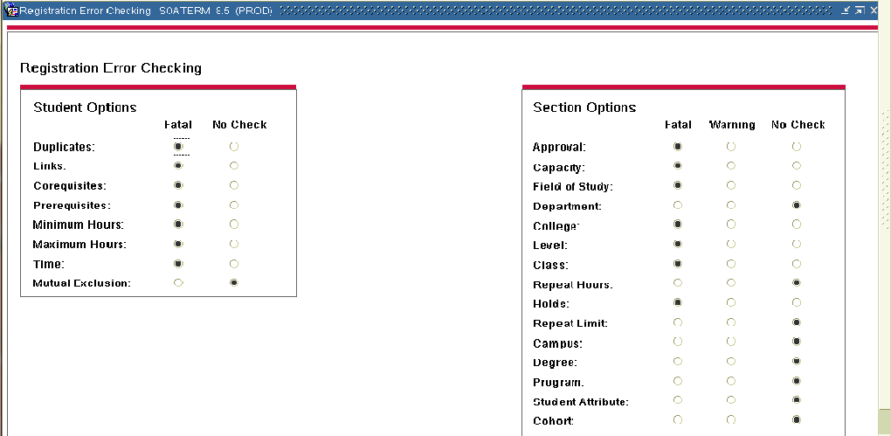
Registration Admin Messages SFRRGAM
Run to assist in finding registration errors, identify students that preregistered for a future term and SOATERM error checking.

Slide 45
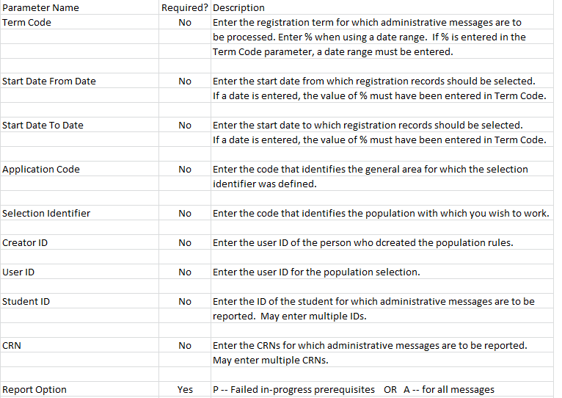

Slide 46
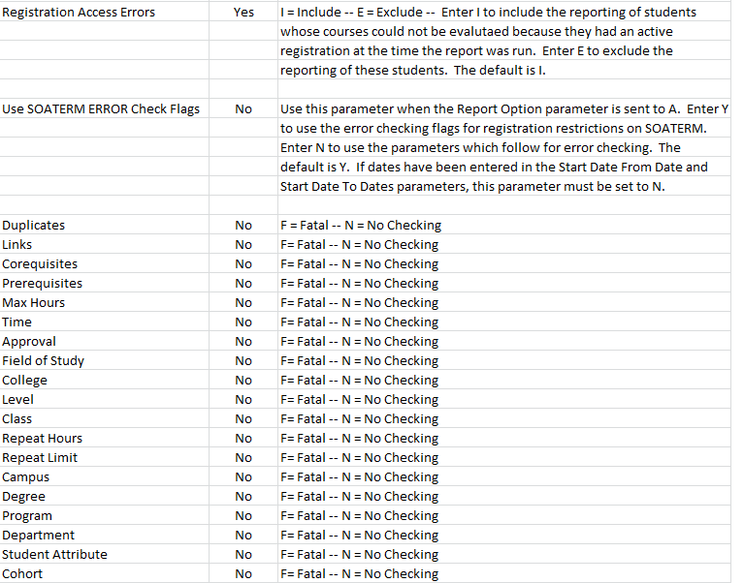
SFRRGAM Parameters cont…

Slide 47
SFRRGAM
 |  |  |  |  |  |  |  |  |  |  | PAGE | 1
SFRRGAM 8 | 0.2 |  |  |  |  |  |  |  |  |  | RUN DATE | 19-Aug-10
 |  |  |  | Registration Admin Messages |  |  | s |  |  |  | RUN TIME | 8:12 AM
ID | Name | LV | Term | Date Added | Crse Start | Crse End | CRN | Subj | Crse |  | Message
--------- | ------------------ | -- | ------ | ----------- | ----------- | ----------- | ----- | ---- | ----- | ------------- | -------- | -------------
555-44-3333 | Student, Ann | UG | 201040 | 10-Mar-10 | 18-Aug-10 | 10-Dec-10 | 4510 | BSB | 230 | Prerequisite and Test Score error
 |  |  | 201040 | 10-Mar-10 | 18-Aug-10 | 10-Dec-10 | 4511 | BSB | 230L | Corequisite BSB 230 required
 |  |  | 201040 | 10-Mar-10 | 18-Aug-10 | 10-Dec-10 | 4512 | BSB | 303 | Prerequisite and Test Score error
 |  |  | 201040 | 10-Mar-10 | 18-Aug-10 | 10-Dec-10 | 4513 | BSB | 303L | Corequisite BSB 303 required
555-55-4444 | Student, Bob | UG | 201040 | 30-Mar-10 | 18-Aug-10 | 10-Dec-10 | 4497 | BSB | 102L | Prerequisite and Test Score error
555-66-5555 | Student, Catherine | UG | 201040 | 22-Mar-10 | 18-Aug-10 | 10-Dec-10 | 4065 | BU | 345 | Prerequisite and Test Score error
555-77-6666 | Student, David | UG | 201040 | 20-Apr-10 | 18-Aug-10 | 10-Dec-10 | 4469 | SPA | 311 | Prerequisite and Test Score error
 |  |  | 201040 | 20-Apr-10 | 18-Aug-10 | 10-Dec-10 | 4470 | SPA | 411 | Prerequisite and Test Score error
555-88-7777 | Student, Emma | UG | 201040 | 20-Apr-10 | 18-Aug-10 | 10-Dec-10 | 4330 | EN | 304 | Prerequisite and Test Score error
 |  |  | 201040 | 20-Apr-10 | 18-Aug-10 | 10-Dec-10 | 4342 | EN | 499 | Prerequisite and Test Score error
555-99-8888 | Student, Frank | UG | 201040 | 17-May-10 | 18-Aug-10 | 10-Dec-10 | 4212 | PSY | 407 | Prerequisite and Test Score error
555-33-2222 | Student, Grace | UG | 201040 | 29-Mar-10 | 18-Aug-10 | 10-Dec-10 | 4064 | BU | 345 | Prerequisite and Test Score error
555-22-1111 | Student, Keith | UG | 201040 | 21-Apr-10 | 18-Aug-10 | 10-Dec-10 | 4083 | BU | 465 | Prerequisite and Test Score error
555-11-0000 | Student, Laura | UG | 201040 | 22-Mar-10 | 18-Aug-10 | 10-Dec-10 | 4211 | PSY | 405 | Prerequisite and Test Score error
555-12-1234 | Student, Matt | UG | 201040 | 13-Apr-10 | 18-Aug-10 | 10-Dec-10 | 4212 | PSY | 407 | Prerequisite and Test Score error

Slide 48
Where do I find _____?
Account Detail (Business Office) – TSAAREV or TSICSRV
Addresses – SPAIDEN to Update and SOADDRQ to view only.
Admission Status – SAAADMS
Advisor – SGAADVR
Attribute (Student) – SGASADD
Audit (Student Course Information) – SFASTCA
Class Attendance Roster – SFAALST
Class Roster – SFASLST
Class Enrollments – SSASECQ
Classification – SGASTDN - Student Term Tab on SFAREGS
Cohort (Student) – SGASADD
Colleges Attended – SOAPCOL
Comments (Transcript) – SHATCMT
Common Matching – GOAMTCH
Courses Taken (Institutional) – SHATERM or SHACRSE
Courses Taken (Institutional and Transfer) – SHATERM
Date of Birth – SPAIDEN or SPAPERS
Degrees Awarded – SHADEGR or SHADGMQ
Dorm Information - SLARASG

Slide 49
Where do I find ____? Cont.
Ethnicity – SPAIDEN or SPAPERS
Financial Aid Eligibility Status - ROASTAT
Financial Aid Authorizations - ROASMRY
GPA – SHATERM
High School Information – SOAHSCH
Holds – SOAHOLD
Last Date of Attendance – SHATERM
Major (Curriculum) – SGASTDN
Pre-Banner Summary Hours – SHAPCMP
RACE – SPAIDEN or SPAPERS
Search by Date of Birth – GUIALTI
Search by Phone Number – GUISRCH
Search by Person – SOAIDEN
Student Schedule – SFAREGQ
Telephone Numbers – SPAIDEN to Update and SPATELE to view only
Test Scores – SOATEST
Transfer Equivalencies – SHATATR
Transcript Requests – SHARQTC
Transfer Work - SHATRNS

Slide 50
Keystrokes
F5 – Display Navigation Window lets you toggle between screens.
F6 in the key block on SAAADMS will take you to SPAIDEN.
Keystroke Navigation:
Rollback – Shift+F7
Next Block – Ctrl+PgDn
Previous Block – Ctrl+PgDN
Insert Record – F6
Remove Record – Shift+f6
Duplicate Record – F4
Next Record – Down Arrow
Previous Record – Up Arrow
Next Field – Tab
Previous Field – Shift+Tab
Enter Query – F7
Execute Query – f8
Cancel Query – Ctrl+Q
Save – F10
List of Values – F9
Direct Access F5
Options List – F2
Print Shift+F8
Exit – Ctrl+Q
Help – F1
Radio Button – Space Bar
Select – Shift+F3

Slide 51
QUESTIONS?
Thank you for attending!
Cay Lollar
clollar@iccms.edu

