Slide 1

MBUG 2015
Session Title: Banner Authentication and Login Validation
Presented By: Allen McGehee
Institution: Mississippi College
September 13, 2015

Slide 2
Session Rules of Etiquette
Please turn off your cell phone
If you must leave the session early, please do so discreetly
Please avoid side conversation during the session

Slide 3

Mississippi College mc.edu
Founded in 1826
FTE = 4,921
Main Systems: Ellucian Banner, Google Apps and Moodle

Slide 4
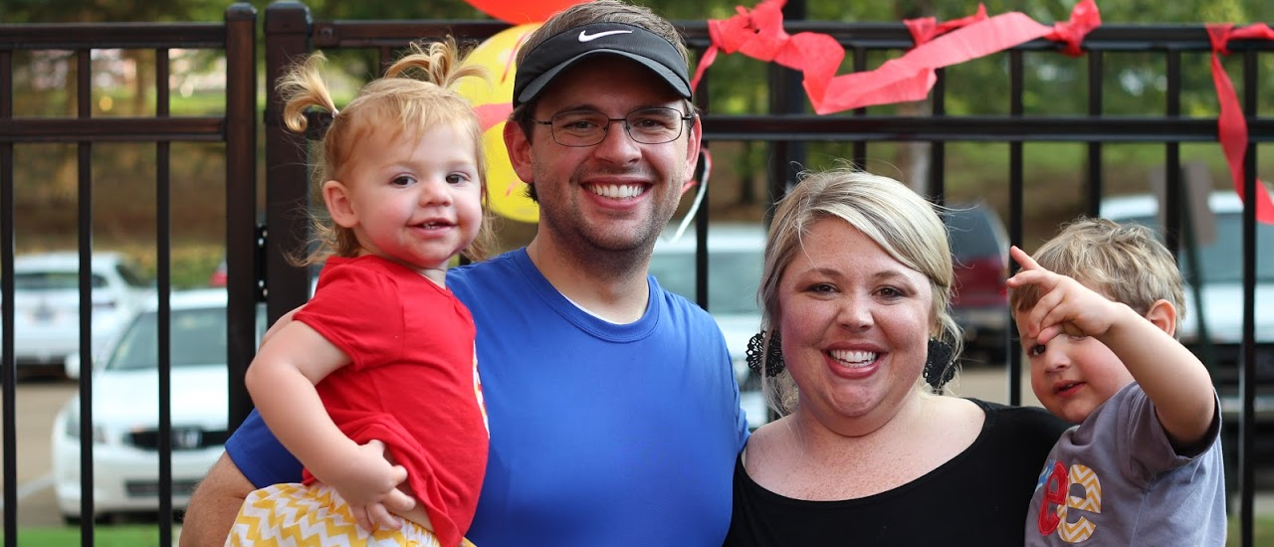
Allen McGehee gmcgehee@mc.edu
Programmer / Analyst
29
Wife and 2 kids

Slide 5
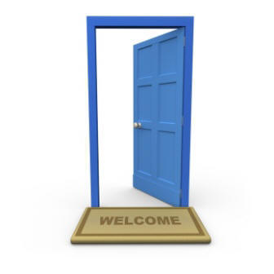
Our Story – Single Sign On(SSO)

Slide 6
Our Systems
MyMC – Central Authentication Service(CAS)
Ellucian Banner
  Self Service - CAS
  INB – DB Authentication
Google Apps - CAS
  Gmail
  Calendar
  Drive

Slide 7
Our Systems - Authentication
Authentication Flow
  Creation
    Banner (Applicants/Enrolled) -> Active Directory(AD)/Google Apps
    AD -> GOBTPAC table
  Authentication to Banner Self Service
    MyMC Username/Passsword against AD
    Redirect to BannerSS Yale PL/SQL CAS Client
    Verify CAS Ticket and cross reference GOBTPAC table for external user id
    Redirect to requested page

Slide 8
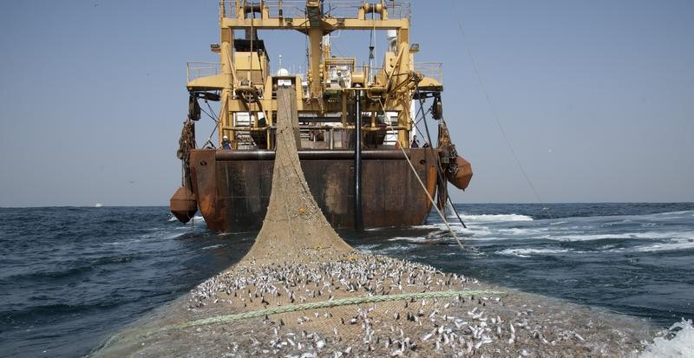
Our Story – Phishing

Slide 9
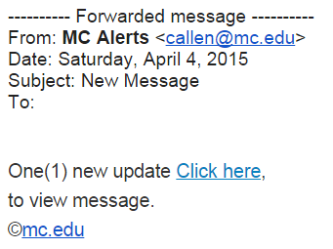
Our Story – Phishing

Slide 10
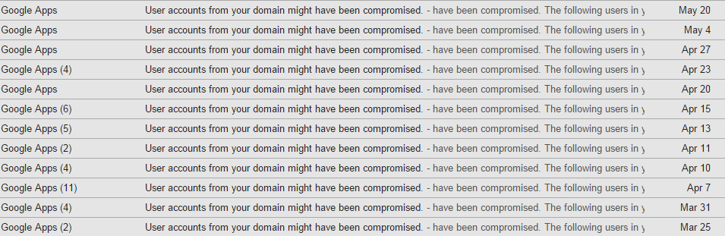
Our Story- Compromised Accounts

Slide 11
MC’s Response
Education
Change Passwords
Block Bogus MyMC URL’s
Tighten Spam Settings in Google Apps
Got Your Back – Delete Emails
Antivirus

Slide 12
MC’s Response cont’d
Block Suspicious IP’s in Africa
Address Robo Login Pattern: reCAPTCHA
Address potential 2 Factor Authentication: Federated Login (Future)

Slide 13

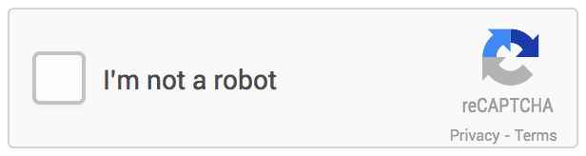
ReCAPTCHA
reCAPTCHA 2.0 – google.com/recaptcha
  Recaptcha 1.0:
  Recaptcha 2.0:

Slide 14
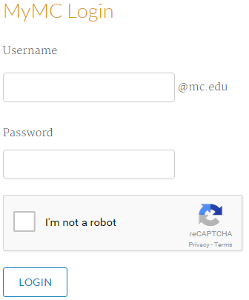
ReCAPTCHA Walkthrough

Slide 15
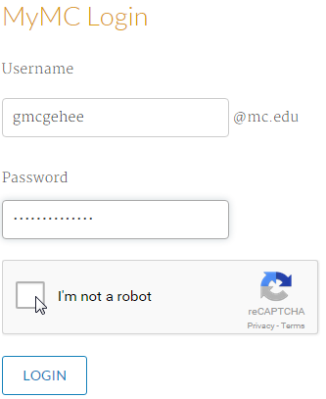
ReCAPTCHA Walkthrough

Slide 16
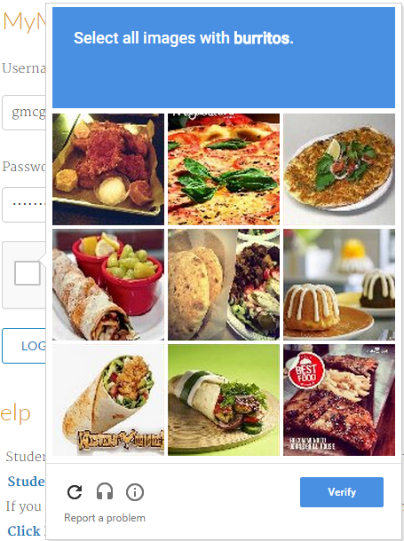
ReCAPTCHA Walkthrough

Slide 17
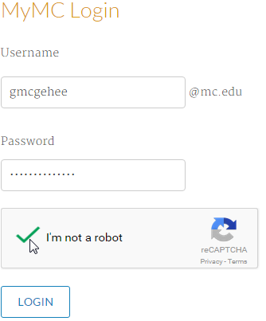
ReCAPTCHA Walkthrough

Slide 18
Federated Authentication
2 Factor Authentication
  Something You Know / Something You Have
Google Apps Security
  Text, Call, Authenticator App, Security Key, Apps Specific Passwords
Hurdles
  Implement Federated Authentication with MyMC
  Google Apps Password Sync (GAPS)
  Figure out how to sync/inject AD Attributes into the SSO/SAML flow (group memberships)

Slide 19

Questions

