Slide 1
MBUG 2015
“Using Argos to Discover a Whole New Data World”
Rhonda B. Loper
Delta State University
September 15, 2015

Slide 2
Session Rules of Etiquette
Please turn off your cell phone
If you must leave the session early, please do so discreetly
Please avoid side conversation during the session

Slide 3
You are in a time crunch, a report is due in less than 24 hours, and the data pulls from a host of different fields, so what should you do now? Well, if you have planned ahead by creating preset reports in Argos, you simply select the report you are needing and pull the data.
This session will share a true story about how Delta State utilized preset reports in Argos to provide the data needed on our First in the World grant proposal, which once awarded, allowed us to implement a new program in our Student Success department.
This session will be a fun-filled journey into how a Whole New Data World was discovered through utilizing Argos, a reporting solution by Evisions software.

Slide 4
First, decide what information you will need in your data block.
Next, work with your OIT Department to set up the Argos reports.
Finally, run the report using the desired parameters.
Using
Argos

Slide 5
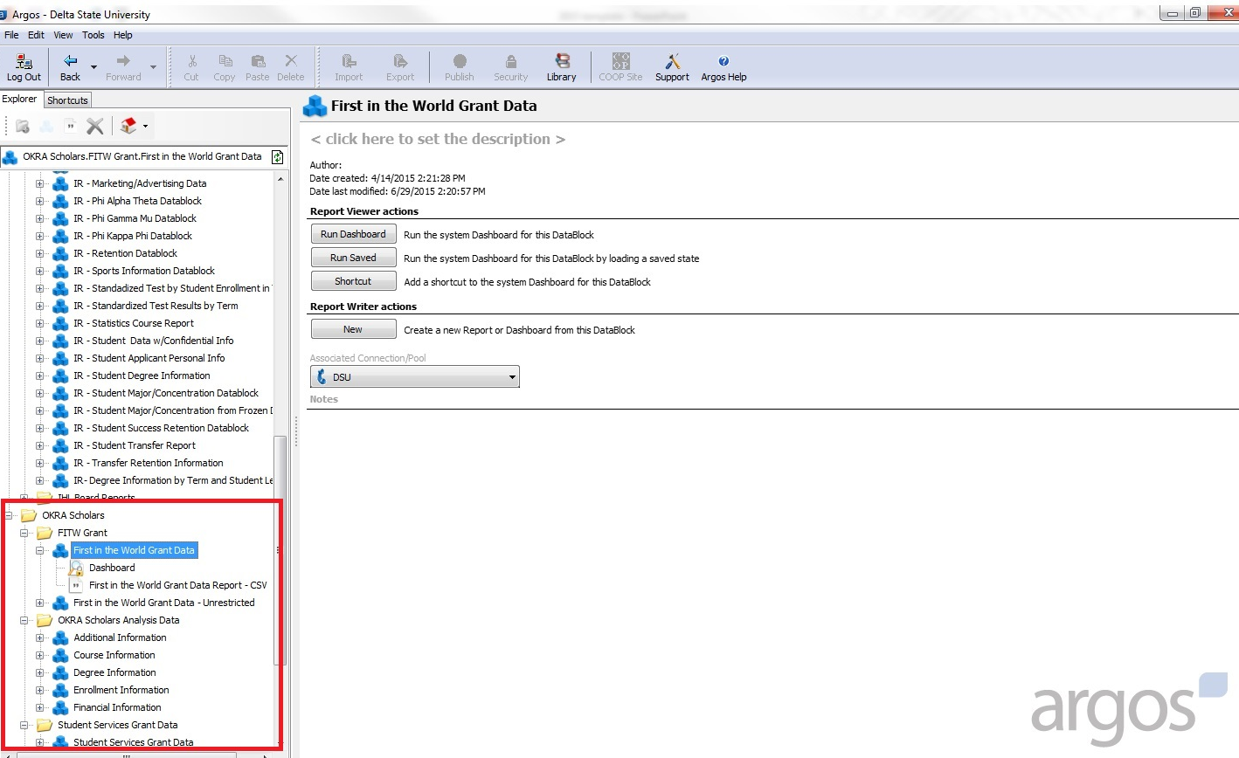

Slide 6
Be aware of what the data is telling.
Add elements as needed.
to Discover
Use the data wisely.
Look for patterns in the data.
Look for ways you can utilize the data to enhance your campus.

Slide 7
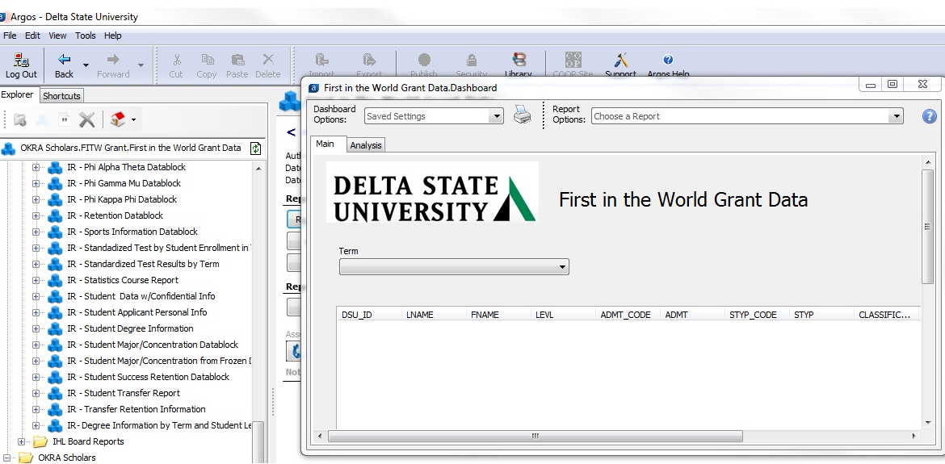

Slide 9
Applying for the Grant
Being Awarded the Grant
Implementing the Program
A
Whole
New

Slide 10
What is the Okra Scholars Program?
My data journey…
Where we are going from here…
Data
World
Notes:
Okra Scholars is a new grant funded program that is a part of the Student Success Department at Delta State University. Last year we were awarded the First in the World grant, funded through the Department of Education. Through this grant we were able to establish the Okra Scholars program which is committed to the retention and completion of our students. Primarily from a cohort of first-time, full-time students found within the 17-21 ACT range. They are considered high-risk student based on the fact this population is where the data showed the greatest loss in retention. These students also fall within the category of either pell-eligible, from a Delta county, or a first-generation student.
Even though I have now transferred from the IR department to the Student Success department, my data journey hasn’t stopped. As this is a data driven grant, I will begin tracking these students and comparing them against a control group to ensure the services provided through Okra Scholars is achieving the desired results.

Slide 11
Thank
You!
Are you ready to start your journey?

