Slide 1
MBUG 2015
Session Title: Banner Advancement Basics
Presented By: Cindy Hampton
Institution: Mississippi College
September 14, 2015

Slide 2
Session Rules of Etiquette
Please turn off your cell phone.
If you must leave the session early, please do so discreetly.
Please avoid side conversation during the session.

Slide 3
AGENDA
Lesson 1: Banner Form Naming Convention
Lesson 2: Navigating Through Advancement
Lesson 3: Search and Common Matching
Lesson 4: Where Do I Find It?

Slide 4
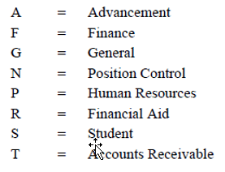
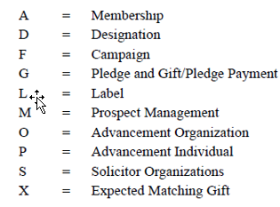
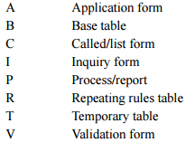
Banner Form Naming Convention
Every Banner form consists of seven characters. Example: A P A I D E N
Position 1 A Position 2 P Position 3 A
System Identifier Module Identifier
Position 4-7 IDEN
Uniquely identifies the form

Slide 5
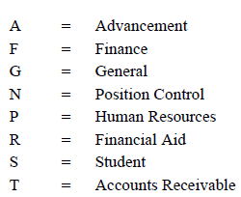
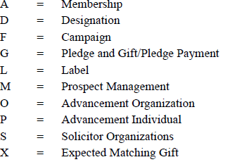
Reports & Processes
Banner reports and processes follow the same naming convention as Banner forms. They are seven characters long and follow this same Position definition as Banner forms. Example: A D P F E E D
Position 1 A Position 2 P Position 3 D
Identifies System Identifies Module Identifies this is a Process/Report
Position 4-7 FEED
Uniquely identifies the report name.
A = Advancement
D = Designation
P = Process/Report
FEED = Advancement to Finance Feed

Slide 6
Navigating through Advancement
• There are multiple ways to navigate through the forms in Banner.
• You can use the mouse or your keyboard.
Example of Next Block using the Mouse on the Menu Bar. Click Block, then Next.
Example of Next Block using the icon on the Toolbar.

Slide 7
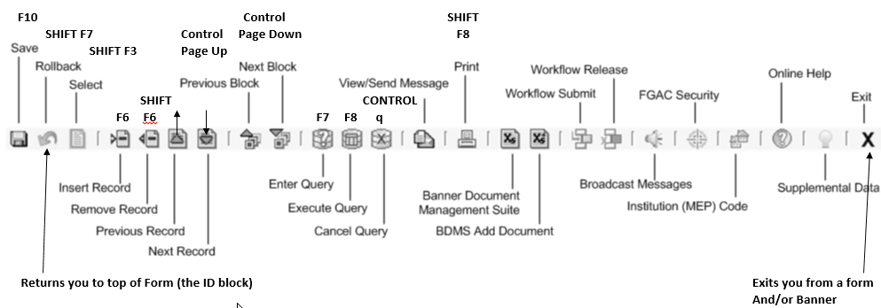
You can use Keystrokes and Functions Keys to navigate through the forms.

Slide 8
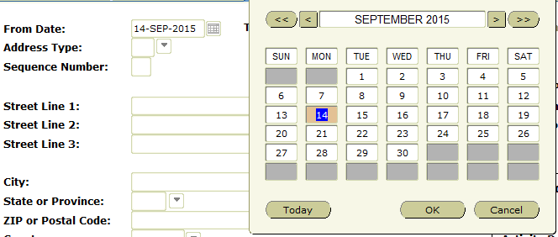
Entering Dates
Enter the date in any date field by typing the month & day, or just the day then press Enter.
the date will populate the field, formatted for you.
You can click on the calendar beside any date field
or you can double click in the date field and the calendar will pop up for you to choose a date.

Slide 9
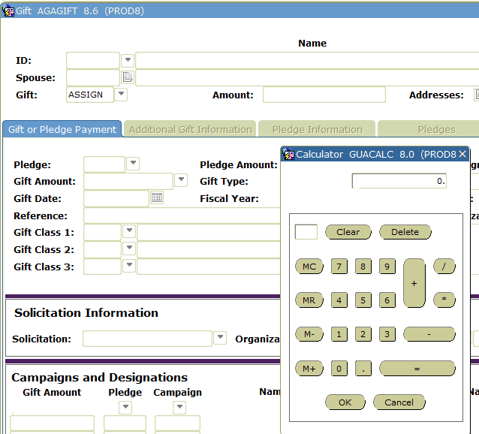
Using the Banner Calculator
You can double click in any financial field and the calculator will appear.
Enter your calculations and press OK and the amount will populate the field.

Slide 10
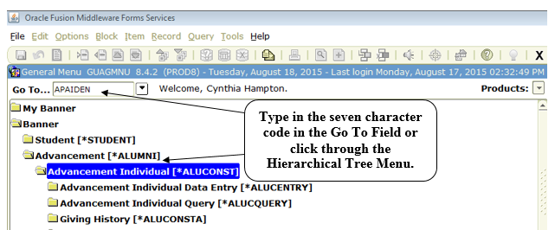
Accessing Banner Forms
Information in Banner is located in “forms”.
There are many ways to get to different forms.

Slide 11
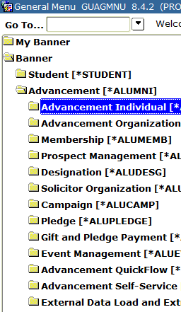
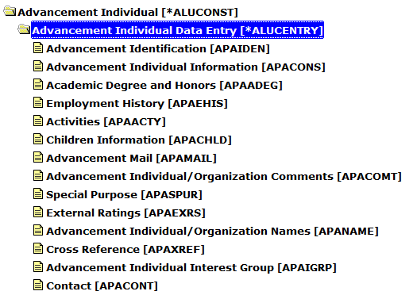
The Advancement Menu provides an easy way to go through a module within the Advancement system.

Slide 12
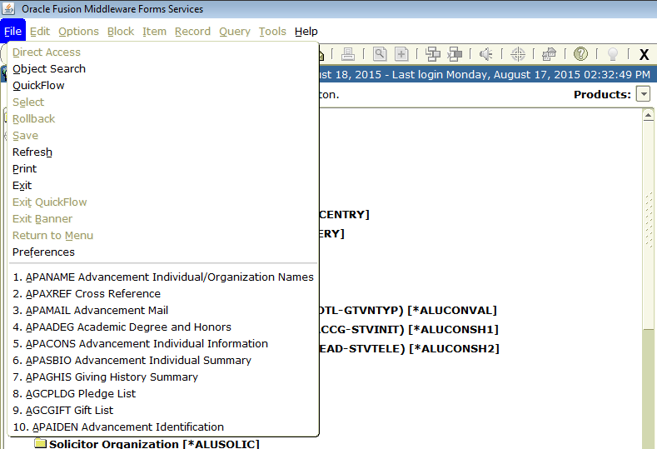
Banner remembers the last 10 forms you have been to, click on File and then click the form needed.
This list will change as you navigate to different forms, but will be available during your current Banner session. You may also use your up and down arrow keys on your keyboard to navigate between forms you have previously accessed.

Slide 13
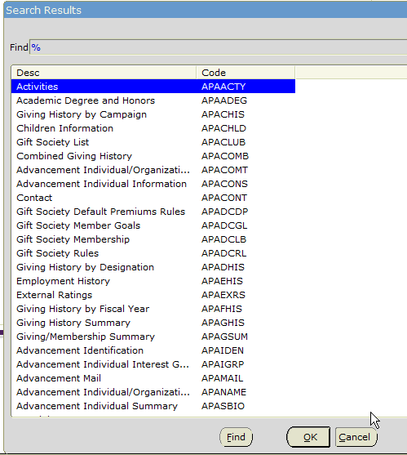
In the Go To… field you can enter part of the form name followed by a percent sign, press enter and Banner will display all forms that meet that criteria. You can review the list of forms displayed. Double click on the form you need and you will directed to that form.

Slide 14
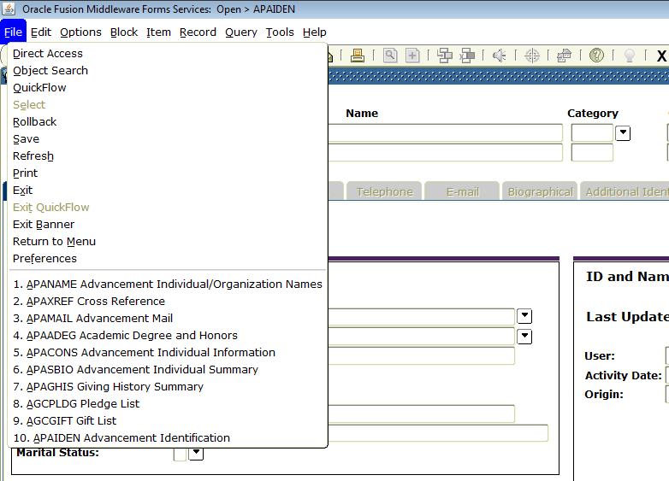
While in one Banner form, you have the option to navigate to another form without leaving the form you are in by clicking File, then Direct Access. Function key F5 will also pop up the Direct Access field.

Slide 15
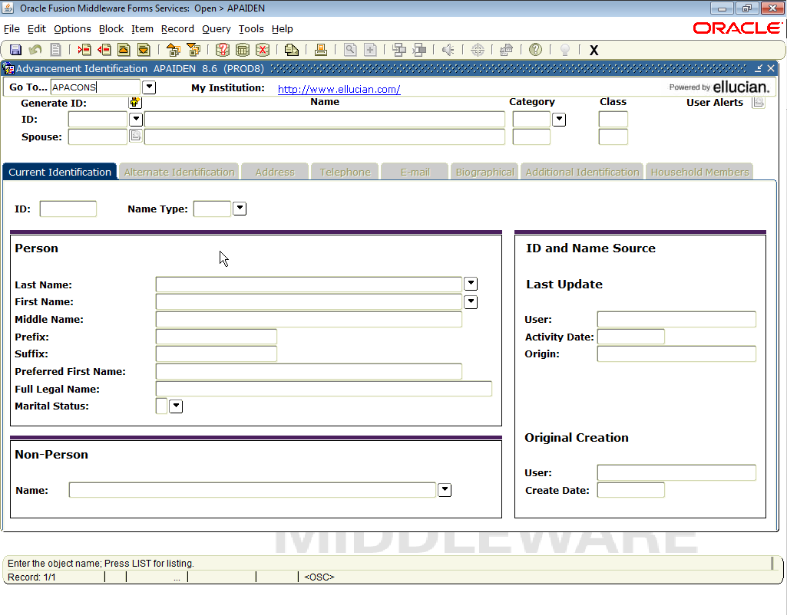
In the Go To….field, type the form name you want to navigate to and press enter. This will navigate you to APACONS. When you exit APACONS, you will be returned to the previous form you had accessed.

Slide 16
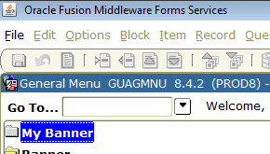
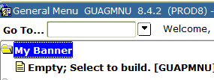
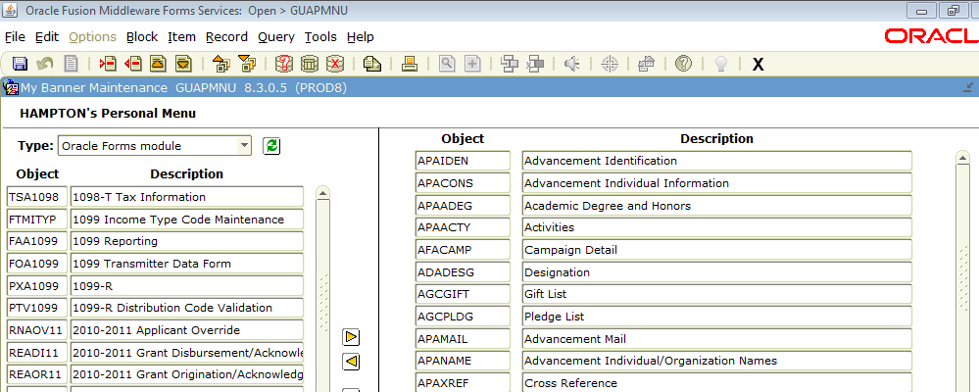
You can create your own Banner menu with a list of forms you use and navigate to the forms on your menu.
1. Click on the My Banner folder
2. Click Empty; Select to Build
3. Enter the Banner forms you would like on your menu. You may change the Banner Description to whatever you would like that makes sense to you. Click Save

Slide 17
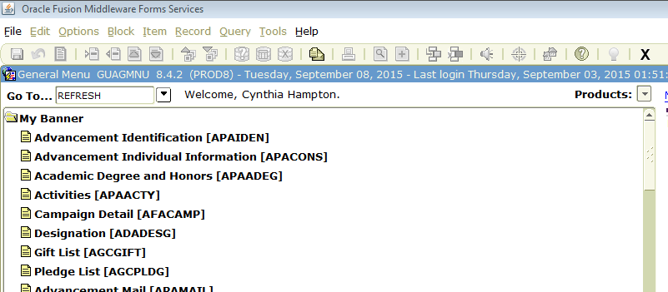
4. Type Refresh in the Go To…field and your additional forms will display.
5. You may add additional forms to your menu at any time. Click on Organize My Banner. This will be located at the end of your my Banner menu list. Make the additions/deletions you need. You may also go to GUAPMNU form to make your changes.

Slide 18
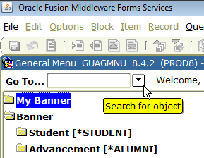
Another way to search for a form/process is to do an object search.
In the Go To…field, click on the search button as shown.
Enter part of the form name using the % sign or tab to the Description field and enter part of the form name using a % sign before and after your entry as shown.

Slide 19
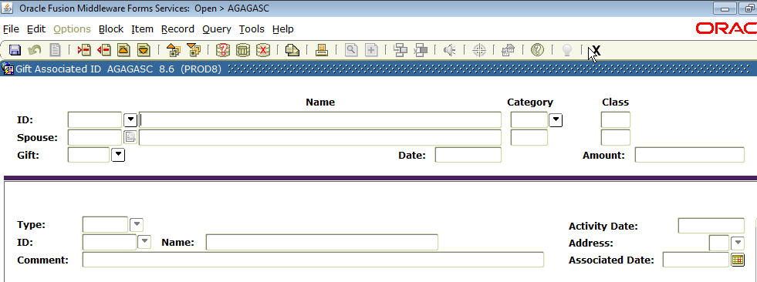
Execute the query to see what forms display that contain the name Gift.
Double click on the form needed and Banner will take you there.

Slide 20
Why Do We Search & Use Common Matching?

Slide 22
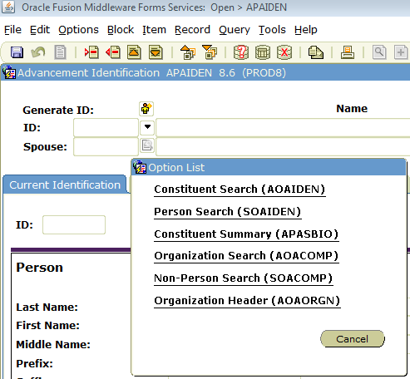
Searching for Constituents
You can search for a constituent/organization/person from any form that contains an ID block.
Beside the ID field, click on the search arrow to display the Option List.

Slide 23
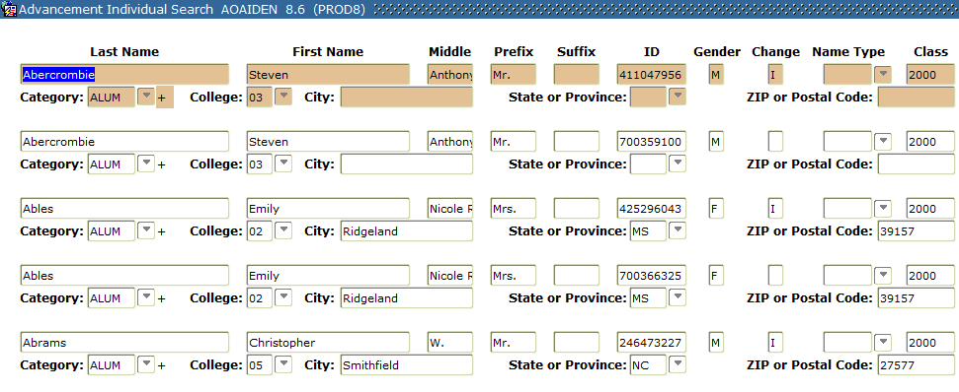
Click on Constituent Search. On this search form you can enter as much or as little information as you may know. All fields are searchable. You can only enter a class year and see all members of that graduating class as shown. Did a search for the call of 2000.

Slide 24
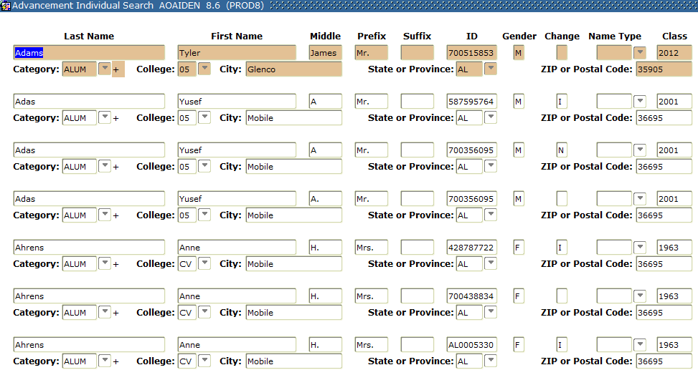
You may need to find all constituents from a particular city or state. Enter only that information as shown. In this example we are looking for all constituents from the state of Alabama.

Slide 25
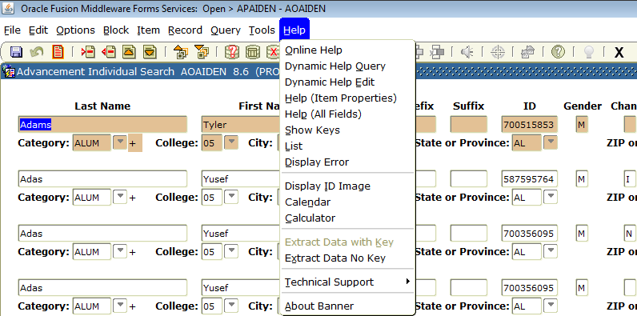
The results of these queries can be extracted into a spreadsheet.
Click on Help on the Menu Bar and choose Extra Data No Key.

Slide 26
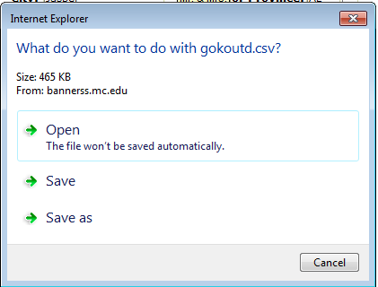
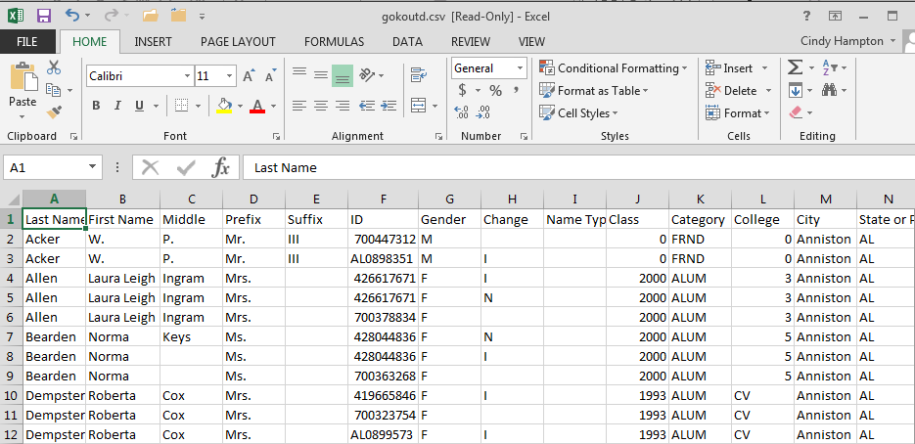
In our setup this IE box will appear. We click open and view the file in an excel spreadsheet.

Slide 27
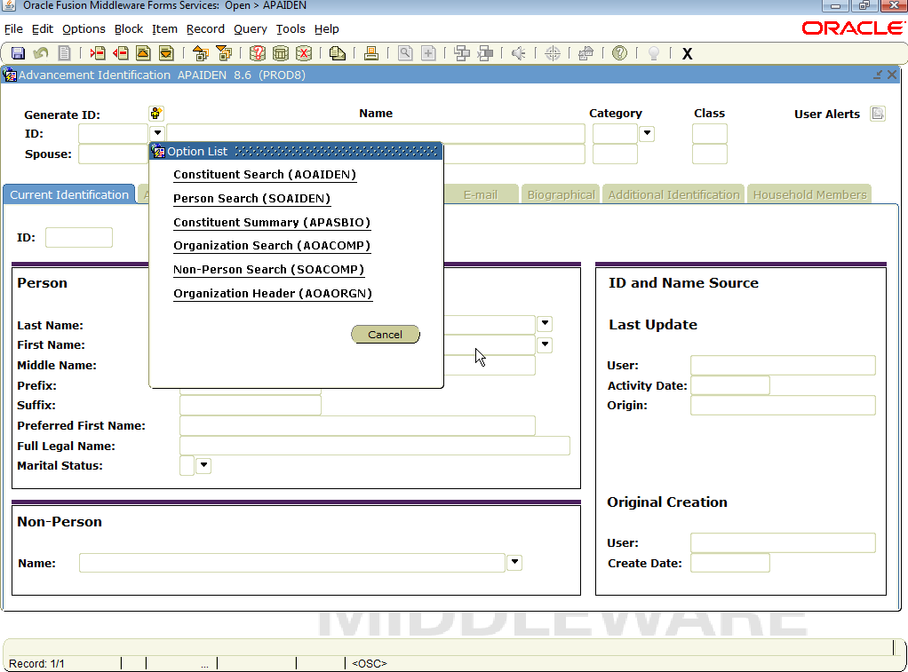
You may find the person you are searching for is not a constituent, but you have received a gift that needs to entered into Banner. The next search you would do is a Person Search.
The person could be in Banner, just not as a constituent, so you should ALWAYS do a person search if you do not find them on the constituent search form before entering them as a new ID in Banner. They may already exists in Banner, just not as a constituent.

Slide 28
You will see SOAIDEN, the Person Search form. You are in Query mode when you enter this form.
Enter the last name of the person and the first initial of what may be the first name followed by the % sign, which is a wildcard in Banner. In this example, I am looking for John Banner.
This query is asking for anyone with the last name of Banner and anyone who has a first name that begins with the letter J. Execute the query to see results.

Slide 29
NOTE: You should always perform a second query to ensure you have or have not located the person you are looking for. The name sent in on the check could actually be their middle name. So perform another query as shown:
The query is executed and finds no results for someone with the last name of Banner and a middle name that begins with the letter J.
So if you were looking for John Banner, then you have not found anyone with that name in the system and it is ok to create the ID using the Common Matching process.

Slide 30
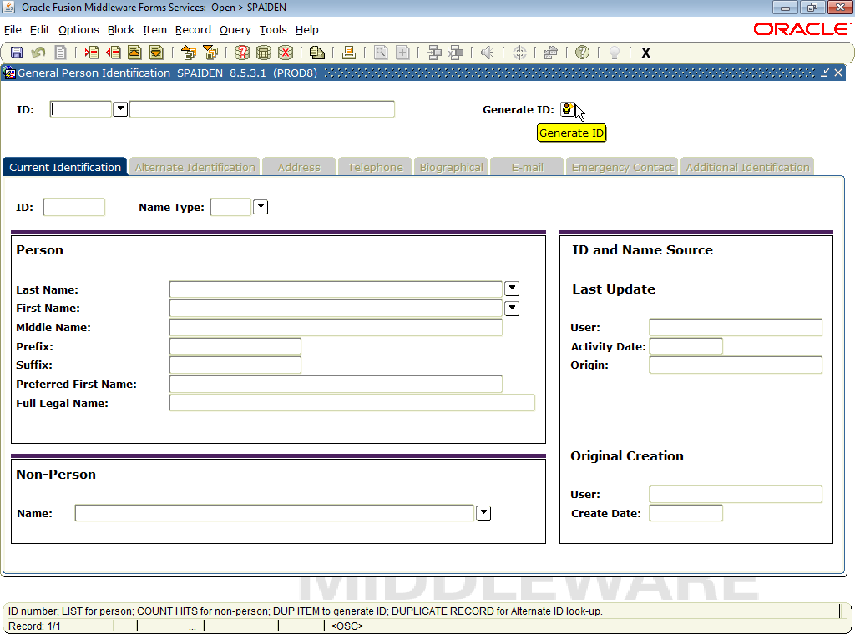
Common Matching Process
The Common Matching process checks for existing identification records before a new one is added to the database.
To begin the process, click on the Generate ID: icon

Slide 31
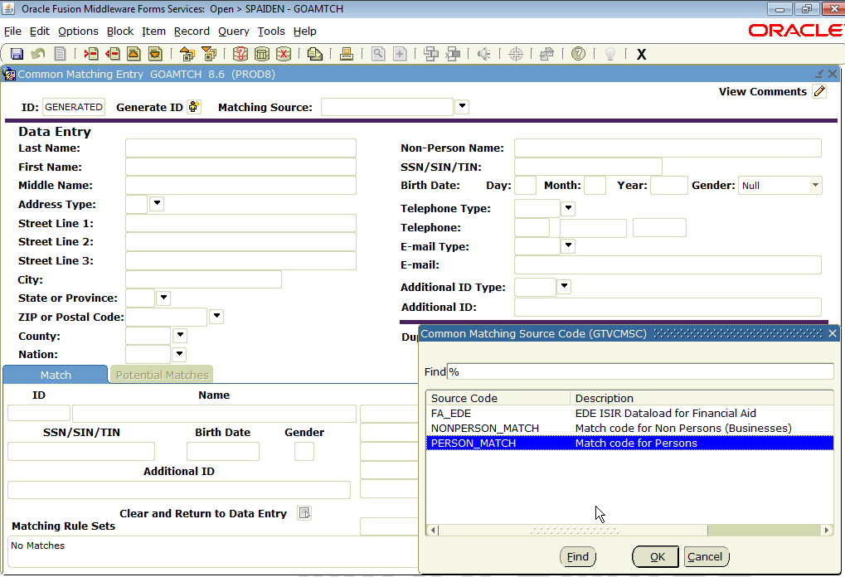
Click on the Matching Source dropdown and choose Person_Match then press OK.

Slide 32
Enter the Last Name, then do NEXT BLOCK to see if there are any possible matches.

Slide 33
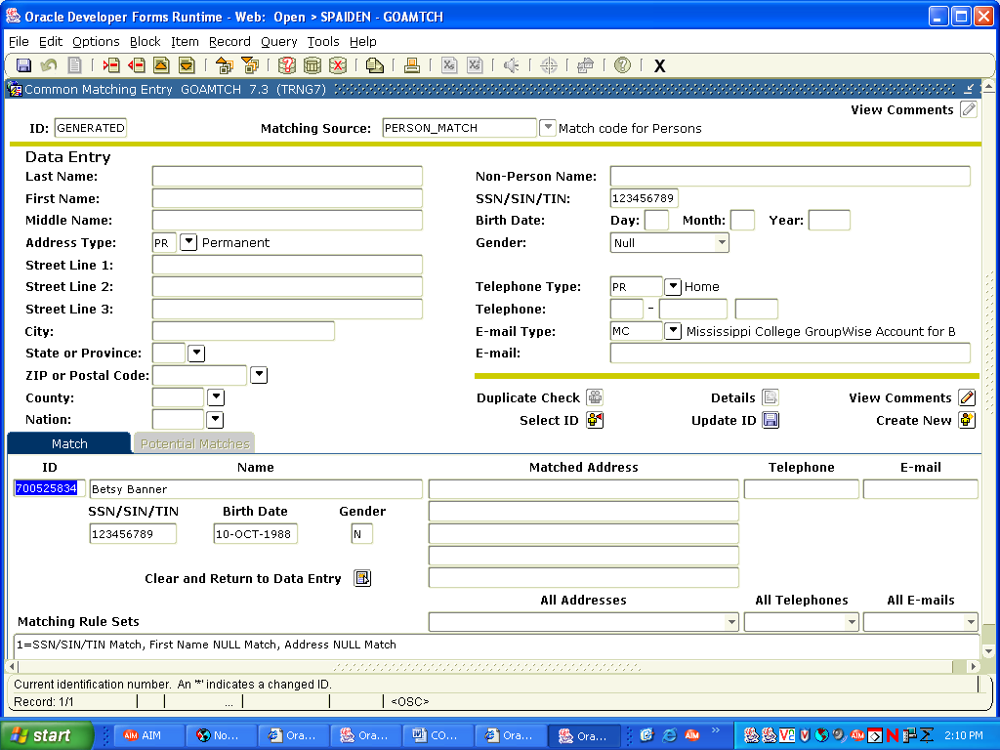
If there is no match, return to the Last Name field, blank it out, and enter the SSN number if you have it, and NEXT BLOCK to see if you find a match.

Slide 34
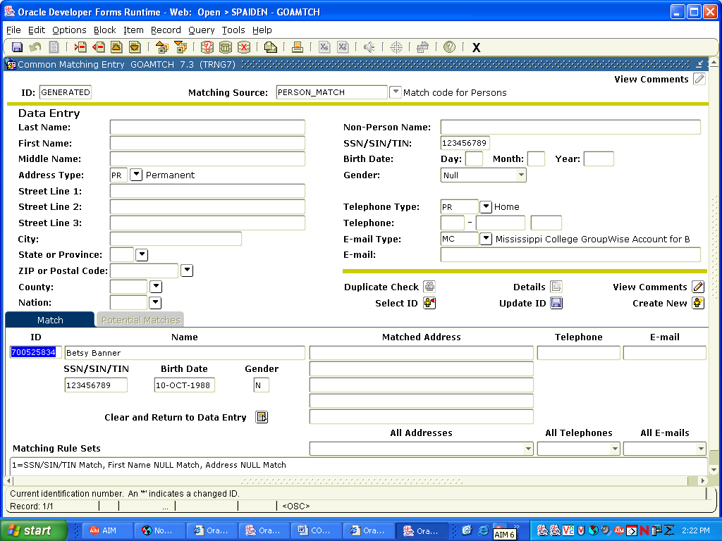
If the Potential Match that displays is your person, then highlight the name of the person in the Potential Match box and click the Select ID icon.

Slide 35
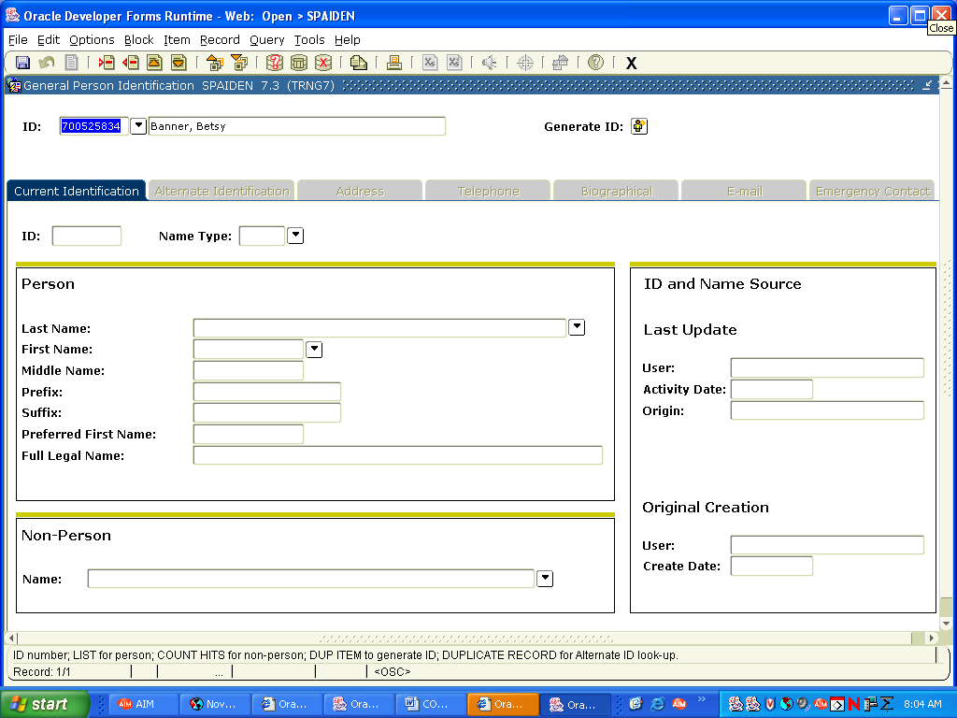
Once you click the Select ID icon, you will be returned to the Identification form and you can continue to update the information on the person.

Slide 36
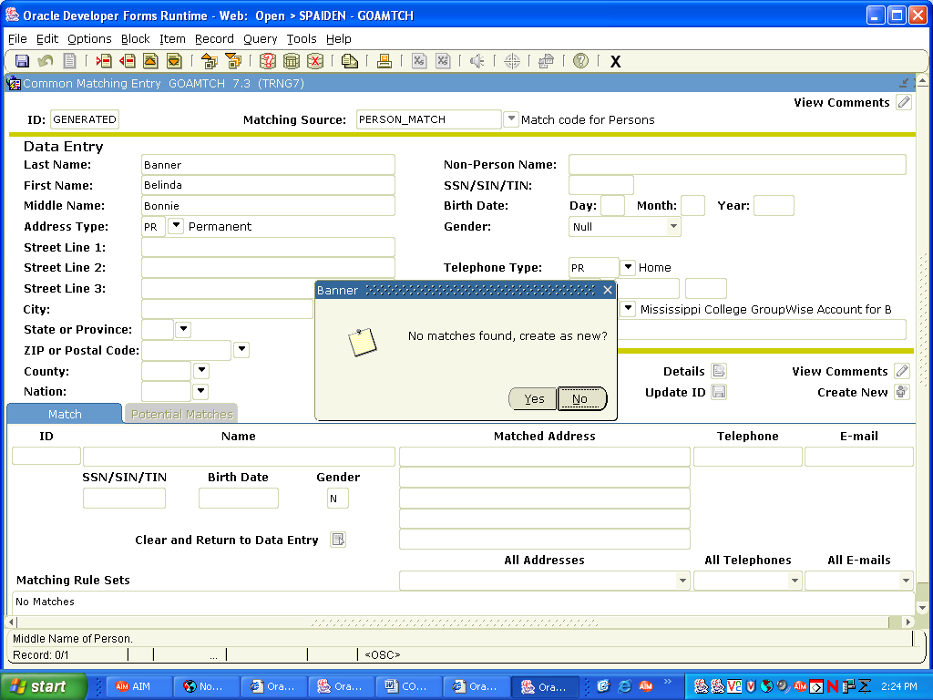
If you did not get a match, press Page Up, remove the SSN and enter the complete name of the person. NEXT BLOCK. If there is no match, you will receive this message. If you feel you have exhausted your search and have not found the person and know that you must generate an ID for the person, then click Yes. NOTE: Always make sure the word GENERATED is in the ID field before pressing Yes.

Slide 37
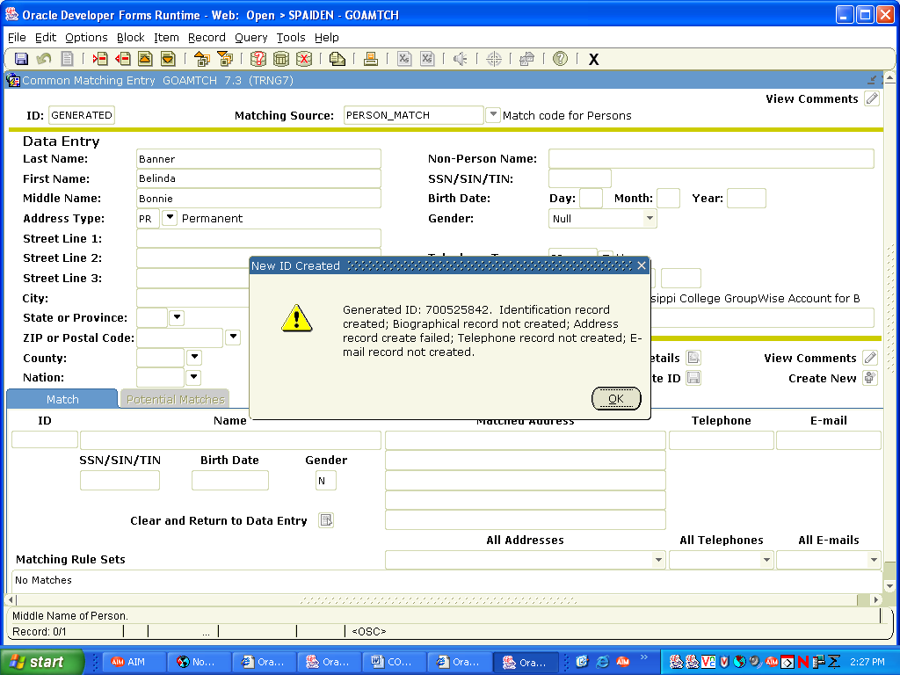
Once you say Yes, you will receive this message. Click OK and you will be returned to the Identification for to continue entering information on the person.

Slide 38
Where Do I Find It?
Donor Category/Class Year – APACONS
Address/Telephone/Email Info – APAIDEN
Organization Info - AOAORGN
Gift Info – AGCGIFT
Pledge Info – AGCPLDG
Giving History – APAGHIS
Contact Reports – AMACONT
Academic Info – APAADEG
Cross Reference Info – APAXREF
Employment History – APAEHIS
Summary Info – APASBIO
Salutations, Exclusion Info – APAMAIL
Combined Mailing Info – APANAME
Activity Info – APAACTY
Designation Info – ADADESG
Campaign Info - AFACAMP

Slide 39
QUESTIONS?
Thank you for attending this session!
Cindy Hampton
Mississippi College
Hampton@mc.edu

