Slide 1
MBUG 2014
Session Title: Reqs to checks
Presented By: Amanda Burgess and Helen Callahan
Institution: Mississippi State University
September 15, 2014

Slide 2
Session Rules of Etiquette
Please turn off your cell phone
If you must leave the session early, please do so discreetly
Please avoid side conversation during the session

Slide 3
Reqs to checks
MSU enhancements

Slide 4
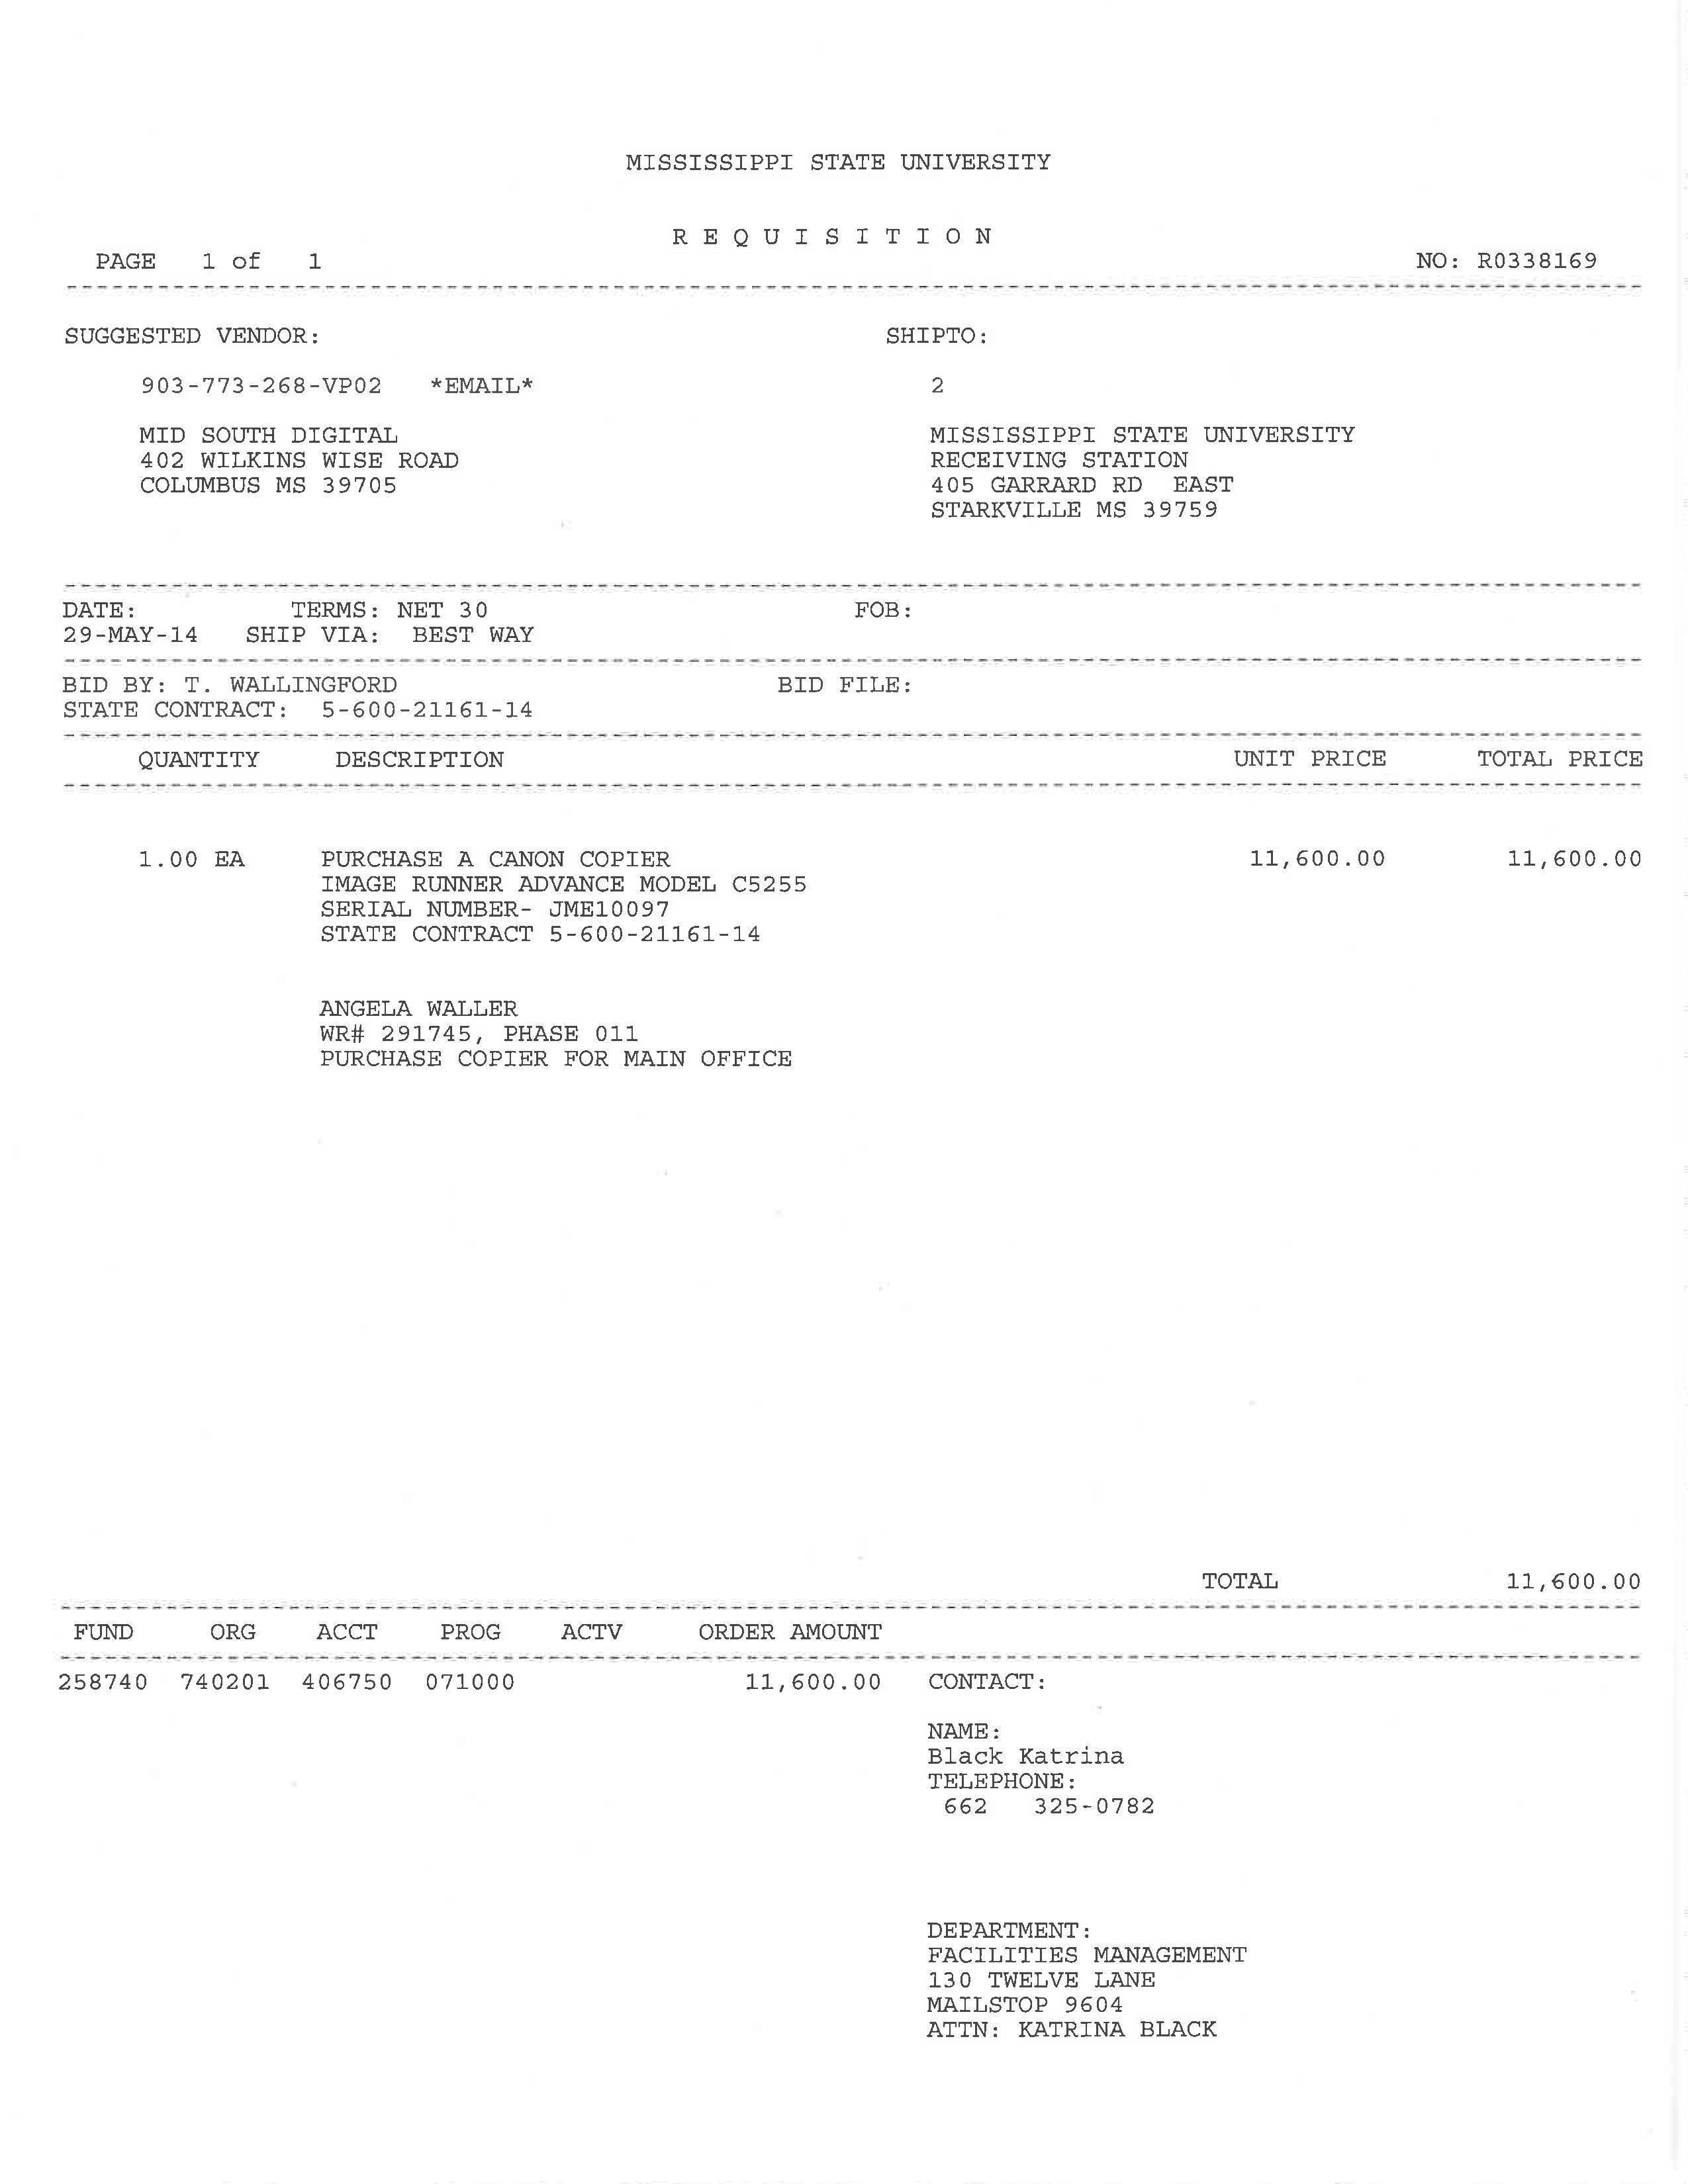

Slide 5
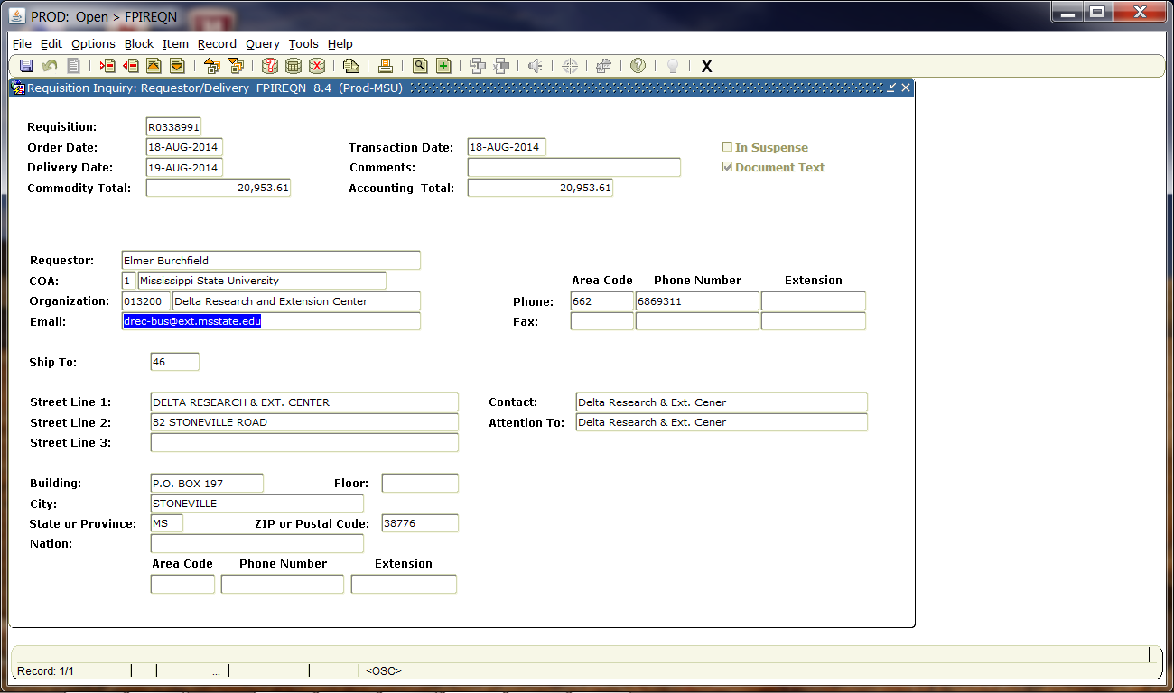

Slide 6
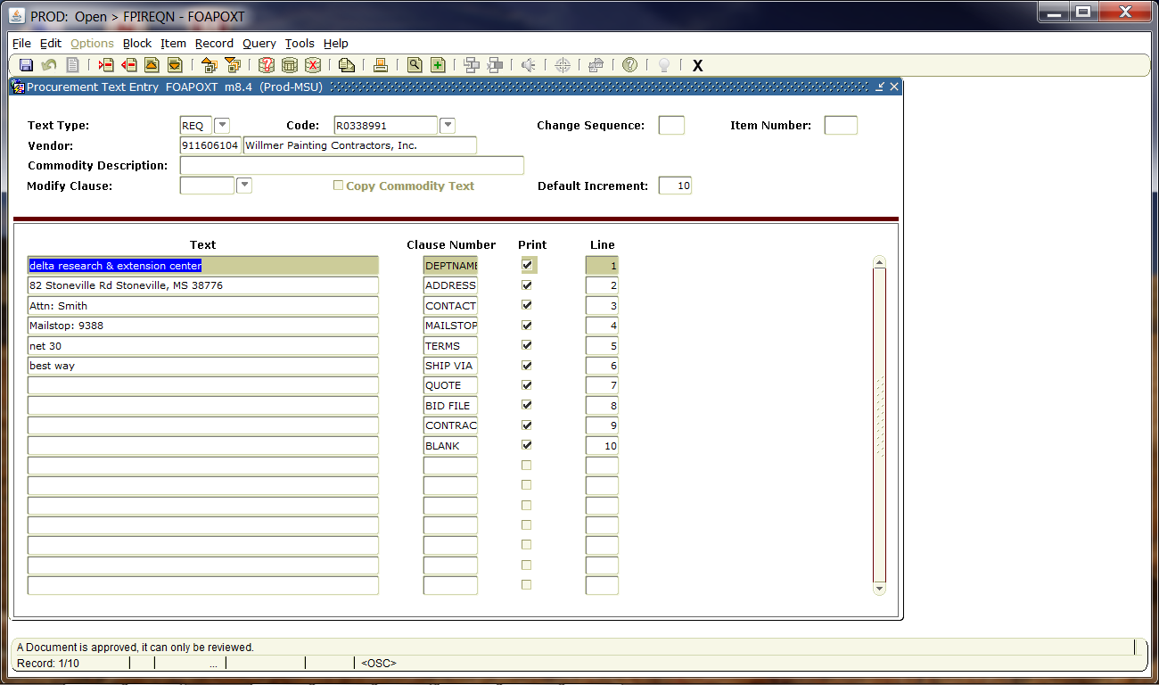

Slide 7
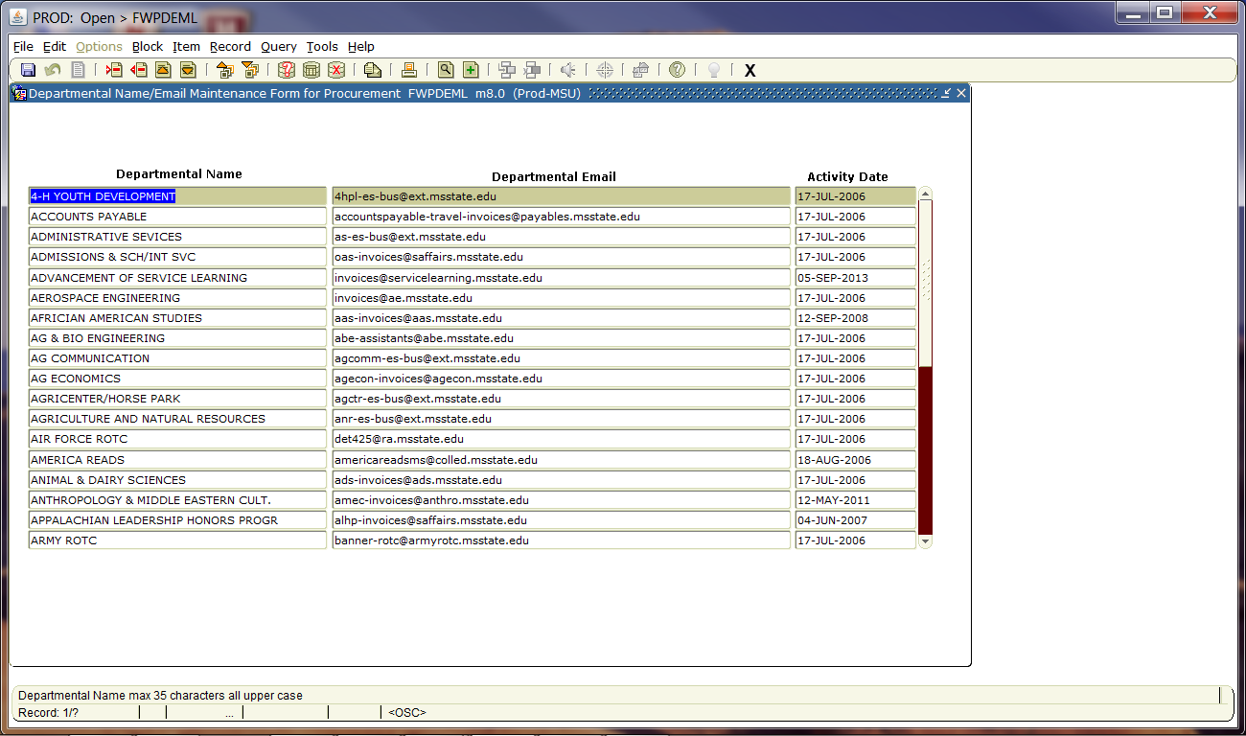
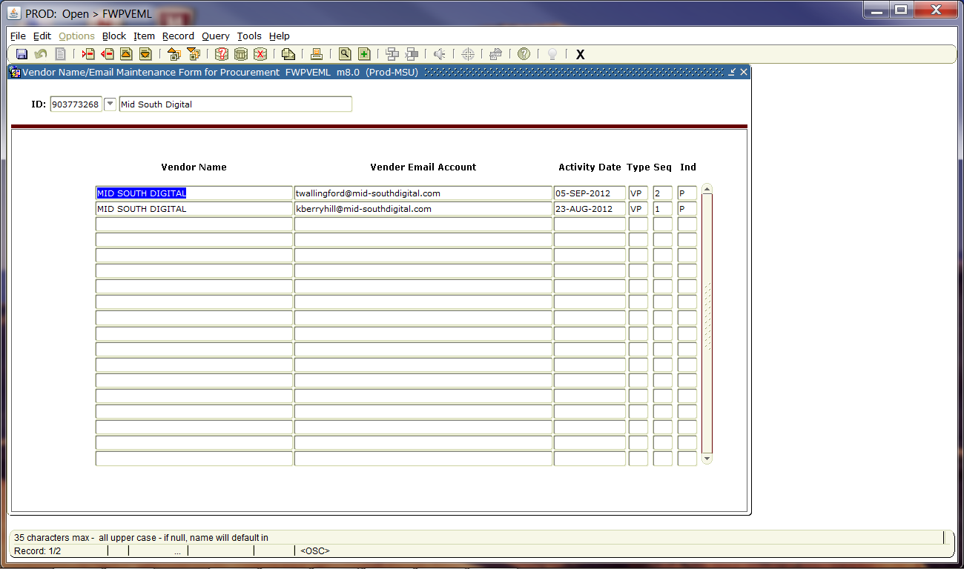
DEPARTMENTAL & VENDOR EMAILS

Slide 8
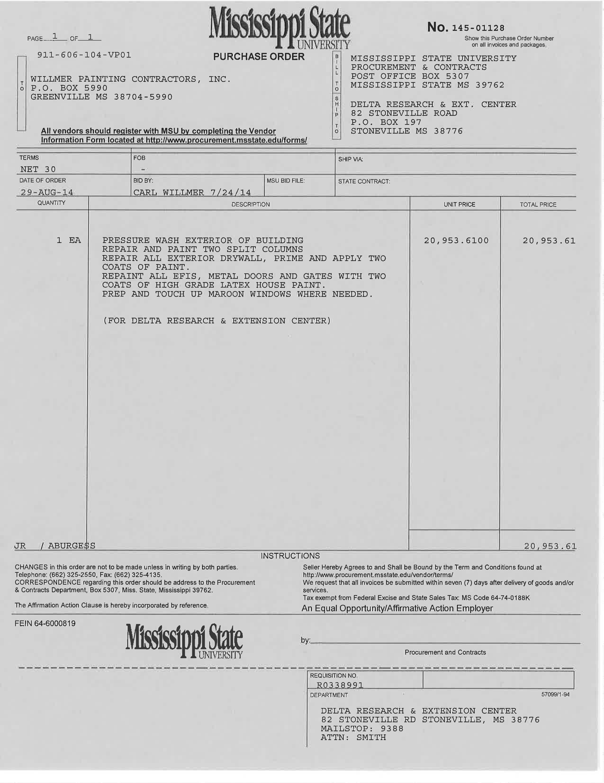
PURCHASE ORDERS

Slide 9
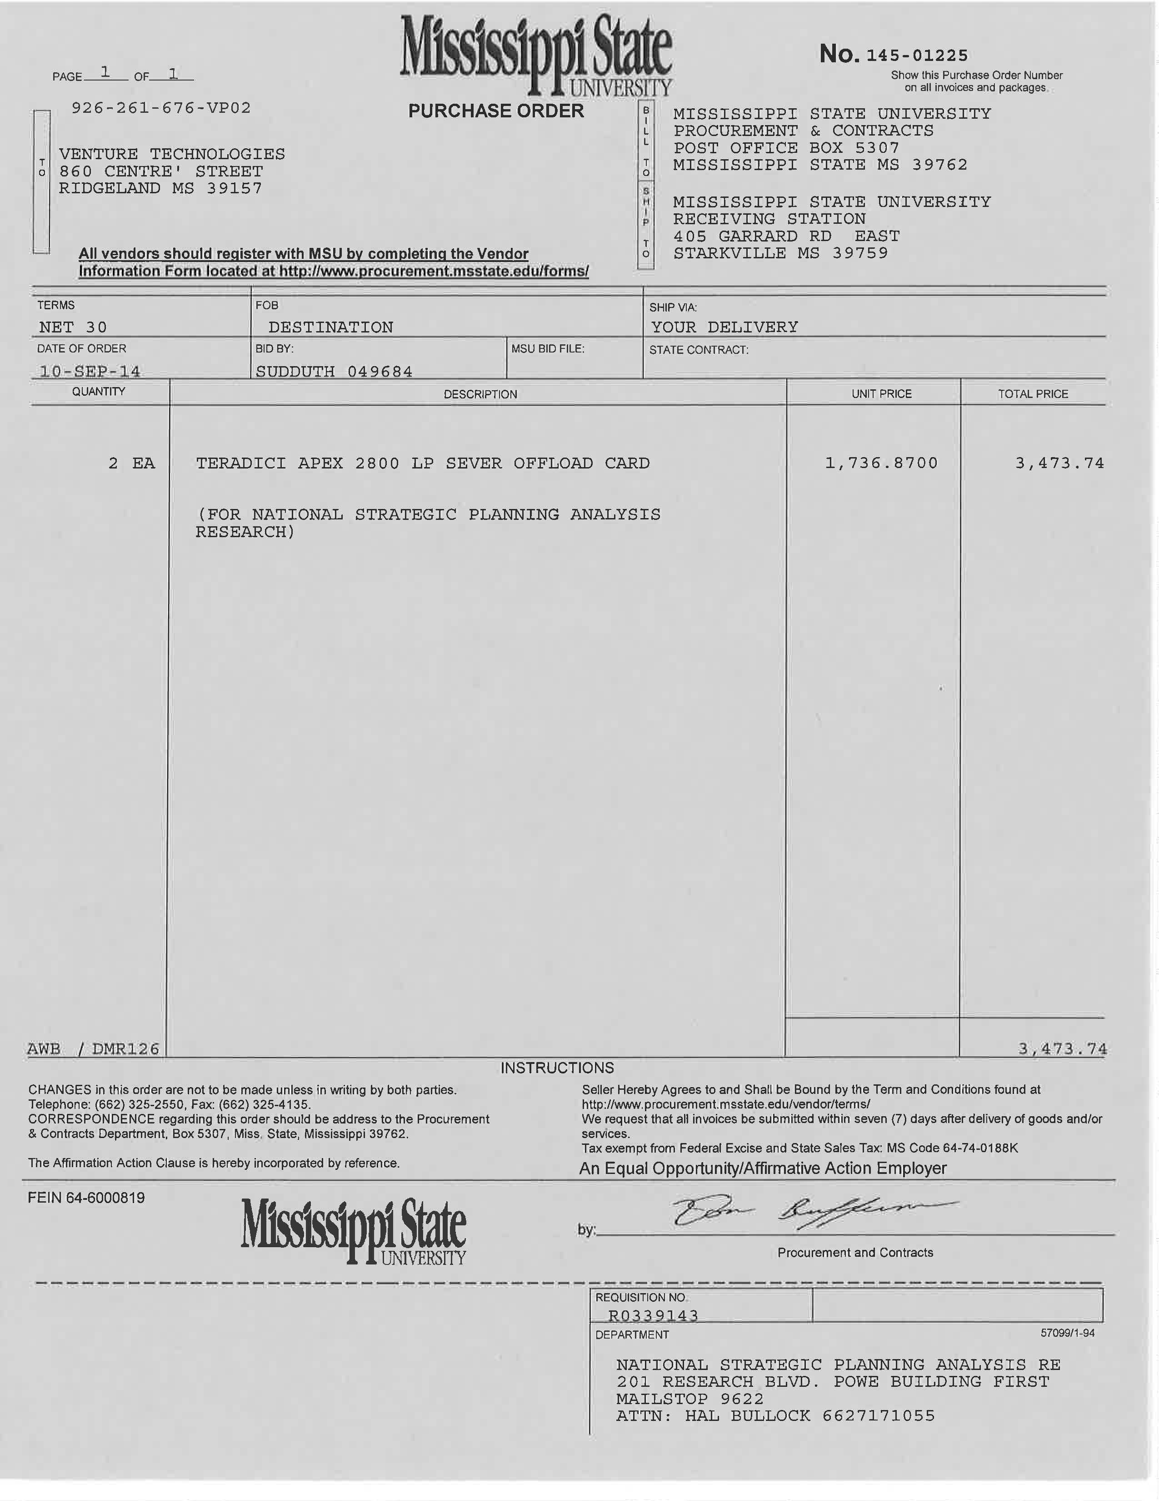
PURCHASE ORDERS

Slide 10
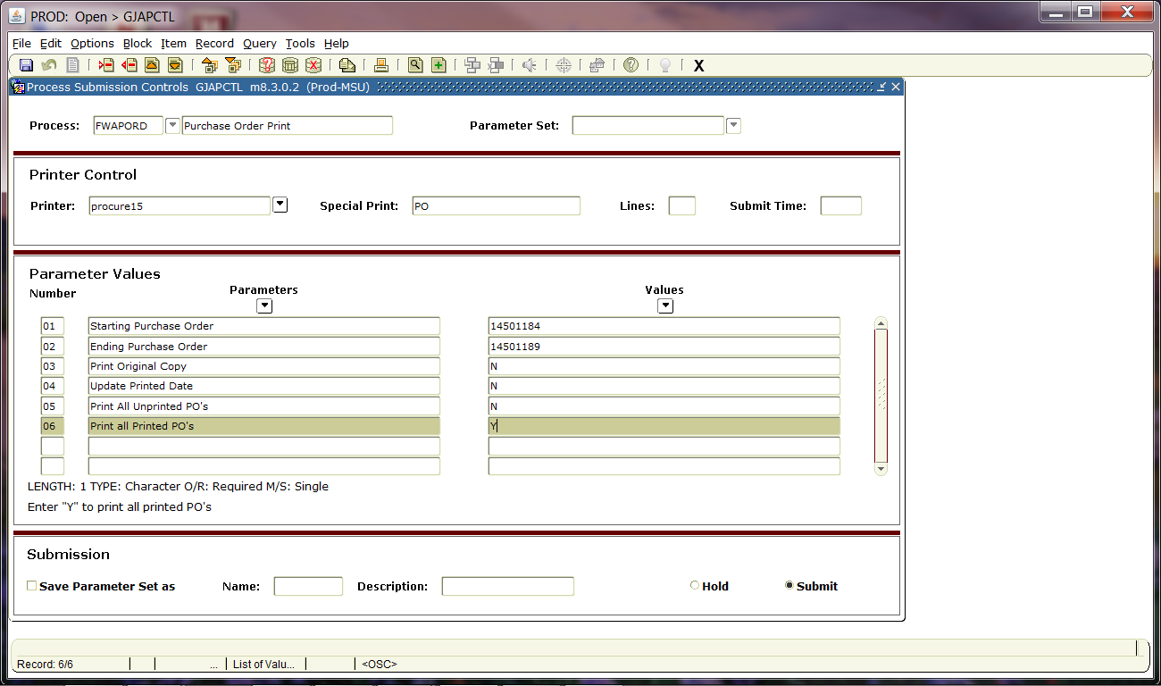
PRINTING AND EMAILING PURCHASE ORDER

Slide 11
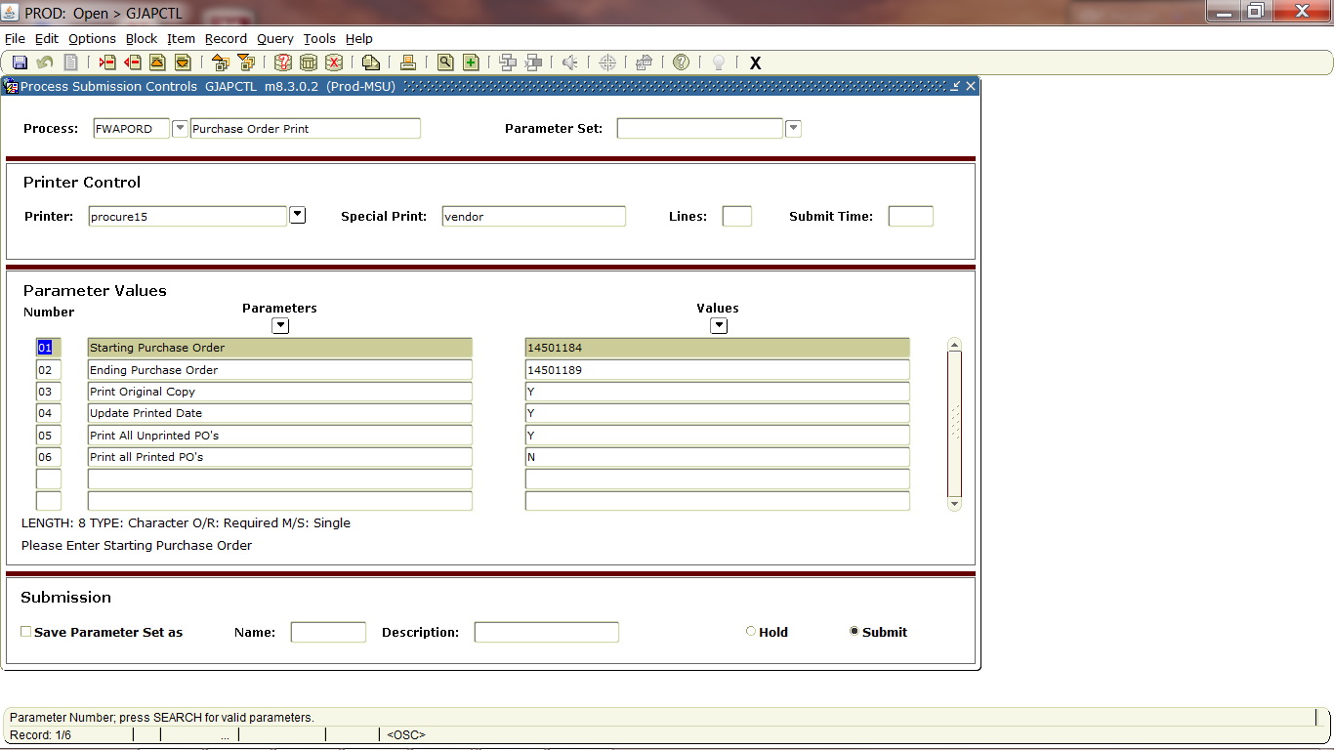

Slide 12
Questions
&
Answers

Slide 13
Purchase orders to checks

Slide 14
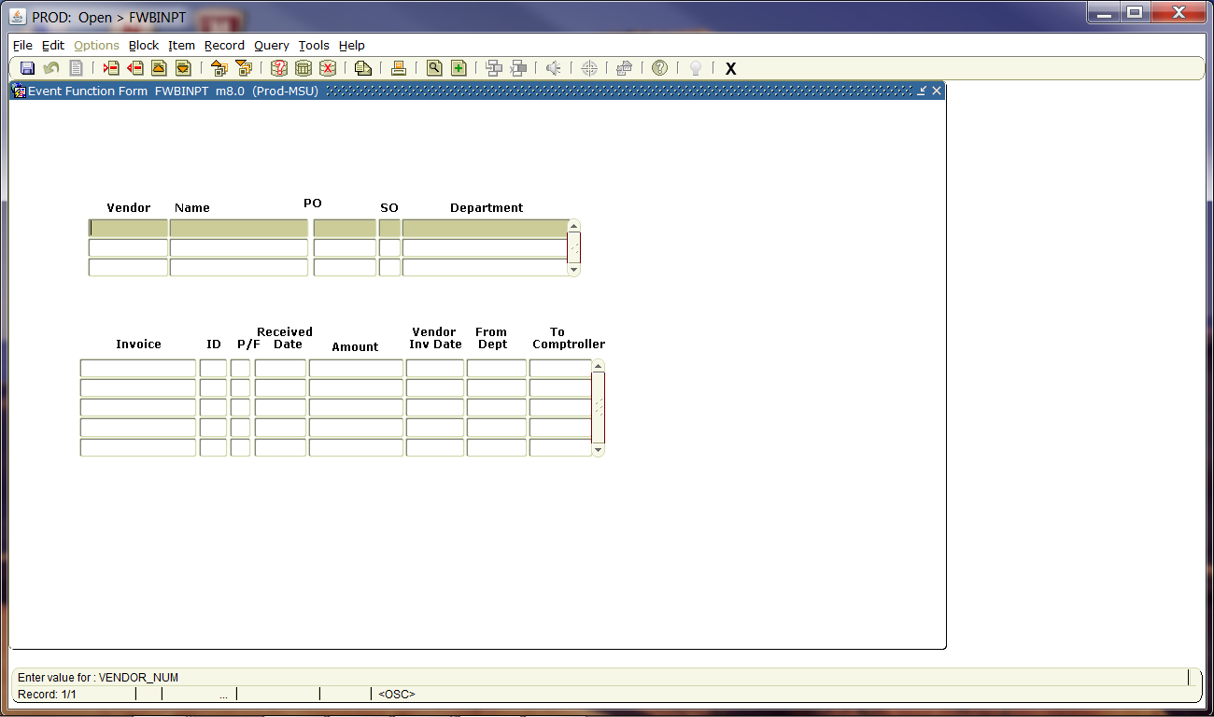
INVOICE TRACKING

Slide 15
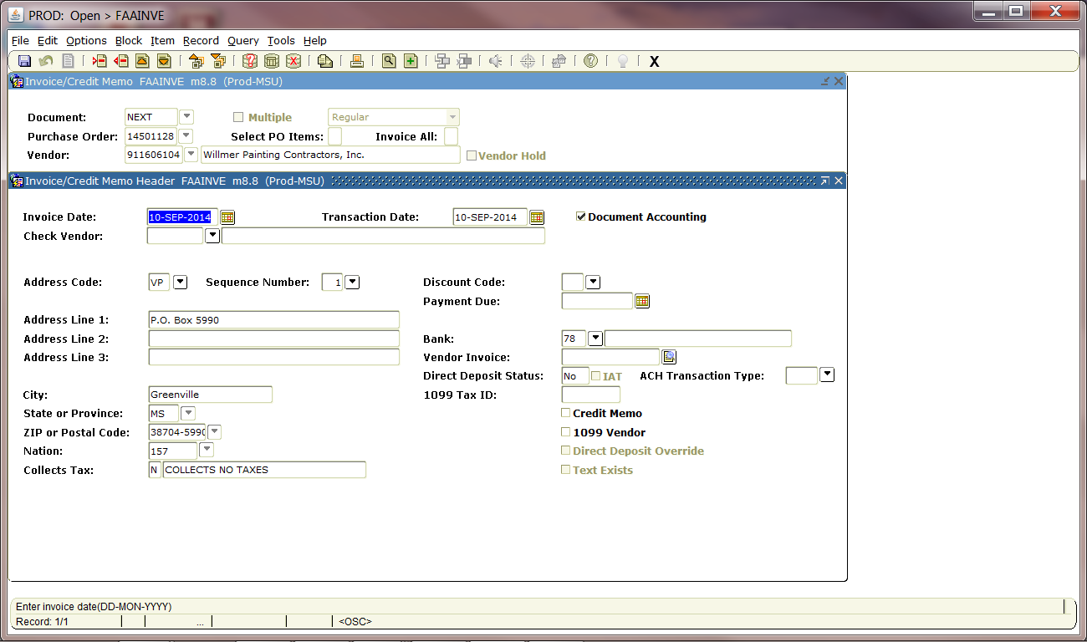
Keying invoice for payment

Slide 16
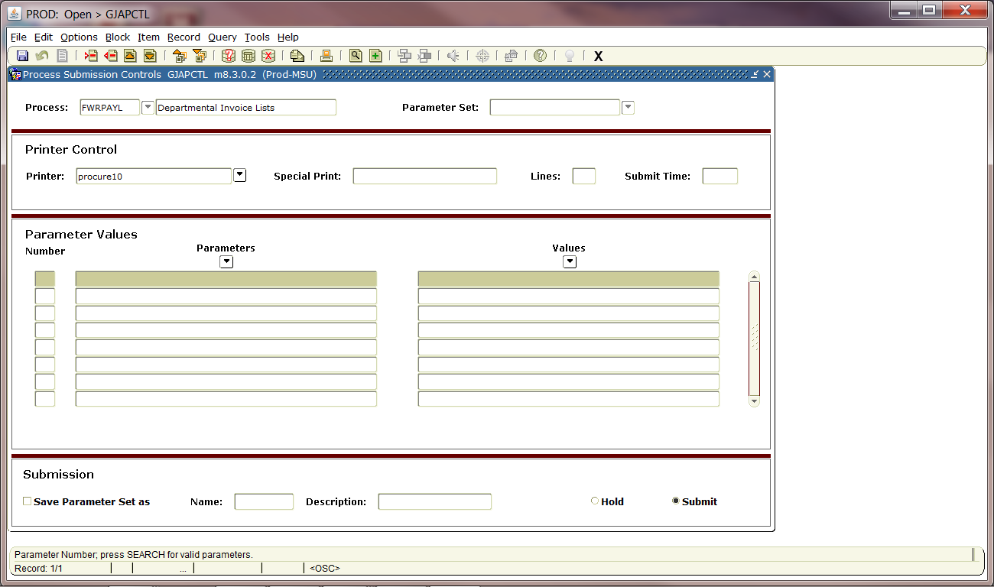

Slide 17
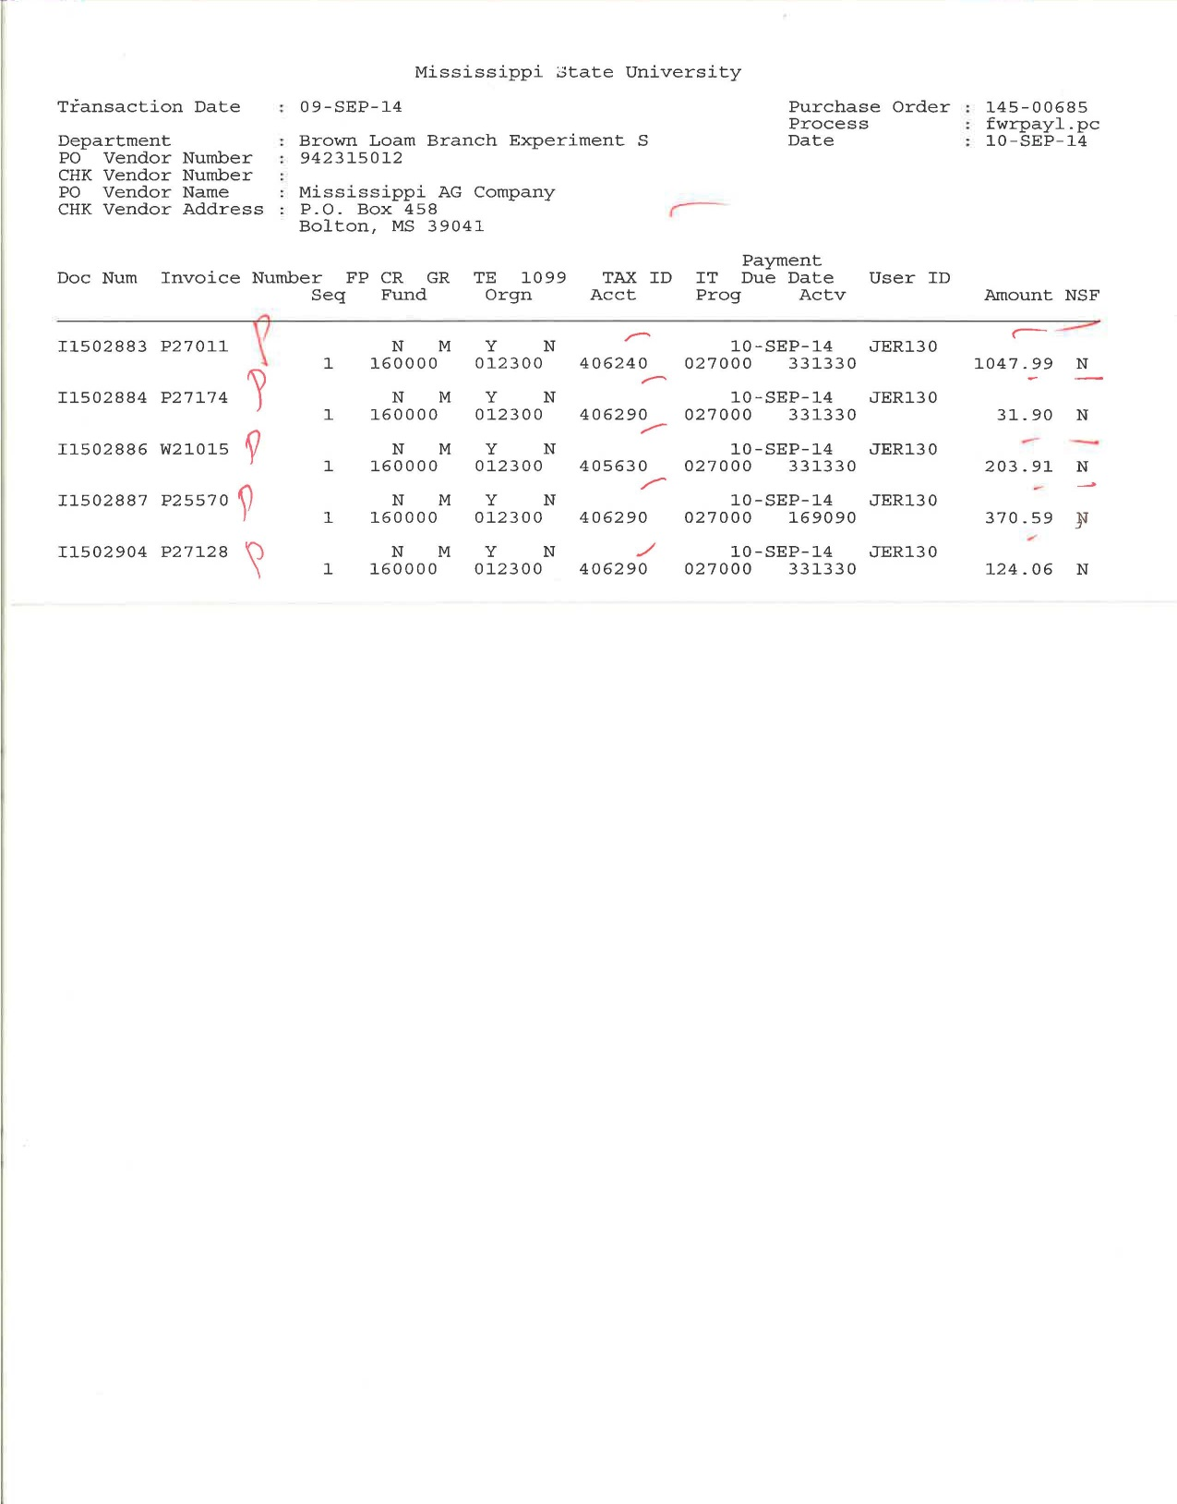

Slide 18
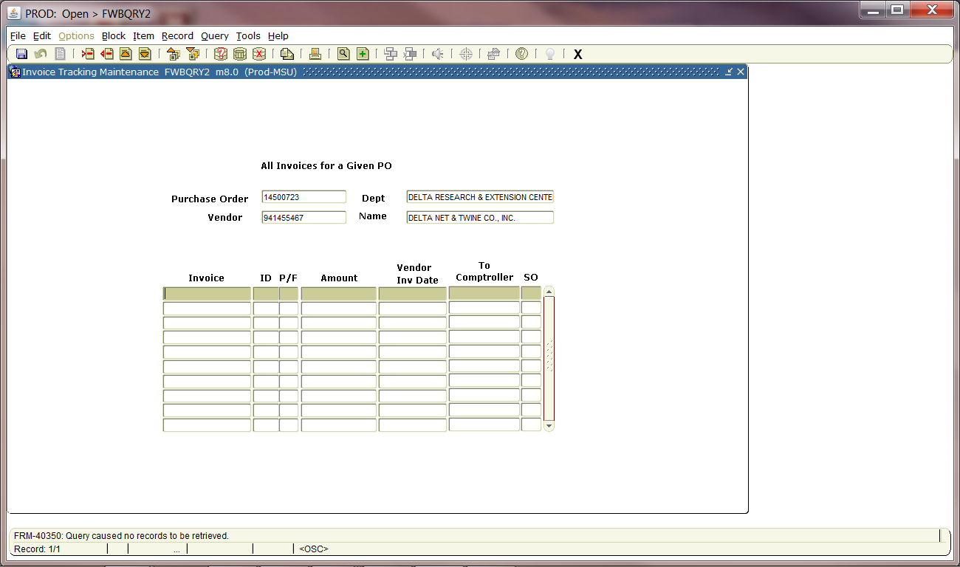
Updating status of an invoice

Slide 19
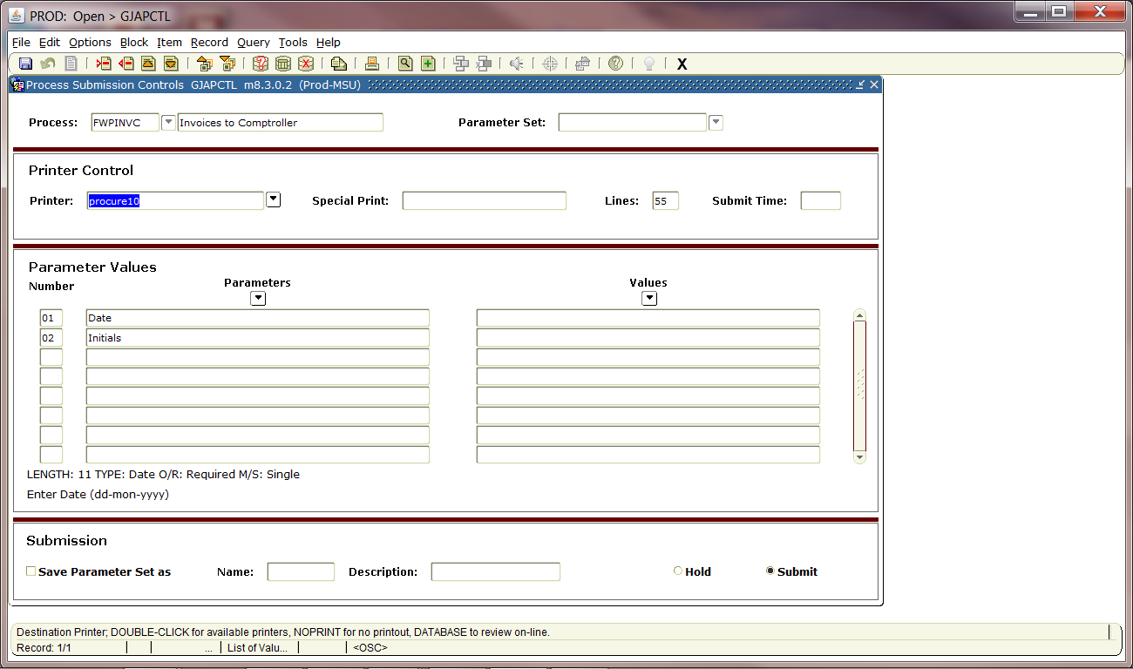

Slide 20
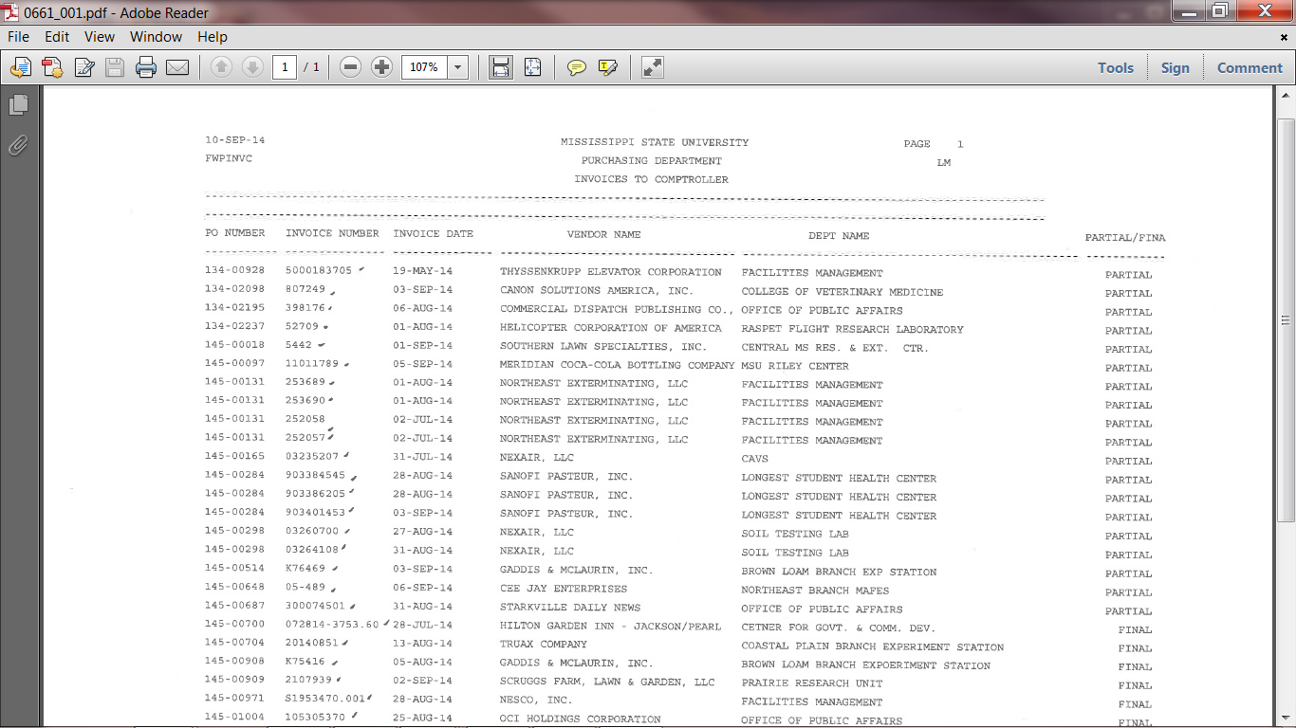

Slide 21
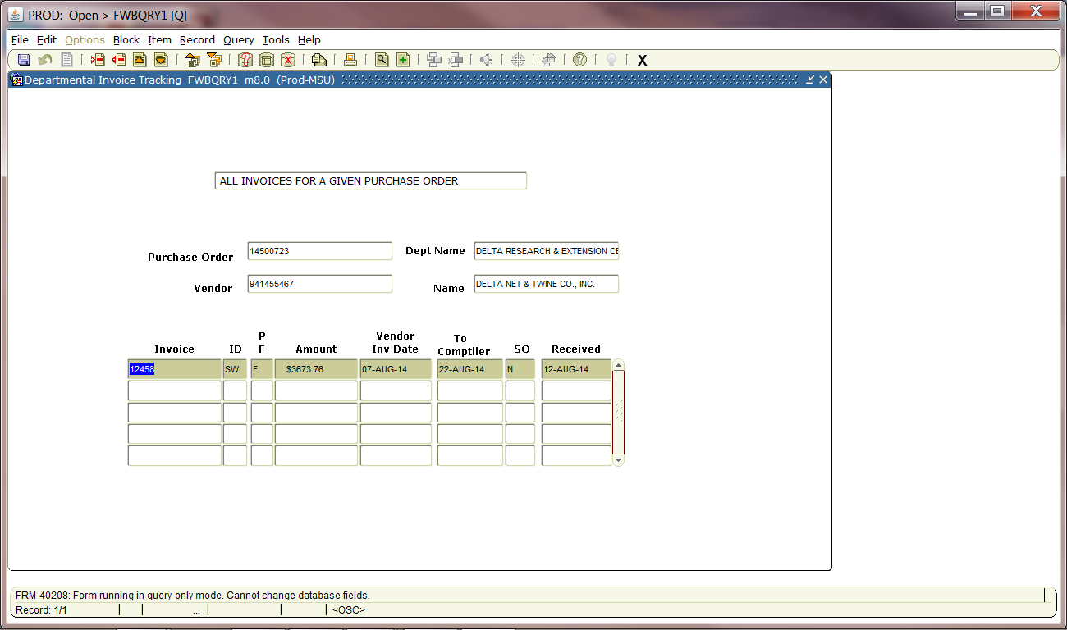

Slide 22
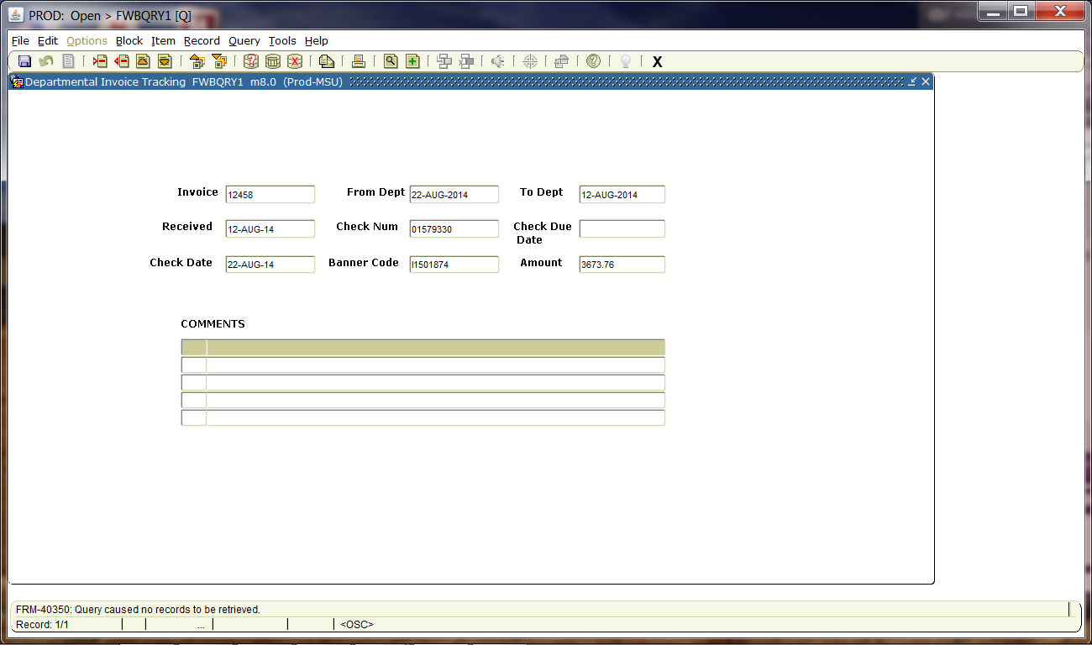

Slide 23
QUESTIONs & ANSWERs

