Slide 1
Delta State University- Justin Chandler & Rhonda Loper
Reporting Data Using ARGOS
X

Slide 2
Data Integrity
Live data vs. frozen data….when to use what?
Forms in Banner to pull data
Uniform reporting across campus

Slide 3
Convenience
Uniform reporting across campus
Ease of report building…combining elements
Simplifies process of finding data

Slide 4
OIT
Be specific…know your own data
Imagine the end results…know where the data comes from
It’s an ongoing process
A special thanks to Ms. Pat Vaughn our Programmer/Analyst *(ARGOS Guru) who assisted us with this presentation.

Slide 5
Future of Argos at DSU
Deans, chairs, secretaries access
Removing Eris…transfer all reports to Argos
Campus-wide training sessions

Slide 6
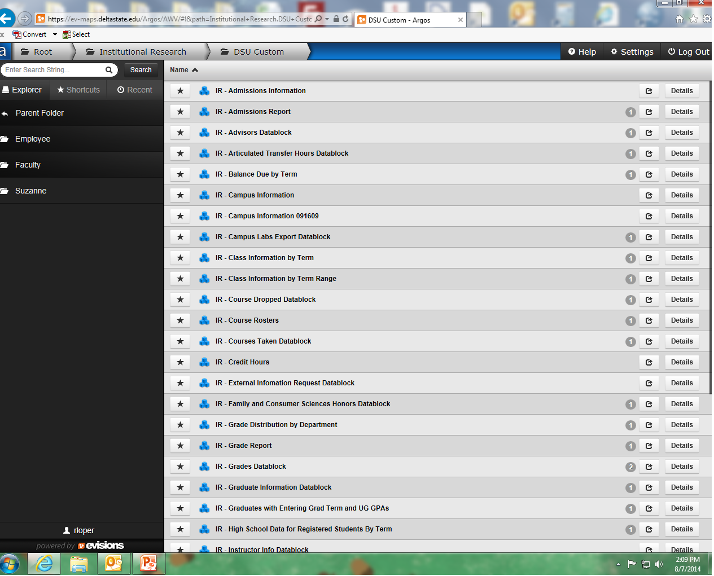

Slide 7
A Closer Look at ARGOS
https://ev-maps.deltastate.edu/Argos/AWV/

Slide 8
Thank you for logging into our program today.

