Slide 1
MBUG 2014
Session Title: Payroll Deductions Beginning to End
Presented By: Donna Switzer, Payroll Manager
Institution: Mississippi State University
September 15, 2014

Slide 2
Session Rules of Etiquette
Please turn off your cell phone
If you must leave the session early, please do so discreetly
Please avoid side conversation during the session

Slide 3
Payroll Deductions Beginning to End
Basic Deductions such as Federal and State Tax Withholding
Add/Replace Functions
Self-Adjusting Deductions
Nonresident Alien Taxation
Problem Solving

Slide 4
Setting Up Banner Deductions
Child Support
Garnishments
Taxes
Required
Deductions
Voluntary
Deductions

Slide 5
Required Deductions
Basic:
Federal and State Taxes
Social Security and Medicare Taxes
Retirement, Tax Liens, Garnishments,
Child Support, Bankruptcies

Slide 6
Voluntary Deductions
Basic:
Credit Union
United Way
Annuities

Slide 7
SETTING UP BASIC DEDUCTIONS
PDADEDN (Form where basic deductions are set up)
You can activate and terminate any deduction here.
FED - Federal Tax
STX - State Tax
FIC -Social Security Taxes
FIA - New Social Security Taxes
FIM- Medicare Taxes
MGV - Garnishments

Slide 8
EXAMPLE OF A BASIC
FEDERAL DEDUCTION SET UP

Slide 9
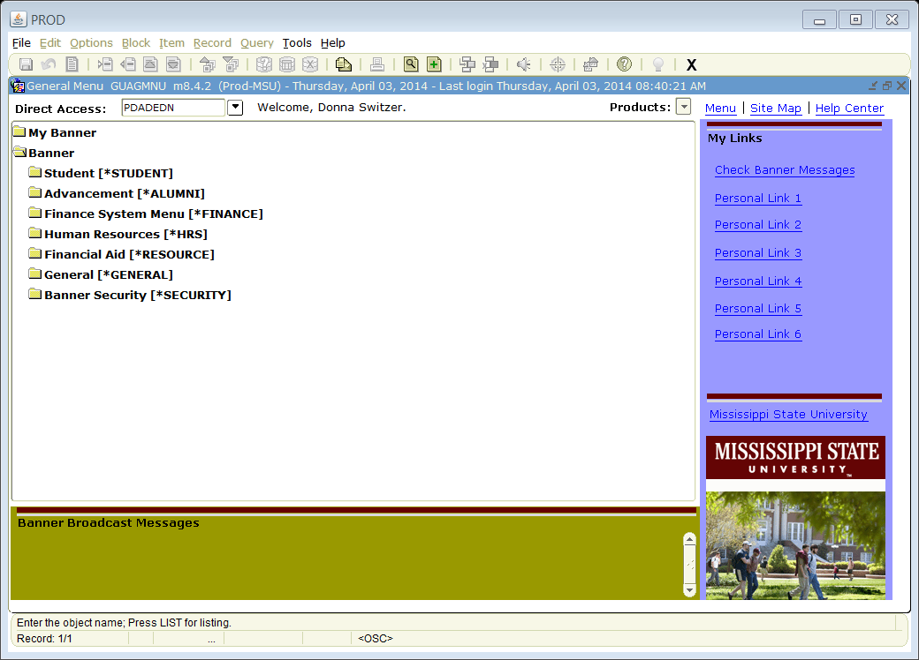
‘
PDADEDN

Slide 10
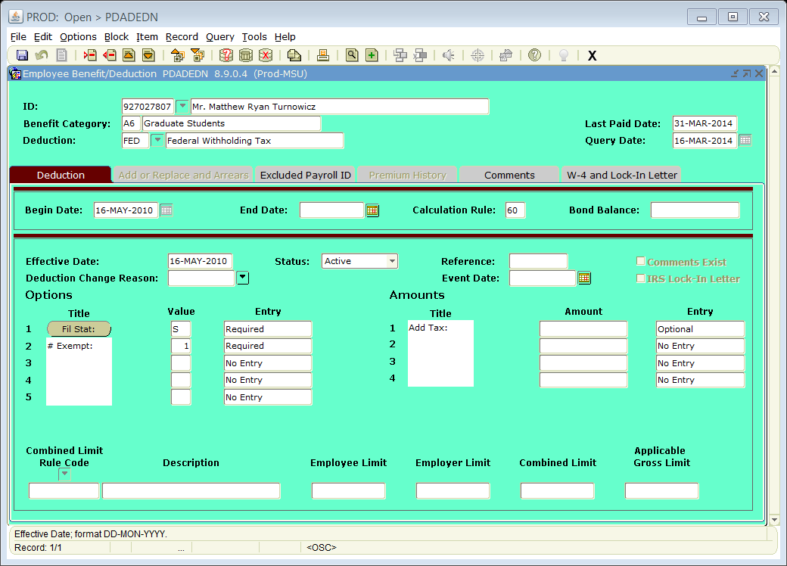
12345 Ms. Minnie Mouse
Minnie Mouse has been using Single, 1, since May 16, 2010. She wants to make a change.

Slide 11
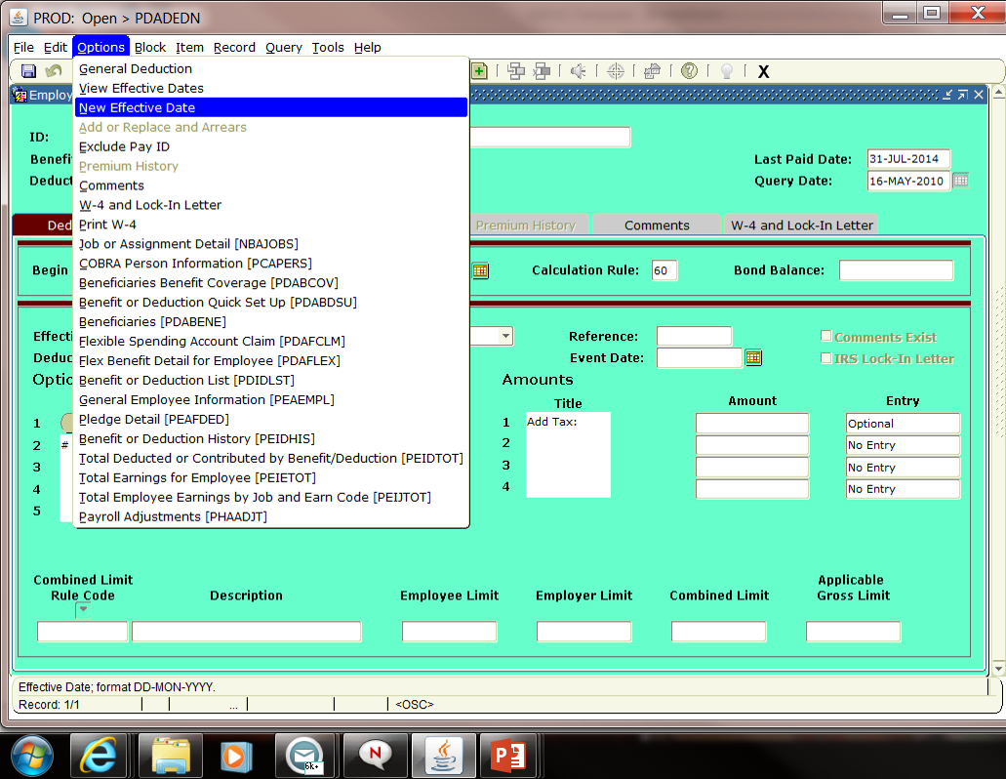
Go under OPTIONS, and click on “NEW” Effective Date
Notes:
We want to set up this deduction before time is pulled.

Slide 12
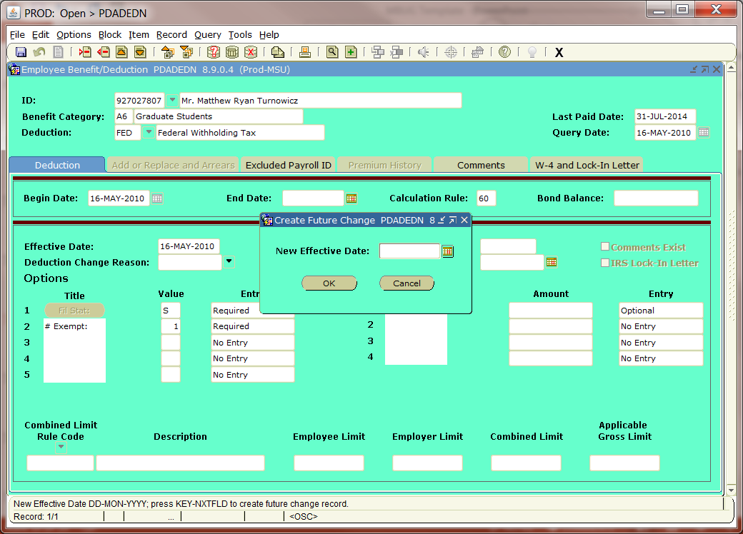
12345 Ms. Minnie Mouse
Insert “New” Effective Date in above box

Slide 13
12345 Ms. Minnie Mouse

Slide 14
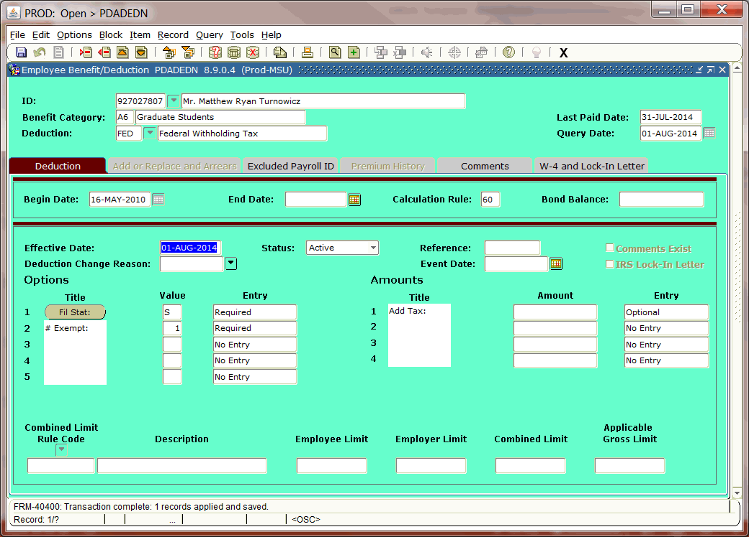
Ms. Minnie Mouse
2
Minnie Mouse now has a new 01-Aug-2014 record for Single, 2 exemptions. Save and you are done.

Slide 15
Example of Garnishment
Deduction

Slide 16
Garnishments can be deducted with three possibilities or a combination thereof:
25% of Disposable Wages
15% of Disposable Wages
10% of Disposable Wages

Slide 17
Most standard garnishments run 25% of disposable wages.
Most School loans begin at 15%.
If you have both a defaulted school loan garnishment (15%) and later receive a standard garnishment (25%) loan, guess how much you can deduct?
You can deduct both a 15% and a 10% garnishment to total 25%. That is all that is allowed by federal law.

Slide 18
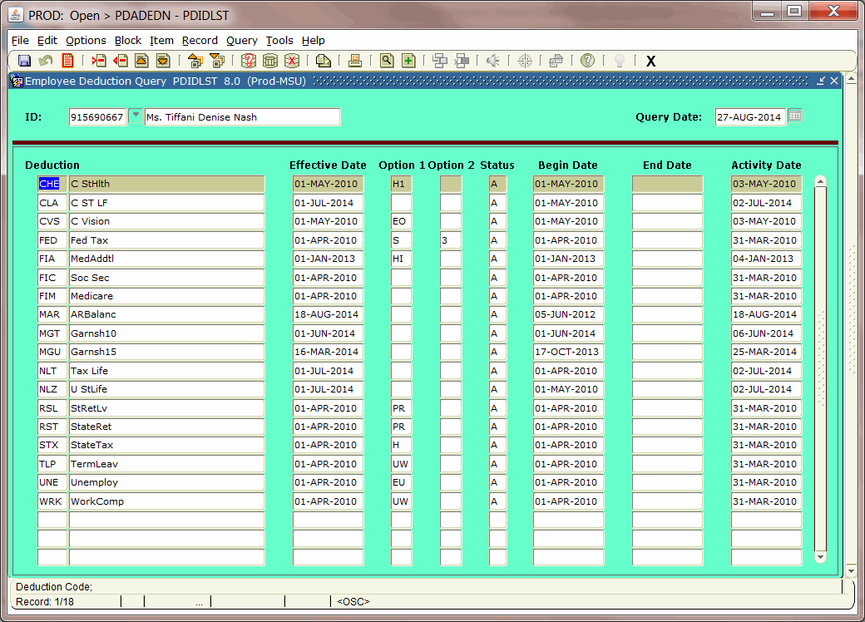
99999 Tired N. Wornout
Here we will see that we have activated and set up both a 10% and a 15% garnishment for a school loan and normal garnishment. The two combined together will only deduct 25%.

Slide 19
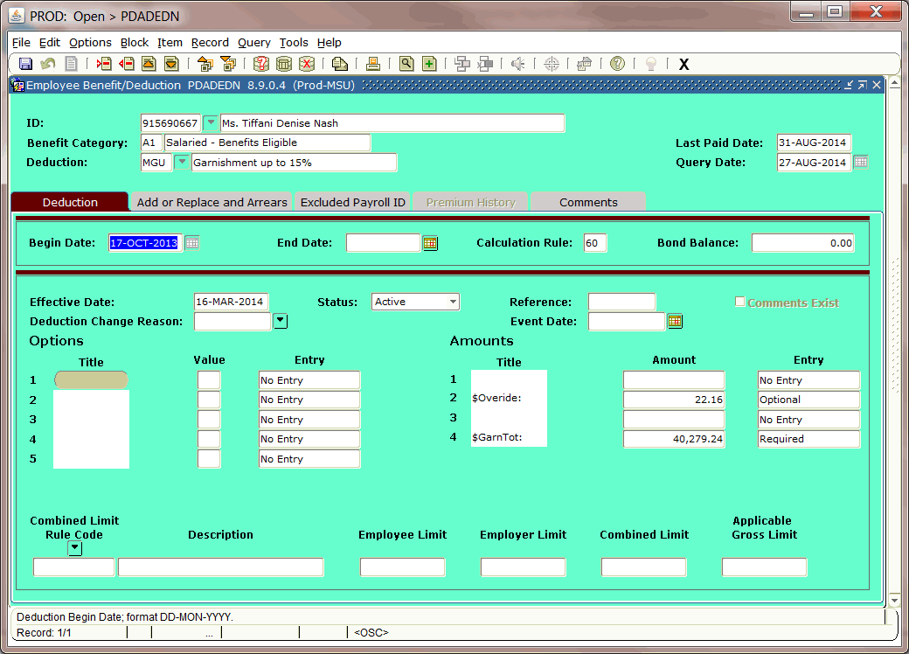
99999 Tired N. Wornout

Slide 20
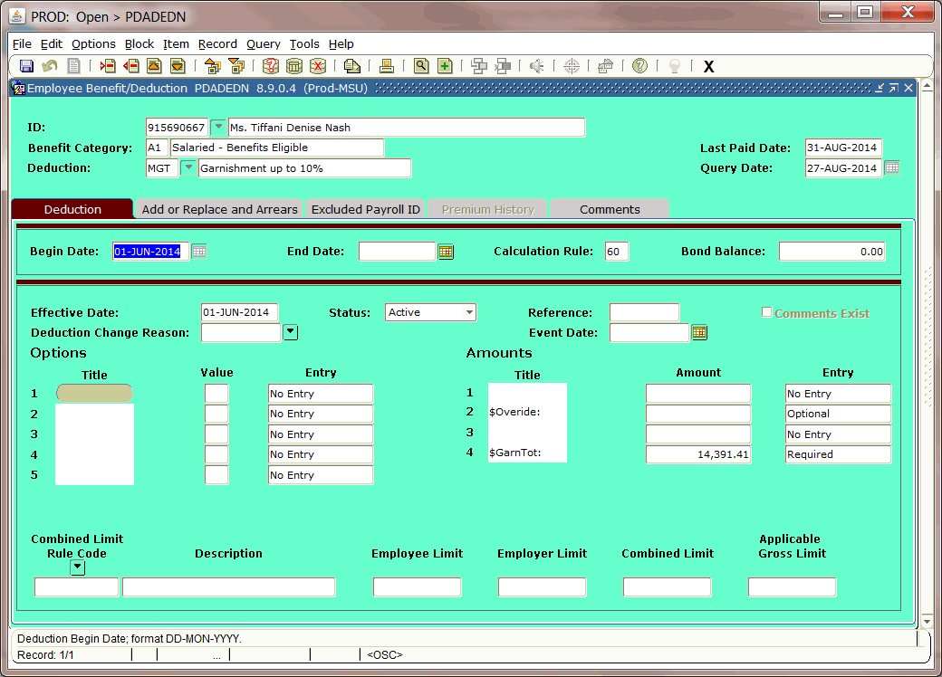
99999 Tired N. Wornout

Slide 21
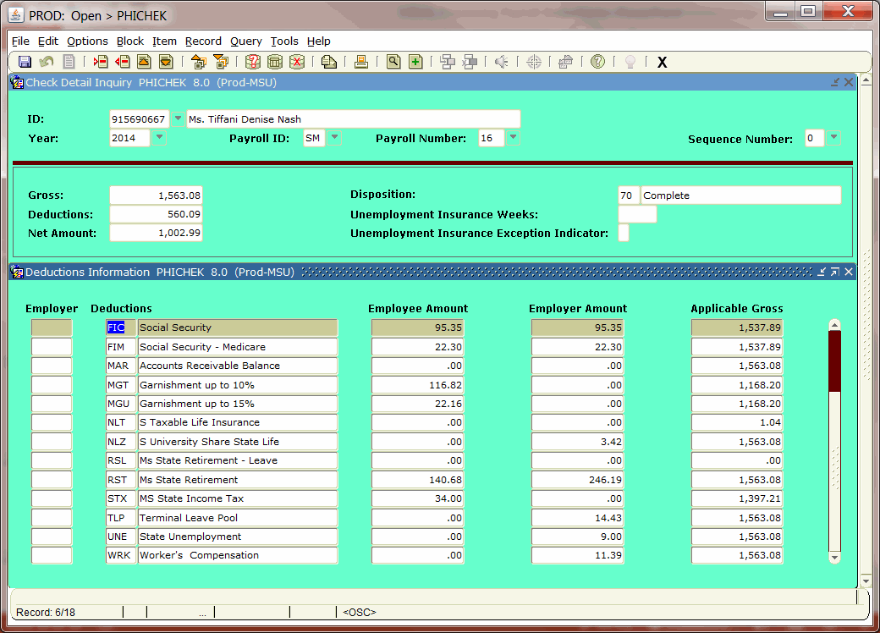
99999 Tired N. Wornout
You can see that both garnishments have been deducted. Should there have been a third, you would have to wait until one of these are finished before you could begin withholding. Remember you can only deduct 25% in total.

Slide 22
ADD/REPLACE FUNCTIONS
An Add/Replace function is a one that works for a one time change and goes away after the paycheck has been produced.
Examples: Catching up insurance, retirement or federal/state applicable gross changes.

Slide 23
Example of Retirement
Add/ Replace

Slide 24
Steps:
1. Go to PDADEDN
2. Control page down to first section.
3. Click OPTIONS
4. You will see the add/replace section.
5. Complete the Employee Deduction, Employer Deduction, and Applicable Wages section with SM (semi-monthly) if you pay twice per month.
6. When time has been calculated, this one time add/replace section will disappear.

Slide 25
Step 1 - PDADEDN

Slide 26
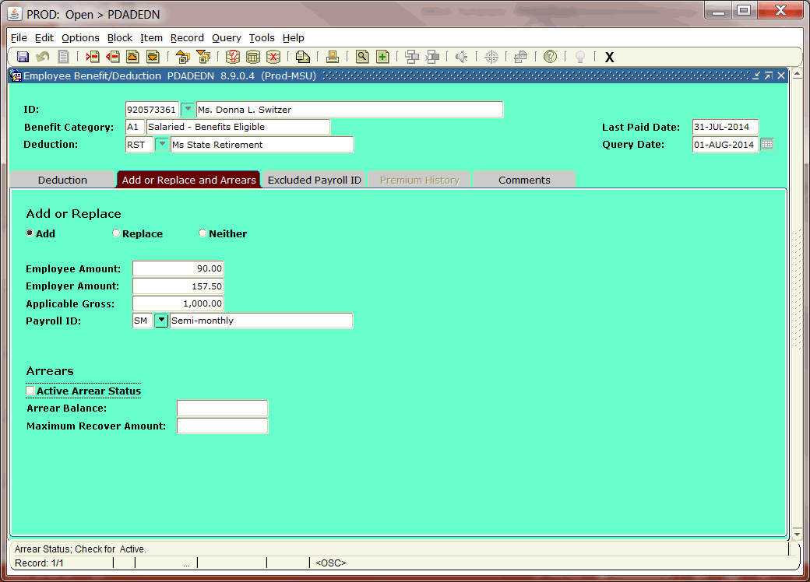
12345 Ms. Minnie Mouse
Step 5 -Add/Replace Section
Fill in the Blanks

Slide 27
AFTER CHECK HAS BEEN CALCULATED:
You can check your deductions to see if they worked, if not complete the following.
1. PZAHOUR - Re-extract first.
2. PDADEDN - Make needed replaced /added deductions to ADD/REPLACE section.

Slide 28
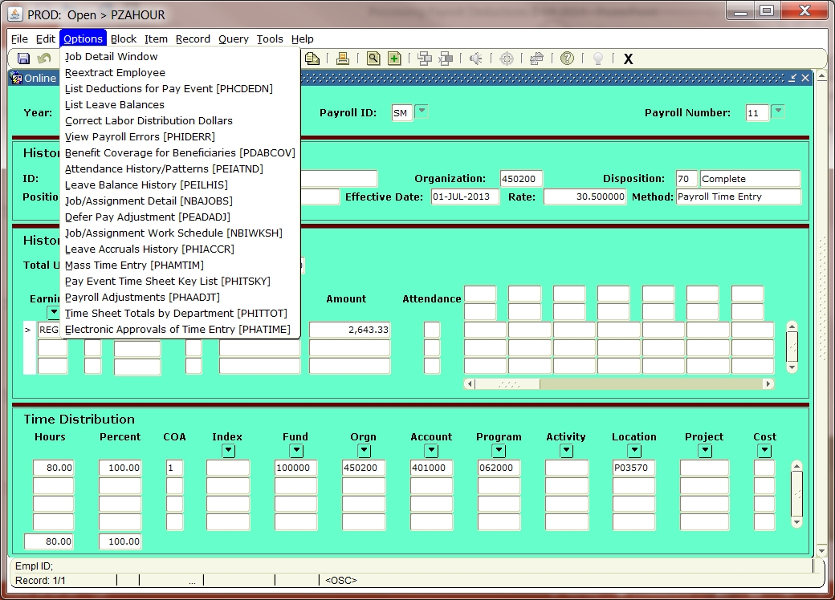
PZAHOUR
.00
600.00

Slide 30
12345 Ms. Minnie Mouse

Slide 31
Paycheck will reflect the following
Gross: 1000.00
Deductions: EE’s ER’s APPLICABLE
GROSS
RST 180.00 315.00 2000.00
NET $ 820.00

Slide 32
12345 Ms. Minnie Mouse
After the paycheck has been calculated, this will return to a normal screen. The previous one time add/replace disappears.

Slide 33
SELF-ADJUSTING DEDUCTIONS
Social Security and Medicare adjusts itself to keep up current deductions. As far as I know it is the only one that does so.
Typical Problems:
You can have a check that did not have enough to capture all the deductions. Hopefully your edits would have caught this first, but if not, there is hope.

Slide 34
EXAMPLE:
Chris Columbus just got paid.
Gross: $ 1000.00 Shortage
Deductions: Federal Tax 100.00
State Tax 10.00
Health Insurance 50.00
Tax Lien 800.00
Social Security * 25.50 s/b 62.00
Medicare 14.50 shorting
Soc. Sec.
Net Paycheck: $ .00 -$36.50

Slide 35
PROBLEM:
Not enough social security taxes were withheld because he did not have enough gross pay.
SOLUTION: Since Social Security and Medicare Taxes self-adjust, they will catch up on future checks. Check your totals while working on payroll and tax edits.

Slide 36
You could have missed the deduction entirely.
Graduate student Full-Time Posn.
Pays NO SS Tax Pays SS Tax
Example: An adjustment check is paid to cover the full time position, but e-class of graduate student has not been changed in PEAEMPL. The employee wants his pay.
???????

Slide 37
SOLUTION:
This one is going to be pretty tricky. Since he was a graduate student, you could wait until the e-class gets changed and start the next available paycheck taking the deduction.
If you use an add/replace for the Social Security and Medicare taxes, it could keep on going. Since it self-adjusts, you just almost cannot do anything about it. The best time to adjust is when they are terminating and you won’t have any more paychecks for them.

Slide 38
OR: (The EXCEPTION) MANUALLY, you can adjust for overpayments and refunds of items such as insurance, etc. This is NOT done through the ADD/REPLACE section, but Manual Adjustment Section (PHAADJT).

Slide 39
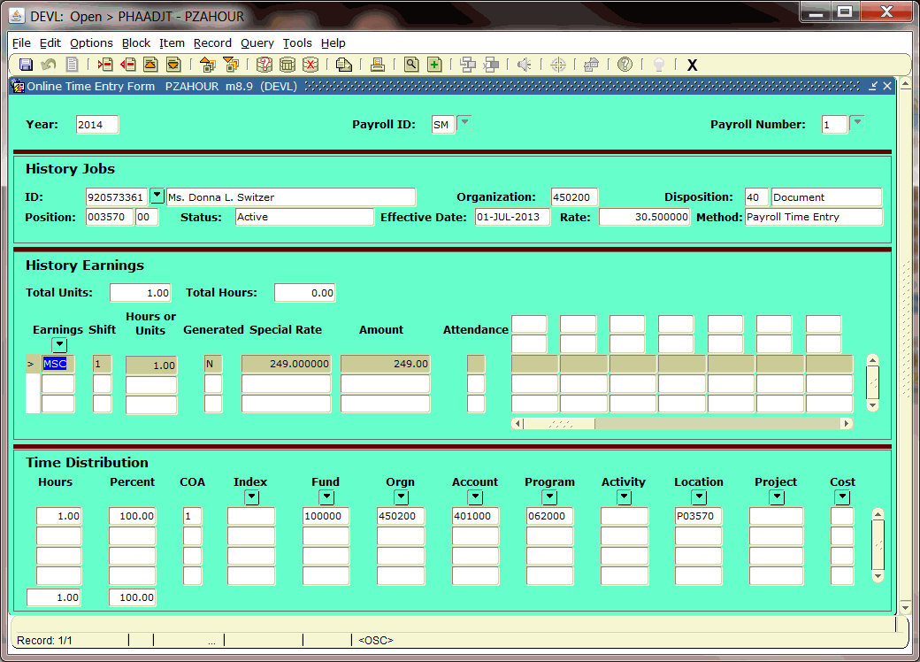
EXAMPLE: Self-Adjusting Social Sec. & Medicare
123123 Chris Columbus

Slide 40
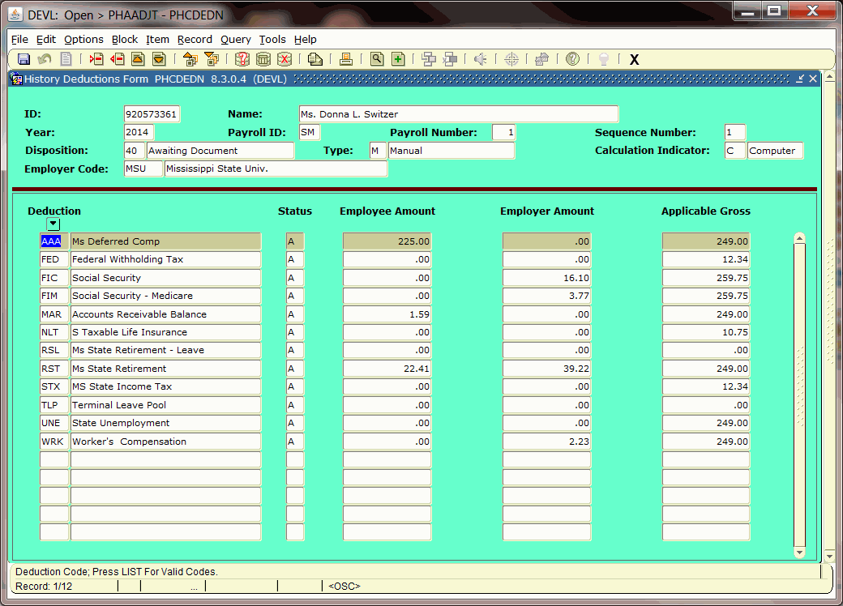
123123
Chris Columbus
This is an example of when the Employee Deduction was not taken, but the Employer's side was taken. All the deductions for the Employee results in a $0 net check.

Slide 41
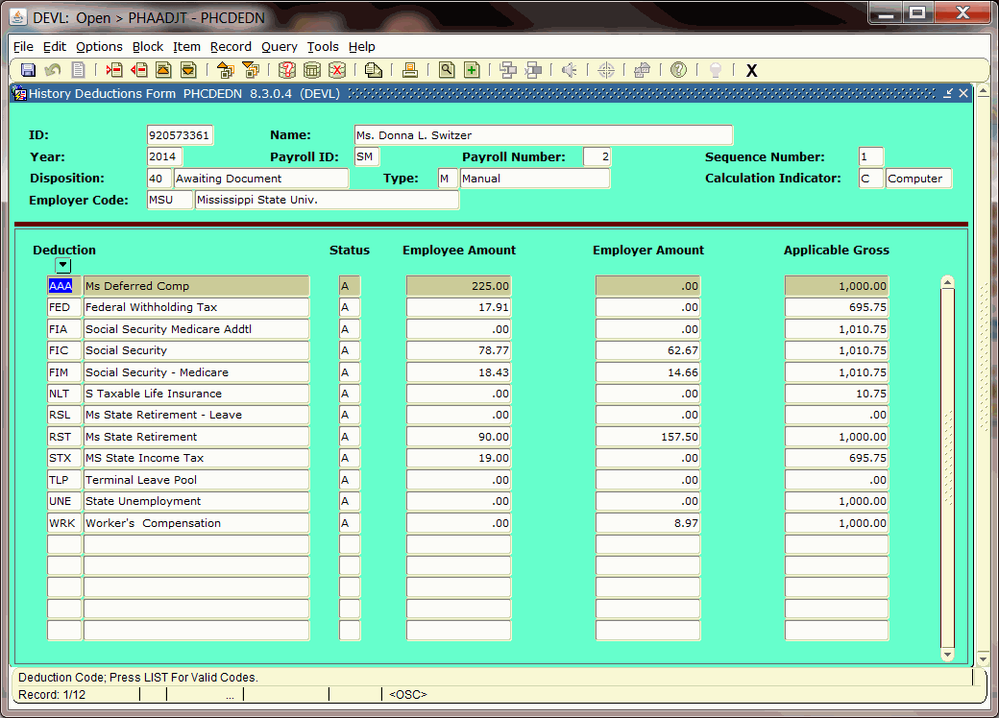
123123 Chris Columbus
Correct Deductions on next check

Slide 42
NON-RESIDENT ALIEN TAXATION:
THE ISSUE:
The IRS taxes Residents and Non-Resident Aliens in
different ways.
THE PROBLEMS:
Availability of Tax Treaties to Certain Countries.
Some Non-Residents are RESIDENTS FOR TAX PURPOSES.
Some Non-Resident Aliens can only claim one withholding
allowance at the single rate.
??????? CONFUSED ????????
Definition: The act of confusing, disorder, upheaval,
chaos, lack of clearness or distinctness,
bewilderment.

Slide 43
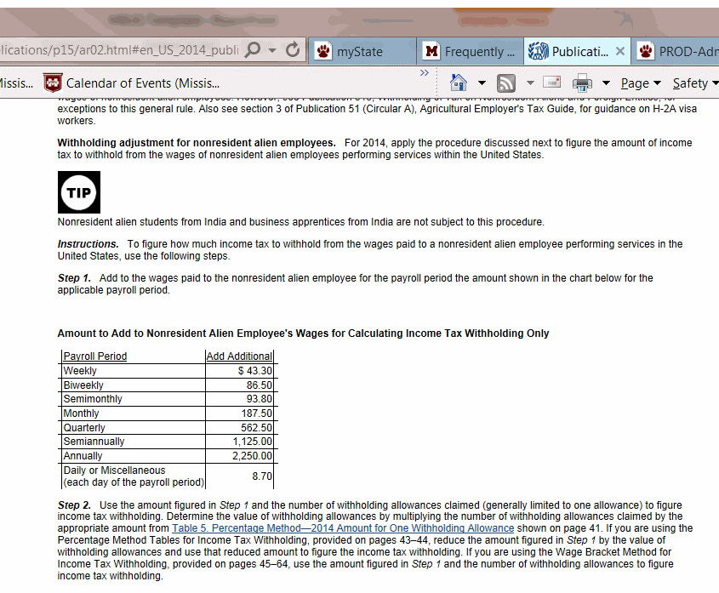
The IRS Circular E references an additional amount which is added to wages when calculating federal income tax withholding for non-resident aliens.
Schedule for additional amount

Slide 44
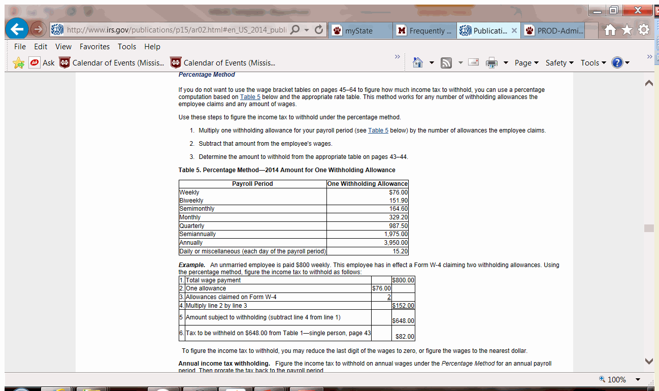
The IRS References the Percentage Method for determining tax amounts. For the normal resident, calculations are straight forward, but when adding the additional amount for non-resident aliens, it is hard to combine both employees into the same tax category. Keeping separate federal deductions might be helpful.

Slide 45
Example of Non-resident
Alien with Tax Treaty

Slide 46
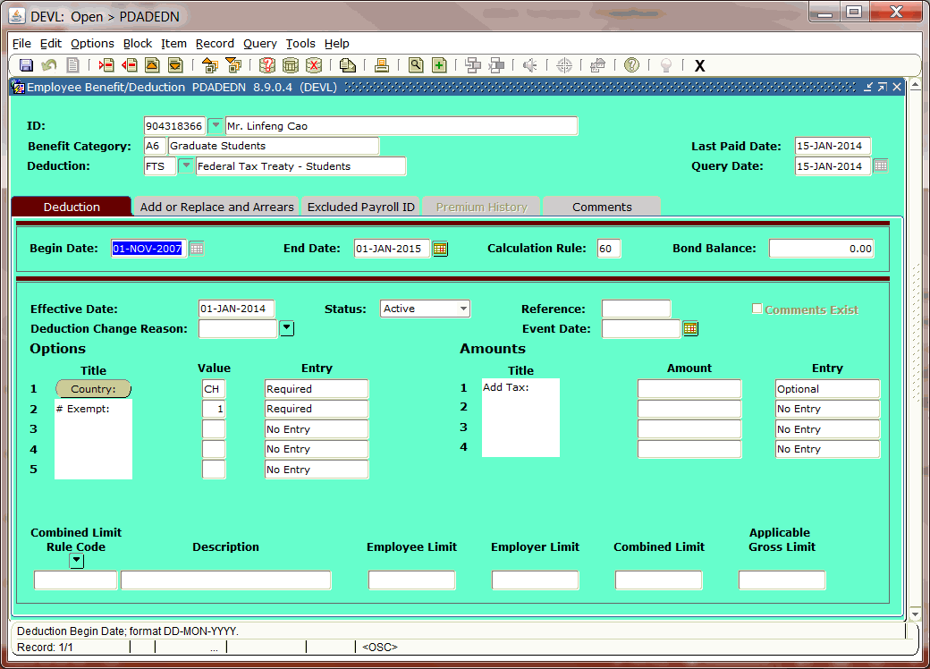
789789 Yong Man
Here we are activating a tax treaty beginning 01-Jan-2014 and terminating it on 01-Jan-2015. Tax Treaties are for one year and can be renewed each year provided they meet all the criteria.

Slide 47
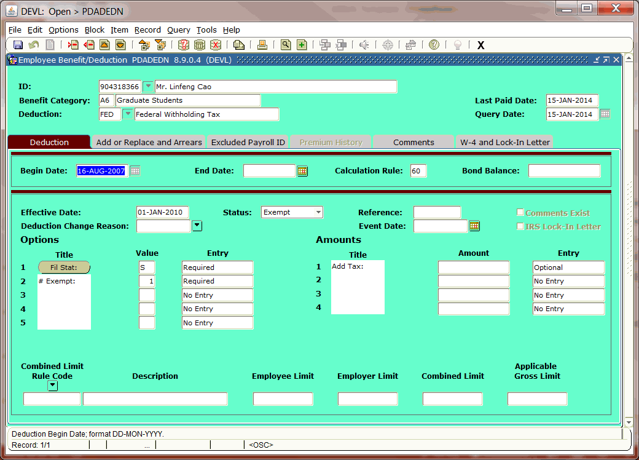
789789 Yong Man
01-Jan-2014
Here you will want to Exempt the FED tax and leave it exempt until they have a change in tax status

Slide 48
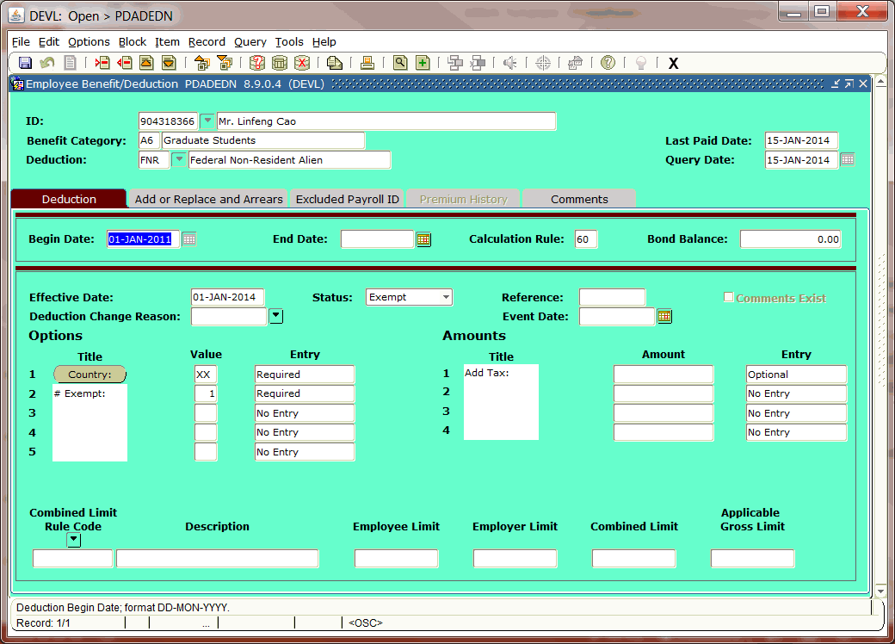
789789 Yong Man
You can do the same with FNR. Exempt for 01-Jan-14 and activate for 01-Jan-2015.

Slide 49
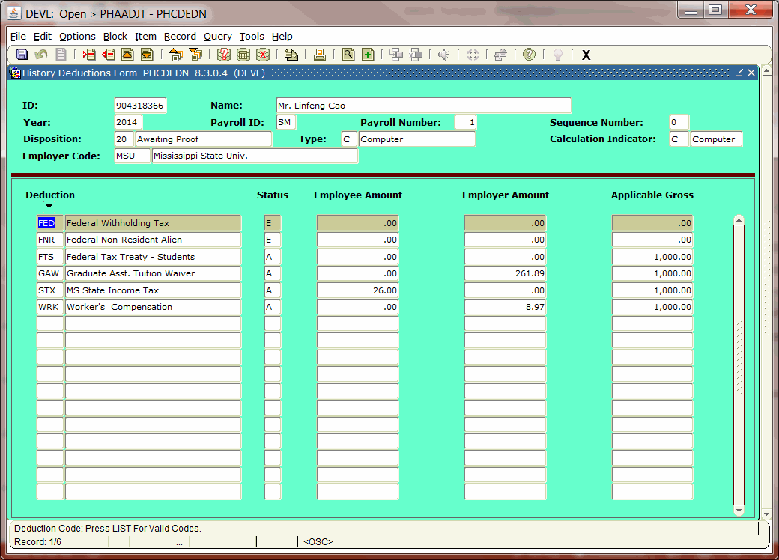
789789 Yong Man
Once the Tax Treaty has been met, then Federal tax will
be deducted under the FTS Tax Treaty Deduction. Taxable Wages will be printed on the W-2, and also a
1042 will be given for the exempted wages. Because each country has an exemption amount built in with the country code, it knows when it has reached its maximum exemption.

Slide 50
PROBLEM SOLVING

Slide 51
Methods to Keep Problems Away
Pre-Edits – Get your ITS to set up pre-time entry deductions prior to payroll time being pulled. This way you can set up all the needed deductions ahead of time.
Calc Edits – While processing payroll, try to catch every mistake from the hour entry, deduction calculations, to total deductions taken on a particular deduction, e.g. such as a garnishment.

Slide 52
TAX EDITS/W2 EDITS – This will alert you to problems before the W-2 processing time. You can run this after each payroll checking:
Calculated Federal Tax with Actual Federal Tax (differences can be reconciled)

Slide 53
Social Security and Medicare Taxes – are they correct and in order, are they reconciled to each other? EX. Earnings Records are matching and 941’s are matching to 100%.

Slide 54
Question:
There is an employee, who has a negative gross pay, is it possible that he can have a net positive check?
TRICKY QUESTION?

Slide 55
Answer: It can be possible.
Mr. Chris Kringle, has terminated and been overpaid, yet his department pays overtime on a delayed basis. He also is getting a refund of insurance on this last paycheck.
Gross: SST Regular 4 Hours x $14.399423 = $57.36
DOC Docked 4 Hours x $14.399423 = $-57.36
PEP 1 Unit of -$4.88 (Overpaid) $ -4.88
Deductions: EE’s ER’s Applicable Gross
CHA (Health Ins) -20.00 -356.00 -4.88
FED 0 0 15.56
FIA (Add. SS) 0 0 15.12
FIC (SS) .93 .93 15.12
FIM (Medicare) .22 .22 15.12
NLA (State Life) - 5.40 0 -4.88
NLT 0 0 0
NLZ (University-Life) 0 -5.40 -4.88
RST (Retirement) -.44 -.77 -4.88
STX 0 0 15.56
NET CHECK = $19.81

