Slide 2
Ellucian Mobile: Don’t text and drive, kids!
In which we present an overview of the features and architecture of the Ellucian Mobile App, as well as one institution’s experience (nearly) deploying it (any day now).

Slide 3
Overview
Architecture – Ellucain’s ‘mobile cloud’, and how one size really can fit all
Basic functionality – the modules and what they can do
The Platform Edition – opportunities and implications
MGCCC – experiences and customizations

Slide 4
Architecture
Configurable framework for deploying a customized mobile app to most iOS and Android devices
Supports phones and tablets
SIS options: Banner, PowerCampus, Colleague
Designed to minimize development and configuration overhead

Slide 5
Architecture - Components
Ellucian GO – runs on users mobile device – “The App”
Ellucian Mobile Cloud Configuration Server – hosted service that provides basic app configuration, and directs app to a specific institution
Mobile Integration Server – runs on your network, and provides Ellucian GO with filtered, secure access to Banner data.

Slide 7
Architecture – Ellucian GO
Ellucian Mobile editions: Application and Platform

Slide 8
Architecture – Ellucian GO
Application Edition:
Users download ‘Ellucian GO’ from app store
User is presented with a list of all schools using the Application edition, and chooses their institution.
Menu and custom formatting delivered from the cloud config & your mobile integration server.
Source code not provided - branding & complex customizations not possible.

Slide 9
Architecture – Ellucian GO
Platform Edition:
Users download a school-branded app (e.g. MGCCC Mobile)
No school selection necessary
iOS and Android source code provided - arbitrary customizations possible…

Slide 10
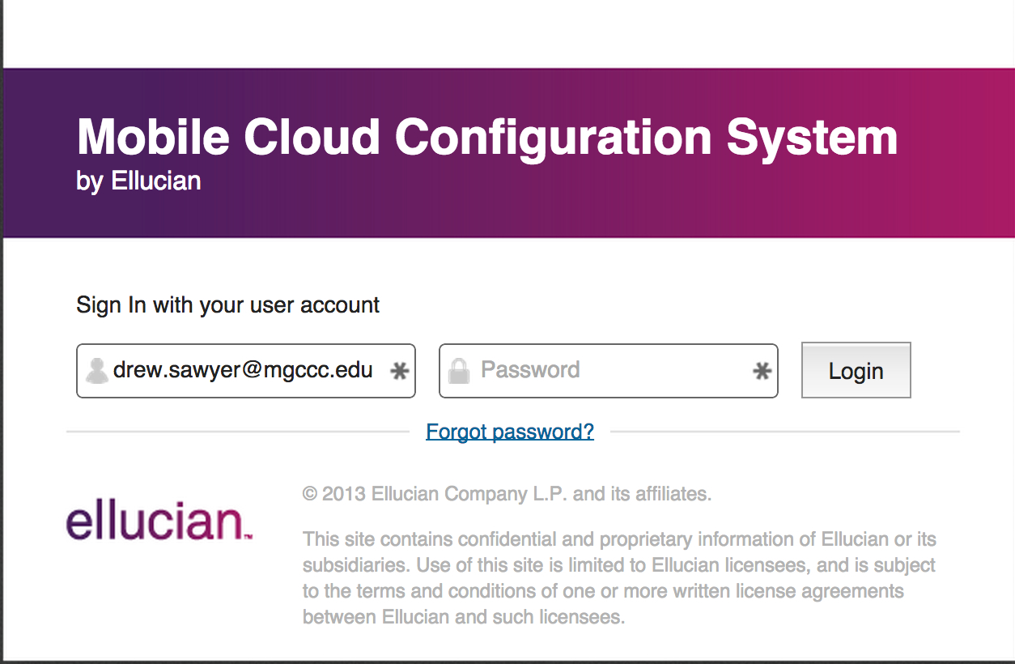
Architecture Mobile Cloud Configuration
Ellucian-hosted web-based system for managing most configurable app features

Slide 11
Architecture Mobile Cloud Configuration
Organizes app settings into named Configurations
Location and credentials of Mobile Integration Server
Basic cosmetics for UI
Settings and menus order for each desired module
Publishing – public or testing mode

Slide 12
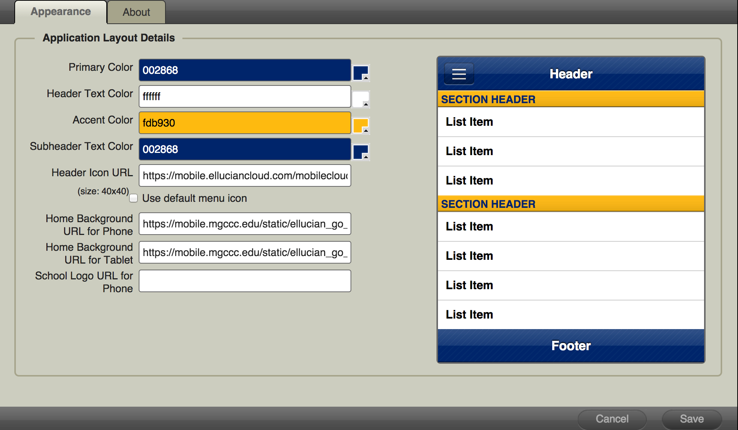
Architecture – Mobile Cloud Config

Slide 13
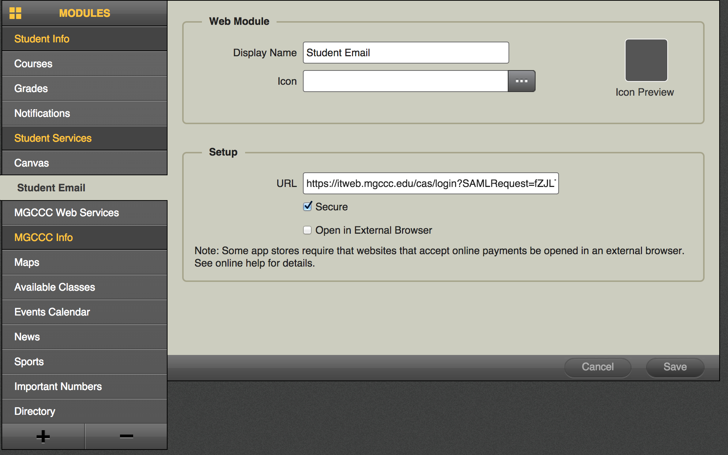
Architecture – Mobile Cloud Config

Slide 14
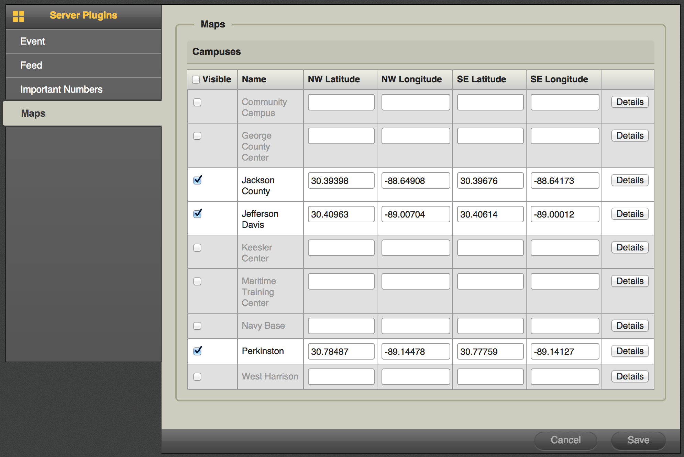
Architecture - Mobile Cloud Config

Slide 15
Architecture Mobile Integration Server
Groovy/Grails application (.WAR file) deployed on customer network
Tested on Tomcat 6 and 7
Mobile clients directed to server URL by Mobile Cloud Configuration
Interface between mobile clients on the public Internet and local network resources

Slide 16
Architecture Mobile Integration Server
Mobile clients do not talk directly w/Banner or other intuitional data sources
Grails web API provides
Authentication for secured features
Banner data access as appropriate (e.g. class schedule, grades, notifications)
Data caching (e.g. RSS/ATOM feeds, event calendar items)

Slide 17
Modules
App functions divided into menu-accessable ‘modules’
Menu contents may be subdivided as desired
Some modules may be used multiple times – e.g. a general news feed, and a sports feed

Slide 18
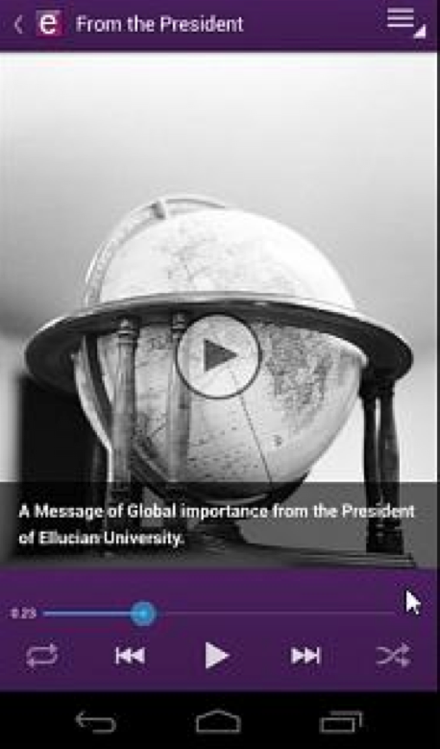
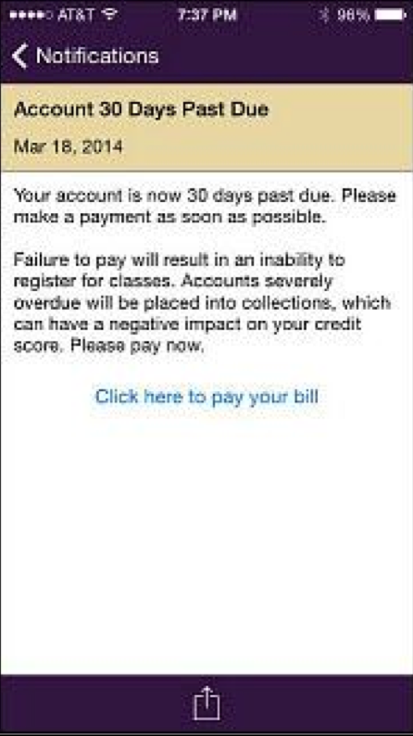
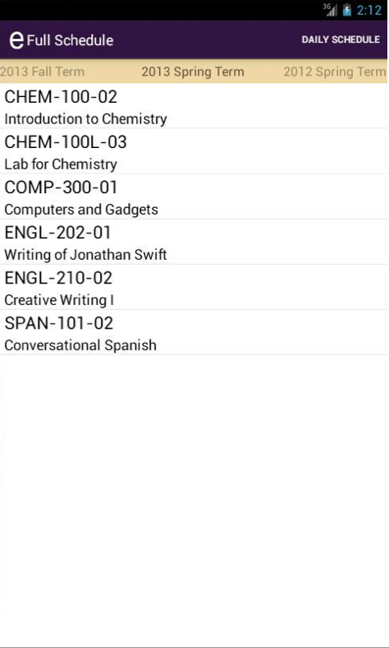
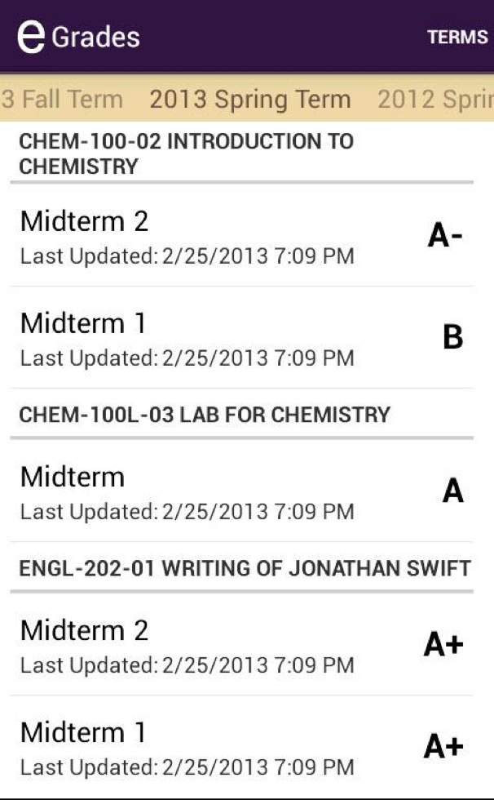
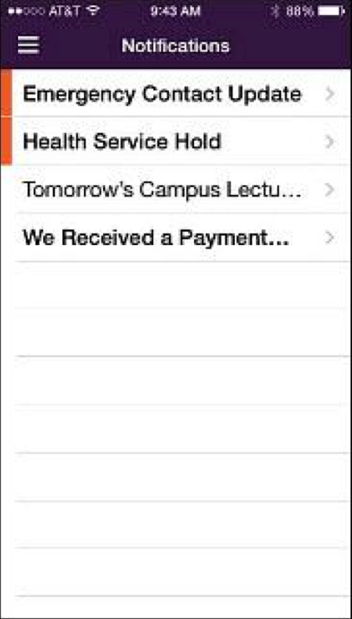
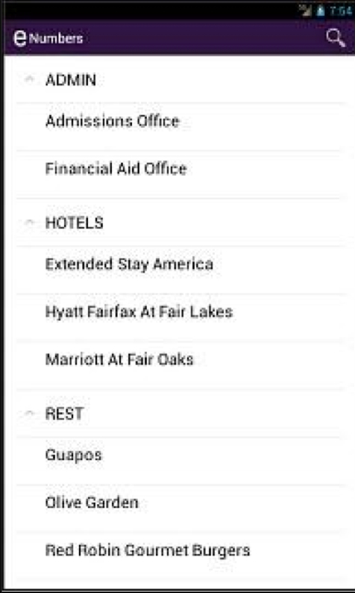
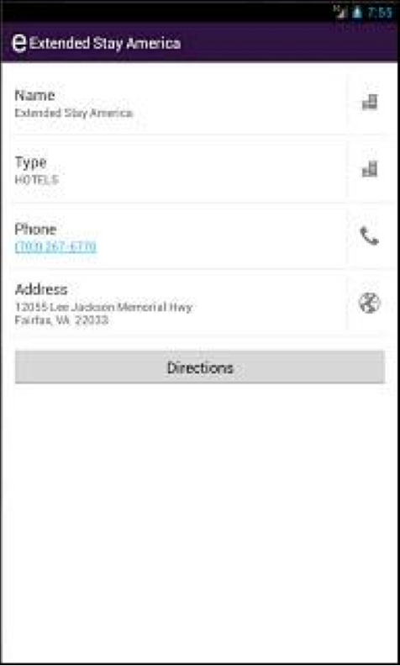
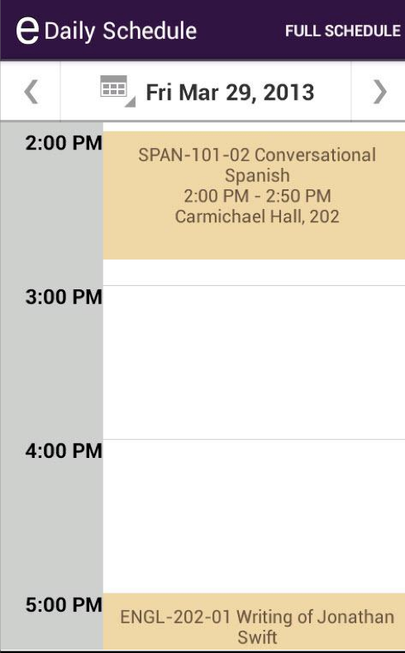
Modules – the basics
About
Important Numbers
Courses
Grades
Notifications
Audio & Video

Slide 19
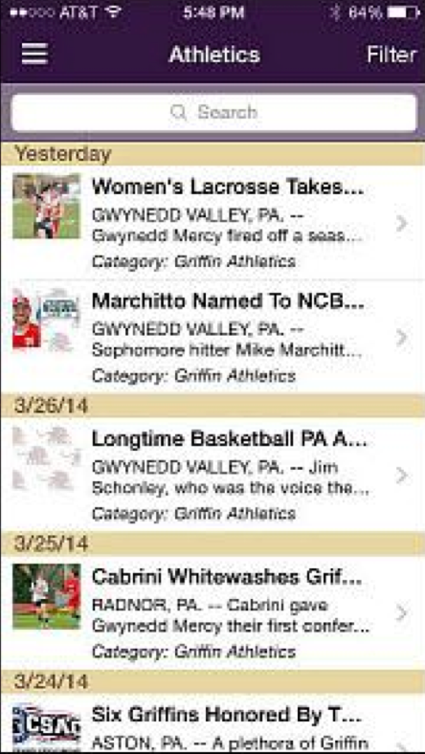
Modules – Feeds and Events
The Feeds module provides access to RSS or ATOM syndicated data
Configured through Cloud Config page
May incorporate module multiple times for different feeds, or combine multiple URLs into one module

Slide 20
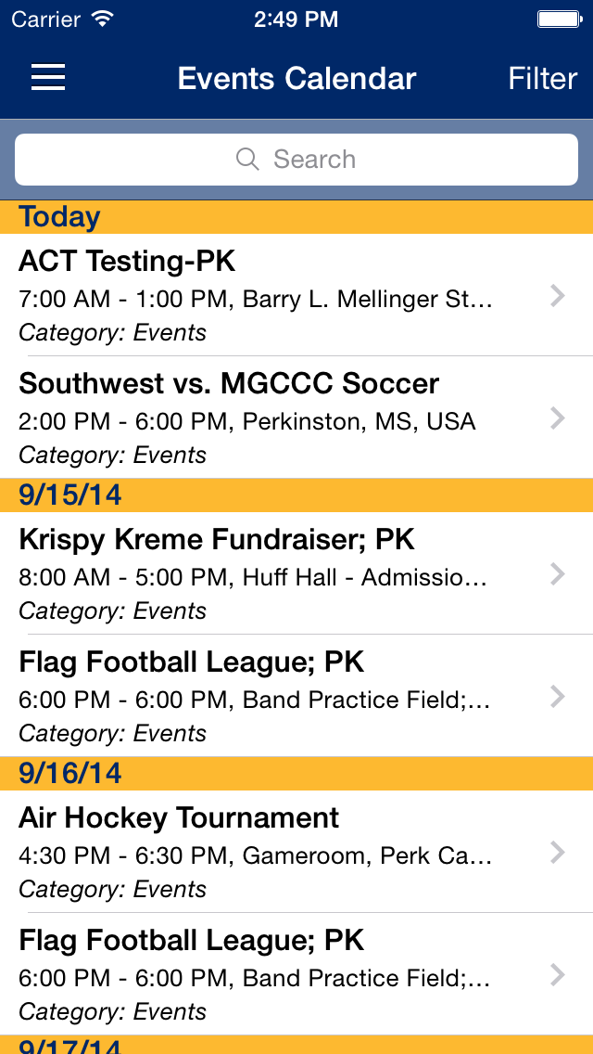
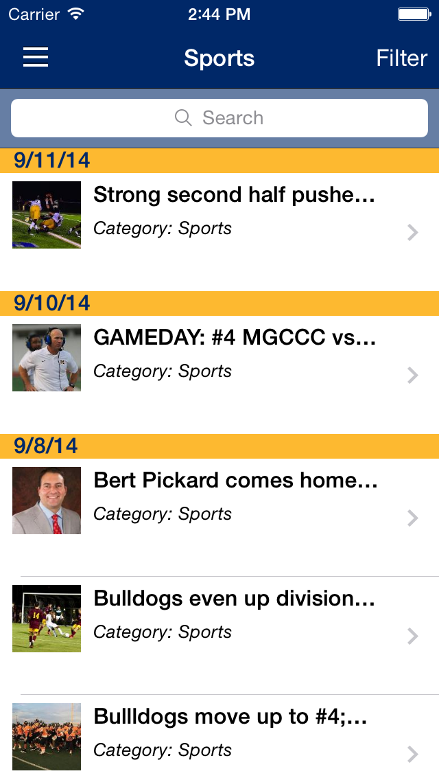
Modules – Feeds and Events
The Events module provides calendar data
May also be used multiple times or composed
Calendar must be iCalendar format, available via public URL

Slide 21
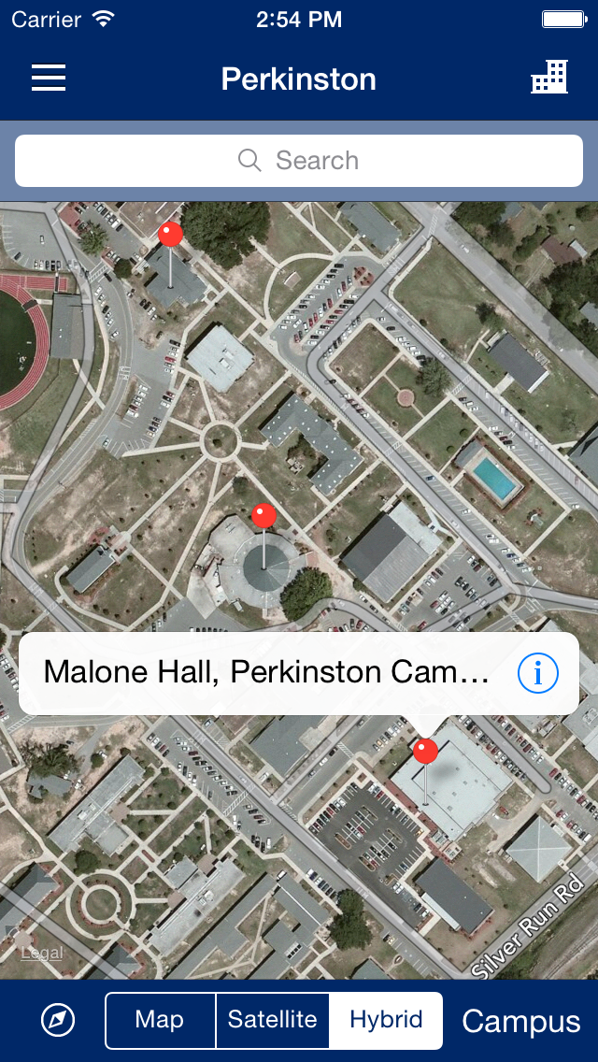
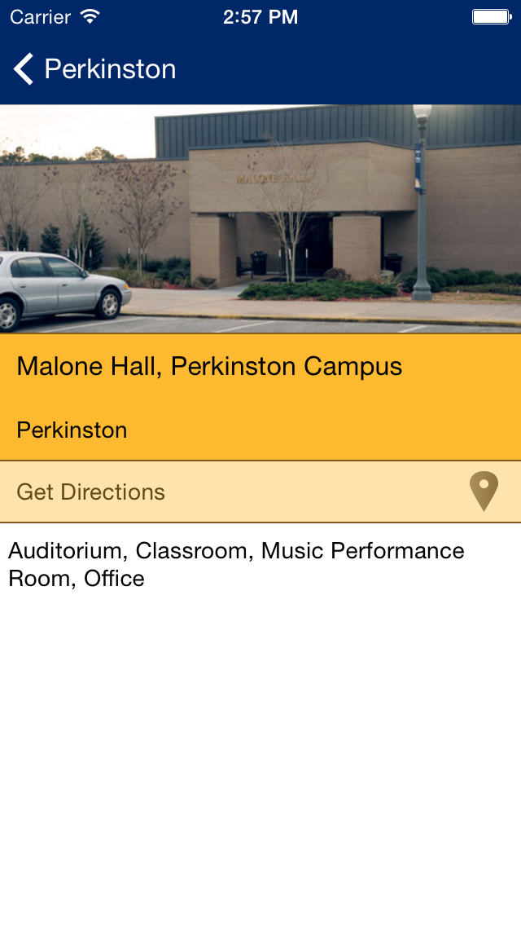
Modules – Maps
The Maps module provides campus mapping, building location/description, and device GPS integration
Campus boundaries, visible buildings, and building locations configured on Cloud Config page
Details page provides building image

Slide 22
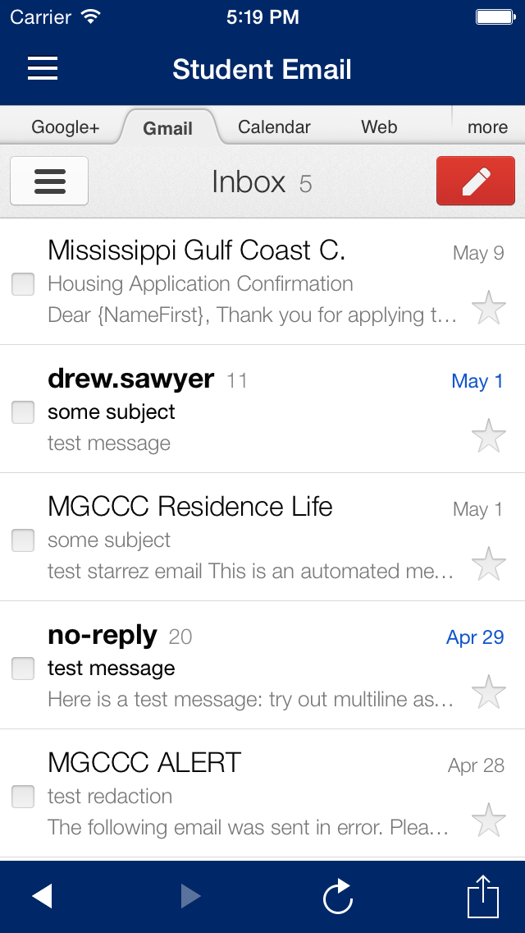
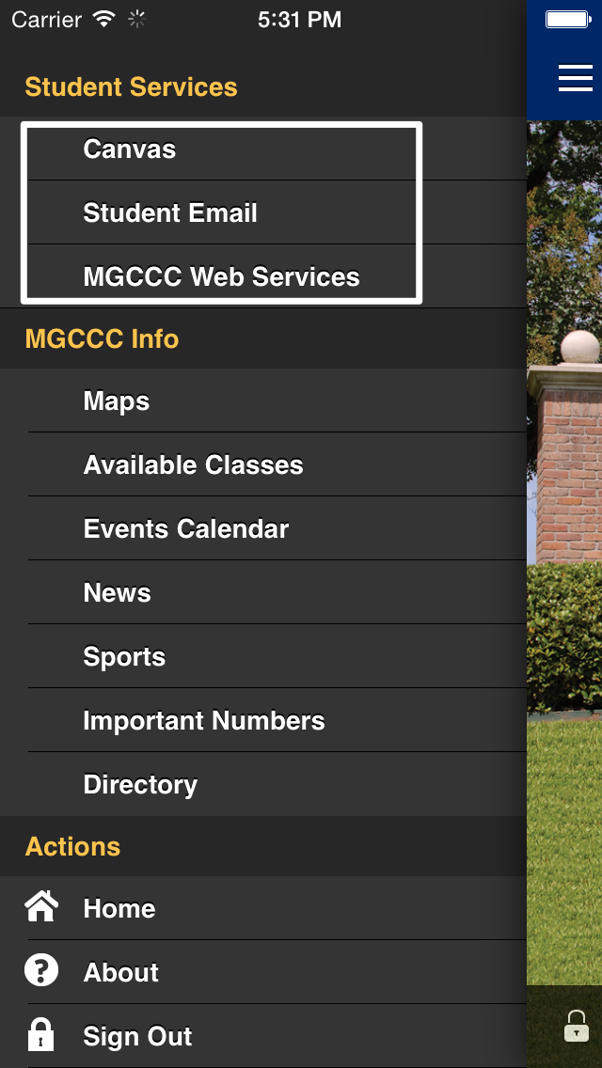
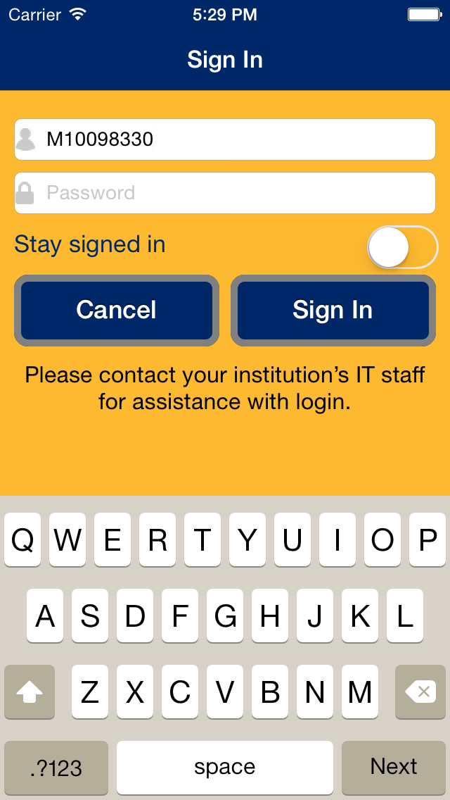
Modules – Web Apps
The Web Apps module allows menu access to arbitrary URLs via an embedded browser
Commonly accessed web pages such as student email may be integrated as persistent menu items
Single-sign-on integration via CAS!

Slide 23
Platform Edition
With great power, comes great responsibility…

Slide 24
Platform Edition
What you get:
Full source code for iOS and Android apps
Fully branded App experience for users
Opportunity to tweak

Slide 25
Platform Edition
What you're getting into:
Full responsibility for post-development lifecycle of Apps in two different mobile ecosystems
Maintaining local modifications to App and Mobile Integration Server across baseline Ellucian GO releases
Establishing and maintaining a relationship with the Apple and Android marketplaces

Slide 26
Platform Edition

Slide 27
Platform Edition

Slide 28
Platform Edition – Basic Branding
Establish developer accounts with Apple and Google
App Icons – multiple sizes for iOS and Android
Image assets for app stores

Slide 29
Platform Edition – Basic Branding
Ellucain GO project modifications
Basic project modification to identify the app uniquely
Remove the switch schools option, and hardcode the URL of the desired Cloud Config
Establish a versioning scheme for each app
Android – Enable Google Maps API and obtain a key for your institution
Android – Generate an App Signging key

Slide 30
MGCCC Mods
Mobile Integration Server
Correct a problem talking with our LDAP server (Directory Module)
Feeds plugin – include HTML when <Content:encoded> present
iOS app – enable HTML parsing in feed module
Android App – HTML parsing was already available.

Slide 31
MGCCC – Lessons Learned
Image assets may be the only major obstacle for Application Edition deployment – establish team to develop home page image, menu icons (if any!), map module images and color scheme early.
Think hard before jumping for the Platform edition – it’s a significant time and knowledge investment for IT
For Platform edition, begin the Apple Corporate iOS developer account early.
Might not be a bad idea to split iOS and Android app maintenance between two people. You’ll know the difference when you see them ☺

Slide 32
Questions?
Answers courtesy of Google.com

