Slide 1
MBUG 2014
Session Title: Tracking Students Using a Sign-In System & Early Alert Program
Presented By: Bronson Prochaska, Ph.D. & Steven West
Institution: Itawamba Community College
September 15, 2014

Slide 2
Session Rules of Etiquette
Please turn off your cell phone
If you must leave the session early, please do so discreetly
Please avoid side conversation during the session

Slide 3
Tracking Students Using a Sign-In System & Early Alert Program
Why track students with a sign-in system?
Where do you have this system?
ADVISING CENTER
STUDENT SUCCESS CENTER
WRITING CENTER

Slide 4
Sign-In System Demo

Slide 5
Early Alert Referral System
Designed to identify students who may be at risk of difficulty at the College
Proactive way to reach out to students
Is an online form (so it’s available 24/7)
Began in 2007

Slide 6
Early Alert Referral System
WHY SHOULD FACULTY/STAFF
SUBMIT EARLY ALERTS FOR STUDENTS?
Because they are struggling academically
Because they are struggling personally
Because they are consistently absent from class or late
Because they are consistently not prepared for class
Because they are not turning in homework or assignments
Because they are bombing test/not doing well

Slide 7
I can submit EARLY ALERTS for…..
my ADVISEES
STUDENTS IN MY CLASSES

Slide 8
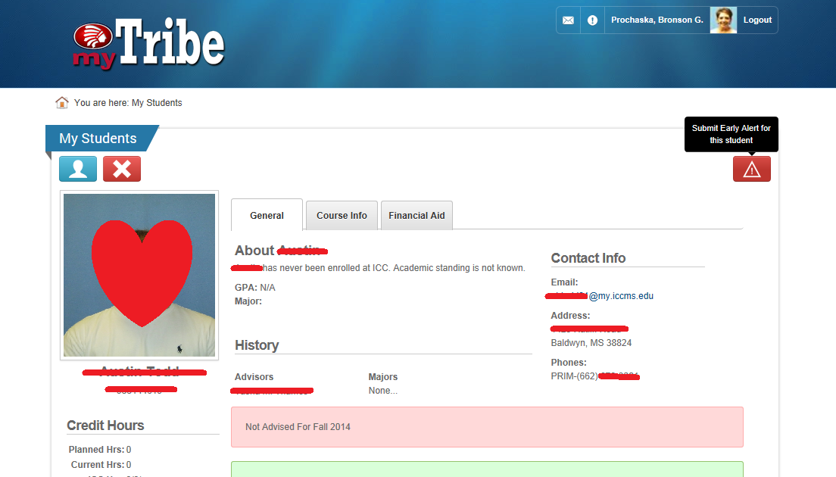
HOW do I submit an Early Alert for an ADVISEE?
Go to “myTRIBE” and Login
Click on
“My Students”
Select the students name then click on “ ”
Complete the online form

Slide 9
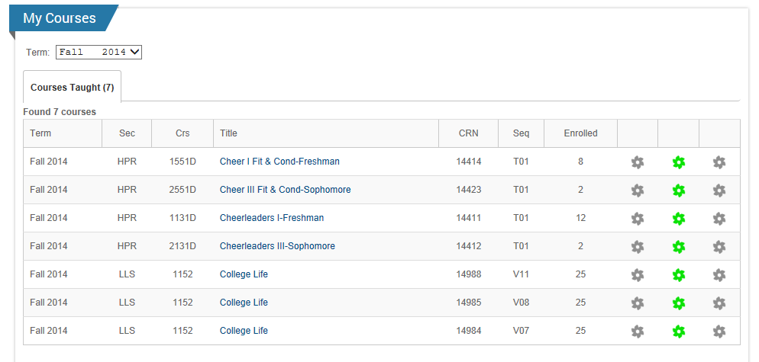
HOW do I submit an Early Alert for a student in my class?
Go to “myTRIBE” and Login
Click on
“My Courses”
Select the course/section the student is in

Slide 10
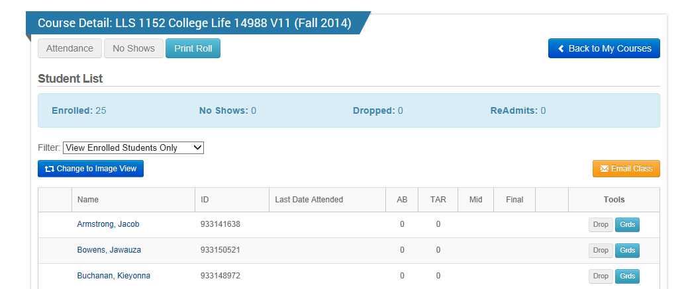
Select the students name on your class role

Slide 11
Then click on “ ” and complete the online form

Slide 12
Once the EARLY ALERT has been submitted, the STUDENT SUCCESS CENTER staff:
-mails a letter to the student
-sends the student an email
-sends an “Itawamba Cares Card” to one of the students classes
If, after a week, the student has not been by to see us, we call them (after hours)!

Slide 13
Our goals are to:
-Help students to needed resources
-Communicate that we are vigilant about helping our students
-Make a connection to our students
-Be proactive

Slide 14
Bronson Prochaska, Ph.D.
Director of Student Success
bgprochaska@iccms.edu
Steven West
Technology & Information Services Department
sawest@iccms.edu

