Slide 1
MBUG 2014
Session Title: Building custom Banner self-service based applications
Presented By: Prashant R Bomidika
Institution: Alcorn State University
September 15, 2014

Slide 2
Session Rules of Etiquette
Please turn off your cell phone
If you must leave the session early, please do so discreetly
Please avoid side conversation during the session

Slide 3
Adding Web Pages to SSB
Steps:
Build the PLSQL package
Compile the Package
Set up the grants to schemas and roles
Add the new procedure to Web Tailor

Slide 4
Complete Registration using Financial Aid:
Registration Process:
Students use authorized financial aid to complete registration online
To complete registration at Alcorn means having received an “REGC” code on account receivable (TBRACCD_DETAIL_CODE) and a “Y” flag (SFBETRM_AR_IND)
Once the registration is complete, students can deposit up to $1,000.00 on their Alcorn Gold Card.

Slide 5
PLSQL Package
CREATE OR REPLACE PACKAGE ZASUREG
AS
PROCEDURE p_selectterm;
PROCEDURE p_checkterm(
sel_term stvterm.stvterm_code%type default null
);
PROCEDURE p_assess;
PROCEDURE p_register(
Accept varchar2 default null
);
PROCEDURE p_receipt;
PROCEDURE p_show_gcdeposit;
PROCEDURE p_pgcdeposit(
deposit varchar2 default null,
Accept varchar2 default null
);
END ZASUREG;
/

Slide 6
PLSQL Package Body
PROCEDURE p_selectterm
IS
reg_open BOOLEAN := FALSE;
BEGIN
IF NOT twbkwbis.f_validuser(stud_pidm) THEN
RETURN;
END IF;
twbkwbis.P_OpenDoc('zasureg.p_selectterm');
twbkwbis.P_DispInfo('zasureg.p_selectterm','DEFAULT');
htp.print('<p><b><font color="purple" face="Verdana" size="2">Hello,</font></p></b><br>');
htp.FormOpen('zasureg.p_checkterm','post');

Slide 7
PLSQL Package Body
twbkfrmt.P_TableOpen('DATAENTRY',
cattributes=>'Summary="Select Term."');
twbkfrmt.P_TableRowOpen;
twbkfrmt.P_TableDataLabel(twbkfrmt.F_FormLabel
('Select Term:',idname=>'Selected_Term'));
twbkfrmt.P_TableDataOpen;
HTP.FormSelectOpen('sel_term',
cattributes=>'ID="sel_term_code"');
FOR sel_active_term_rec IN sel_active_term_cur
LOOP
twbkwbis.P_FormSelectOption(
sel_active_term_rec.tdesc, sel_active_term_rec.tcode);
reg_open := TRUE;
END LOOP;
HTP.FormSelectClose;

Slide 8
PLSQL Package Body
twbkfrmt.P_TableDataClose;
twbkfrmt.P_TableRowClose;
twbkfrmt.P_TableClose;
IF reg_open THEN
HTP.Para;
HTP.FormSubmit(cvalue=>'Continue');
HTP.FormReset(cvalue=>'Reset');
ELSE
htp.print('<p><font color="red" face="Verdana" size="2">Registration closed!</font></p><br>');
END IF;
HTP.FormClose;
twbkwbis.P_CloseDoc();
END;

Slide 9
Compiling the Package
Connect as BANINST1 to compile the package
$sqlplus baninst1
SQL> @ asu_onlinereg_zasureg.sql
Package created.
No errors.
Package body created.
No errors.
SQL>

Slide 10
Set up the grants to schemas and roles
Connect as BANINST1
create public synonym zasureg for zasureg;
START gurgrtb zasureg
START gurgrth zasureg

Slide 11
Add the new procedure to Web Tailor
Login to SSB and select Web tailor Administration.
Select “Customize a Web Menu or Procedure”
Click “Create” to add a new menu or procedure
Continue the above steps for all the procedures defined in your package

Slide 12
Add the new procedure to Web Tailor
Determine a location from where you would like your users to launch your custom application.
Select “Customize a Web Menu or Procedure”
Select “Customize Menu Items”
Select “Add a New Menu Item”

Slide 13
Add the new procedure to Web Tailor
Customize the selected menu item
Submit Changes

Slide 14
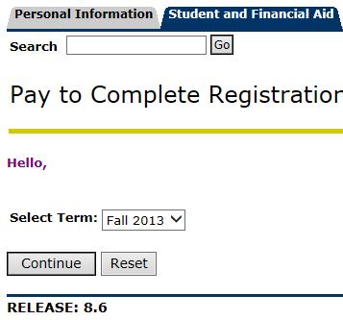
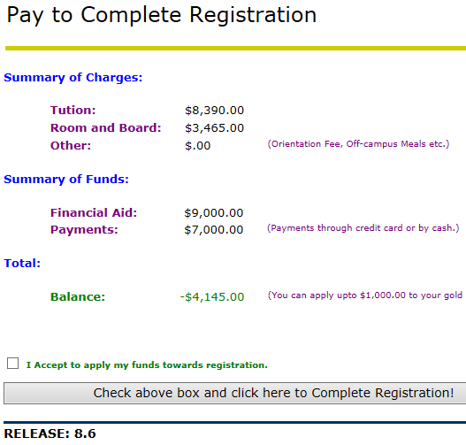
Screen Shots of the Custom Application

Slide 15
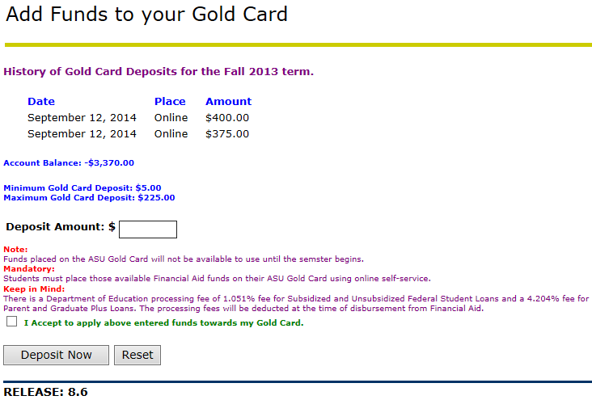
Screen Shots of the Custom Application

Slide 16
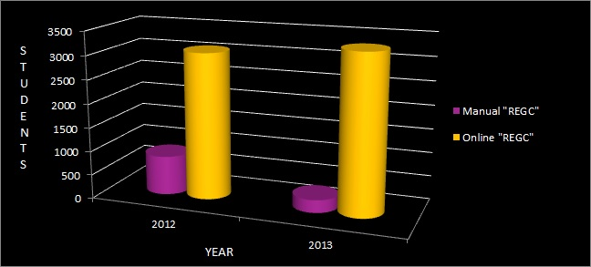
Efficiencies Gained

Slide 17
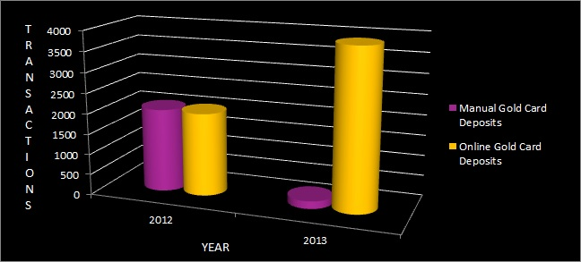
Efficiencies Gained

Slide 18
Questions?

Slide 19
Contact Information:
Prashant Bomidika
bomidika@alcorn.edu
(601) 877 2463
Alcorn State University

