Slide 1
MBUG 2014
Session Title: Banner Boot Camp II
Presented By: Cay Lollar and Sandi South
Institution: Itawamba Community College
September 15-16, 2014

Slide 2
Session Rules of Etiquette
Please turn off your cell phone
If you must leave the session early, please do so discreetly
Please avoid side conversation during the session

Slide 3
GOAMTCH Common Matching
Use common matching to help prevent duplicate records – IT staff hates duplicate PIDMS. Stay on their good side by always searching before entering a new student into Banner.
Can go to directly or though SPAIDEN when creating a person record.

Slide 4
GOAMTCH

Slide 5
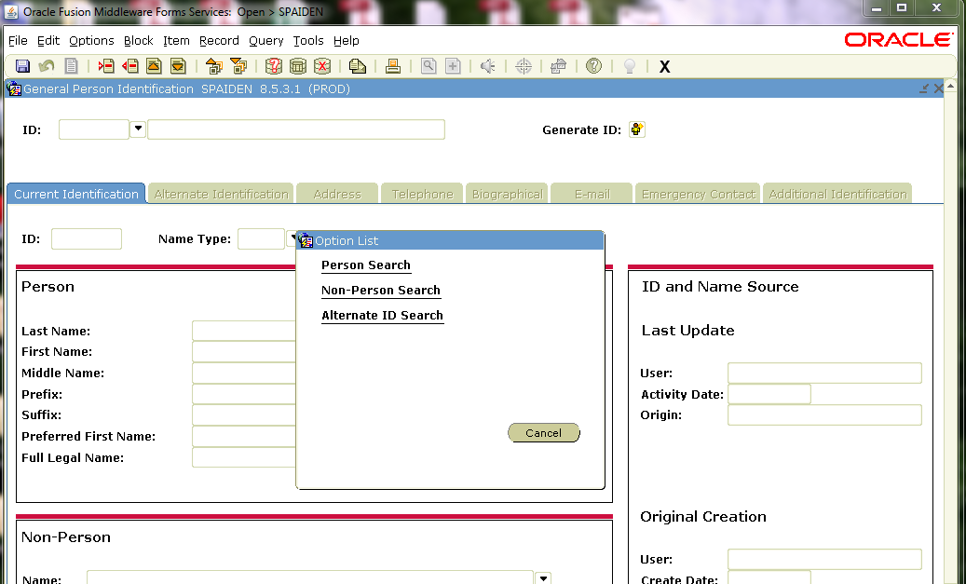
SOAIDEN Person Search
Always search before entering a new person in the system.

Slide 6
GUIALTI Alternate ID Search
Difference in this search and SOAIDEN (Person Search) is that one can search on DOB. DOB must be entered as DD-MON-YYYY.

Slide 7
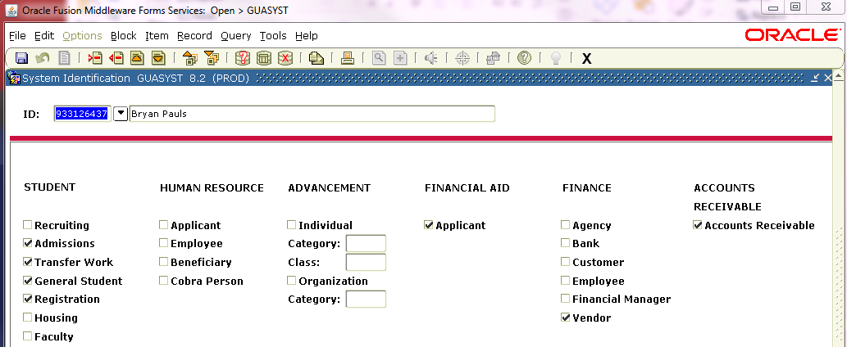
GUASYST System Identification
Provides a reference to modules where information about an ID may be stored.
Used when duplicates exist for a student and data must be combined into one record.
Does not list by term or date

Slide 8
GUISRCH General Search
New in Banner 8.4
Search by
Additional ID
E-mail
Country Code
Area Code and Phone Number

Slide 9
GUISRCH cont.

Slide 10
SOAIDNS Person Search Detail
Student Name, DOB, Gender
Address Details
General Learner
Registration Terms
Curriculum

Slide 11
SOAIDNS

Slide 12
SPAIDEN or PPAIDEN General Person Identification
Address Information
Telephone
Biographical (SPAPERS)
Gender
Date of Birth
Social Security Number
Citizenship
Ethnicity
Confidential
Deceased Date

Slide 13
REGISTRATION SFAREGS – SFAREGQ - SFAREGF
SFAREGS – Student Course Registration
SFAREGQ – Registration Query – Display the student’s schedule with meeting times, building, and rooms
SFAREGF – Student Course/Fee Assessment Query – Shows Percentage Tuition Refund

Slide 14
SGASTDN General Student
General Learner Record – Term, Student Status, Student Type, Residence
Curricula Summary
Field of Study
Veteran
Comments
Academic and Graduation Status
Miscellaneous

Slide 15
Academic and Graduation Status on General Student Form SGASTDN
Academic Term
Academic Status
Academic Standing Override – (i.e., Student was dismissed after the spring term and has appealed to return the fall term. Enter override of standing so student can register for fall term)
Graduation Status
Expected Graduation Date – Typically populated by scrip for Student Clearinghouse Reports.

Slide 16
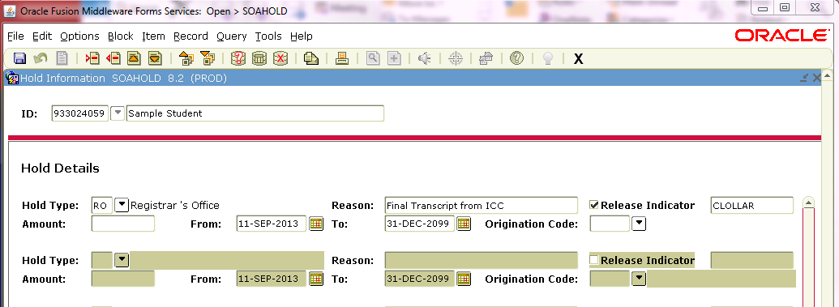
SOAHOLD Hold Information
Note: If Release Indicator is checked, only the person that placed the hold can remove the hold.

Slide 17
SAAADMS Admissions Application
Admission Type
Student Type
Residence
Application Status
D – Decision Made
C – Complete and Ready for Review
I – Incomplete Items Outstanding

Slide 18
SHATERM Term Sequence Course History
Current Standing
First Term Attended
Last Term Attended
Academic Standing
Academic Standing Override
Institutional – Transfer and Overall
Attempted Hours (Financial Aid)
Passed Hours
Earned Hours
GPA Hours
Quality Points
GPA

Slide 19
SHATERM cont. Term GPA and Course Detail Information
Term GPA and Course Detail Information
Transfer by term
Transfer Number
Attendance Period
Institutional by term
Term and Cumulative Attempted Hours, Passed Hours, Earned Hours, GPA Hours, Quality Points, GPA

Slide 20
SHADEGR Degree and Other Formal Awards

Slide 21
SHADGMQ Degree Summary

Slide 22
SHATCMT Transcript Events and Comments
Academic Comments
PTK, NCATE, ASHA, etc.
Transcript Comments By Level
Degrees from prior institutions
Transcript Comments By Term
Withdrawal Dates
Approved for Readmission

Slide 23
SHATCMT Transcript Events and Comments

Slide 24
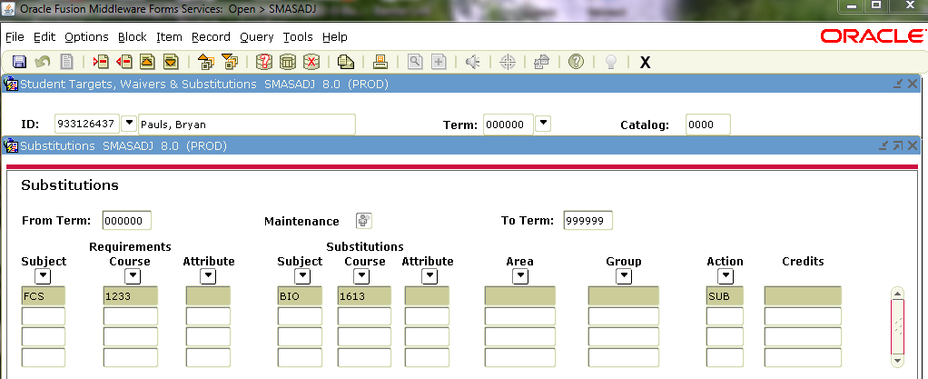
SMASADJ Student Waivers & Substitutions

Slide 25
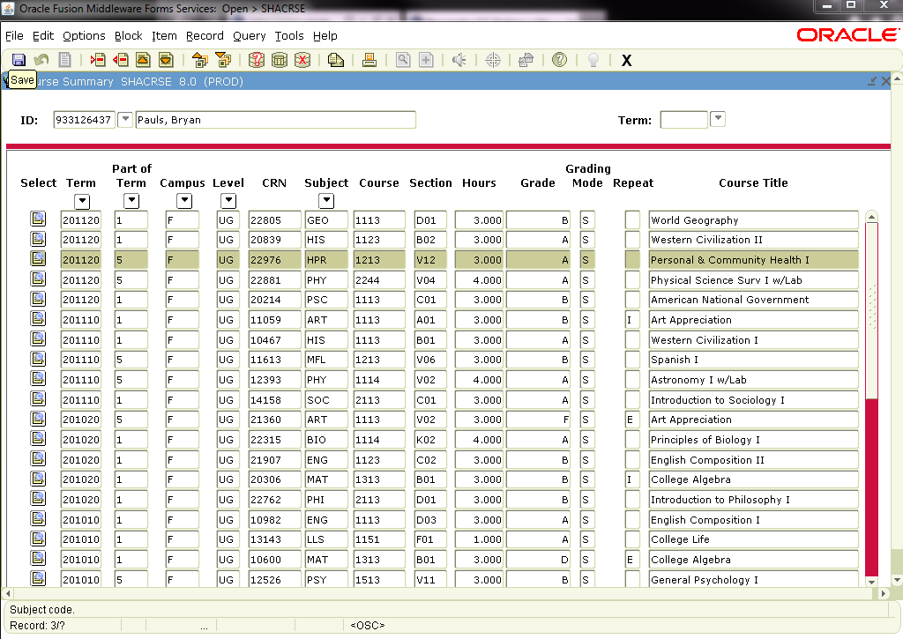
SHACRSE Course Summary
Institutional Course Summary
Leave Key Term Blank if you want all history

Slide 26
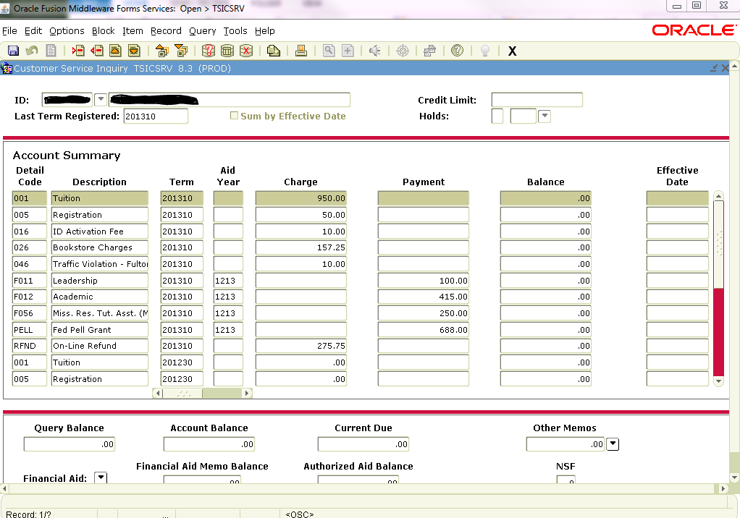
TSICSRV Customer Service Inquiry
Student Account Detail

Slide 27
TSAAREV Account Detail Review Form

Slide 28
ROASTAT Applicant Status (Financial Aid)

Slide 29
ROASMRY Applicant Summary (Financial Aid)
Financial Aid and Scholarship Awards

Slide 30
TGIACCD Account Detail Query
Note: After query results can’t rollback, must exit.
Query can’t be too broad or will lock up or take forever. The more search variables you enter the better. Need at least 2 variables.
There are 30 different search variables

Slide 31
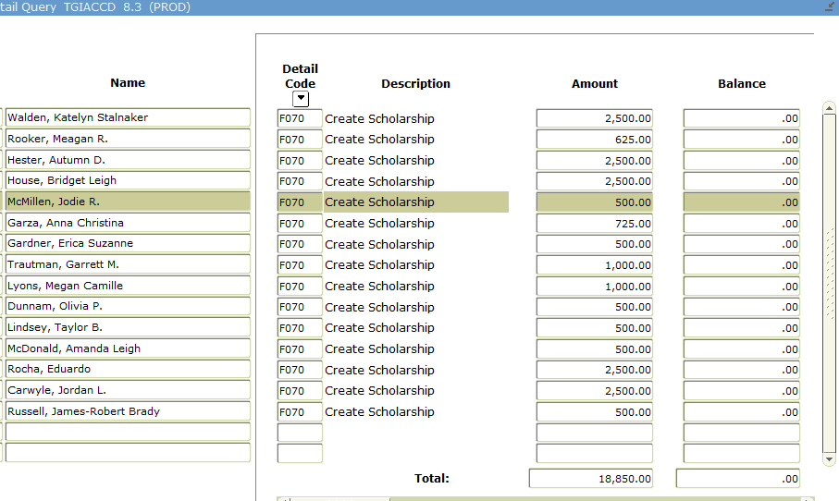
TGIACCD EXAMPLE
Search: Create Scholarships disbursed for Spring 2014 Semester.
Enter: Detail Code…..F070
Term…..201420
Then F8 to execute

Slide 32
FINANCE QUERY FORMS
FOIDOCH (Document History by Doc Type)
FGIBDST (Organization Budget Status)
FPIPURR (Purchase Order Query by PO#)
FPIOPOV (Purchase Order by Vendor)
FAIVNDH (Vendor Detail History)

Slide 33
FOIDOCH (Document History)
After search click on document then “options” at top to see detail.

Slide 34
FGIBDST (Org. Budget Status)
Click on line item then “options” to get detail info of line item.

Slide 35
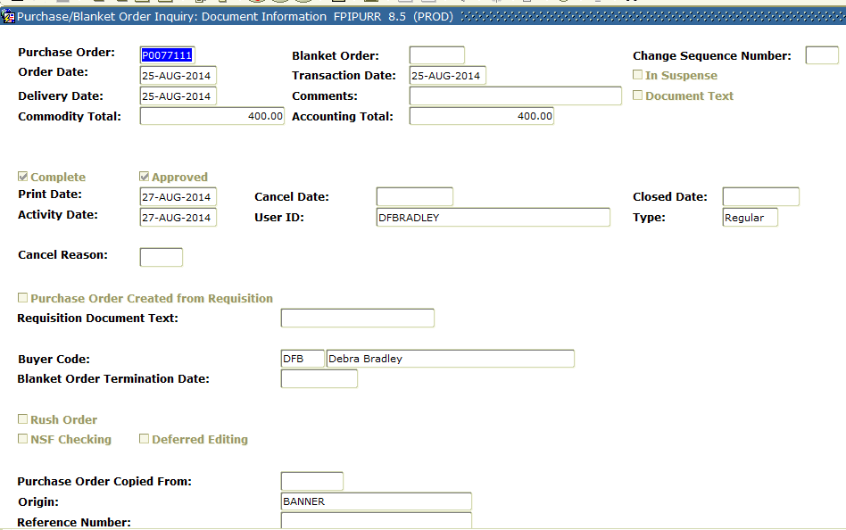
FPIPURR (PO query by #)
Enter PO number then ctrl page down.
Continue to ctr pg down to get to next page of form

Slide 36
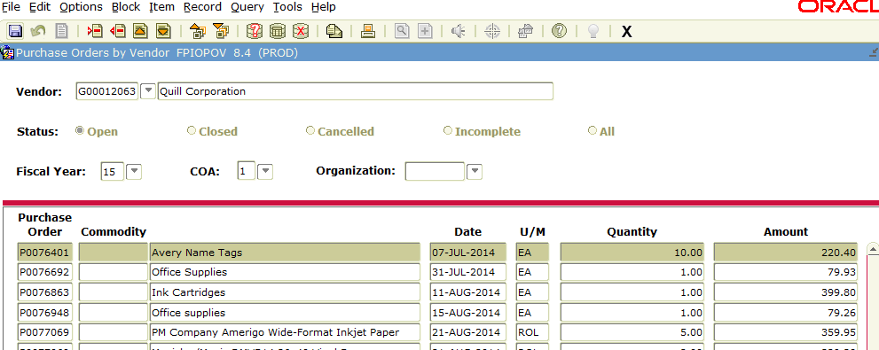
FPIOPOV (PO by Vendor)
Key in vendor # or do search by vendor name.
After selecting vendor, ctrl pg down.
Click on PO# then “options” at top will give you detail

Slide 37
FAIVNDH (Vendor History)
Click on invoice/line item then “options” at top will give more detail

Slide 38
Where do I find _____?
Account Detail (Business Office) – TSAAREV or TSICSRV
Addresses – SPAIDEN to Update and SOADDRQ to view only.
Admission Status – SAAADMS
Advisor – SGAADVR
Attribute (Student) – SGASADD
Audit (Student Course Information) – SFASTCA
Budget Status (available balance) - FGIBDST
Class Attendance Roster – SFAALST
Class Roster – SFASLST
Class Enrollments – SSASECQ
Classification – SGASTDN - Student Term Tab on SFAREGS
Cohort (Student) – SGASADD
Colleges Attended – SOAPCOL
Comments (Transcript) – SHATCMT
Common Matching – GOAMTCH
Courses Taken (Institutional) – SHATERM or SHACRSE
Courses Taken (Institutional and Transfer) – SHATERM
Date of Birth – SPAIDEN or SPAPERS
Degrees Awarded – SHADEGR or SHADGMQ
Document History - FOIDOCH
Dorm Information - SLARASG

Slide 39
Where do I find ____? Cont.
Ethnicity – SPAIDEN or SPAPERS
Financial Aid Eligibility Status - ROASTAT
Financial Aid Authorizations - ROASMRY
GPA – SHATERM
High School Information – SOAHSCH
Holds – SOAHOLD
Last Date of Attendance – SHATERM
Major (Curriculum) – SGASTDN
Pre-Banner Summary Hours – SHAPCMP
Purchase order details - FPIPURR
Purchase order by vendor name - FPIOPOV
RACE – SPAIDEN or SPAPERS
Search by Date of Birth – GUIALTI
Search by Phone Number – GUISRCH
Search by Person – SOAIDEN
Student Schedule – SFAREGQ
Telephone Numbers – SPAIDEN to Update and SPATELE to view only
Test Scores – SOATEST
Transfer Equivalencies – SHATATR
Transcript Requests – SHARQTC
Transfer Work – SHATRNS
Vendor History/Vendor Payments - FAIVNDH

Slide 40
Keystrokes
F5 – Display Navigation Window lets you toggle between screens.
F6 in the key block on SAAADMS will take you to SPAIDEN.
Keystroke Navigation:
Rollback – Shift+F7
Next Block – Ctrl+PgDn
Previous Block – Ctrl+PgUp
Insert Record – F6
Remove Record – Shift+f6
Duplicate Record – F4
Next Record – Down Arrow
Previous Record – Up Arrow
Next Field – Tab
Previous Field – Shift+Tab
Enter Query – F7
Execute Query – f8
Cancel Query – Ctrl+Q
Save – F10
List of Values – F9
Direct Access F5
Options List – F2
Print Shift+F8
Exit – Ctrl+Q
Help – F1
Radio Button – Space Bar
Select – Shift+F3

Slide 41
QUESTIONS?
Thank you for attending!
Cay Lollar
clollar@iccms.edu
Sandi South
sssouth@iccms.edu

