Slide 1
Autopacking Institutional Awards 101
Robert Gatewood, m.ed.
Ellen little

Slide 2
Current Practices at Mississippi College
Prior to Fall 2014, all federal aid is automatically packaged and awarded by Banner
Prior to Fall 2014, all institutional aid was manually awarded by the students’ Admissions Counselor
After the Admissions Counselor’s awarded students, the Office of Financial Aid manually applied aid to RPAAWRD.

Slide 3
Why automate the packaging of institutional aid
Remove the human error
Expedite the process of awarding students
Remove manual processed from Admissions
Remove manual processes from Financial Aid

Slide 4
BANNER to the Rescue!!
BANNER

Slide 5
Key Points
Once a student has been placed into a tracking and budget group and completed the requirements, he/she is ready for the packaging process, using Award Form (RPAAWRD).
Packaging Groups can be posted automatically using the Batch Automatic Grouping Process (RORGRPS). Packaging groups can also be assigned manually through the RPAAWRD form.

Slide 6
Key Points
Before Automatically posting packaging groups, you must build Packaging group codes (RTVPGRP) and group assignment rules using the Financial Aid Selection Rules form (RORRULE).
Once the packaging group is assigned, the packaging process (RPEPCKG) will assign funds to the student as determined by the user-defined packaging rules. Many factors determine packaging strategy.

Slide 7
Step 1: Determine what factors are used in awarding institutional aid

Slide 8
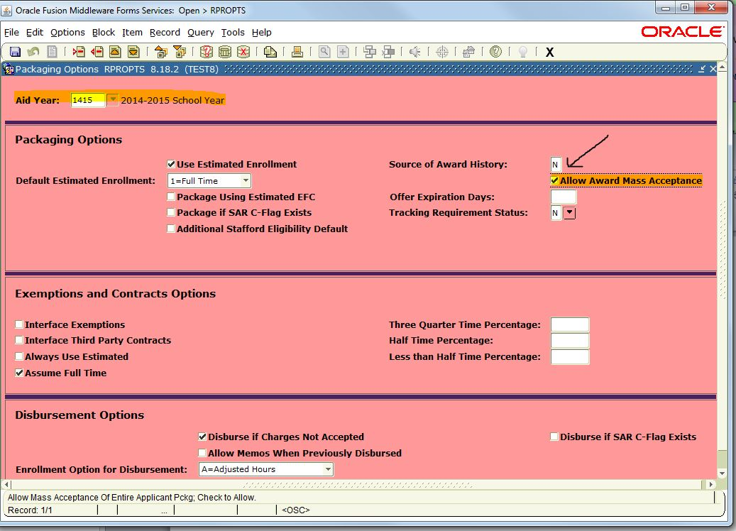
Step 3: Use RPROPTS to allow mass acceptance

Slide 9
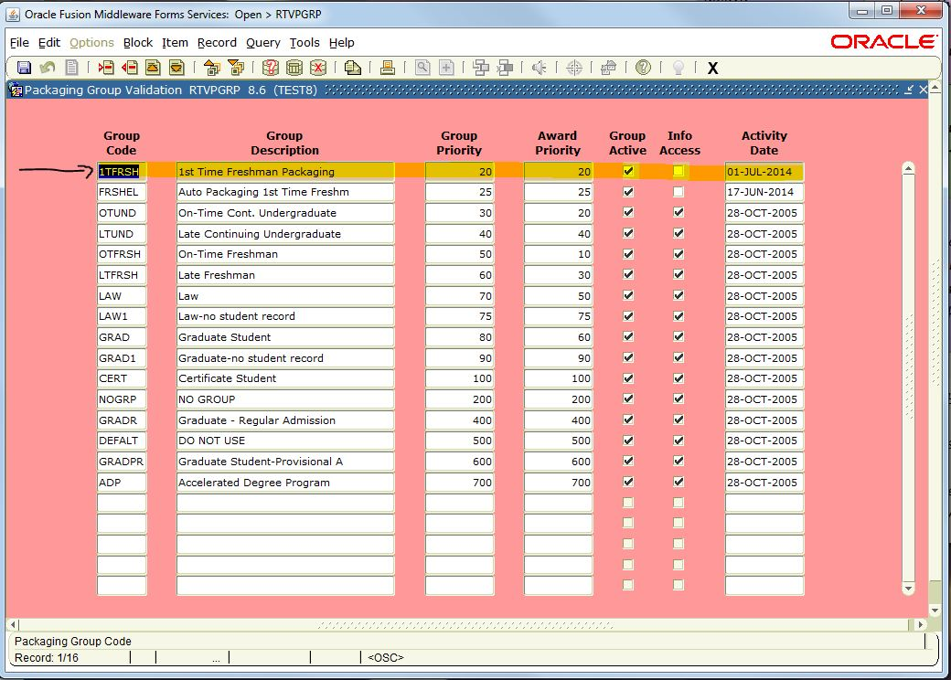
Step 4: Use RTVGRP to create a new packaging group

Slide 10
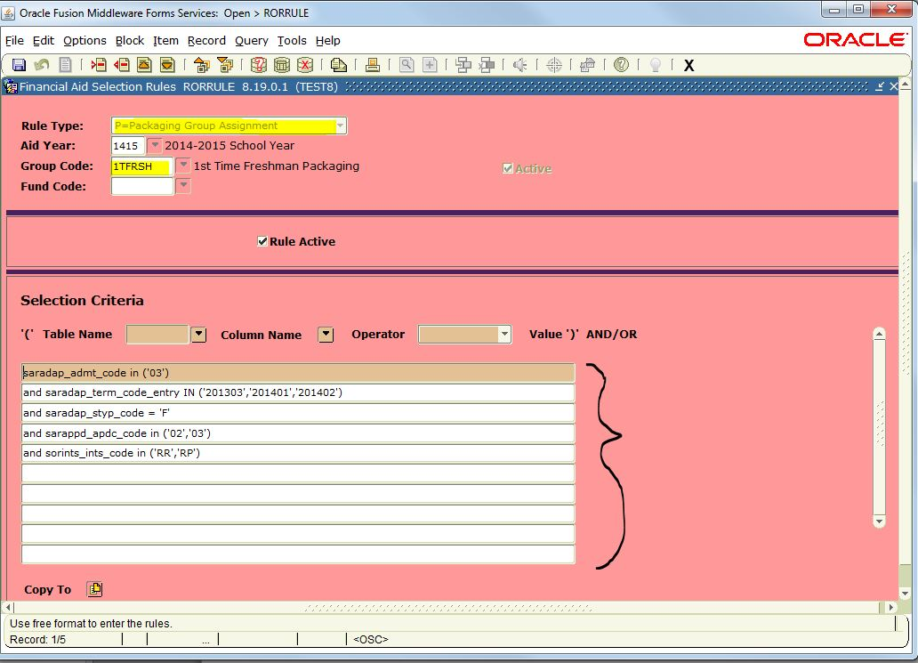
Step 5: Use RORRULE to define selection rules

Slide 11
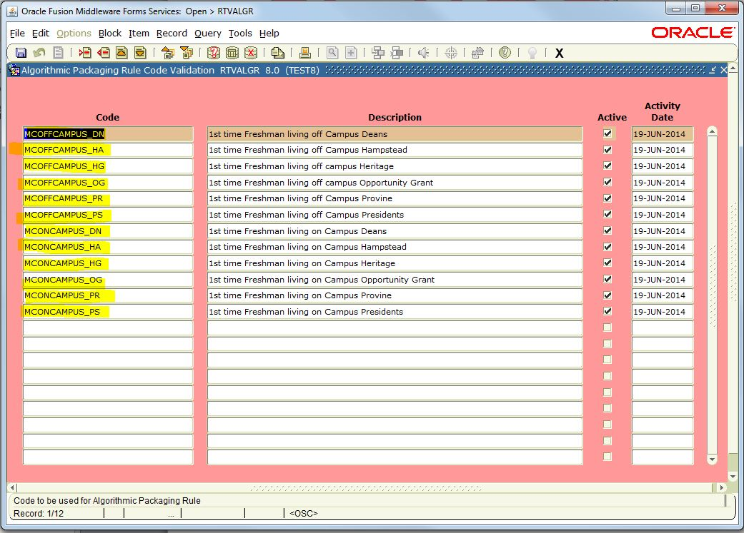
Step 7: Use RTVALGR to create algorithm codes for awarding

Slide 12
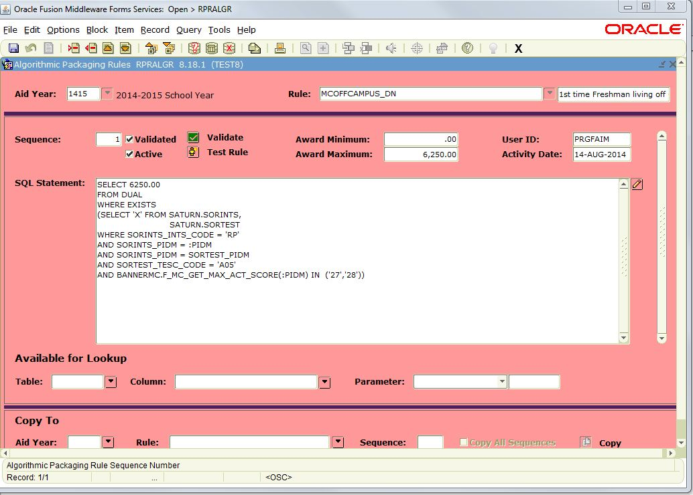
Step 8: Use RPRALGR to create each rule for EACH fund code

Slide 13
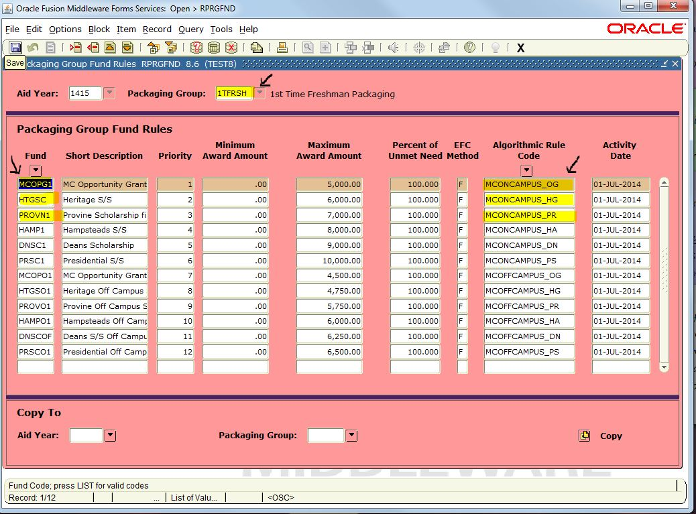
Step 9: Use RPRGFND to assign fund codes to algorithmic rules

Slide 14
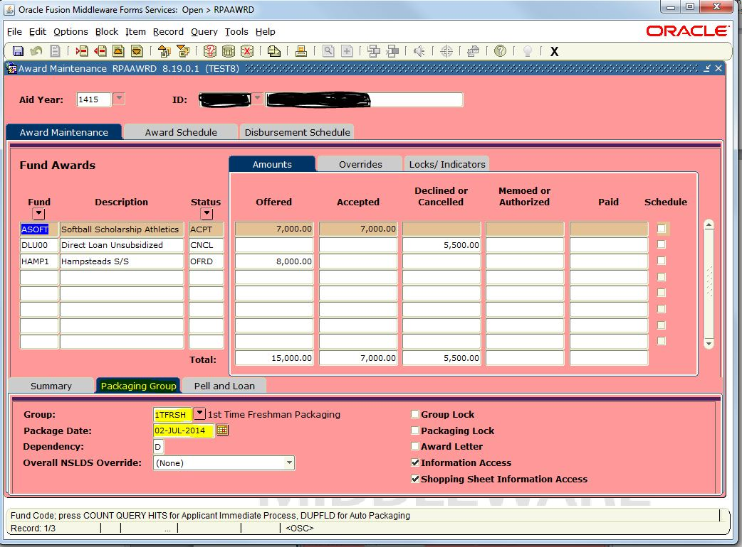
Step 10: Assign the packaging group (manually)

Slide 15
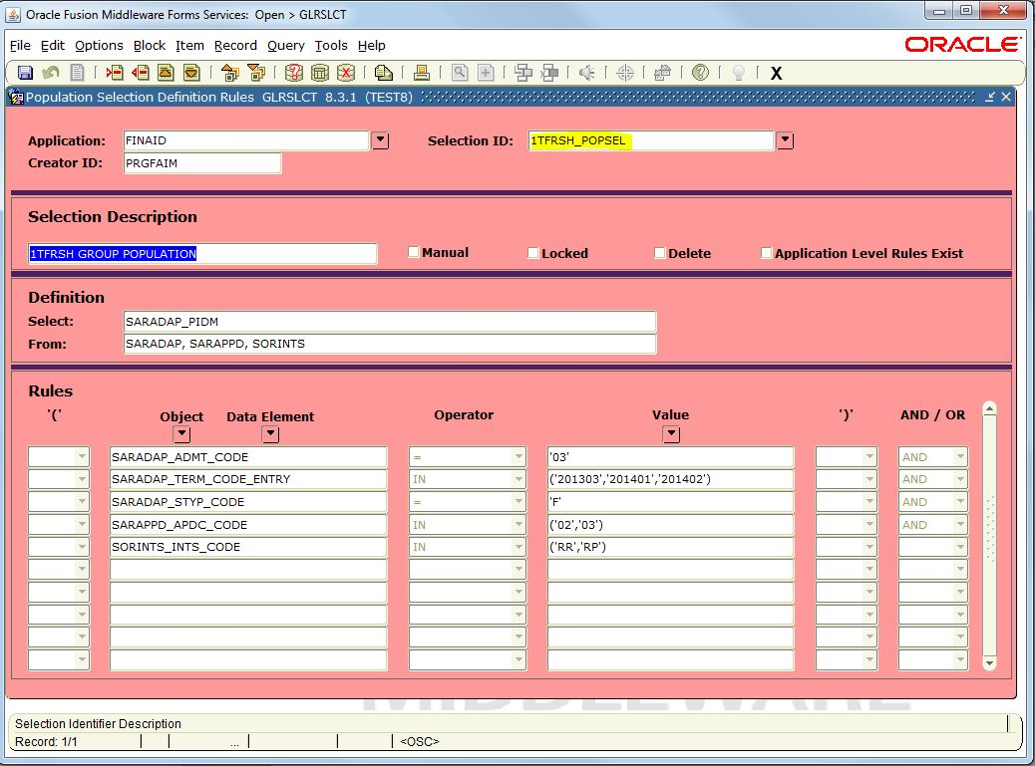
Step 10: Assign the packaging group (automatically) GLRSLCT

Slide 16
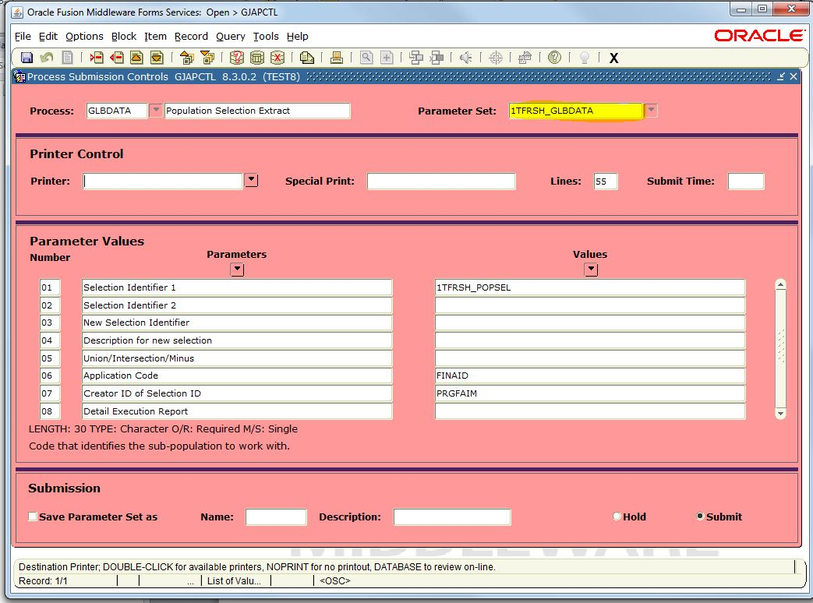
Step 10: Assign the packaging group (automatically) GLBDATA

Slide 17
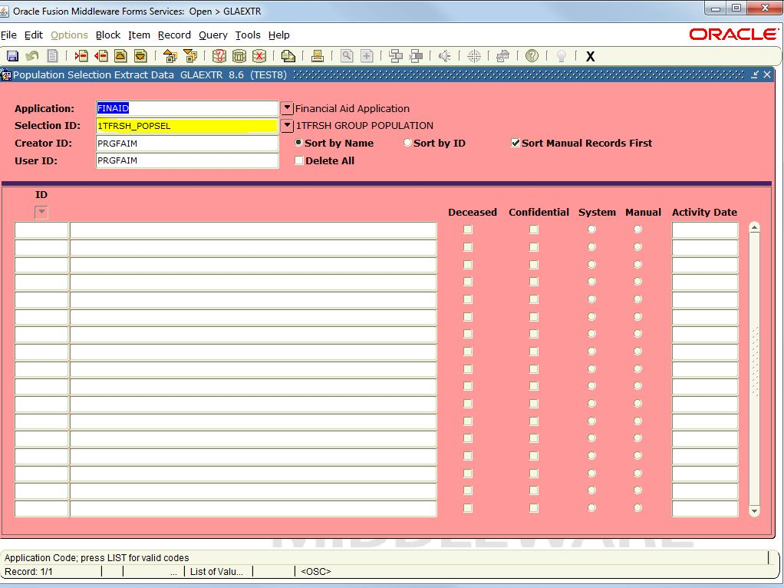
Step 10: Assign the packaging group (automatically) GLAEXTR

Slide 18
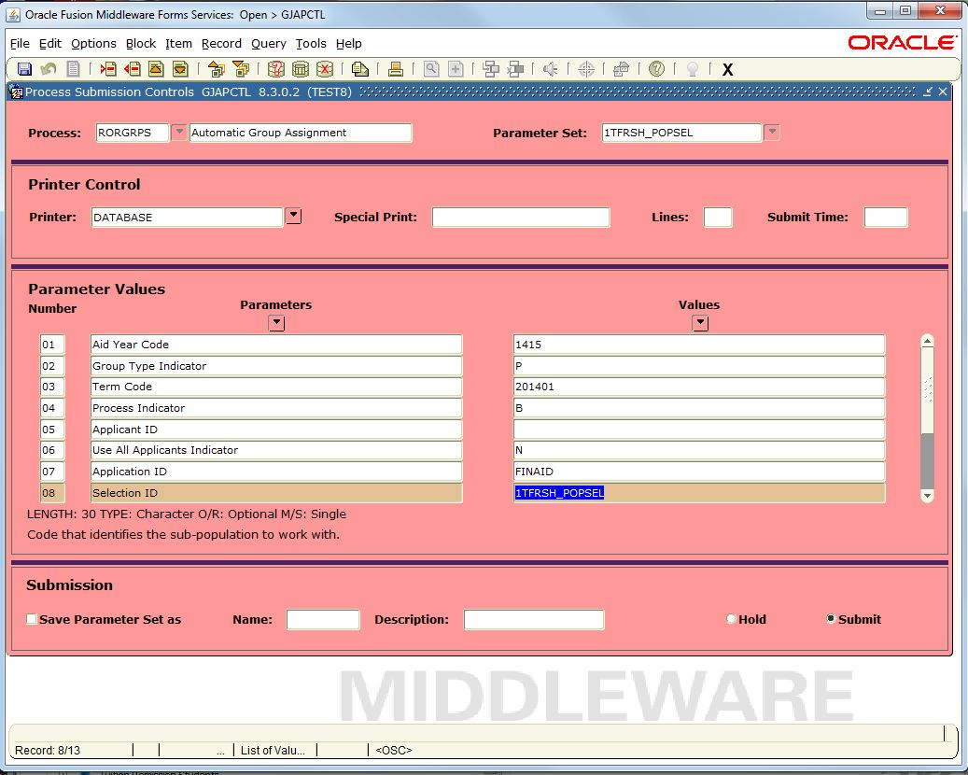
Step 10: Assign the packaging group (automatically) GJAPCTL

Slide 19
Notes
After this batch process has run, then everyone should have the 1TFRSH Fund code to be batch processed. However, if they have ever been packaged before then they will have a date in the RPAAWRD – Packaging Group Tab. This needs to be nulled.
Please note that you must be careful nulling out the date field. There are issues with repackaging students.
If any awarded funds are completely spent, it will delete the award because the fund is out of money.
Re-packaging can cause a student that accepted fund to be put back in an offered status. (There is an Argos Report .. Institutional Accepted by Student Listing for Auto Packaging that will go out and set the fund code to accepted).

Slide 20
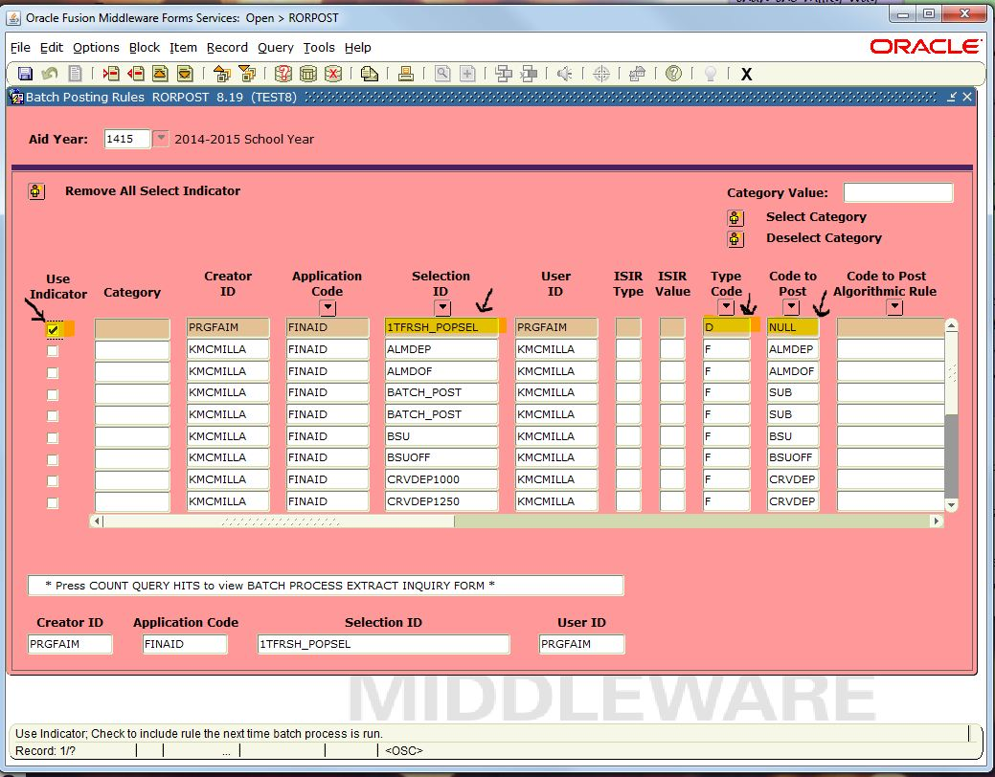
In the case of after awarding institutional funds, you want to run Pell, you can null out the field in Banner with the following steps. Open Form RORPOST form and choose the selection criteria, and be sure and click on Use Indicator. You will need to set the Type Code to D and Code to Post to Null

Slide 21
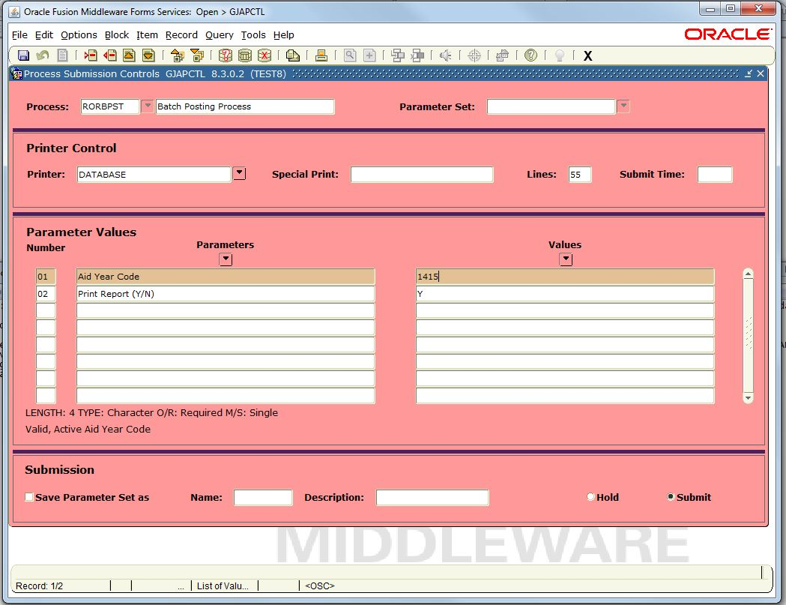
Open form RORBPST and run the batch process. This will null out the date field for the 1TFRSH group.

Slide 22
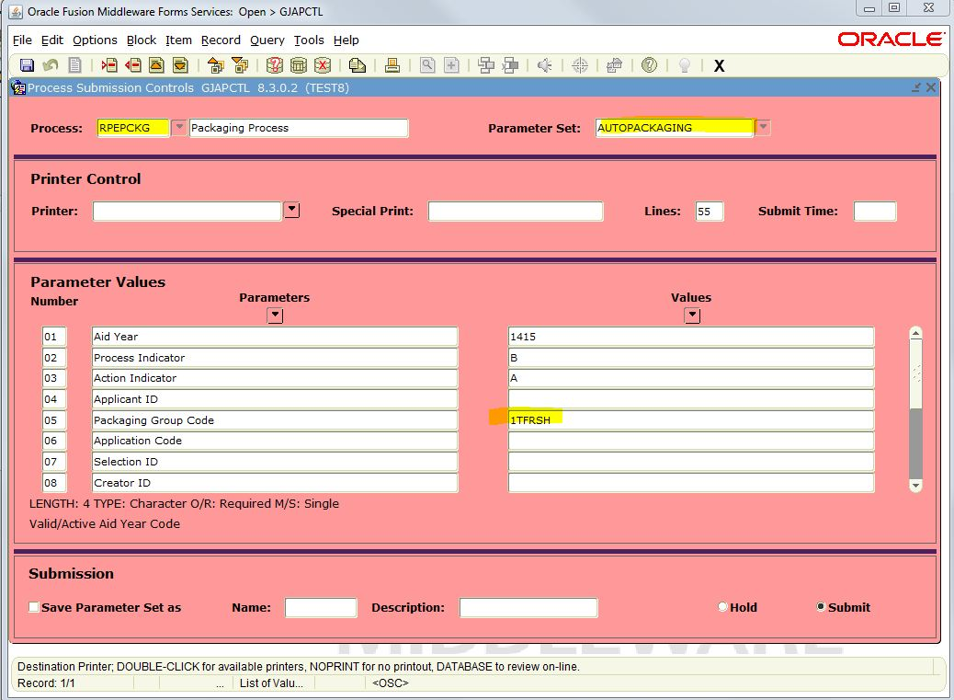
After you null out the date fields, then you can run the package process to assign the Inst. Awards based on ACT scores. Open form GJAPCTL – RPEPCKG – This will scholarship to the qualified individuals in the 1TFRSH group based on their ACT scores.

Slide 23
Important Note
As long as you Package the students via Batch then you can re-package them via batch. If you MANUALLY add a fund code to any student, when it comes to re-packaging, that student will not be re-packaged because that Fund Code now has a system indicator of M for Manual. The Batch process (if any changes) will only add that new fund code to the student rather than updating the current fund code. (Batch process has a system indicator of S for System .. rprawrd_sys_ind on the rpaawrd form)

Slide 24
Demonstration
Time!

Slide 25
Contact Information
Robert Gatewood, M.Ed. Director of Enterprise Applications
gatewood@mc.edu
601.925.3286
Ellen Little Programmer/Analyst
elittle@mc.edu
601.925.3475

