Slide 1

MBUG 2014
ADMISSIONS: MAKING THE MOST OF THE QUICKFLOW
Cassandra T. Atley
Mississippi Delta Community College
September 16, 2014

Slide 2
Session Rules of Etiquette
Please turn off your cell phone
If you must leave the session early, please do so discreetly
Please avoid side conversation during the session

Slide 3
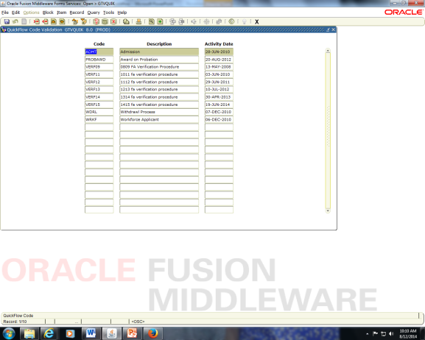
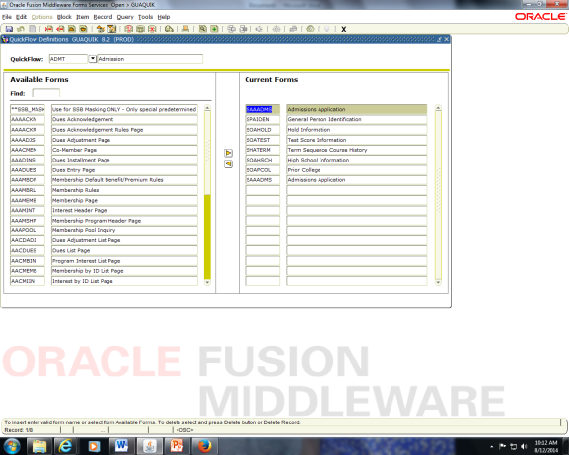
What is Quick Flow?
Process that lets you access a set of forms in a specific sequence
  GTVQUIK (Name it)
  GUAQUIK (Add the sequence of forms)

Slide 4
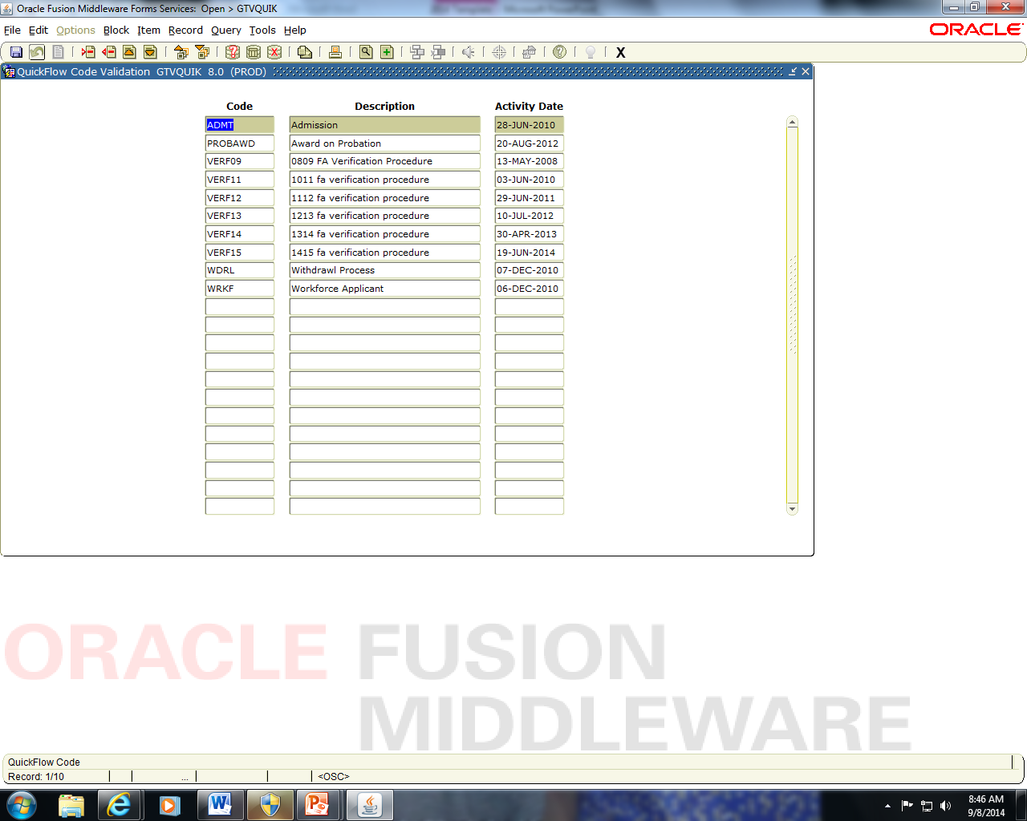
GTVQUIK

Slide 5
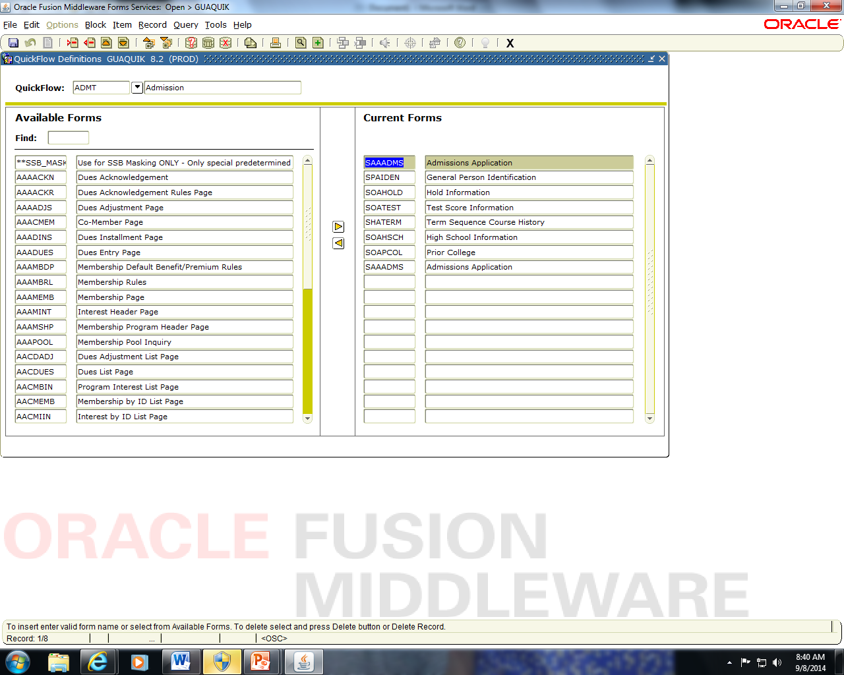
GUAQUIK
*SHADEGR

Slide 6


Why use the Quickflow?
You won’t miss a beat!!!
CONSISTENCY CONSISTENCY CONSISTENCY

Slide 7

Quick Flow Benefits
New Colleagues
Forgetful Colleagues
Busy Colleagues
L#$% Colleagues

Slide 8
Share Your Quickflow with Me…
MDCC ADMT
SAAADMS
SPAIDEN
SOAHOLD
SOATEST
SHATERM
SOAHSCH
SOAPCOL
SAAADMS

Slide 9
1. SAAADMS
To determine if an application is already there
Enter name and next block
  Readmits
  Previous applicants
Notes:
Students will complete an application, submit it, and do it again. Especially if they haven’t completed process, i.e., lacking transcripts.

Slide 10
2. SPAIDEN
If the person is new, create an ID
If the person is readmit, update information

Slide 11
3. SOAHOLD
Learn up front whether the person has a HOLD
Address the HOLD situation if necessary
HOLD window*
Notes:
Hold window is always up in order to place a hold during the process

Slide 12
4. SOATEST
Enter Test Scores
  GED
  ACT
May need to place a hold (DV Holds)

Slide 13
5. SHATERM
For previously enrolled students
  Determine how to admit them on SAAADMS, i.e., Readmit Continuing, Admit on Probation, etc.

Slide 14
6. SOAHSCH
7. SOAPCOL
Enter high school
Enter college(s)

Slide 15
8. BACK TO SAAADMS
You have the information needed to enter correct information
Use the open HOLD window if necessary
  Summer (IN Holds, because we give them 35s)
Notes:
Other than summer the incomplete apps serve as holds

Slide 16
Other Issues
Dual Enrollment

Slide 17

QUESTIONS, SUGGESTIONS, COMMENTS, NEW IDEAS….
Thank you

