Slide 1
MBUG 2014
Session Title: Banner Accounts Receivable Refreshing the Basics
Presented By: Laura Chisolm
Institution: Pearl River Community College
September 15, 2014

Slide 2
Session Rules of Etiquette
Please turn off your cell phone
If you must leave the session early, please do so discreetly
Please avoid side conversation during the session

Slide 3
Student Accounts Receivable
Actions which affect AR
Communication
Financial Agreement
Detail and Priority Codes
Fee Assessment Rules
Application and Unapplication of Payments
1098T
XE Product

Slide 4
Actions which affect AR
Admissions
In State & Out of State coding
Campus Codes
Education
Program setup
Course setup
Program/Course Charges to individual accounts
Withdrawals and No Shows
Financial Aid
Pell
Loans
Scholarships

Slide 5
Communication
Always Communicate!
Classes are dropped which will affect financial aid or account balance.
No Shows
Courses are added which will affect billing.
Schedule changes (campus changes).
Email
Good resource to communicate.
Microsoft Sharepoint

Slide 6
Communication
Microsoft Sharepoint
There is a free version of the program.
Helps organize information, people, and tasks.
Workflow and approval process.
Withdrawals and no show processing
Major changes
Course additions
Can be used for document retention

Slide 7
Financial Agreement
Pros
Physical reminder that tuition and fees are related to attending college and the student will be held responsible for those charges.
Aids in the collection process.
Cons
? Why Not ?
Temple University - Session at Ellucian 2014 Live
University of Vermont and Texas A & M
Tied their Agreement to Registration

Slide 8
Financial Agreement

Slide 9
Financial Agreement

Slide 10
Detail and Priority Codes
Links AR module to GL
Charges
Payments
Creates accounting transactions which feed to GL
Review of form specifics

Slide 11
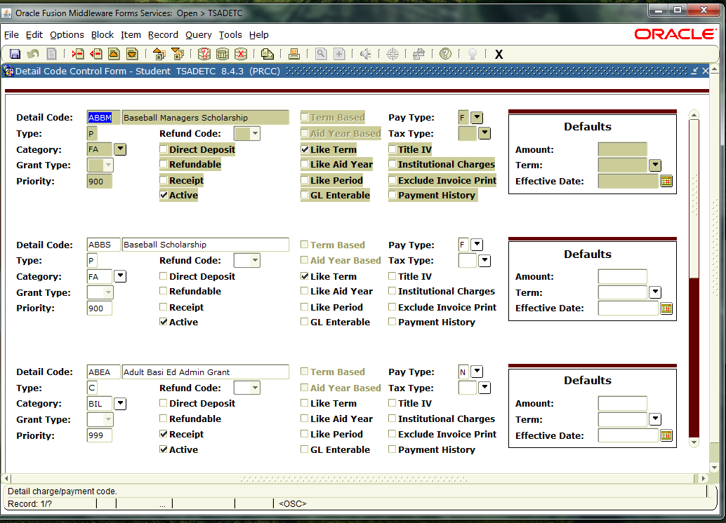
Detail and Priority Codes
Description on Bill
TSADETC

Slide 12
Detail and Priority Codes

Slide 13
Detail and Priority Codes

Slide 14
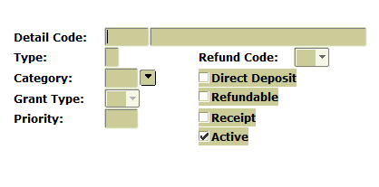
Detail and Priority Codes
Detail Code – 4 character code
Type – C for charge; P for payment
Category – 3 character Category groups for specific processing
Grant Type – only used for grant accounting
Priority – 3 character number that assigns the application order to transactions

Slide 15
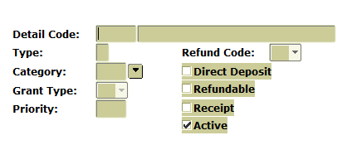
Detail and Priority Codes
Refund Code – assign only to Refund detail code (Y, P, M)
Direct Deposit – assign only to Refund detail codes
Refundable –should student receive the credit balance
Receipt – should a receipt number be generated
Active – indicates and active code

Slide 16
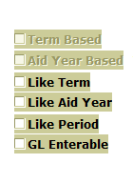
Detail and Priority Codes
Term based & Aid Year Based – determined by the build of accounting
Like Term, Like Aid Year, Like Period – restricts use during application of payment
GL Enterable – can the GL account be entered when on the T%AMISC form

Slide 17
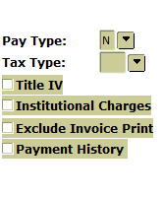
Detail and Priority Codes
Pay Type – another way to group detail codes
Tax Type – Canadian T2202A processing
Title IV – Federal Title IV payments
Institutional Charges – Inst. Charges as defined by the U.S. Dept of Ed
Exclude Invoice Print – exclude the transaction from printing on invoice
Payment History – display on payment history (SSB/INB)

Slide 18
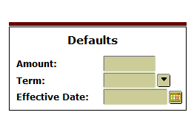
Detail and Priority Codes
Defaults – can be assigned to assist in data entry

Slide 19
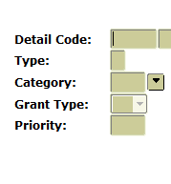
Detail and Priority Codes
Priority Codes
Order by which charges are paid
Order by which payments are used
Application of charges paid by the appropriate payments

Slide 20
Detail and Priority Codes
Priority Codes
3 numbers
Zero’s are wildcards
Numbers match by columns
Payment detail codes with the highest priority number will be used first
Charge detail codes with highest priority numbers will be paid first
More than one detail code which has the same priority
Oldest effective date
Oldest transaction date

Slide 21
Detail and Priority Codes
Example of column matching
Payment 900 pays 900 – 999
Payment 800 pays 800 – 899
Payment 880 pays 880 – 889
Payment 901 pays 901, 911, 921, 931, 941, 951, 961, 971, etc.
Use a wildcard of 0 on charges if the 03 parameter in TGRAPPL = N
Apply Negative Charge to any priority

Slide 22
Detail and Priority Codes
Remember 000 will pay all charges
If you have a charge to be paid specifically by a payment any payments with 000 will be able to pay that charge as well.
Detail codes are charges or payments
Payments apply to charges
Payments are used in order of priority
Application of Payment parameters will supersede
Priority codes are compared by column

Slide 23
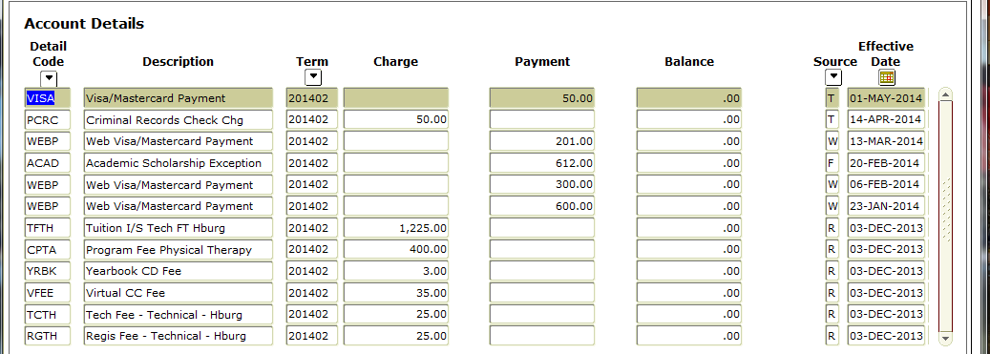
Detail and Priority Codes
Example:

Slide 24
Detail and Priority Codes

Slide 25
Detail and Priority Codes

Slide 26
Detail and Priority Codes

Slide 27
Fee Assessment Rules
Rules can be based on several factors.
Student Characteristics
Course Characteristics
Fees attached directly to the courses

Slide 28
Fee Assessment Rules
Fee Assessment Rule Forms
SCADETL - Catalog/Section - Catalog Detail
SSADETL - Catalog/Section -Schedule Detail
SSADFEE - Catalog/Section - Section Fee Assessment Control
SSPMFEE - Catalog/Section -
SFARGFE - Registration Fee Assessment Rules
SFAFMAX - Registration - Registration Fees Min/Max Charge control
SFAAFEE - Registration Additional - Registration Additional Fees Control
SFAEFEE - Registration Additional - Registration Additional Fees
SFRFASC - Batch Fee Assessment

Slide 29
Fee Assessment Rules
SCADETL
Default to sections
Must be built in catalog before sections are built
Fees can be in addition or instead of SFARGFE rules
SSADETL
Rules default from catalog
Rules can be added/changed to specific sections manually
Section fees can be updates based on course characteristic rules
SSADFEE and SSPMFEE
Fees can be in addition or instead of fees from SFARGFE

Slide 30
Fee Assessment Rules

Slide 31
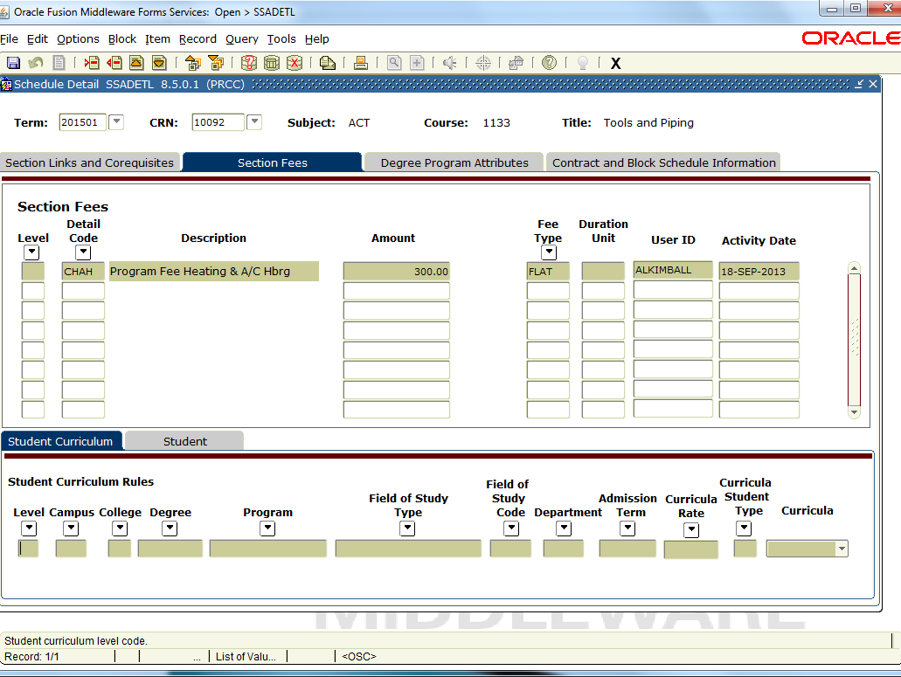
Fee Assessment Rules
SSADETL

Slide 32
Fee Assessment Rules
SSADETL
Add Fee Rules to SSADETL for rules in addition to SFARGFE
Add Fee Rules to SSADETL for rules instead of SFARGFE
Add fee rules to SSADETL
Check Tuition and Fee Waiver Box in SSASECT
Check OVR on SFARGFE for every rule to be ignored for the section
(see screen prints)

Slide 33
Fee Assessment Rules
Section Fee Assessment Control
SSADFEE
(see screen print)
Section Fees
Build section fee based on course characteristics
Run the fee population script (SSPMFEE) to load the rules to the SSRFEES table
SSRFEES is the table viewed in SSADETL

Slide 34
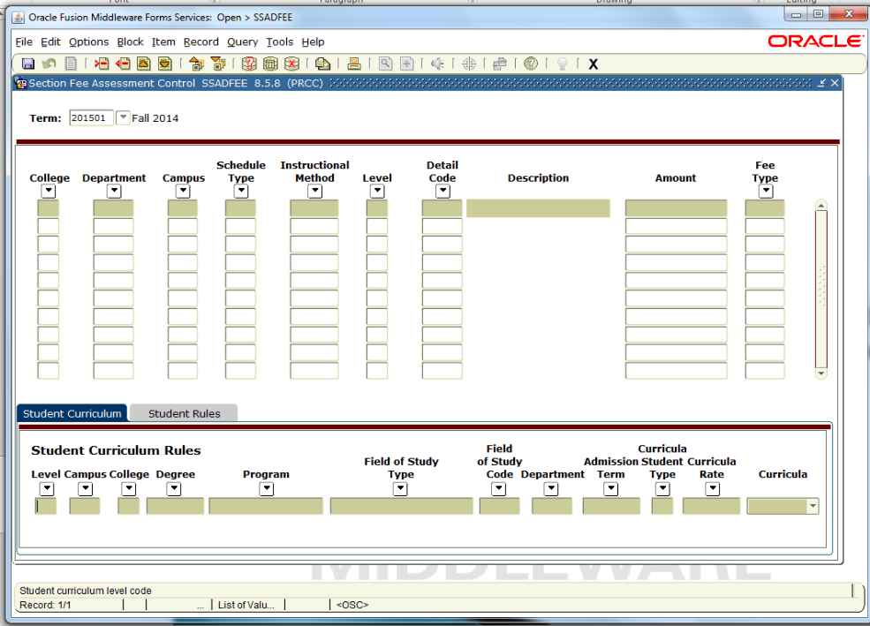
Fee Assessment Rules
SSADFEE

Slide 35
Fee Assessment Rules
SSPMFEE
Record insertions will only occur if no section level fees have already been defined. If fee entries already exist in the SSFRFEES table, no insertion of new or update of existing records will be made.

Slide 36
Fee Assessment Rules

Slide 37
Fee Assessment Rules
SFARGFE
Registration Charges and Fees Form
Each Rule has tabs of additional configuration fields
All data from configuration fields resides in the table
SFRRGFE
Remember:
Student is assessed for every rule they qualify
A negative rule doesn’t cancel another negative rule
Allow more reversals than charges

Slide 38
Fee Assessment Rules
SFARGFE
Registration Charges and Fees form
Established by Rule Type
ATTR – Attribute
Campus
Level
Student
Studypath – Field of Study Type field and Field of Study Code
Studypath_Attr

Slide 39
Fee Assessment Rules

Slide 40
Fee Assessment Rules
Copy rules from one term to another term
Processes the set copy setting to all rules (must be in the data block when clicking icon)
Defaults or Updates the rules in the data block

Slide 41
Fee Assessment Rules
Check if the rule will be copied
Should the rule be ignored if the tuition or fee should be waived in SSASECT
Prebill or Regular

Slide 42
Fee Assessment Rules
SFARGFE
Registration Charges and Fee Form
Three configuration tabs for each rule.
Student Curriculum
Level, Campus, College, Degree, Program, Admission Term,
Curricula, Field of Study, Field of Study Code, Department,
Curricula Student Type, and Curricula Rate
Registration Criteria
Liable Billing Hours From and To
Flat Charge Hours Range From and To
Course Overload Start Hours
Total Student Liable Hours From and To
Flat Charge Amount
Registration Dates From and To

Slide 43
Fee Assessment Rules
Registration Criteria
Total Student Liable Hours
Used in assessment by course level, campus, and attribute

Slide 44
Fee Assessment Rules
SFARGFE
Registration Charges and Fee Form
Three configuration tabs for each rule.
Student/Course Rules
Student Attribute
Student Type
Student Rate
Residence
Visa
Class
Cohort
Assess by Course – each course will be assessed individually
Grade Mode
Instructional method
Schedule Type

Slide 45
Fee Assessment Rules
SORLCUR_STYP_CODE
SORLCUR_RATE_CODE

Slide 46
Fee Assessment Rules
Last credit hour charged at flat rate
Enrollment Record status date
SFBETRM

Slide 47
Fee Assessment Rules
Student Attribute – SGRSATT Student Type – SGBSTDN_STYP_CODE Student Rate – SGBSTDN_RATE_CODE Residence – SGBSTDN_RESD_CODE VISA – GORVISA_VTYP_CODE Class – SGSTDN POT – SFRSCTR Cohort – SGRCHRT Grade Mode – SFRSTCR Instructional Method – SFRSTCR Schedule Type - SFRSCTR
Each course is to be assessed the rule individually

Slide 48
Fee Assessment Rules

Slide 49
Fee Assessment Rules

Slide 50
Fee Assessment Rules

Slide 51
Fee Assessment Rules

Slide 52
Fee Assessment Rules

Slide 53
Fee Assessment Rules

Slide 54
Fee Assessment Rules

Slide 55
Fee Assessment Rules

Slide 56
Fee Assessment Rules

Slide 57
Fee Assessment
Part of Term
POT = C
Student with multiple parts of term are considered to be in POT C
Course rules, assess by Course and POT, will always use the POT of the course

Slide 58
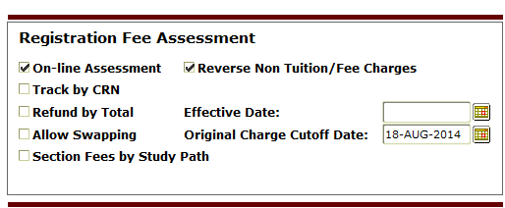
Fee Assessment
SFAFMAX
Minimum and Maximum set for each Detail Code
Applies to SFARGFE and SSADETL rules
Track by CRN must not be turned on

Slide 59
Fee Assessment

Slide 60
Fee Assessment

Slide 61
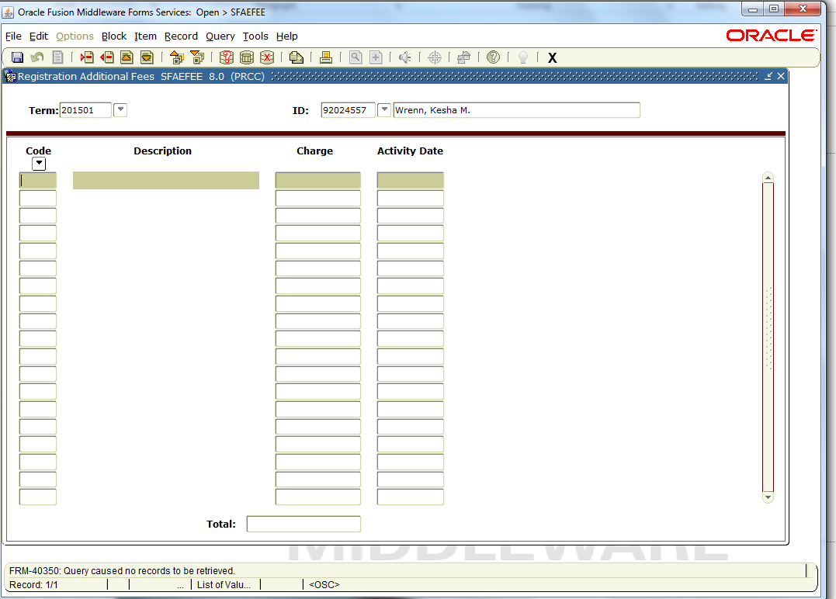
Fee Assessment
SFAEFEE
Registration Fee assessed to individual student

Slide 62
Fee Assessment
SFRFASC
Batch Fee Assessment
Regular and Prebill assessments
Assess individual students, a population, or everyone registered for a term.
Run online or batch.

Slide 63
Fee Assessment

Slide 64
Fee Assessment

Slide 65
Fee Assessment
The assessment date uses the greater of the SOATERM effective date or the date entered in parameter .
Assessing one student or a population parameter 8 must be blank.
Assessing Pre-Bill use P in parameter 11
Testing use parameter 19 in A – audit mode.

Slide 66
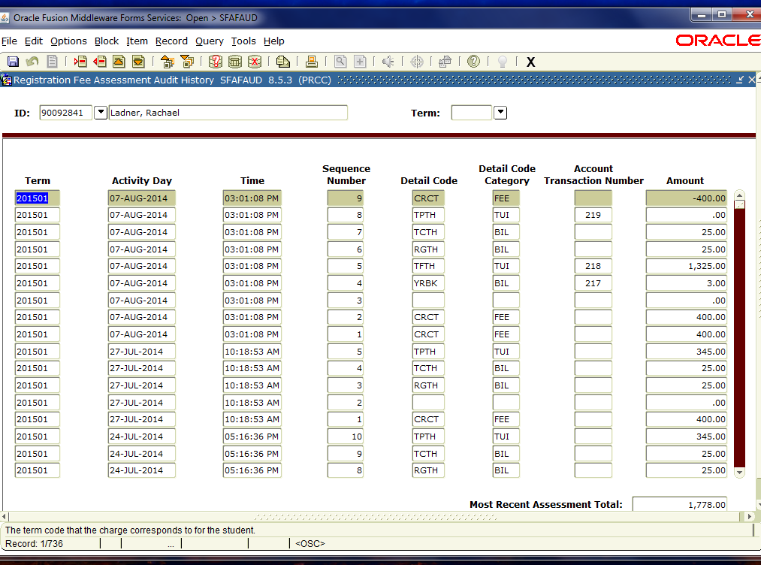
Fee Assessment
SFAFAUD
Registration Fee Assessment History

Slide 67
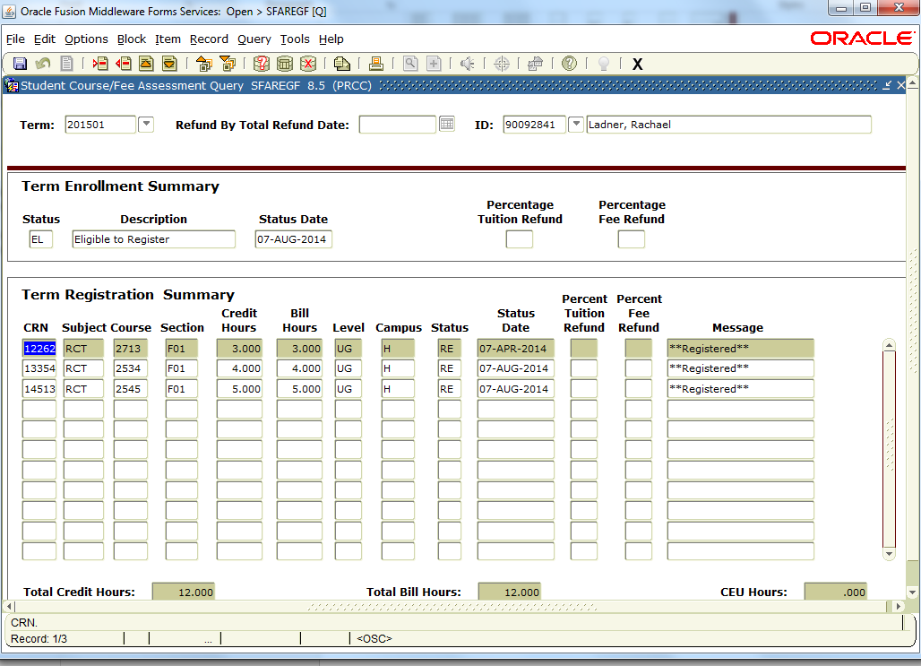
Fee Assessment
SFAREGF
Student Course/Fee Assessment Query (SFAREGS)

Slide 68
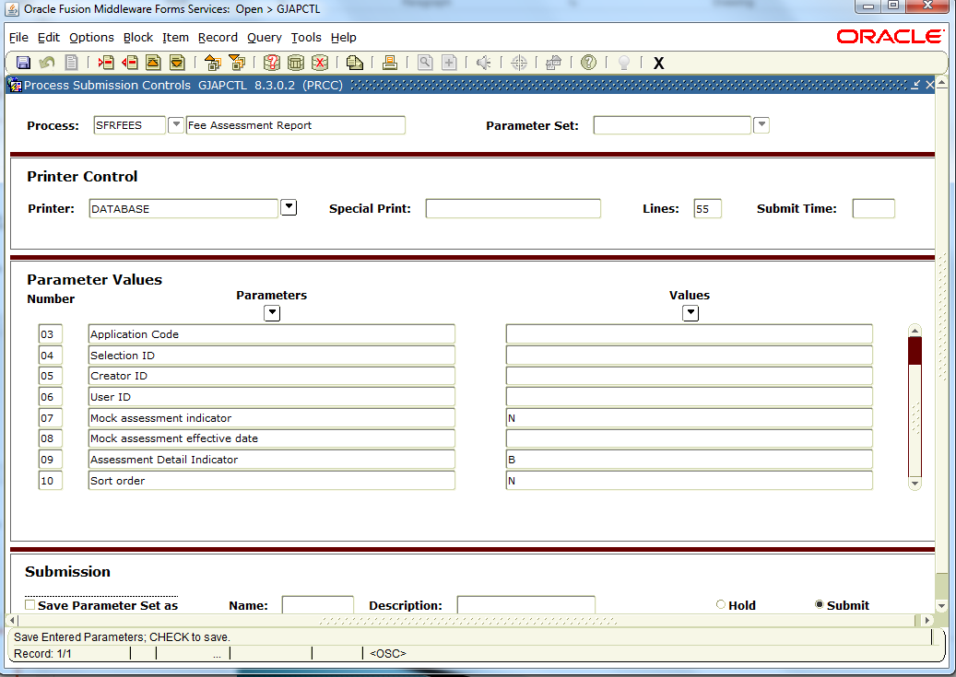
Fee Assessment
SFRFEES
Fee Assessment Report

Slide 69
Fee Assessment

Slide 70
Fee Assessment

Slide 71
Application of Payment
Process payments are applied charges
Payments applied to charges give accurate balance outstanding or account paid in full.
TGRAPPL – Application of Payment Process
Apply for individual student, population selection, or all.
Batch job
Reduces proper receivables in General Ledger
Effects aging
Gives accurate past due balance in bills.
Determines what is paid or past due.
Process can be scheduled or run while working on an individual account.

Slide 72
Application of Payment

Slide 73
Application of Payment

Slide 74
Application of Payment

Slide 75
Application of Payment
Transactions from TSAAREV saved in TBRACCD table
Finance
Rule class 1, 2, 3 are reserved for application of payment transactions

Slide 76
Unapplication of Payments
TSAUNAP
Cleans accounts
Change the way application of payment is applied
Clears Transactions Paid or Invoice Paid
Run as needed.

Slide 77
Unapplication of Payment

Slide 78
Unapplication of Payment

Slide 79
Unapplication of Payment

Slide 80
Unapplication of Payment

Slide 81
Application of Payment

Slide 82
Application of Payment

Slide 83
Application of Payment

Slide 84
Application of Payment

Slide 85
Application of Payment

Slide 86
1098 T

Slide 87
Credits
MBUG
Pearl River Community College
Temple University
Conrad Muth & Anthony Lower
Texas Tech University
Christina Blakney
Ellucian
Rose Most

Slide 88
Thank You
Laura Chisolm
lchisolm@PRCC.edu

