Slide 1
MBUG 2013
Session Title: Online Requisitions
Presented By: Kevin Baker
Institution: Holmes Community College
September 16, 2013

Slide 2
Session Rules of Etiquette
Please turn off your cell phone
If you must leave the session early, please do so discreetly
Please avoid side conversation during the session

Slide 3
Online Requisitions
INB
Create Requisitions
Approve Requisitions
SSB
Create Requisitions
Approve Requisitions
Setup Requisition Approvals

Slide 4
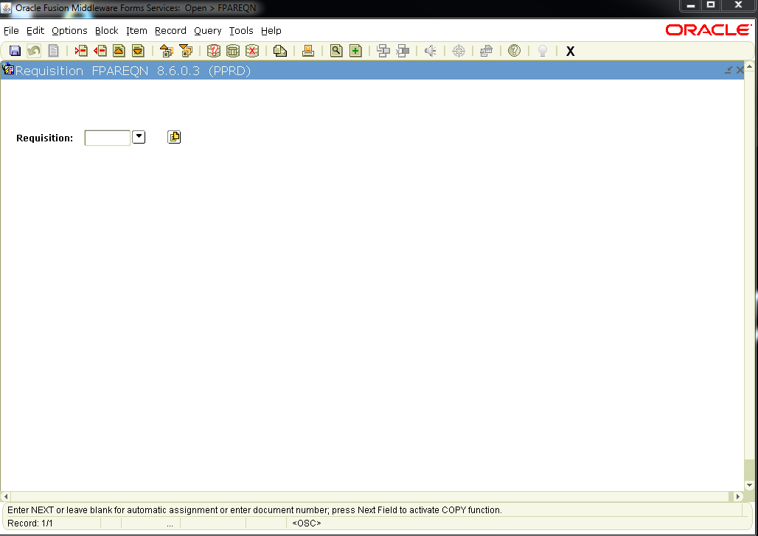
INB - Create Requisitions
FPAREQN
Next Block

Slide 5
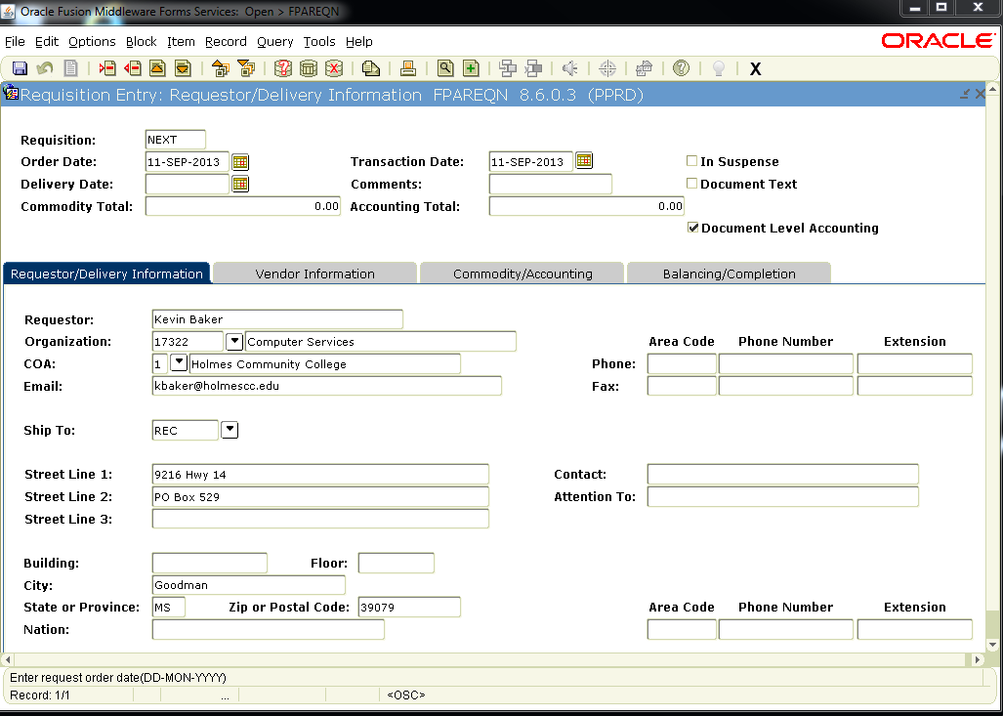
Requestor/Delivery Information
Enter “Deliver date:”
Enter “Attention To:”

Slide 6
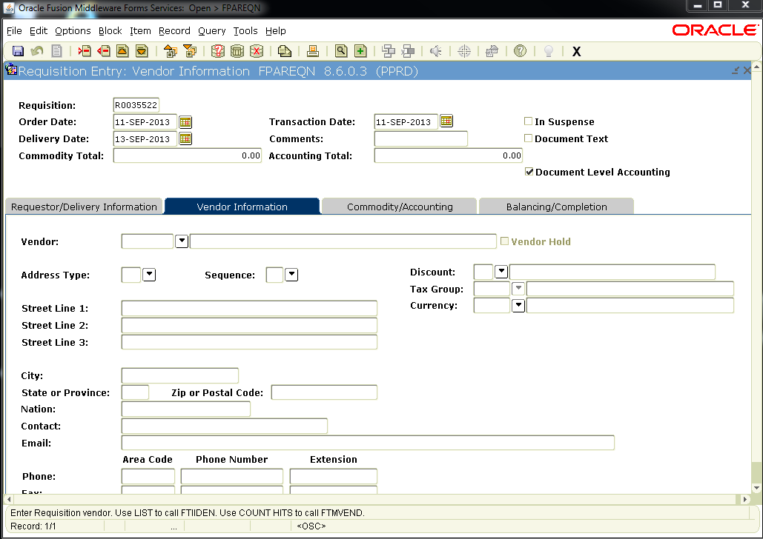
Vendor Information

Slide 7
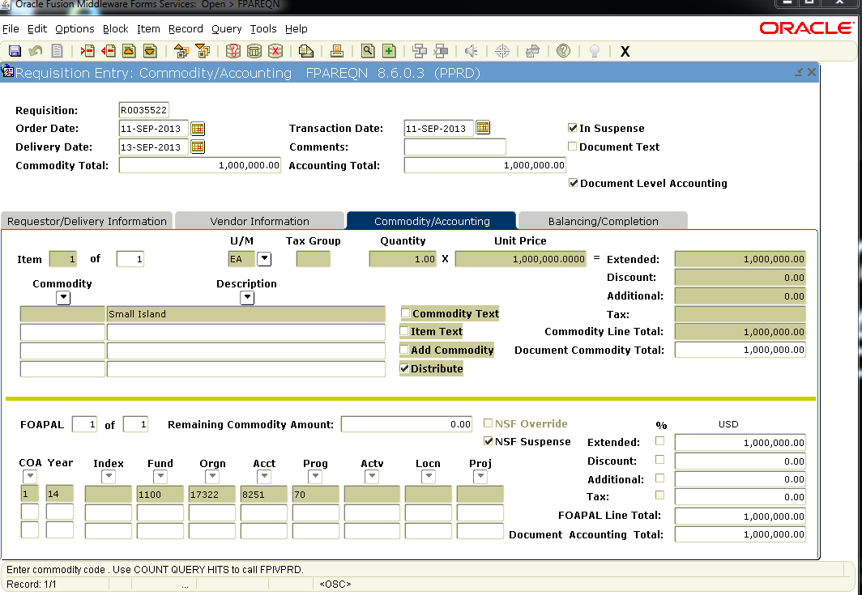
Commodity/Accounting

Slide 8
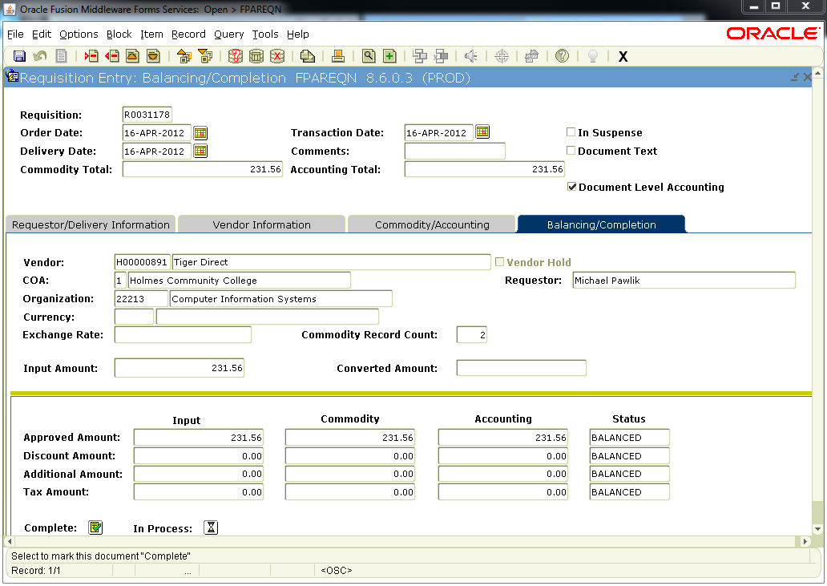
Balancing/Completion

Slide 9
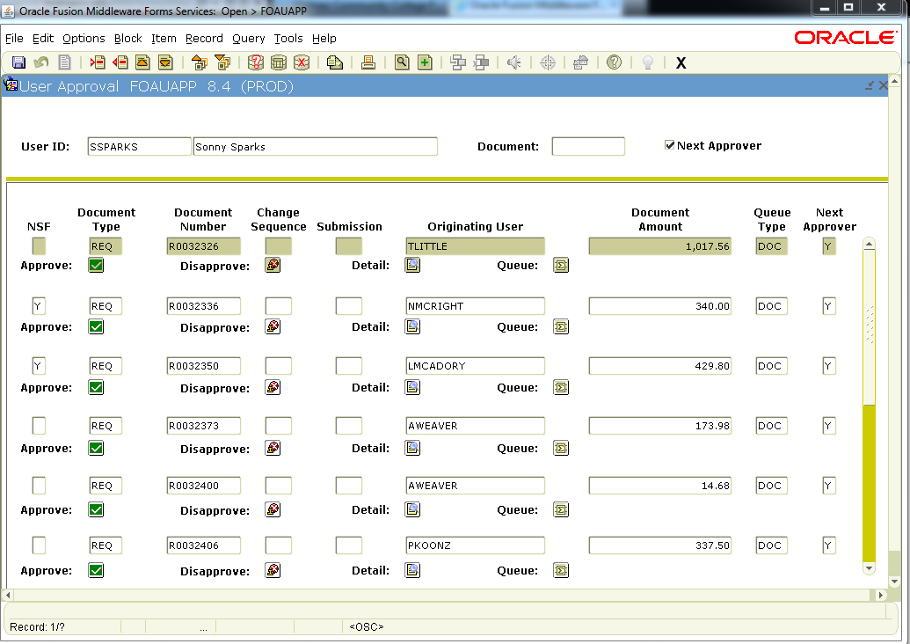
Approve Requisitions
FOAUAPP
Select Detail

Slide 10
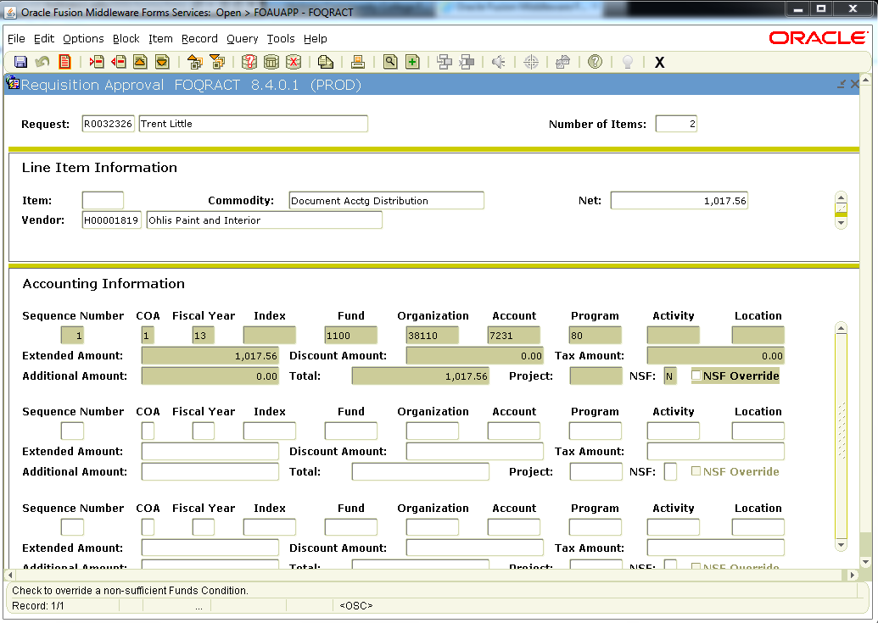
Detail
Options – View Commodities

Slide 11
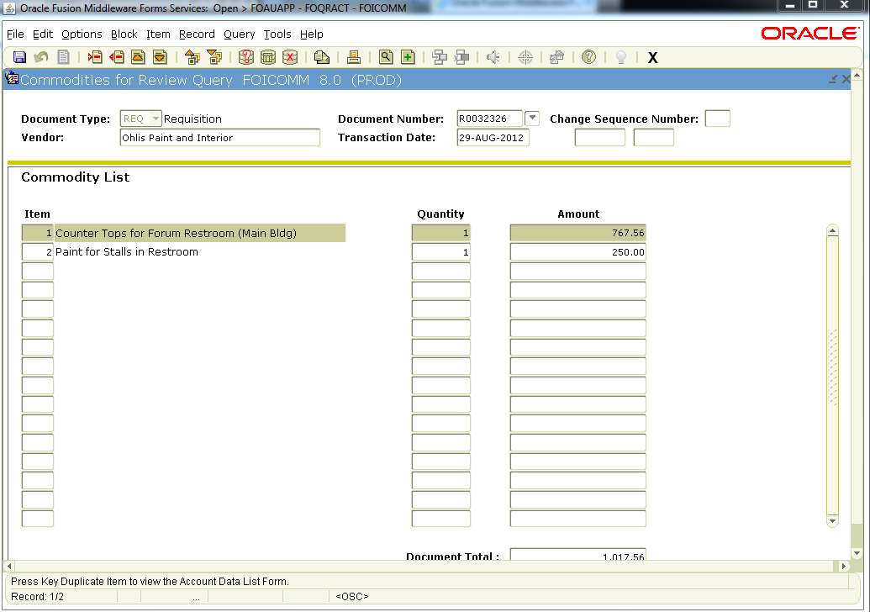

Slide 12
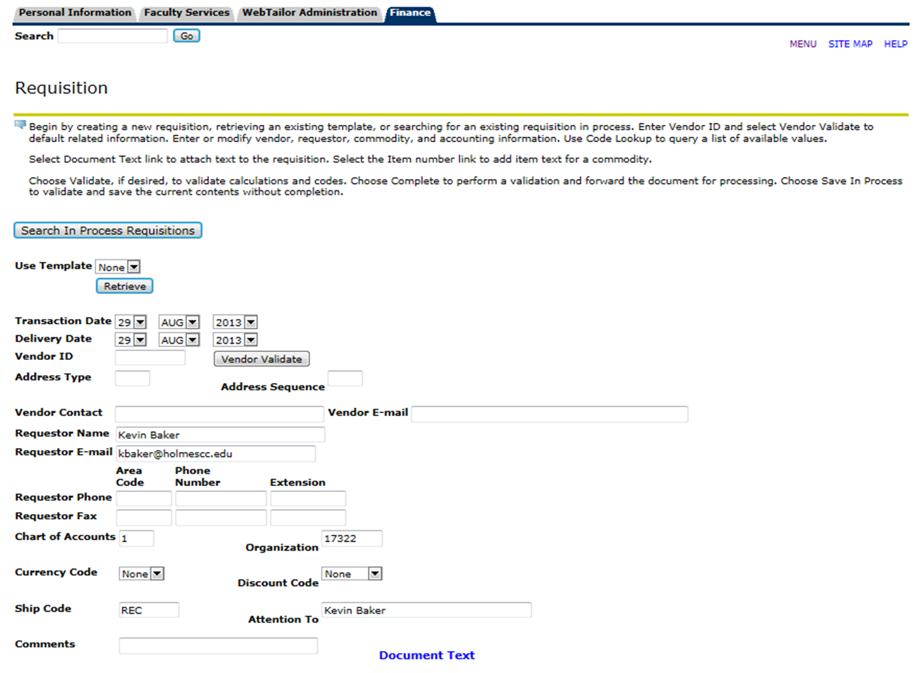
SSB - Create Requisitions

Slide 13
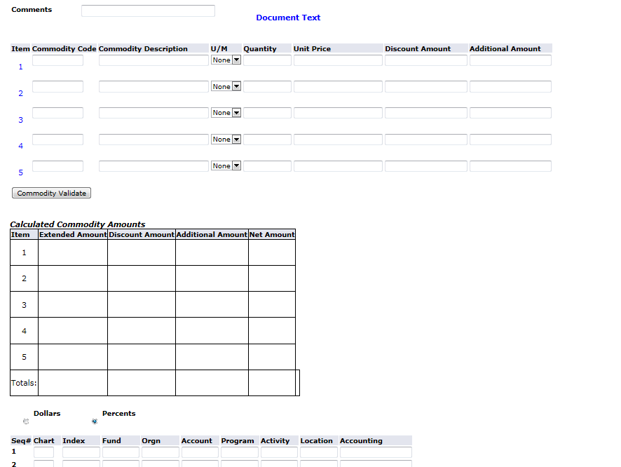

Slide 14
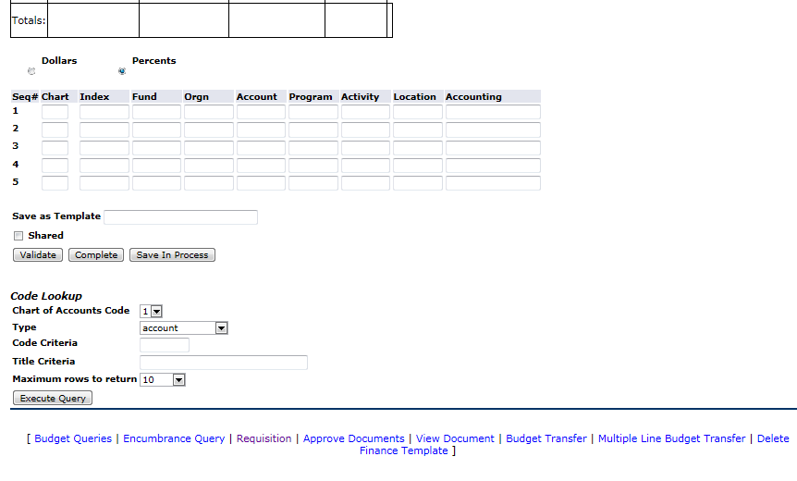

Slide 15
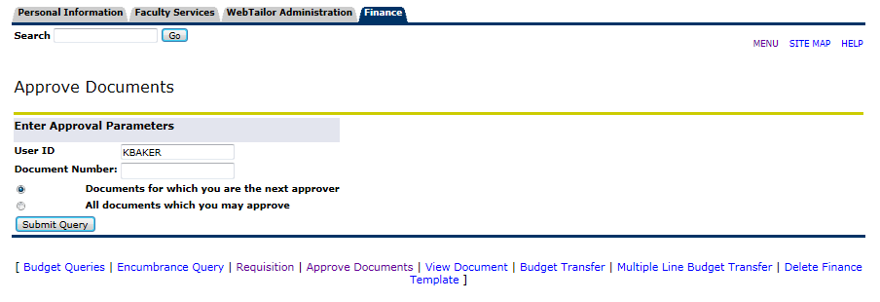
Approve Requisitions

Slide 16
Setup Requisition Approvals
Turn on Approvals
Setup Approval Queues
Configure Routing
Setup Users

Slide 17
Step 1. Turn on Approvals
FOASYSC
You can only make changes to this maintenance form by setting the effective date as the current date.
Insert Record
Duplicate Record
Change the Effective Date

Slide 18
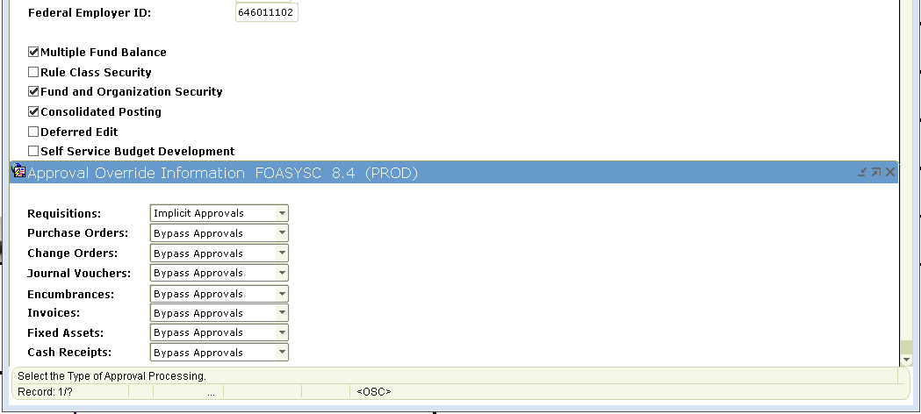
Select Approval Processing Info
Choose Implicit Approvals
Save and Log off

Slide 19
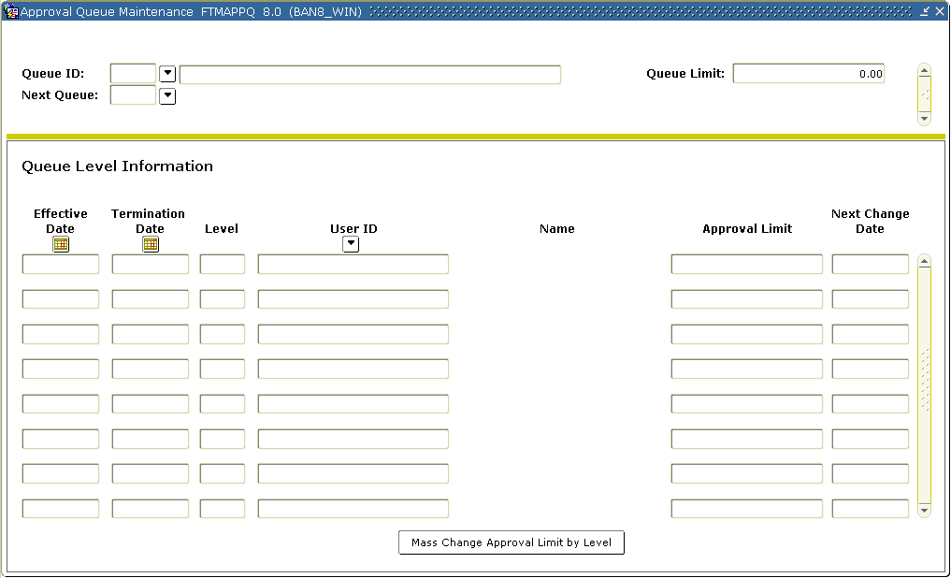
Step 2. Setup Approval Queues
FTMAPPQ

Slide 20
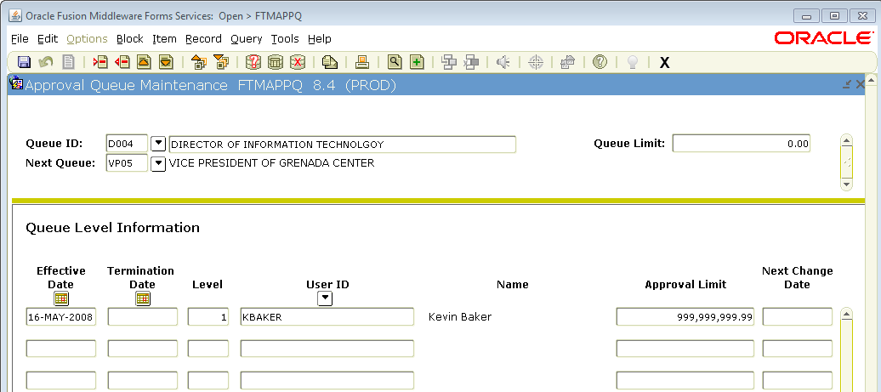
Queue Limit of 0.00 will route the requisition to the next queue.
Otherwise, if the amount of Req is less than this limit, it will be routed to purchasing.

Slide 21
If a queue limit is set here > 0.00
Then this limit must be less
Queue Limit here is the amount
that each level can approve.
999,999,999.99 = unlimited

Slide 22
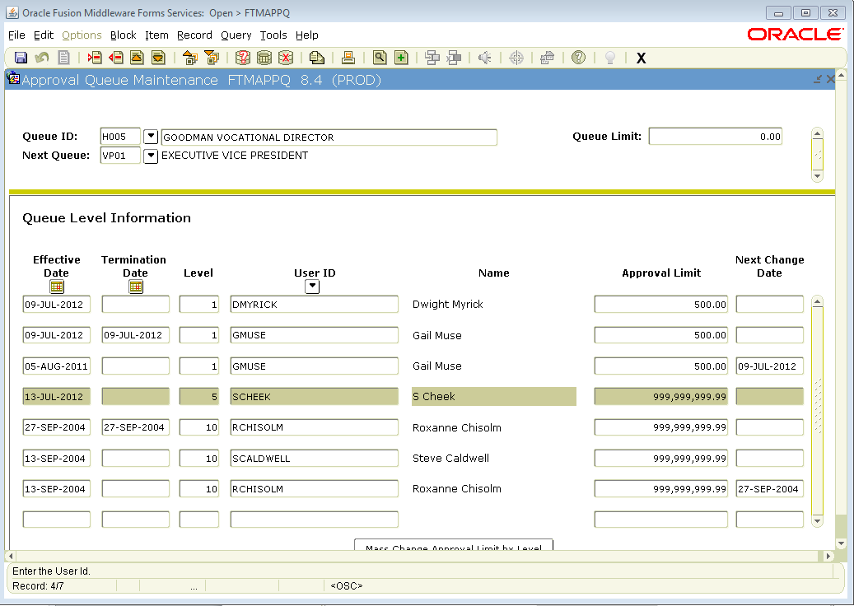
Users are terminated, not removed

Slide 23
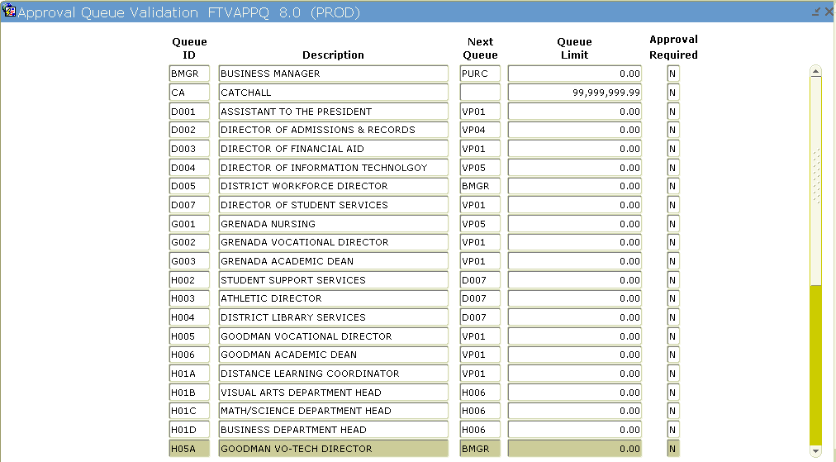

Slide 24
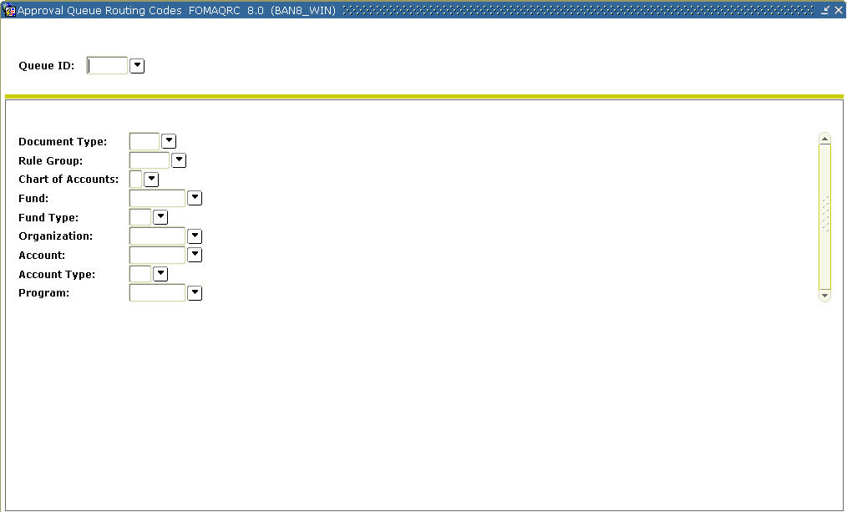
Step 3. Configure Routing
FOMAQRC

Slide 25
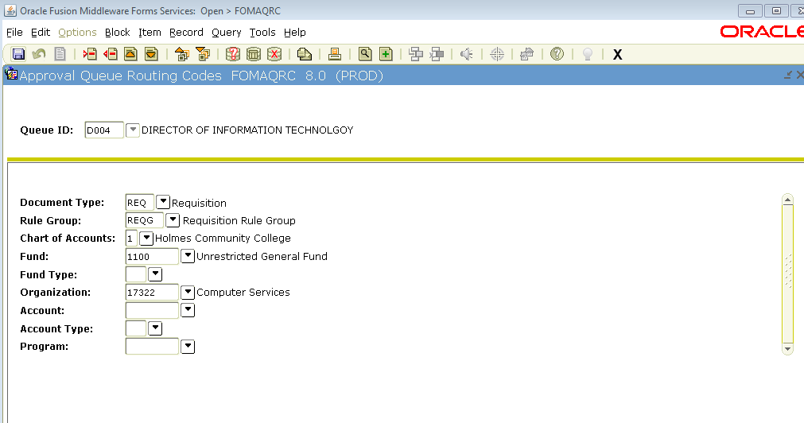

Slide 26
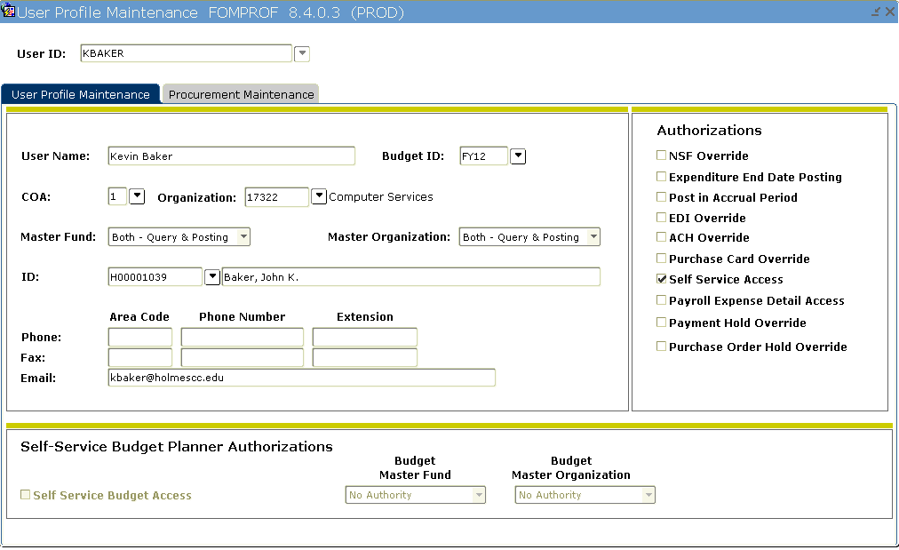
Step 4. Setup Users
FOMPROF

Slide 27
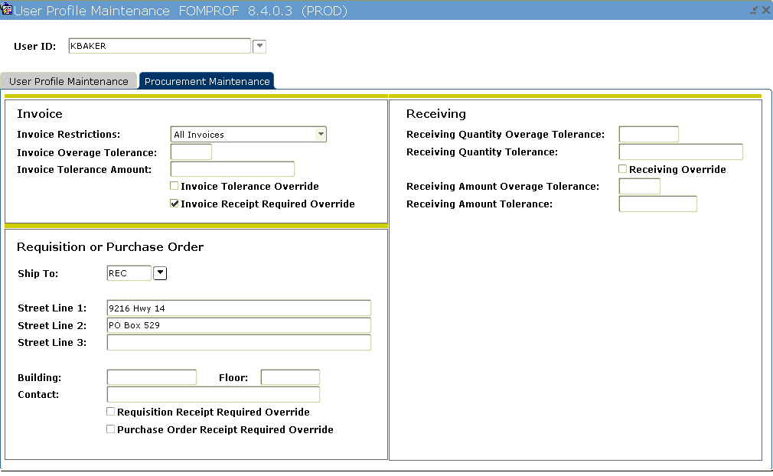

Slide 28
Things to Consider
NSF Queue
Catchall Queue
Backup approvers

Slide 29
Useful Forms
Setup Forms
Finance System Control Form (FOASYSC)
Approval Queue Maintenance Form (FTMAPPQ)
Approval Queue Validation Form (FTVAAPQ)
Approval Queue Routing Codes Form (FOMAQRC)
User Profile Maintenance (FOMPROF)
Approval Process (FORAPPL)
User Forms
Approvals Notification Form (FOIAINP)
Document by User (FOADOCU)
User Approval Form (FOAUAPP)
Document Approval Form (FOAAINP)
Document Approval History Form (FOIAPPH)
Approval History Form (FOIAPHT)

Slide 30
Questions???

