Slide 1
MBUG 2013
Session Title: Identifying and Merging Multiple Entities
Presented By: Lisa McDaniel, MUW
Edith Riley
September 17, 2013

Slide 2
Session Rules of Etiquette
Please turn off your cell phone
If you must leave the session early, please do so discreetly
Please avoid side conversation during the session

Slide 3
Prevention
Search on SOAIDEN
Use wild card (*) on last name and first name
Check birth date
GOAMTCH – used for tape loads in admissions and financial aid

Slide 4
When Multiples Are Found
A primary contact person to start resolution process and confirm “clean up”
Functional / IT contact list
Established timeline to make all decisions and changes

Slide 6
Student
Admissions records
Academic history
Reporting files
Recruiting only can be deleted
IDs
Blackboard
Xtender

Slide 7
Human Resources
Same benefits under both numbers?
Paid under both numbers on different payrolls?
Paid under both numbers on same payroll?
W2/1042S issued under incorrect SSN?
Should be periodically verifying new employee information
with SSA

Slide 8
Financial Aid
If possible, reload EDE records onto correct record for all aid years.
Move other records electronically.

Slide 9
Finance
Check for vendor addresses on each number
If required, ‘move’ vendor address from “bad” ID to “good” (will need for tracking if invoices have been processed)
‘Move’ TRND and TRNH data
Delete records from “F” tables

Slide 10
Accounts Receivable
‘Move’ records from “bad” ID to good starting with max transaction number +1 on “good” ID
Rerun application of payments
Delete records from “T” tables

Slide 11
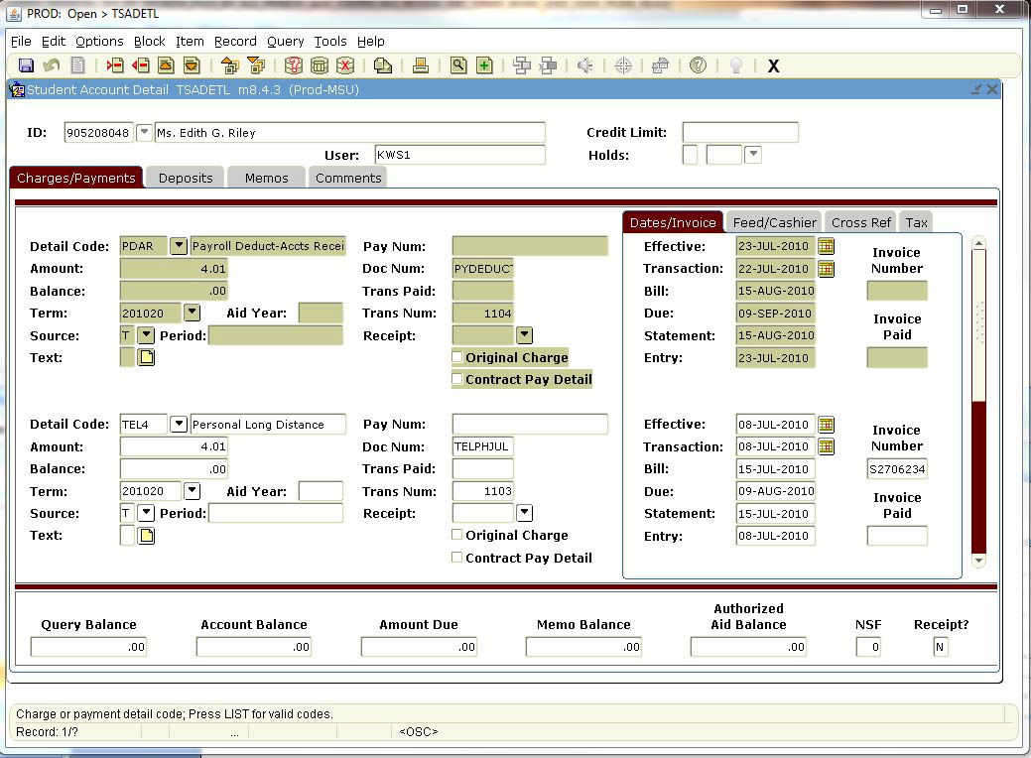

Slide 12
Clean Up
Check all tables for bad pidm
Delete all remaining general information tables for example SPRIDEN, SPBPERS
Notify those involved in process

Slide 13
Questions

