Slide 1
MBUG 2013
Academic Scheduling and Configuration in Practice
Amy Adkerson, Associate Registrar
Sterling McCool, Systems Analyst
Mississippi State University
September 17, 2013

Slide 2
Session Rules of Etiquette
Please turn off your cell phone
If you must leave the session early, please do so discreetly
Please avoid side conversation during the session

Slide 3
A Brief History
2007 – Astra 6
2009 - Astra VII (version 7.2)
2010 - Astra VII (version 7.3)
2010 - Move from Oracle to SQL Server
2011 - Object Accounting
2011 - Platinum Analytics (hosted)
2011 - Astra VII (version 7.4)
2012 - Astra VII (version 7.5)
2013 - Platinum Analytics (on site)
2013 - Hardware upgrade

Slide 4
Our Configuration
SIS: Banner (Oracle/Linux)
Astra Schedule: Application Server (Windows Server 2008) and Database Server (MS SQL Server 2008)
Platinum Analytics: Application Server (Windows Server 2008) and Database Server (MS SQL Server 2008 shared)
Object Accounting: Database Server (MS SQL Server 2005)

Slide 5
Demonstration

Slide 6
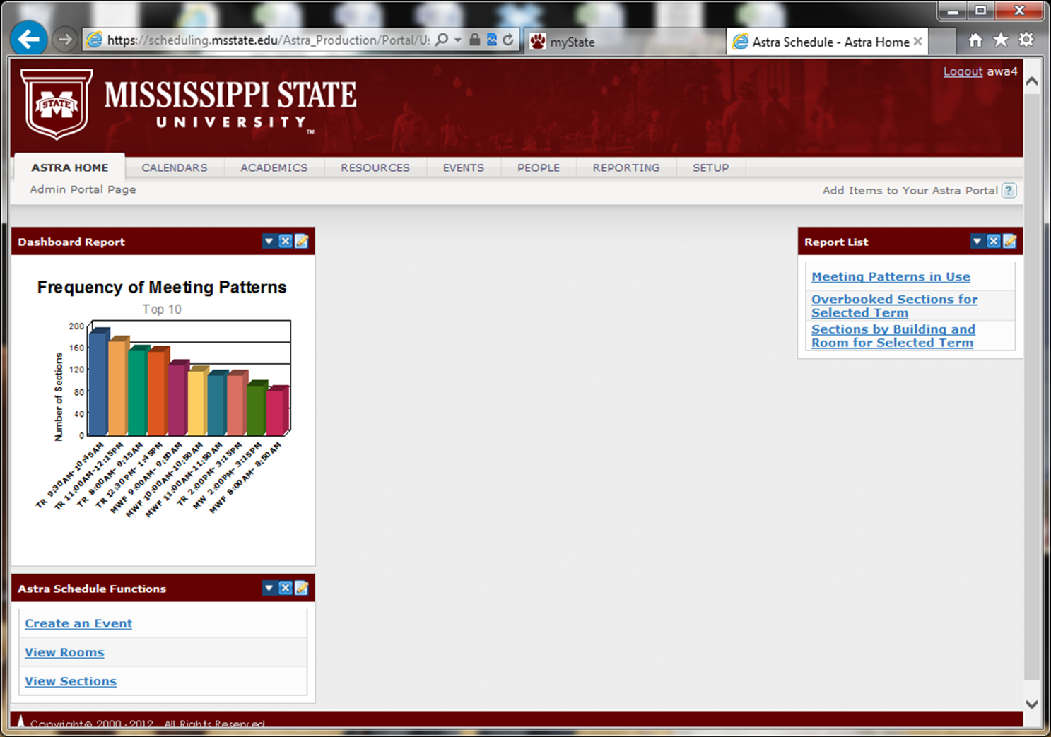

Slide 7
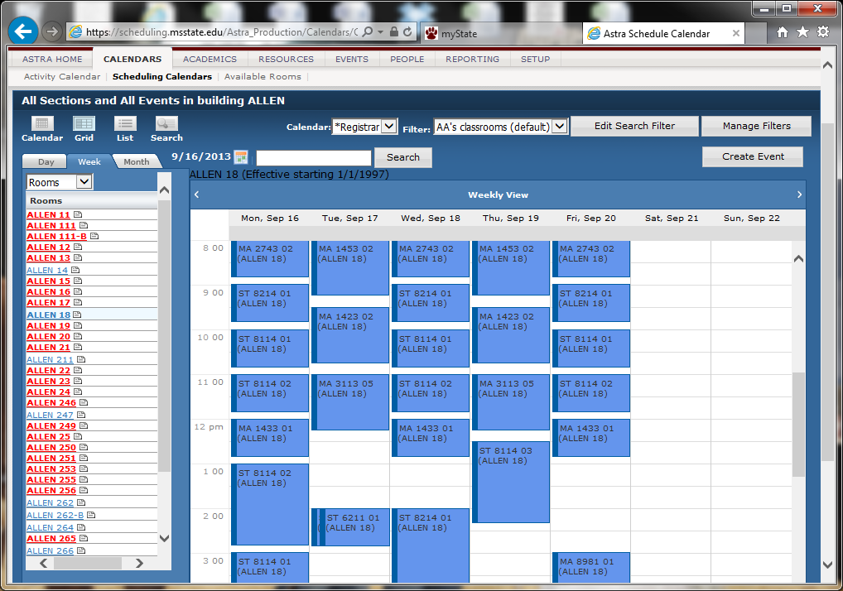

Slide 8
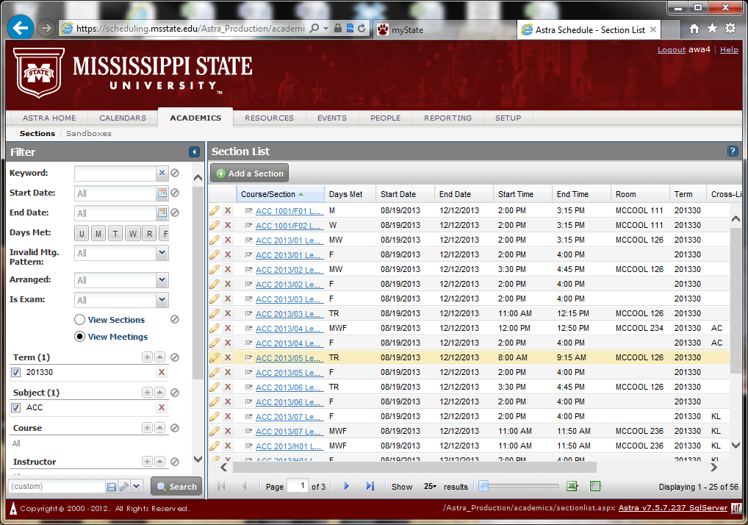

Slide 9
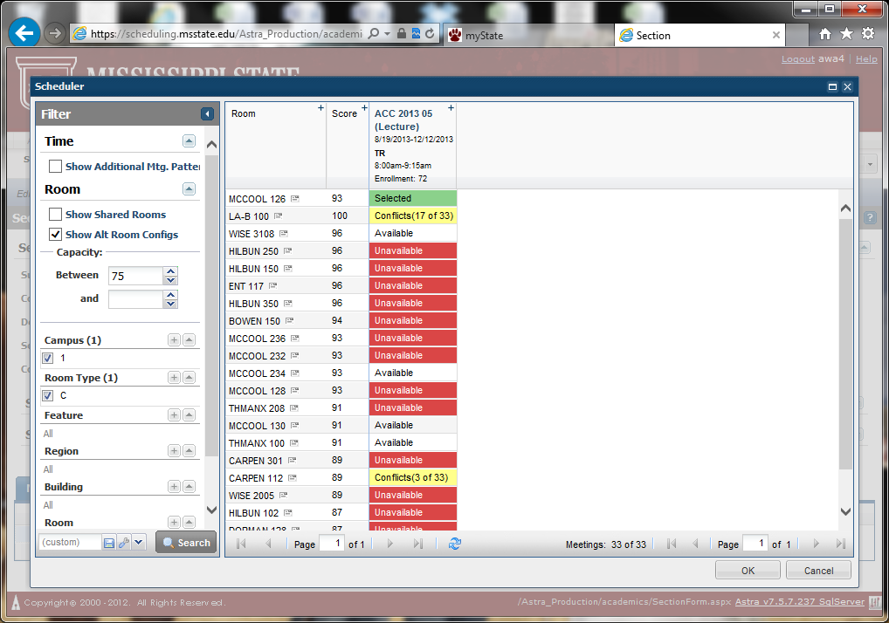

Slide 10
