Slide 1
Workflow Basics
Tommy Parker
Sr. Systems Analyst & Team Leader
Mississippi State University

Slide 2
Session Rules of Etiquette
Please turn off your cell phone/pager
If you must leave the session early, please do so as discreetly as possible
Please avoid side conversation during the session
Thank you for your cooperation!

Slide 3
Session Agenda
What exactly is workflow and what are the benefits
Possible candidates for workflow
Getting started
What causes a workflow to start
Workflow Modeler
Types of workflow activities
How workflow looks to the user
Integration with INB Banner
Misc. – Routing, Email notifications, Proxy
Question and Answer

Slide 4
What Is “Workflow”?
Workflow automates, simplifies, directs and manages the flow of information and tasks.
Workflow distributes documents, information and tasks.

Slide 5
Benefits of Workflow
Automatic movement of the right work to the right people at the right time
Helps to insure that all correct information is included in the task as it is moved along
Work and information move along automatically with fewer delays
Electronic notification that work needs done (or that work has been done)
Improved adherence to university policies and procedures

Slide 6
Benefits of Workflow – Cont’d.
Allows us to better determine where we are in the process
Elimination of lost paperwork
Possible elimination of duplicate data entry and less chance of data entry error (auto updates in Banner)
Increased efficiency

Slide 7
Possible Candidates For Workflow
Tasks that involve movement of paper or information from one person to another
Tasks that involve approvers
Cases in which persons need to be informed of a data change in a timely fashion
Tasks that need to be completed in reaction to a data change. Ex. - When a student withdraws, several offices such as Financial Aid, Housing, Accts Receivable, etc. may need to be notified.

Slide 8
Current Workflows at MSU
Transfer Student Transcript Processing – Undergraduate Admissions & Registrar’s Office
Application processing within the Undergraduate Admissions Office
Application processing – Office of Graduate School & Academic Departments
Student Withdrawal Request

Slide 9
Ideas For Future Workflows
Grade Changes
Major Changes
Access Request Forms – Banner & Other Systems

Slide 10
Getting Started
Start with something simple
IMPORTANT: Analyze the Business Process!
Typically requires some SQL expertise

Slide 11
What Causes A Workflow To Start
Trigger on database table
Self Service Web Page
Batch Job run in job submission or in cron
External system – web services

Slide 12
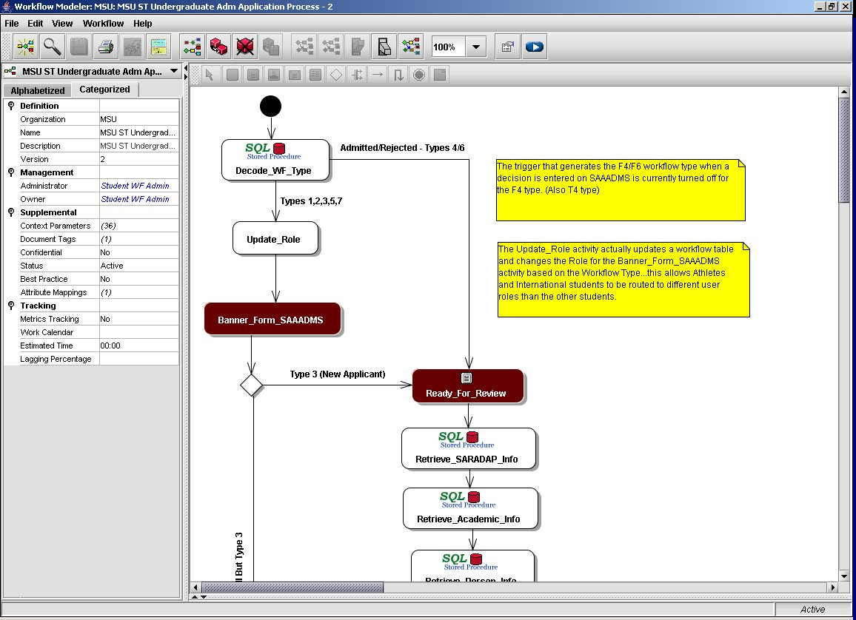
Workflow Modeler

Slide 13
Types Of Workflow Activities
Internal – Business Component
Retrieve data from Banner tables
Update data in Banner tables
Custom Form
Display information, Enter Information, Make decisions
Interactive
Open Banner and go to a specific form
Email
User Notifications
External Email (Students)

Slide 14
How Workflow Looks To The User

Slide 15
Custom Form Activity

Slide 16
Interactive Activity - INB Form

Slide 17
Other Considerations
Routing of Workflow
Roles & Performer Rules
“Adhoc Routing”
Proxies
Email Notification
Workflow Monitoring

Slide 18
Questions & Contact Info
Tommy Parker
tep@its.msstate.edu

