Slide 1
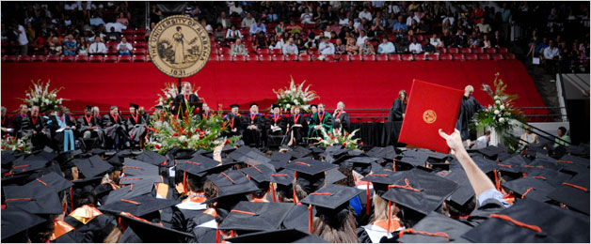

Paperless Graduation
Leana Wilson
Assistant University Registrar
The University of Alabama

Slide 2
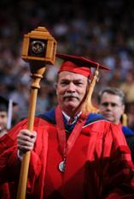

Agenda
UA Introduction
Previous process overview
Benefits of proposed solution
Initial application process
Award process
Challenges/Successes

Slide 3
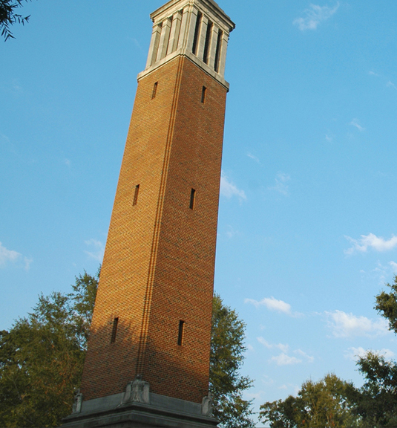
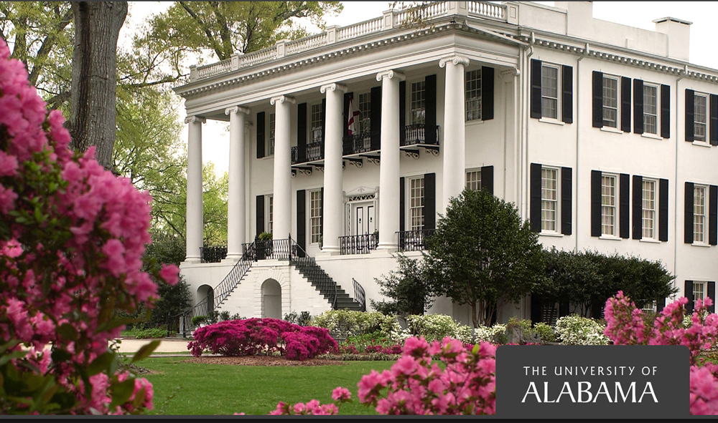
The University of Alabama
Founded 1831
Alabama’s first public college
Fall 2011: 31,747 students
  UG: 26,234
  GR: 4,913
  Professional: 600
34% of students come from states other than Alabama
Notes:
Paper
Different versions
Dependent on student for accurate info

Slide 4
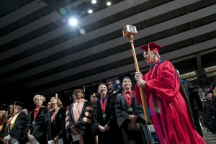
Previous Process
Paper applications
2011
  UG = 5258
  GR = 1986
  LW = 269
  Total = 7513
Notes:
Paper
Different versions
Dependent on student for accurate info

Slide 5
Previous Process
Undergraduate vs. Graduate vs. Law
Communication with students
Manual data entry
Proofing
Final sign-off
Notes:
Undergraduate vs. Graduate vs. Law
Undergrad applies directly to college
Grad stalls/gets lost in dept
Law runs by their own deadlines
Communication
Students in the dark throughout approval process
Dependent upon email for attendance
Manual Data Entry
Takes weeks to enter apps
Building audit spreadsheets
Proofing
Paper Applications vs. Banner vs. Program
Final Sign-off
College reps have to come to our office
Colleges do everything at once

Slide 6
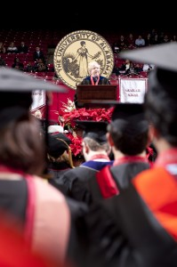
Proposed Solution
Online application
Initial application approval workflow
Final award workflow
Notes:
Online application
Students can access 24/7
OUR controls availability
More information included during application process
Initial application approval workflow
Depts/colleges approve 24/7
OUR approves as applications arrive, not all at once
Applications automatically flow into Banner
Audit integrated into OUR approval
Final award workflow
Ability to kick off different populations
Colleges start approving as soon as grades roll for term

Slide 7
Web Application Setup
Term availability
Student eligibility
Student information
Web text localization
Notes:
Banner Screens
STVGADR – graduation application display rule code validation (set up different rules for different levels)
SHAGADR – self-service graduation application display rules (set up dates and which forms to display to students based on )
SHAGADS – determine order of rule processing (we only did by level, but you could do it by campus, degree, program code, major, or dept – or any combination)
SHAGELR – graduation application eligibility rules
Term availability
Define availability dates by level
Set for terms/years in advance
Student eligibility
By level/curriculum
By GPA/earned hours
By attribute
Student information
Diploma name
Diploma mailing address
Web text localization
Specific instructions/warning
Be sure program is correct (UG)
What to expect next

Slide 8
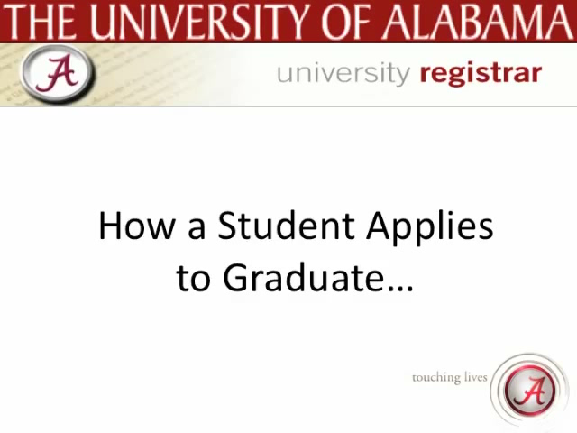

Slide 9
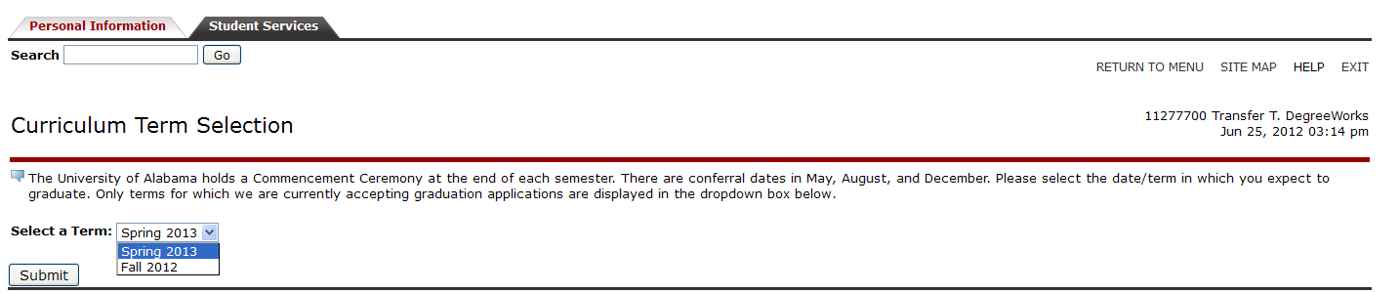
Term Selection

Slide 10
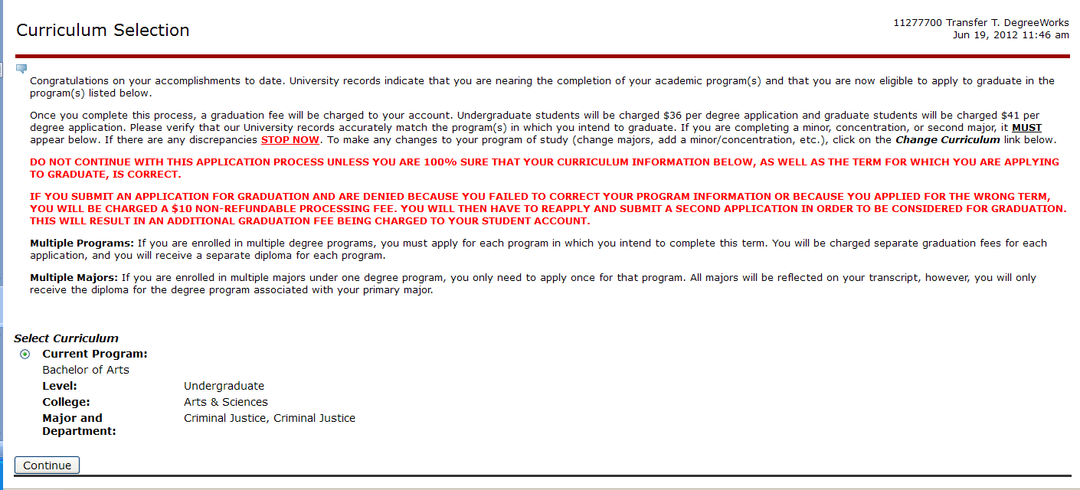
Curriculum Selection

Slide 11
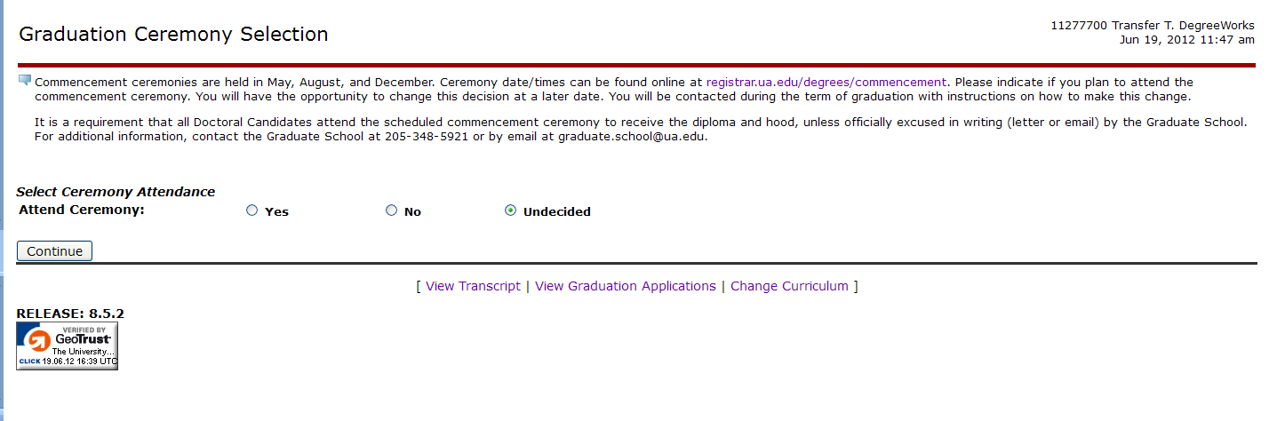
Ceremony Selection

Slide 12
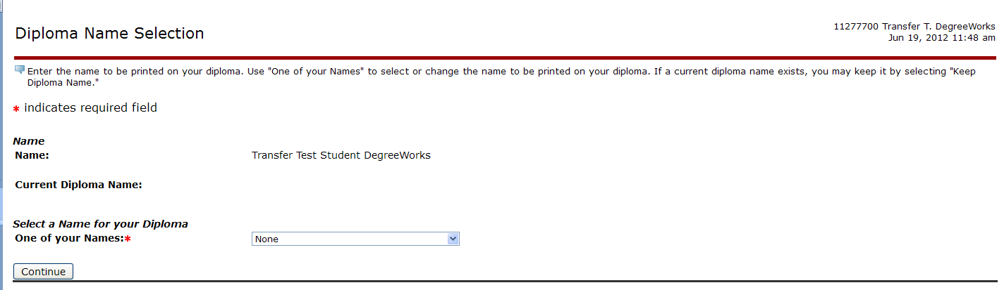
Diploma Name Selection

Slide 13
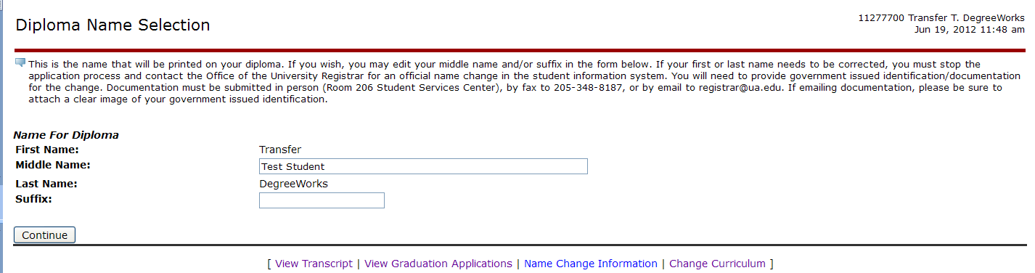
Diploma Name Editing

Slide 14
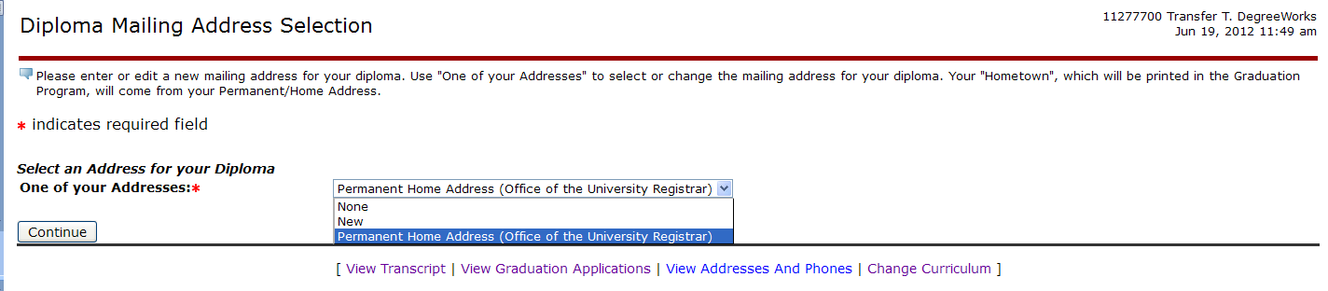
Diploma Address Selection

Slide 15
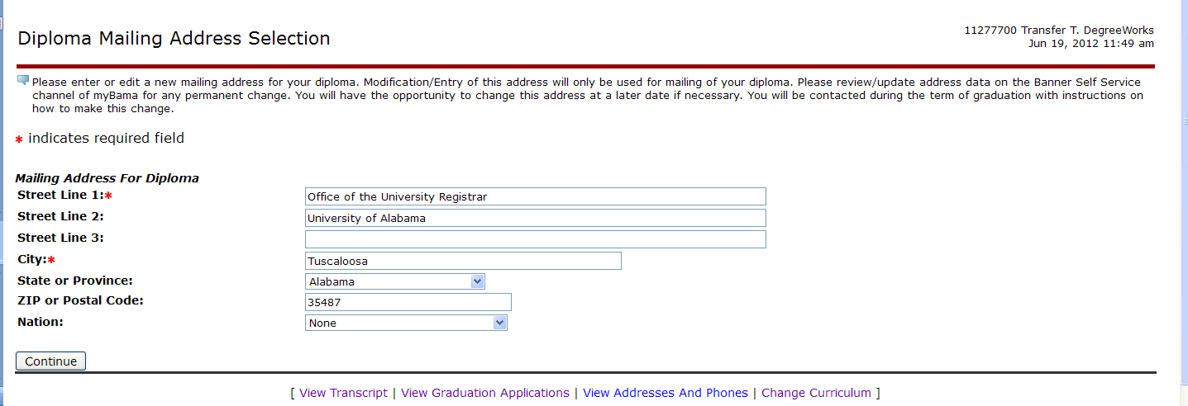
Diploma Address Selection

Slide 16
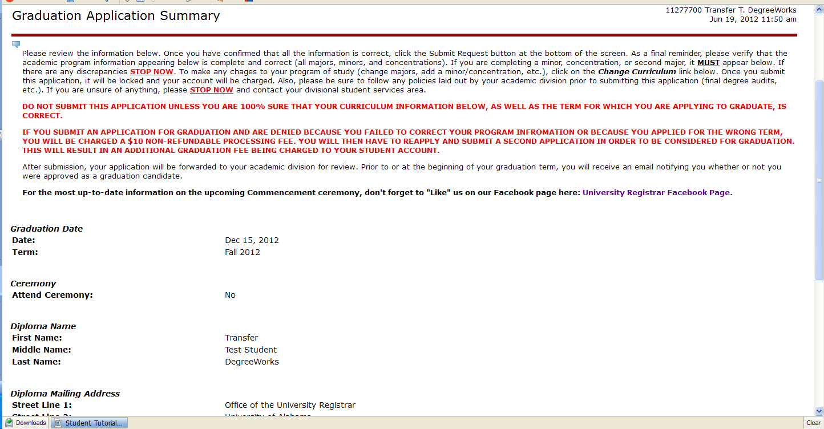
Application Summary

Slide 17
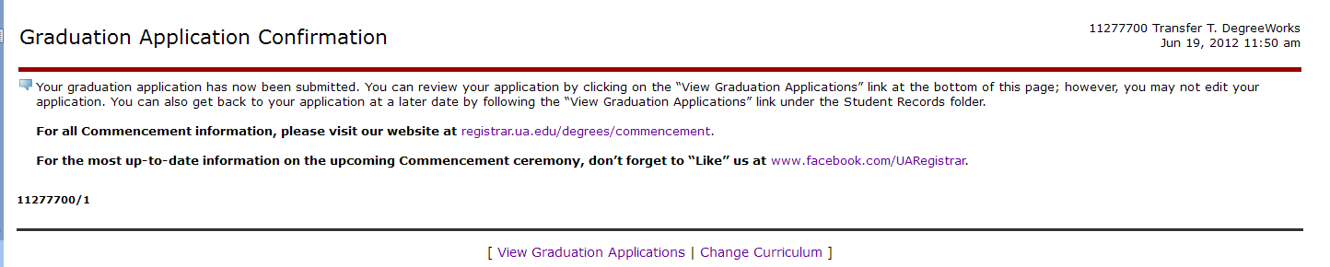
Application Confirmation

Slide 18
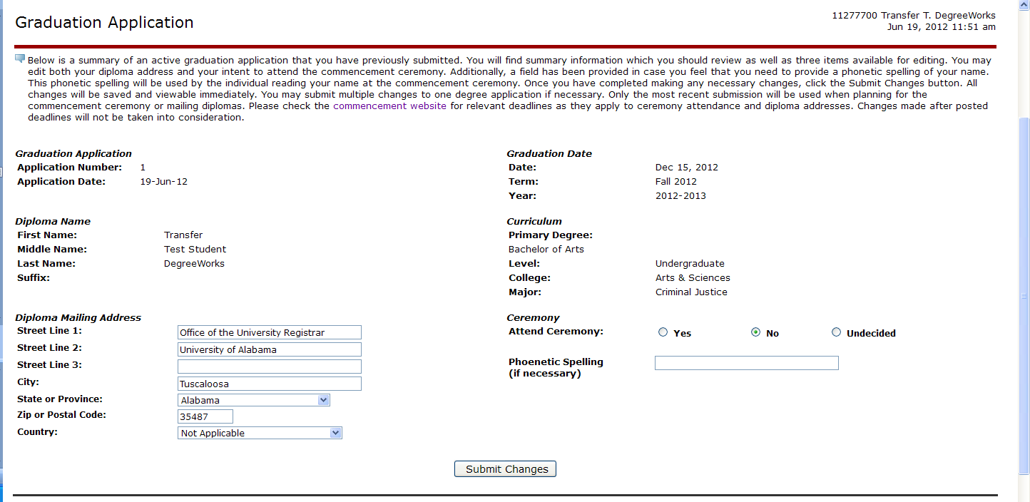
Web Application Changes
Notes:
Allows students to alter diploma mailing address, ceremony attendance, and phonetic spelling

Slide 19
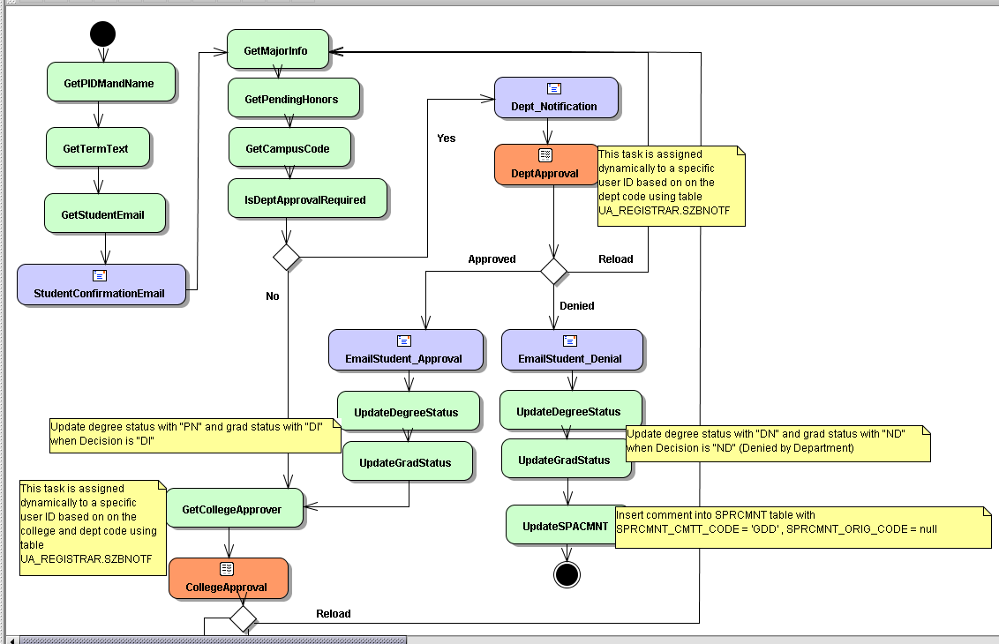
Initial Workflow Overview
Notes:
Starts with student clicking submit
Gathers student information
Dept Approval
Determined by level
Based on dept code associated with curriculum
Requires database table maintenance
Proxies are possible

Slide 20
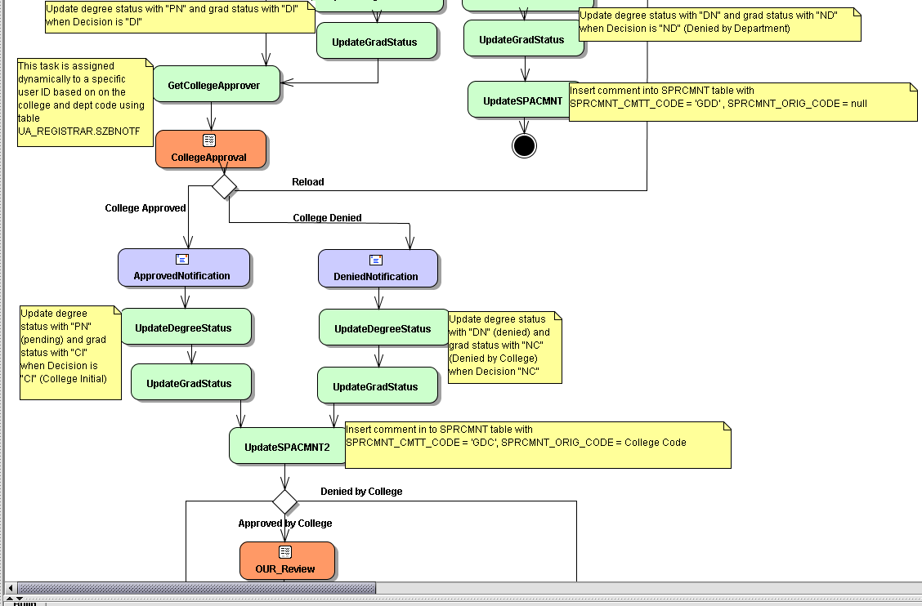
Initial Workflow Overview
Notes:
College Approval
GR based on letter of alphabet
AS based on dept code
All other UG/LW go to individual approver who can have proxies

Slide 21
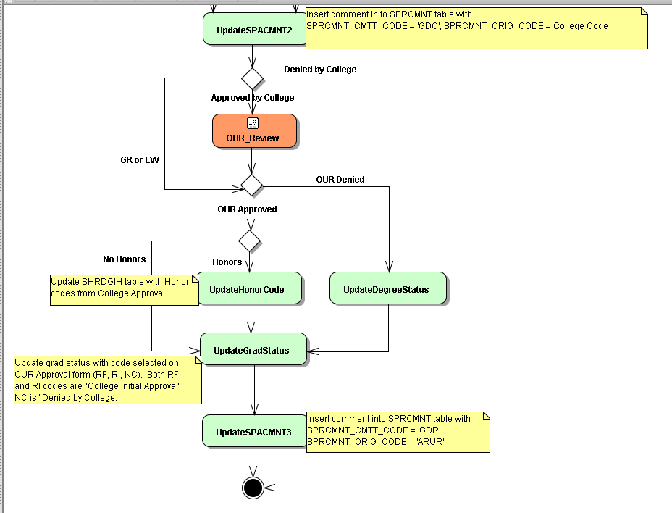
Initial Workflow Overview
Notes:
GR or LW do not require OUR approval

Slide 22
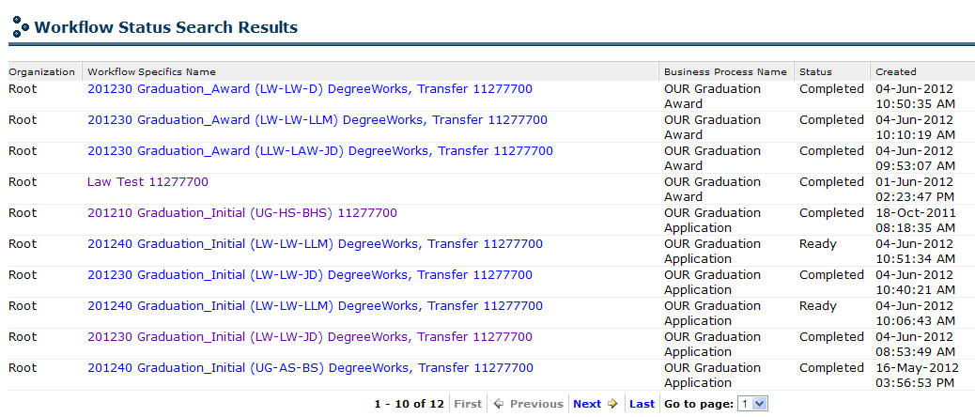
Approver Worklist

Slide 23
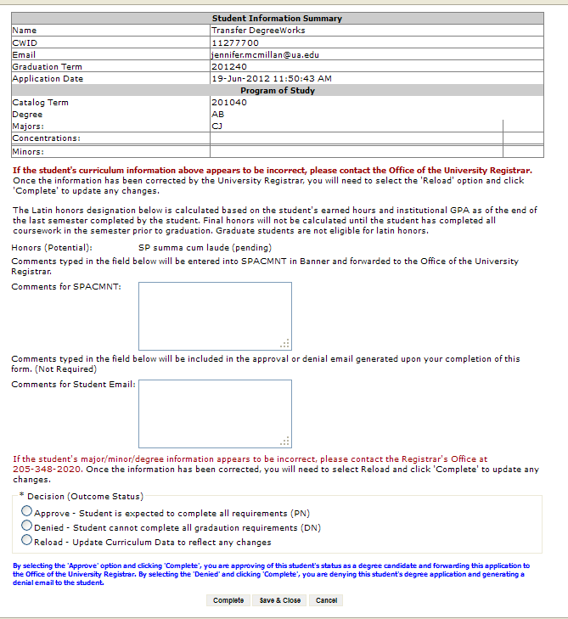
Approver Task View
Notes:
Explain difference between dept/college
Dept cannot reload or post comments directly into Banner
College looks exactly like this
OUR process
Only see UG tasks
OUR sees college comments
Uses comments field for standardized audit comments
Only has initial and final OUR approval
No email field/no email is generated to student

Slide 24
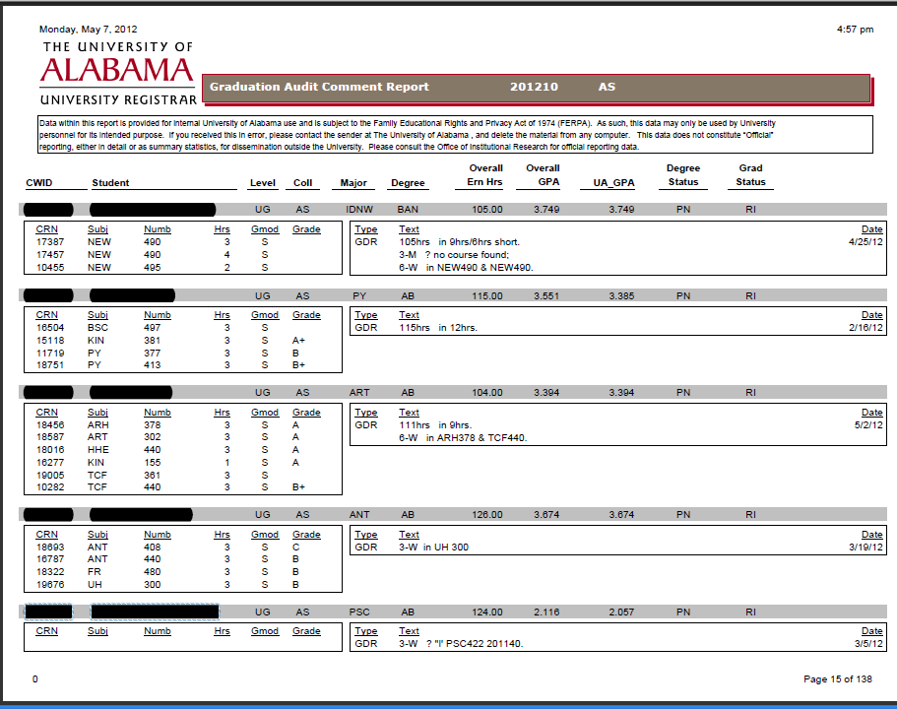
Notes:
Audit Report
Student info blacked out
Earned credits
GPA
Degree/Grad Status codes
Current registration and any reported grades
Graduation comments and date

Slide 25
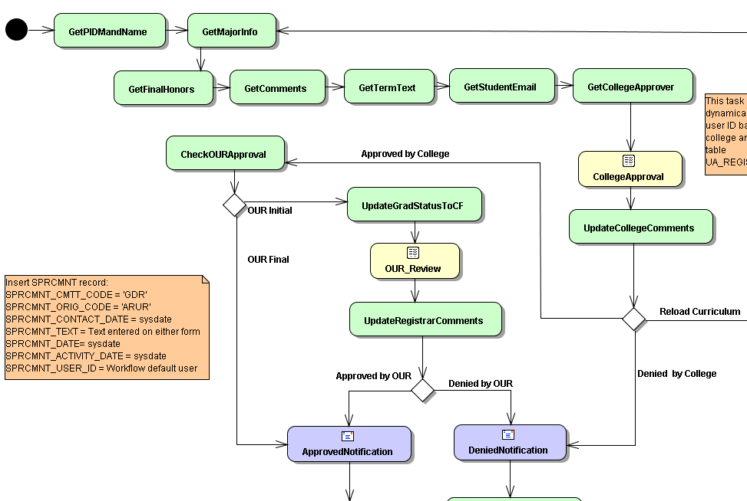
Award Workflow
Notes:
Batch kickoff
No dept. approval (goes straight to college)
Check OUR Approval
RI goes to OUR
RF goes straight to award
Allows us to work concurrently with colleges

Slide 26
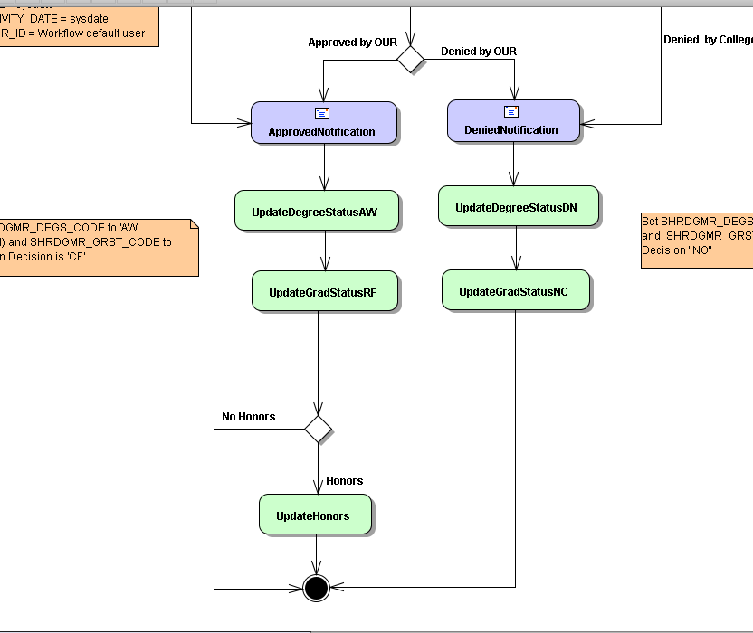
Award Workflow
Notes:
Honors calculation done last
Allows for grade changes after workflow has been kicked off

Slide 27
Award Workflow
Batch kickoff
Honors calculation
Working concurrently
Notes:
Batch kickoff
Can kick off by term, level, college, and degree
Honors calculation
Final honors calculated dynamically after final approval and posted to transcript
Working concurrently
Because RI/RF not picked up until college approves, tasks can be worked simultaneously by OUR and college

Slide 28
Challenges
Testing, testing, testing
Undergraduate Engineering
Verbiage on forms/emails
Maintaining departmental approvers
Stalled applications/workflow tasks
Baseline application curriculum selection
Denied & cannot reapply
Notes:
Student adoption not a challenges
Students only apply once and don’t know how it works
Colleges spread the word
Email reminder at beginning of the term
Testing, testing, testing
So many different scenarios to test
Show colleges then make more changes
Undergraduate Engineering
Culture change from decentralized to centralized
Lack of communication from within college
Verbiage on forms/emails
Making forms/emails apply to all students to make workflow as simple as possible
Maintaining departmental approvers
Original list from graduate school was mainly department heads (65)
Have probably changed at least half already
Stalled applications/workflow tasks
Monitoring stalled apps because of depts not acting
Applications stalled because of invalid curriculum information
Workflow alerts on items missing parameters
Correcting college/dept. errors manually
Baseline application curriculum selection
Modified how curriculum is selected during start of application
Bypassed extra term screen (Banner asked which term’s curriculum you wanted and then which term you wanted to graduate in)
Denied & cannot reapply
Banner handles application records separately from outcome records
Identify students who will not be able to reapply
Working towards an automated solution

Slide 29
Successes
4 weeks extra application time
2 weeks less award time
Easier on students/colleges/OUR
Manual entry error elimination
100% attendance response
Training materials

Slide 30
Questions?
Leana Wilson
Leana.Wilson@ua.edu
205-348-8179
Denny Savage
Denny.Savage@ua.edu
205-348-0261
registrar.ua.edu

Slide 31

San Antonio, 2013
When: February 3-6, 2013
How do I register and get information
http://www.sacrao.org/index.html
Conference Hotel Information
http://www.Westinlacantera.com
Ya’ll come, YEEHAW!!!!

