Slide 1
Online Requisitions
This is a technical session, so there won’t be any nice graphics to distract you.

Slide 2
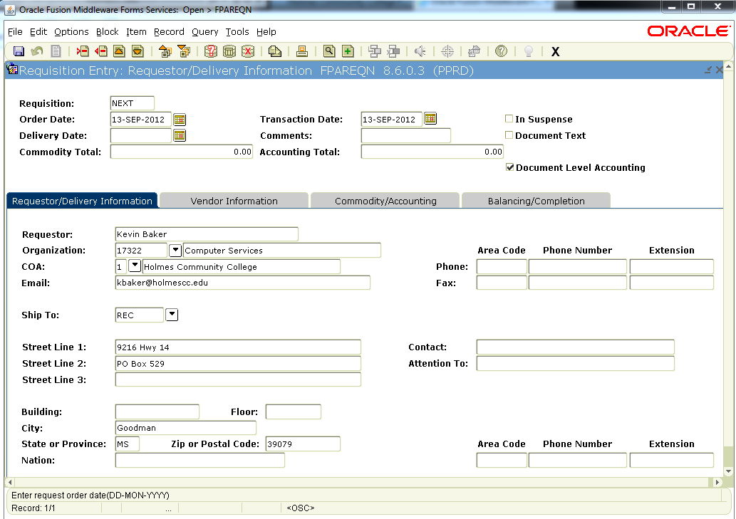
Create Requisitions

Slide 3
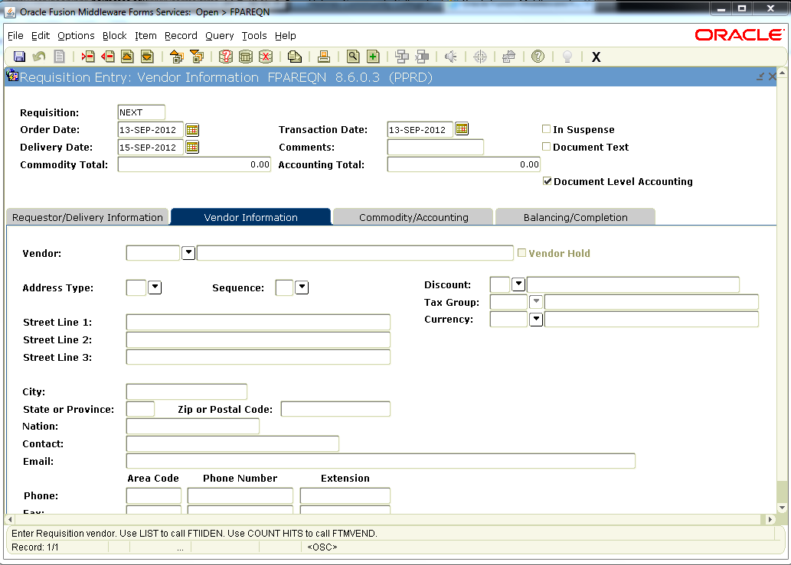

Slide 4
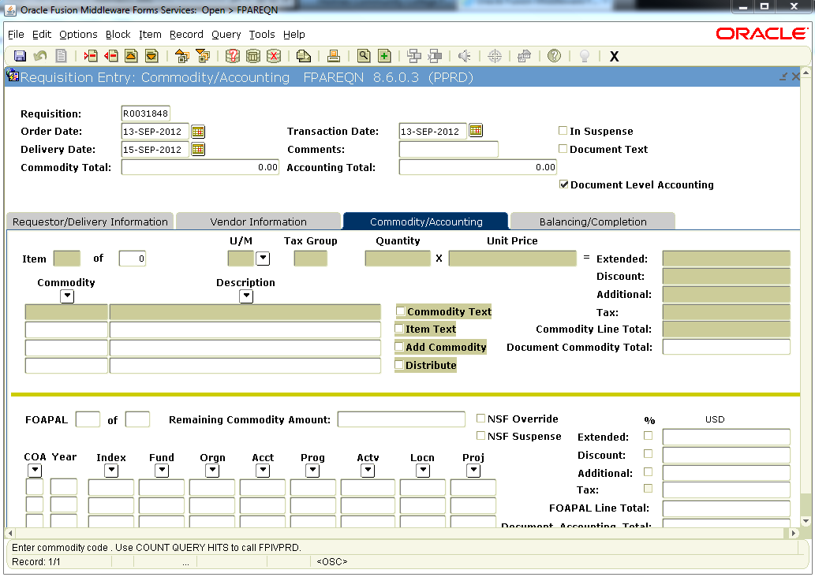

Slide 5
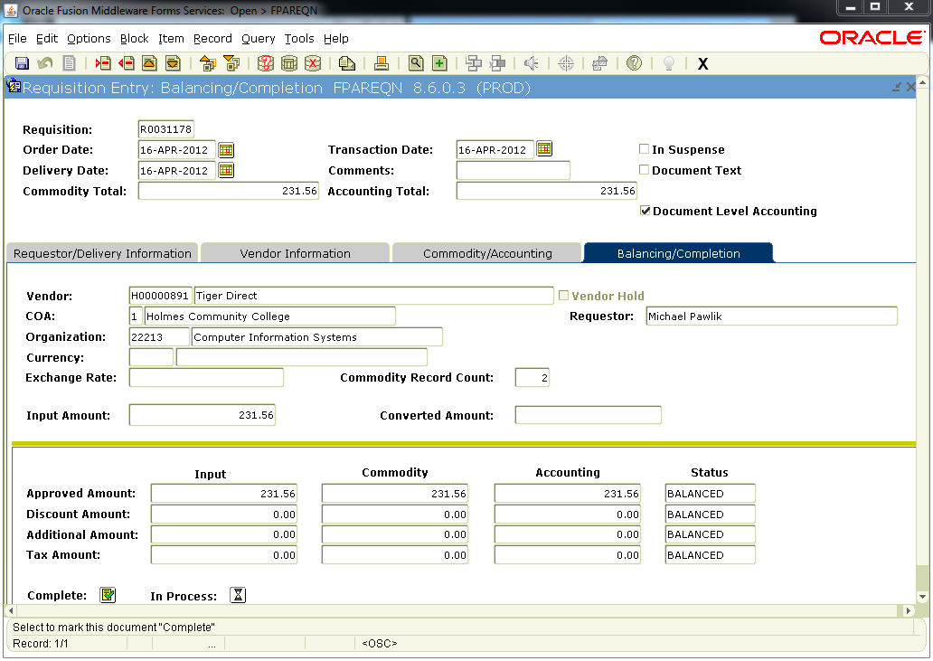

Slide 6
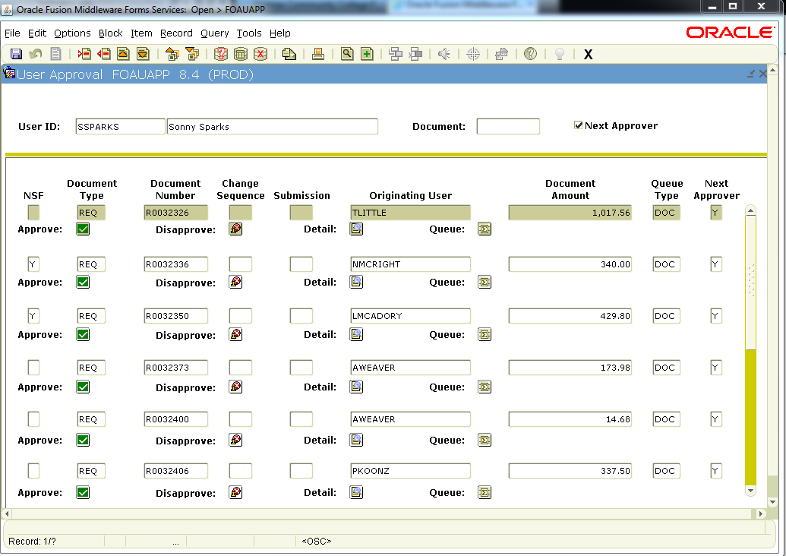
Approve Requisitions

Slide 7
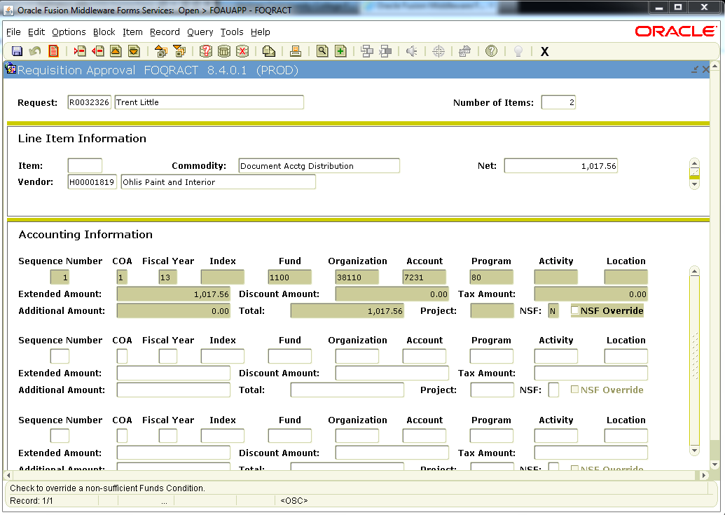

Slide 8
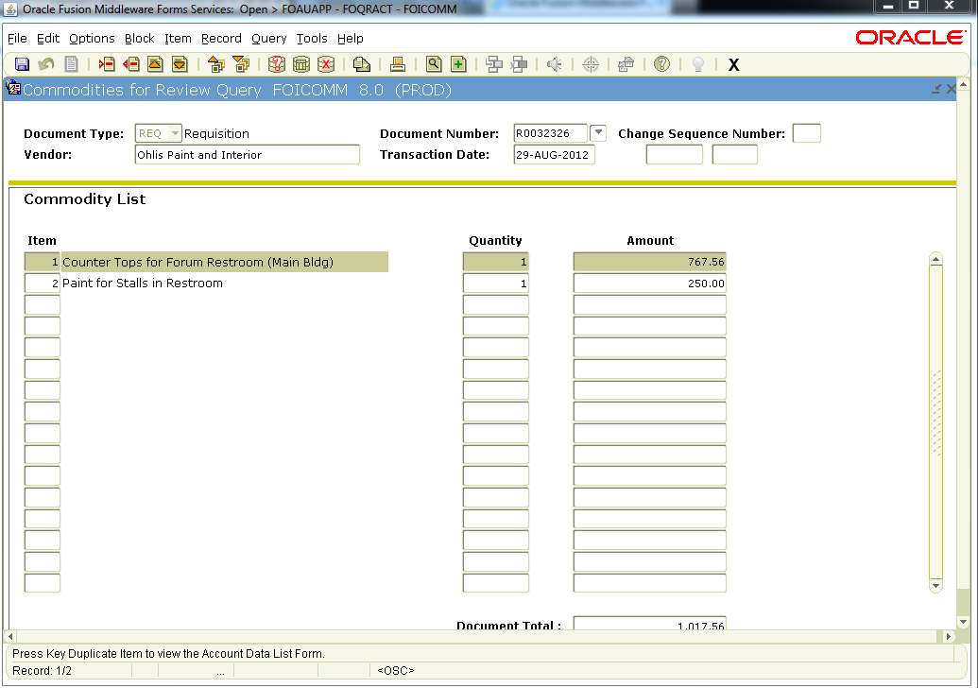

Slide 9
Approve Requisitions

Slide 10
1. Turn on Approvals
2. Setup Approval Queues
3. Configure Routing

Slide 11
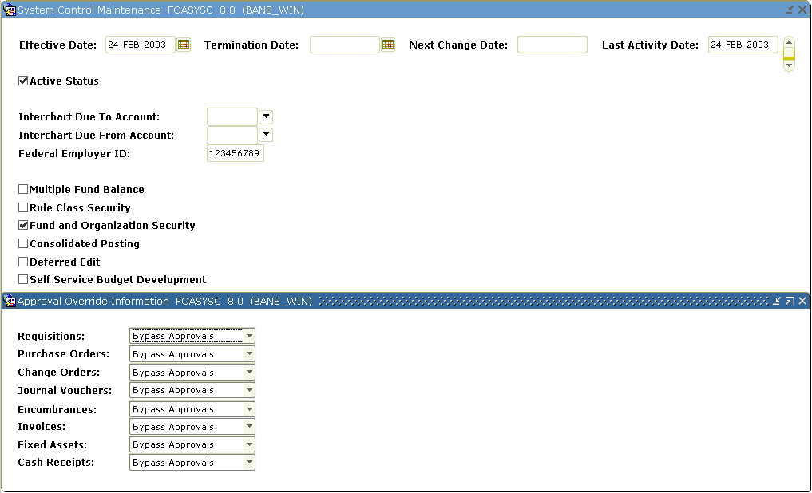
Step 1. Turn on Approvals
FOASYSC

Slide 12
Explicit Approvals
This means the approval process is “turned on” for this document type. If the originator of the document is also an approver,
he/she will have to approve the document in a separate step.
Implicit Approvals
This means the approval process is “turned on” for this document type. If the originator of the document is also an approver,
his/her approval will be assumed (implied) when the document is completed. No additional approval by this user will be required.

Slide 13
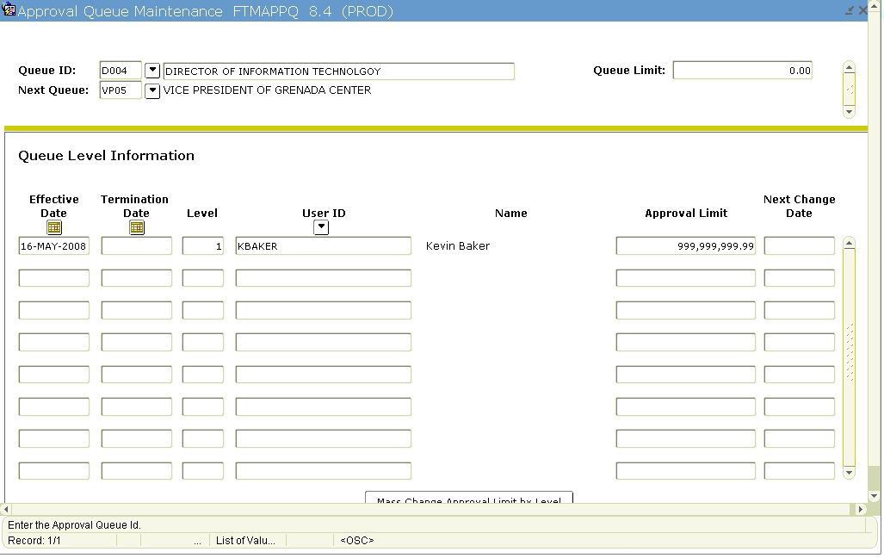
Step 2. Setup Approval Queues
FTMAPPQ

Slide 14
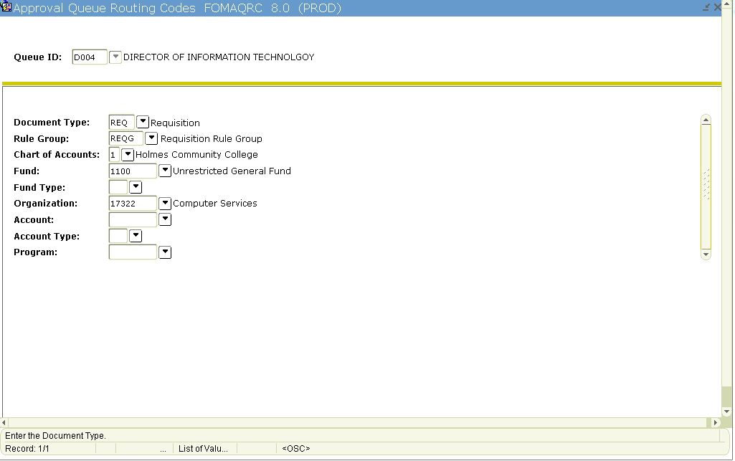
Step 3. Configure Routing
FOMAQRC

Slide 15
Things to Consider
NSF Queue
Catchall Queue
Backup approvers
Set default organization - FOMPROF

Slide 16
Setup Forms
Finance System Control Form (FOASYSC)
Approval Queue Maintenance Form (FTMAPPQ)
Approval Queue Validation Form (FTVAAPQ)
Approval Queue Routing Codes Form (FOMAQRC)
User Profile Maintenance (FOMPROF)
Approval Process (FORAPPL)
User Forms
Approvals Notification Form (FOIAINP)
Document by User (FOADOCU)
User Approval Form (FOAUAPP)
Document Approval Form (FOAAINP)
Document Approval History Form (FOIAPPH)
Approval History Form (FOIAPHT)

