Slide 1
Monarch Pro
Presented by: Bernadette Coleman
Assistant Coordinator of Payroll Alcorn State University
bcoleman@alcorn.edu
September 17, 2012

Slide 2
Introduction
Overview of the model building process
Closer look at individual steps
An example of the process

Slide 3
What is Monarch?
Data mining software that extracts data from existing reports
Lets you customize, analyze, and visualize your data
No rekeying, programming skills, or help from IT is required
Supports virtually any source formats used by your
organization, including text, PDF, HTML, and formatted
ASCII files
Monarch leverages the investments in the reports you already
have in place

Slide 4
Monarch allows you to use your existing reports as live actionable data, because it has the ability to apply structure to unstructured data
Notes:
Here’s a n example of a report
You may want to :
1 Analyze these numbers
2 Sort or group this information
differently
3 Focus only on a portion of the report
that is relevant to the task at hand
4 Monarch will help you assimilate this
information

Slide 5
Quick Look at the Process
Report
Extract data from a report
Decide what information is important
Select a sample of the information
Establish a “trap” to select all lines that are like the sample
Highlight the field or fields you want
Repeat for each grouping level
Data
The report has been transformed into a live data table
Manipulate Data
You can then add sorts and filters
Export
You can export your data to other file extensions such as excel, word, or PDF.
Finally, Save all the steps as a Monarch “Model File” for future use.

Slide 6
Demonstration of the
Process

Slide 7
Report View

Slide 8
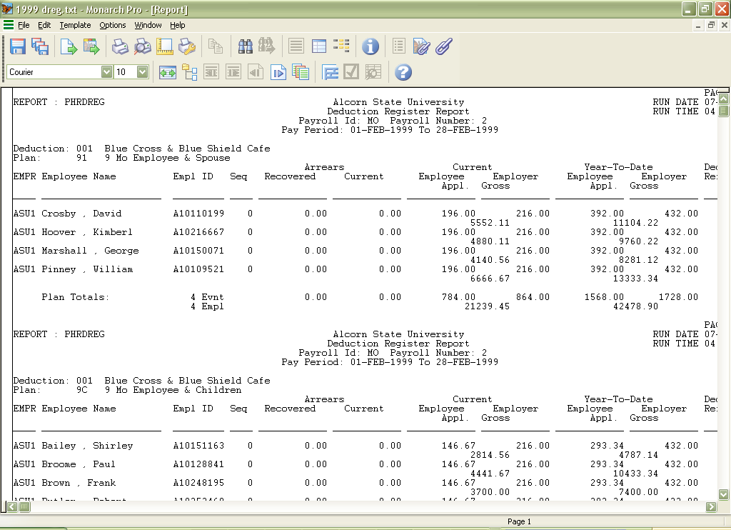
Take a close look at your
report and become
familiar with the layout
and its contents
Determine which
information is needed
– all of the fields or
only certain fields
What information is
fixed, constant, or
likely to change
What information
repeats most often

Slide 9
Notes:
This is an example of the raw data report

Slide 10
Notes:
The different highlights shown here are the various templates that will be built…

Slide 11
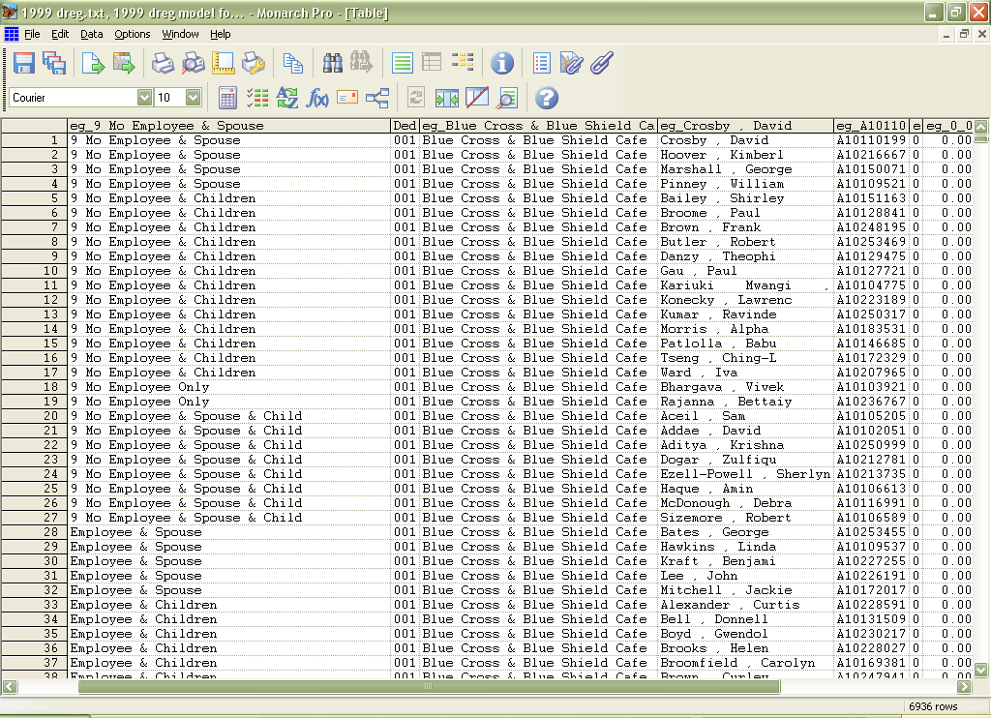
Notes:
Monarch can turn this report into actionable live data that you see here

Slide 12
Open Source Report

Slide 13
Templates
Four Main Steps in Building a Template
Select a Sample
Set the Trap
Define the field(s)
Verify

Slide 14
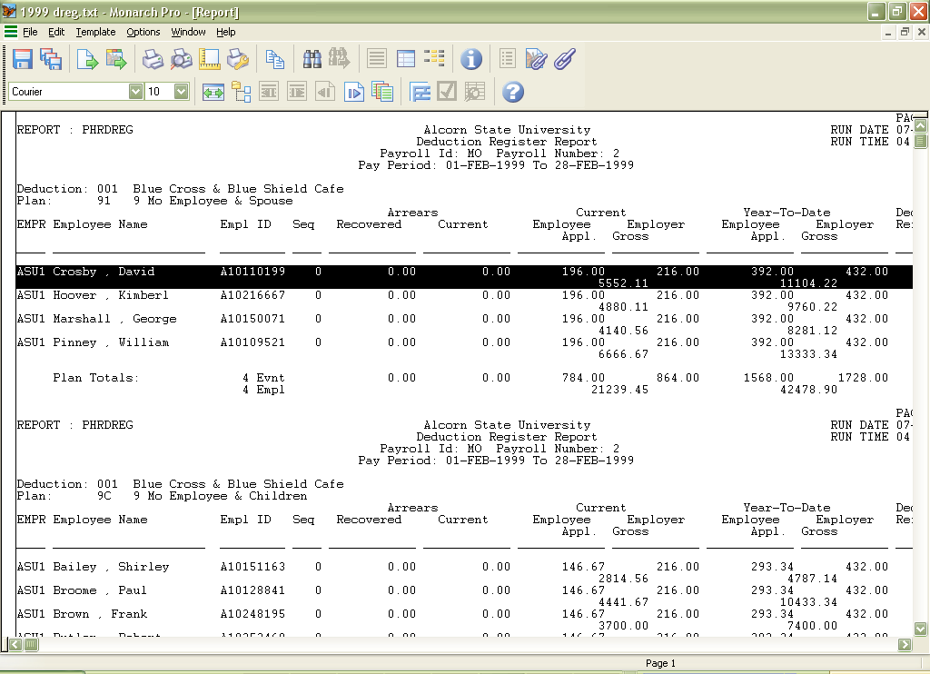
Step 1 - Select a Sample

Slide 15
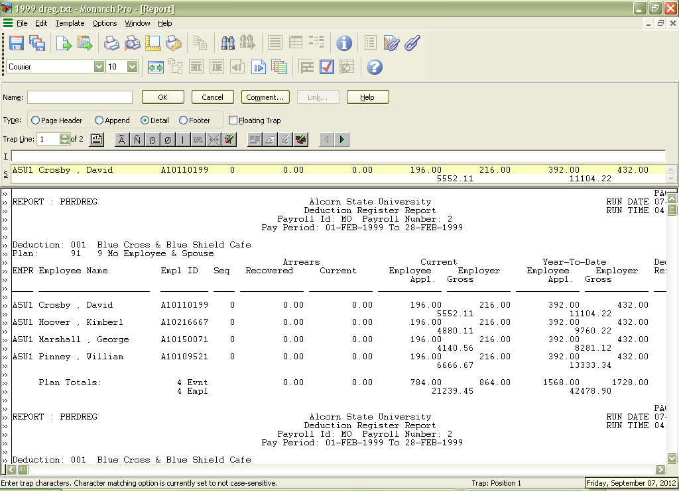
Step 2 - Set the Trap

Slide 16
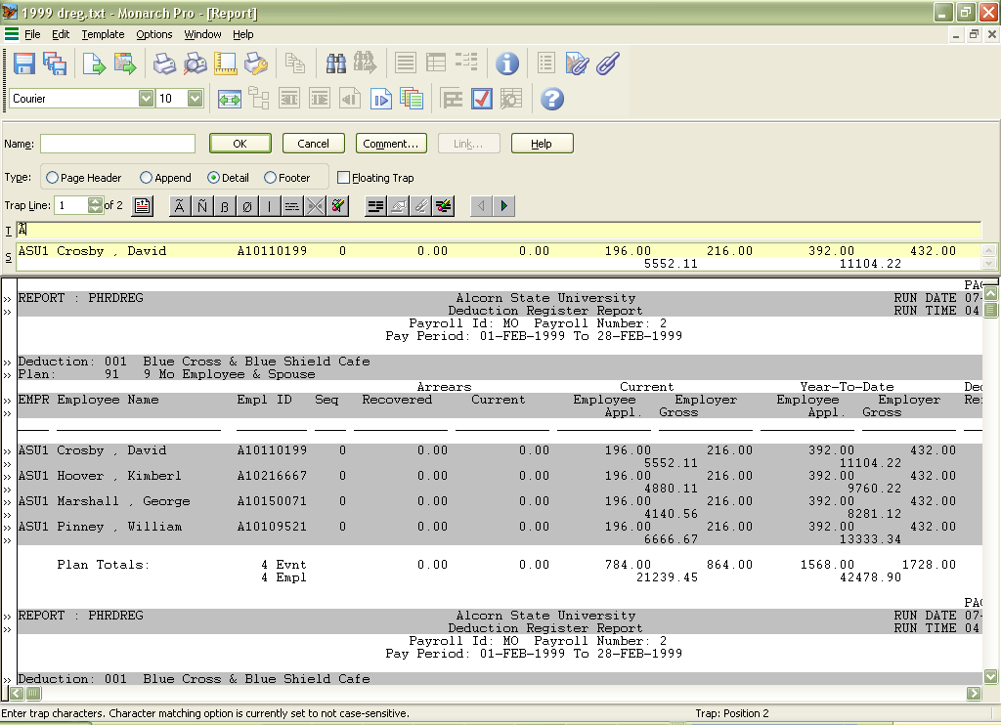
Alpha
Numeric
Blank

Slide 17
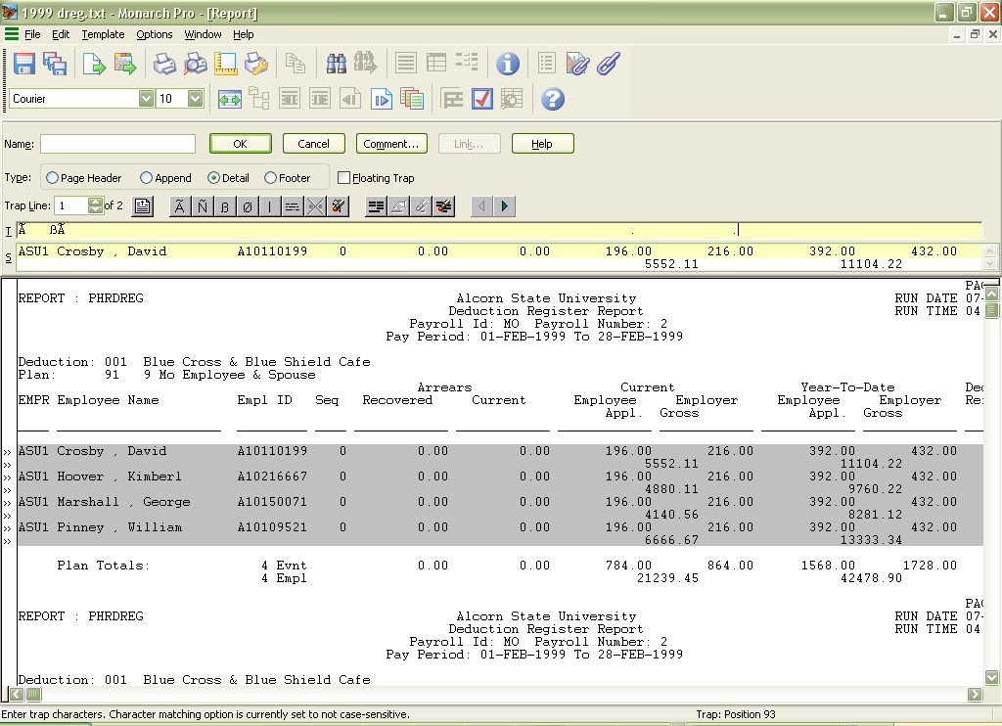

Slide 18
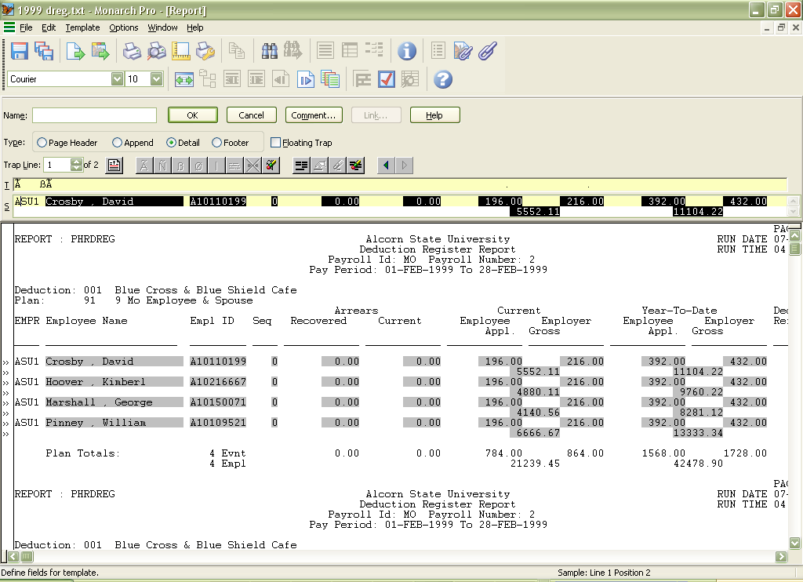
Step 3 - Define Fields
Step 4 - Verify

Slide 19
Repeat Steps for Grouping

Slide 21
Data Tables

Slide 22
Data Tables

Slide 23
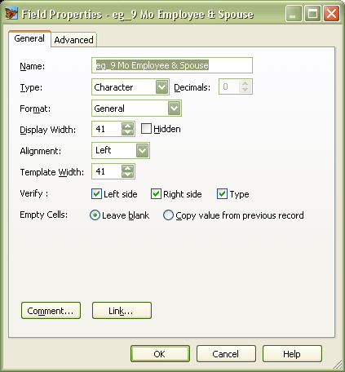
Manipulate Data

Slide 24
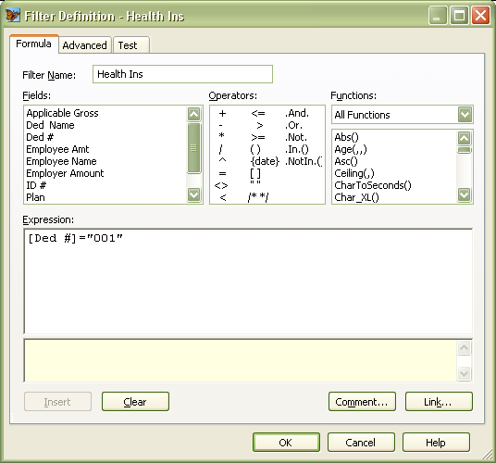
Sorts and
Filters
Establish a
filter name
Select field
Select
Operator

Slide 25
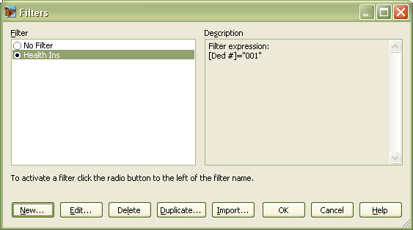
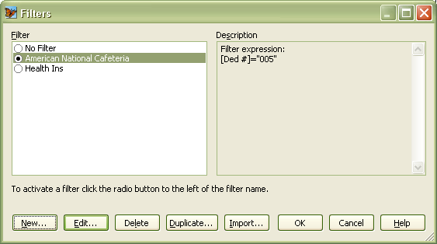

Slide 26
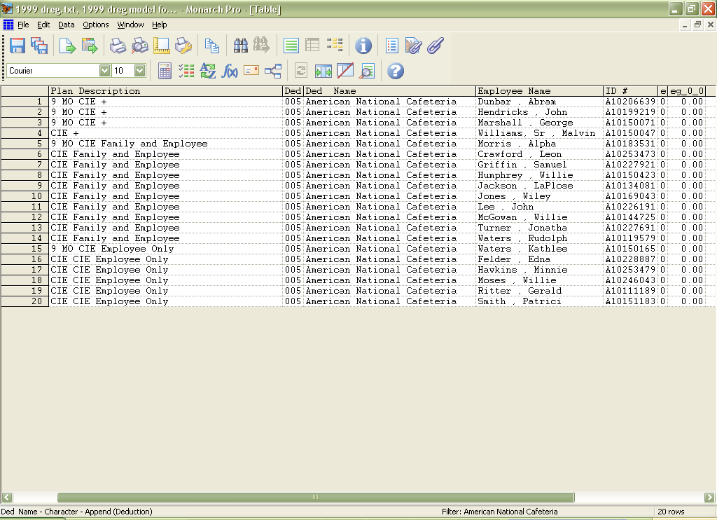

Slide 27
Exporting

Slide 30
Save your model!
Models can be applied to a singular or series of the same report type.
Notes:
Create only once!

Slide 31
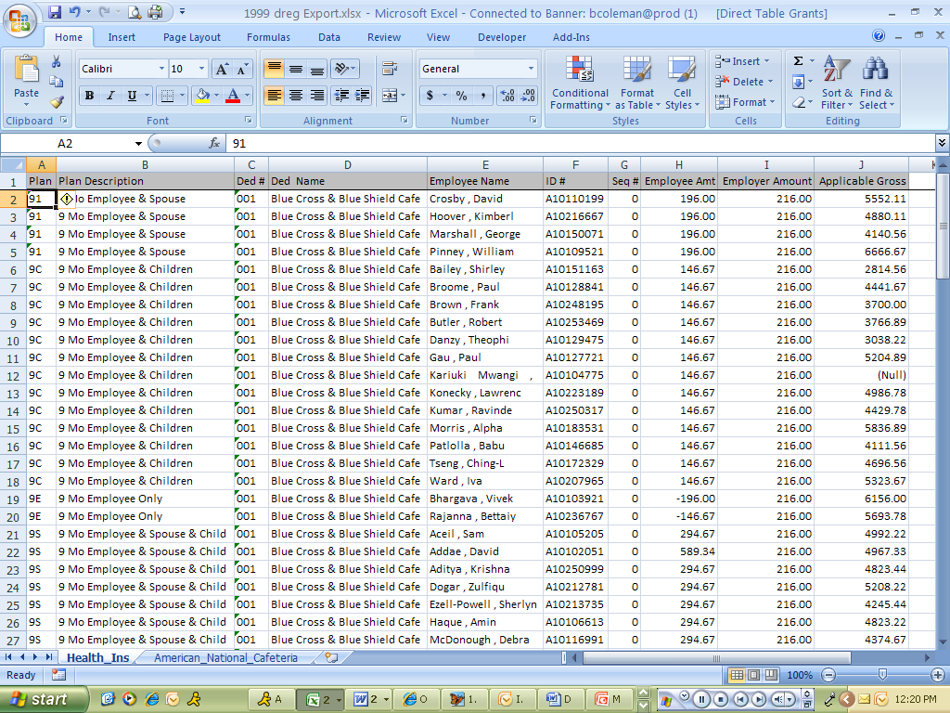

Slide 32
Questions?

