Slide 1
Alice: Which way should I go?
The Cat: That greatly depends on
where you want to go.
Alice: I don’t care where I go.
The Cat: Then it doesn’t matter how
you get there.
Data Integrity: Banner and You.
- Alice In Wonderland
MBUG 2012

Slide 2
Data Integrity: Banner and You.
Angela E. Payne, Director of Admissions
Meridian Community College
MS Banner User’s Group MBUG 2012

Slide 3
Data Integrity: Banner and You.
Today’s Discussion:
What is Data Integrity?
Why is it important?
Who is responsible?
What is are roles?
How/When do you get it done?
Questions/Comments.
Data Integrity: Banner and You.
MBUG 2012

Slide 4
WHAT IS DATA INTEGRITY?
Data integrity is the general trustworthiness (reliability and validity) of data.
As an concept:
Established
Standardized
Predictable
Consistent
Tangible
“Exists when computerized data is predictably related to its source and has been subject to processes that are authorized by appropriate personnel.”
- University of Waterloo, 1998.
Data Integrity: Banner and You.
MBUG 2012

Slide 5
WHAT IS DATA INTEGRITY?
As a Process:
Perpetual
Quality Control and Assurance
Input, Updates, and Maintenance
Absent of assumption
Vigilant and Cognizant

Slide 6
WHY IS DATA INTEGRITY IMPORTANT?
Credible, valid, efficient reporting
Fosters database security
Accountability
Reliability (predictability)
Easier trouble-shooting and problem-solving
Fluidity/easier in training
Empowering
Builds relationships and continuity
Inter-departmentally
Intra-departmentally
Externally
SAVES MONEY and TIME!
Data Integrity: Banner and You.
MBUG 2012

Slide 7
Who is responsible for data integrity?
Anyone at data collection or entry points or with data access
Anyone who reviews the data
Anyone responsible for the final disposition
Everyone who has an interest in the data
EVERYONE IS ACCOUNTABLE!
Administrators, faculty, and staff
Students and their agents
Environmental constituents (state offices, etc.)
Data Integrity: Banner and You.
MBUG 2012

Slide 8
WHO and WHAT ARE THE ROLES?
Who:
Data custodians
Define roles
Design training
Develop policy and/or procedures
What:
Oversee area data
Departmental/shared data
Banner User’s Trainer (institutional/depart-mental level)
Document standards (institutional/depart-mental level)
Data Integrity: Banner and You.
MBUG 2012

Slide 9
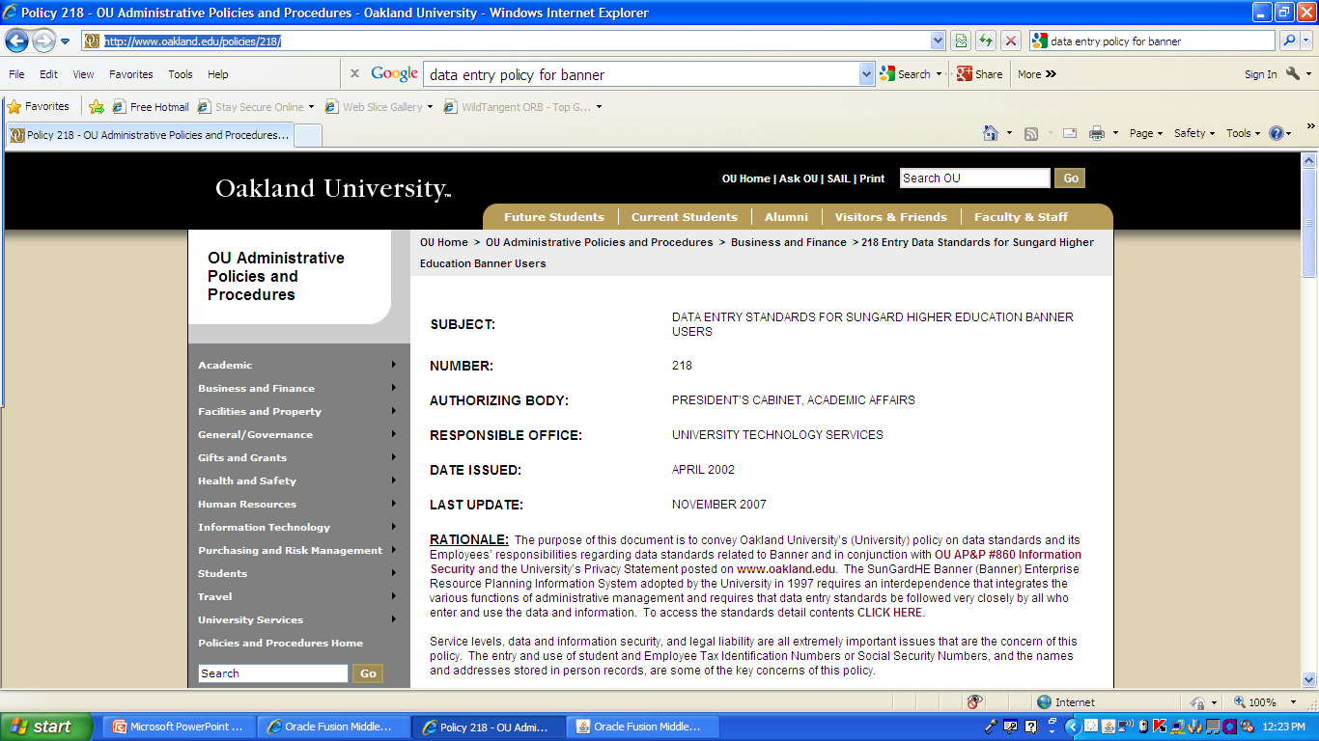
WHO and WHAT ARE THE ROLES?
Data Integrity: Banner and You.
MBUG 2012

Slide 10
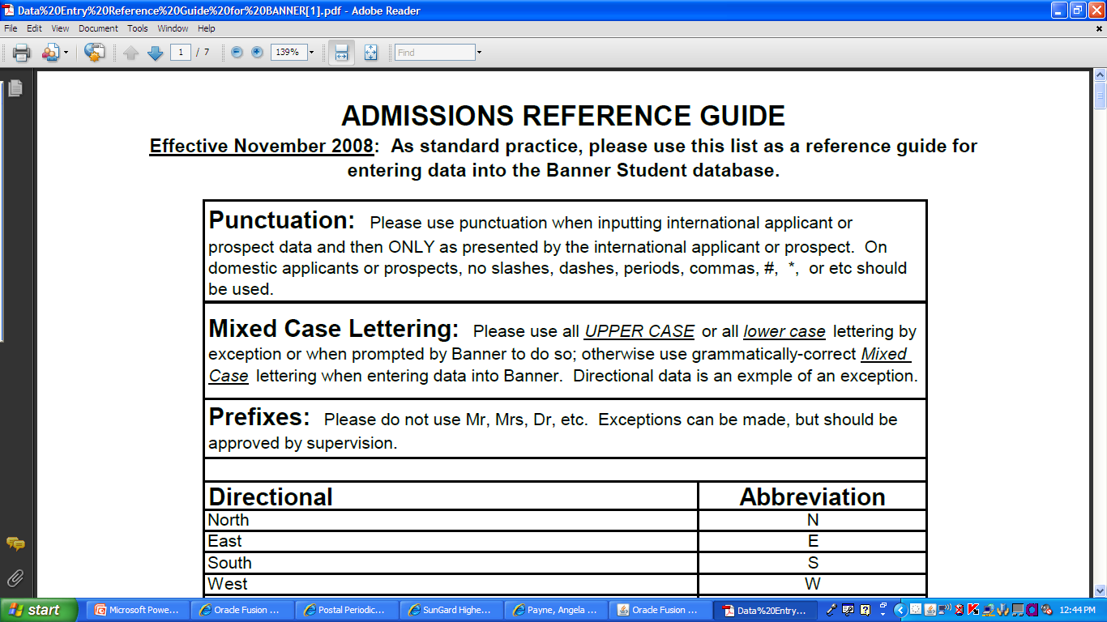
How is IT DONE?
Let’s visit BANNER:
Search screens:
Person Search (SOAIDEN)
Alternate ID Search (GUIALTI)
Non-person Search (SOACOMP)
GUASYST
GOAMTCH
Incorporate standards
Follow standards
Data Integrity: Banner and You.
MBUG 2012

Slide 11
WHEN is IT DONE?
Let’s talk BANNER:
A vendor account is established?
Graduation evaluation?
A recruiter meets a student at a college fair?
A donor makes a contribution?
A new employee comes on board?
A financial aid data load is completed?
A study-aboard candidate ends their program?
A student graduates?
A report is submitted to the state agency?
Data Integrity: Banner and You.
MBUG 2012

Slide 12
Do you have data integrity?
Is there ownership?
Are staff trained with consistency?
Are there policies and procedures in place?
Are there data collection/entry protocols?
Is there continuity between departments?
Are you inputting garbage expecting more?
Have a painted a big picture where everyone plays a part?
Data Integrity: Banner and You.
MBUG 2012

Slide 13
TRY IT OUT!
Insert your data into the dataflow so you can get your own letters and other communications, if possible.
Make yourself a prospect or applicant.
Check out your student record in self-help portals.
Share the end-user experience occasionally.

Slide 14
Angela: Which way should I go?
The Cat: That greatly depends on
where you want to go.
Angela: I care where I go.
The Cat: Then it matters how
you get there.
Data Integrity: Banner and You.
- Angela in Wonderland
MBUG 2012

Slide 15
Questions/comments/Contacts:
Angela E. Payne, Director of Admissions
apayne@meridiancc.edu
601.481.1357
RESOURCES/REFERENCES:
https://www.usps.com
www.whitepages.com
http://www.unco.edu/aboutursa/resources/data_standards.pdf
http://www.oakland.edu/policies/218/
Data Integrity: Banner and You.
MBUG 2012

