Slide 1
Oracle Application Express
(Oracle APEX), formerly called HTML DB, is a Free rapid web application development tool for the Oracle database.

Slide 2

Web-based
Rapid application development environment
Installed to your Oracle database
Free to use
Minimal coding required to create functional apps/reports; wizards
Access to any table in database (with perms)
Can customize processing with PL/SQL
Powerful Interactive Reports for sorting/filtering results
Can run on your SSB web server (DAD)

Slide 3

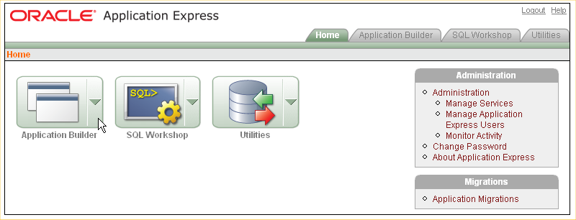
Application Express provides three primary tools
Application Builder - to create dynamic database driven web applications
SQL Workshop - to browse your database objects, run ad-hoc SQL queries, as well as a graphical query builder
Utilities - allows for data to be loaded and unloaded from both flat files and spreadsheets

Slide 4
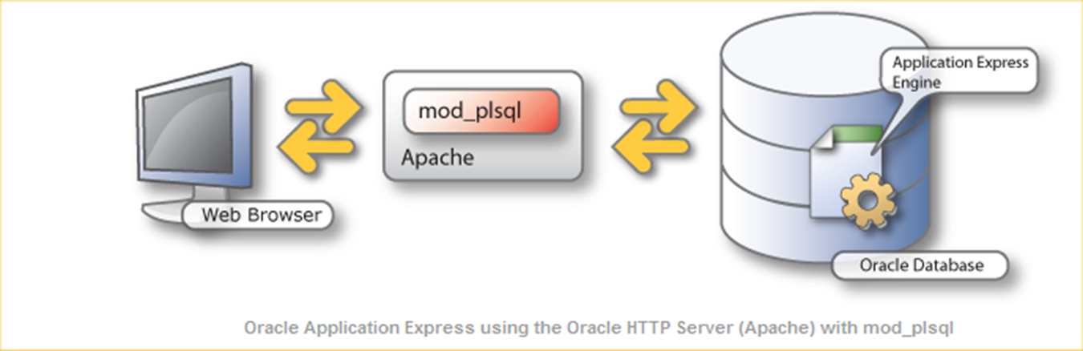
Architecture
Application Express lives completely within your Oracle database. It is comprised of nothing more than data in tables and large amounts of PL/SQL code. The essence of Oracle Application Express is approximately 215 tables and 200 PL/SQL objects containing 300,000+ lines of code.

Slide 5
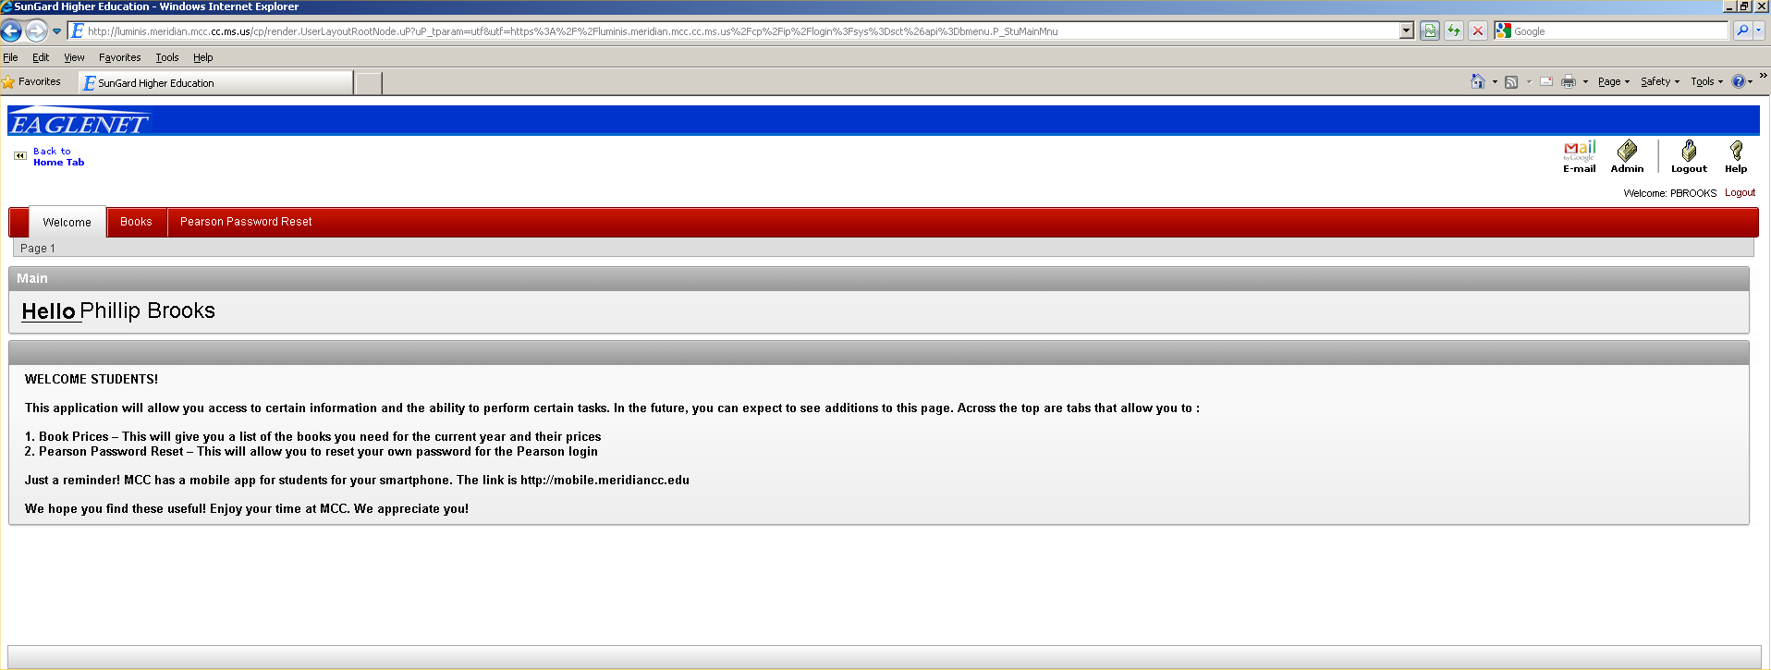
Luminis SSO to SSB via sctssb connector

Slide 6
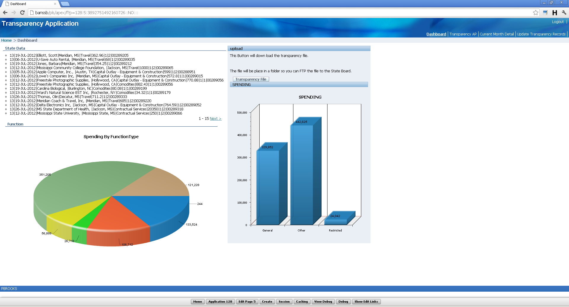
Feature rich web based applications can be built quickly.

Slide 7
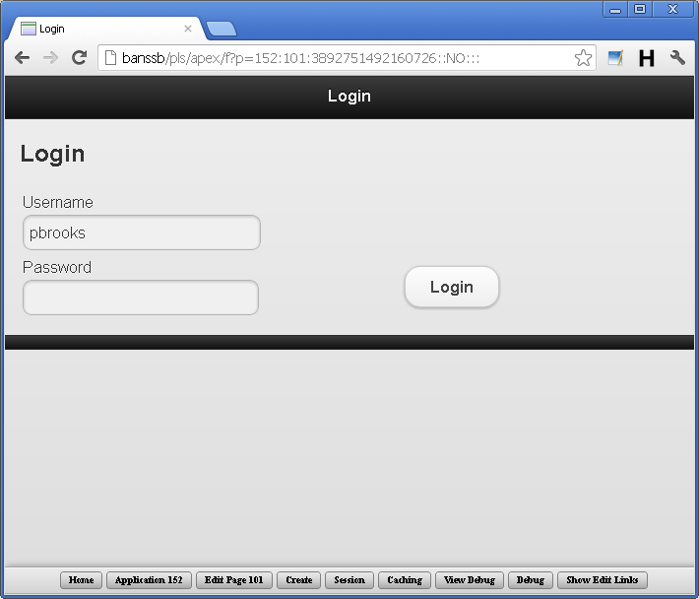
Feature rich web based Mobile applications can be built quickly.

Slide 8
Converting Applications
Oracle Application Express Application Migration Workshop (Application Migration) enables you to convert Oracle Forms and Microsoft Access applications and generate an Oracle Application Express application from the retrieved objects.
Key Features
Reporting
Forms
Charting
PDF Printing
Web Services
Spreadsheet Upload
Session State Management
User Interface Themes
Flow Control & Navigation
Conditionality on all Components
External Interfaces & Extensibility
Declarative BLOB Support
Optional Runtime-Only Installation
Security
SQL Workshop Tools
Supporting Objects Utility
Performance
Packaged Applications
Hosted Development
Links:
http://www.oracle.com/technology/products/database/application_express/html/what_is_apex.html#06
http://www.oracle.com/technology/products/database/application_express/packaged_apps/packaged_apps.html

