Slide 1

ICC WEB
George Pharr,
Senior Programming & Systems Design Specialist
Bronson Prochaska, Ph.D.
Director of Student Success

Slide 2
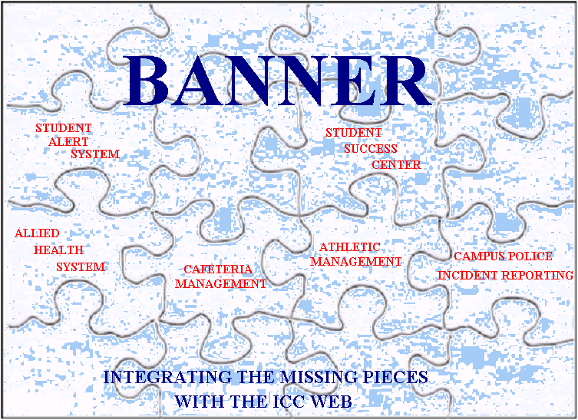

Slide 3
What is the ICC WEB?
System designed by ICC employees to interface with Banner to meet the needs of various departments on campus.
Applications for the College:
-Student Early Alert System
-Allied Health System
-Campus Police Incident Reporting System
-Athletics Management System
-Cafeteria Management System
-Student Success Center Management System
-Student Writing Center Management System

Slide 4
The Early Alert Referral System…
WHAT IS IT?
-System designed to be a resource for faculty/staff to identify students who may be at risk of academic difficulty or failure
-A proactive means of reaching students having problems in various areas of their lives (both academic and personal)
-Available to faculty and staff throughout the semester
-Online form available to faculty and staff 24/7
-Began in Fall 2007
HOW IT WORKS
-Step 1-Faculty/Staff member complete online form on the “GO2ICC”.
-Step 2-SSC Staff mail letter to student, email student and send an “Itawamba Cares Card” to an instructor the student has in the upcoming 2 days.
-Step 3-If student has not made contact with SSC staff after 2-3 days, SSC staff member calls student.
-SSC staff may refer students to Writing Center, Advisor or Personal Counseling Services.
-Tracking system put in place (Spring 2010)
DEMO-Early Alert Online Form Completed by Faculty/Staff

Slide 5
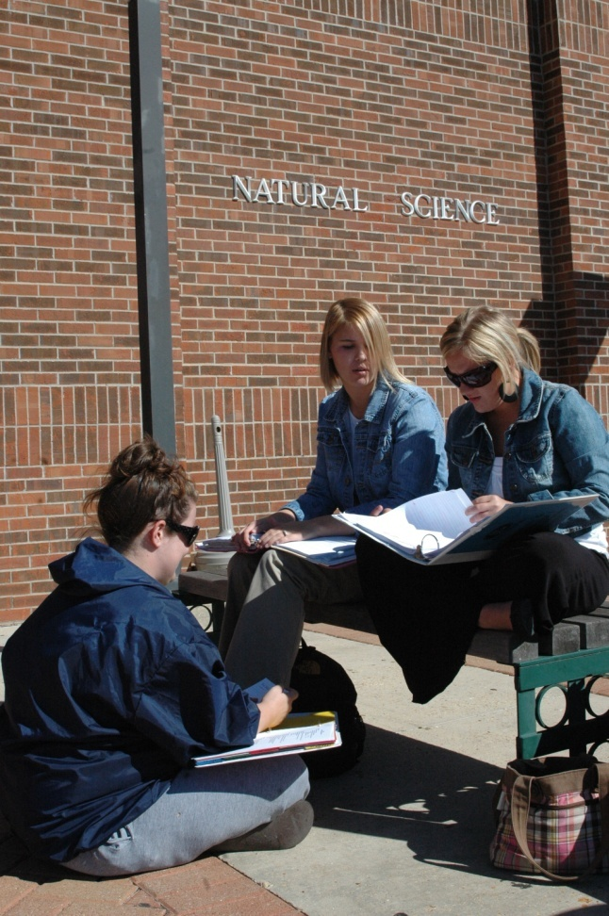
Early Alert System focuses on students experiencing…
Attendance problems
Inadequate class preparation
Poor test results
Poor writing skills
Underdeveloped time management & study skills
Personal issues affecting student’s academic success
Campus resources (tutoring, career selection, etc.)
Adjusting to college life
DEMO-Early Alert Assignment Page

Slide 6
Allied Health System
What it is- Why it was needed
System designed to interface with Banner and allow
Management of all 10 Allied Health programs.
Programs were being managed manually from 3 different locations which required excessive copying, faxing and
transfer of records stored in Excel spread sheets.
Ability to obtain reliable, valid data for reports was almost non-existent.
Excessive redundancy of records, maintaining changes and
sharing of data required enormous labor efforts.
DEMO

Slide 7
Campus Police
Incident Reporting System
Fall 2007 EA incident involving student attempting suicide…we realized we needed to do more
Virginia Tech-pieces to the puzzle were there, just scattered all around campus
Established Personal Counseling services 3 days per week
Created Behavioral Intervention Team
Integrated EA, Campus Police Incident Reporting, Campus Housing Incident Reporting and Success Center reporting into 1 screen
DEMO-Student System Details Screen

Slide 8
Athletic Management System
System provides coaches of all athletic programs the ability to manage their athletes with a real time access to Banner.
Reporting and tracking of our athletic programs was previously non existent. Banner does not provide a comprehensive module for managing athletes.
Obtaining real time attendance information on athletes, which is critical to maintain player eligibility, did not exist.
Managing scholarship awards for athletes was a very comprehensive and manual endeavor.
DEMO-Athletic Management System

Slide 9
Cafeteria Management System
Cafeteria services are out sourced to a food management
company. A system is required to manage meals for dorm
students as well as cash customers. System utilizes student
ID cards to manage accurate accountancy of meal
purchases and prevent abuse and shrinkage by students.
System provides valuable reporting information for a
number of departments in addition to the food management
companies needs.
DEMO-Cafeteria Management System

Slide 10

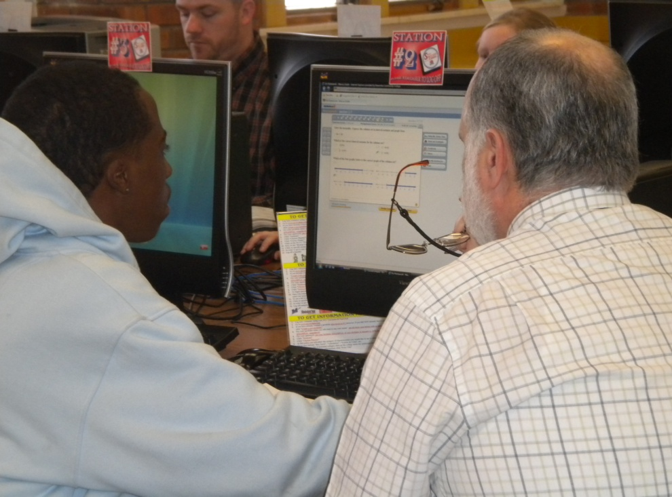
Student Success Center
Track Student Usage
Track Tutors
Determine Success
By Grades
(SSC Report Card)

Slide 11
Reactions from students & staff……
“I appreciate someone checking with me to see if I need anything, it makes me feel important”
“just knowing that I have someone I can go to makes me feel like you care”
“the Early Alert program has helped with attendance in my science classes”

Slide 12
Thank you!
George Pharr,
Senior Programming & Systems Design Specialist
gtpharr@iccms.edu
662.620.5185
Bronson Prochaska, Ph.D.
Director of Student Success
bgprochaska@iccms.edu
662.862.8250

